Slide 1



PYTHON WITH ANACONDA DISTRIBUTION
Luciano Gabbanelli
“The world’s most popular open-source Python distribution platform”
Tech Lead Data Science

Slide 2








ÍNDICE
1
Download Anaconda / Install Python
2
What is all this stuff?
3
Built-in structures
4
Let's code!!
Go to the Jupyter notebook
2.1-Introduction_to_Python.ipynb

Slide 3

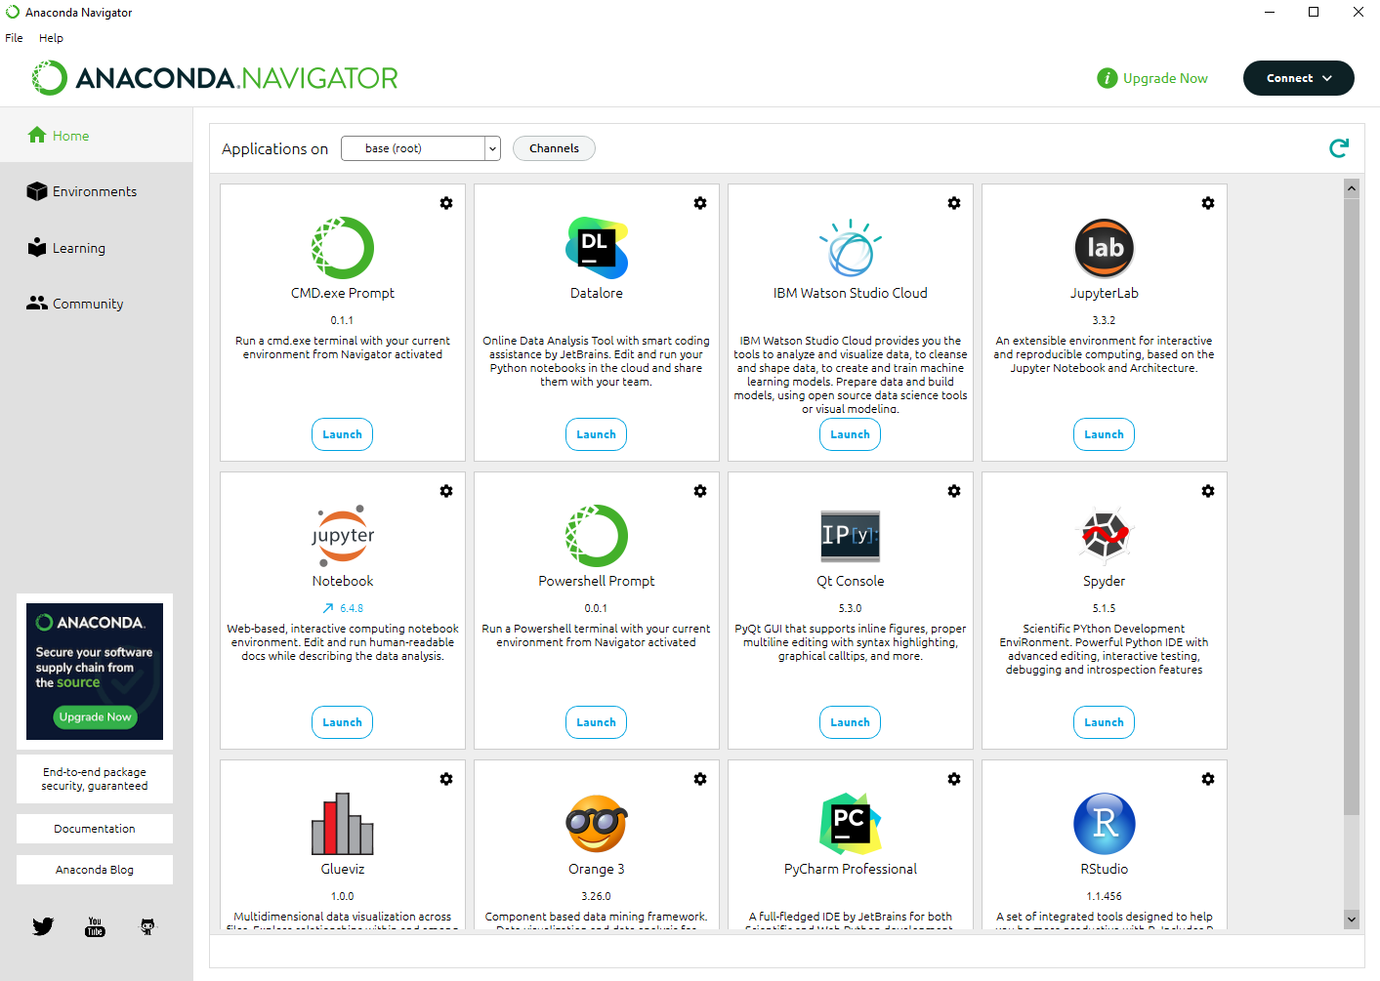
What is ?
Distribution of Python and R programming languages
For scientific computing (data science, machine learning applications, large-scale data processing, predictive analytics, etc.)
aims to simplify package management and deployment.
Initial release: 2012
Anaconda Navigator is a desktop graphical user interface (GUI)
Una frase para explicar qué es lo que vamos a ver en esta sección

Slide 4

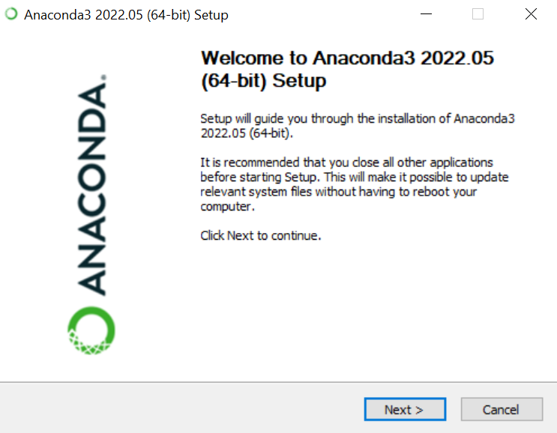

INSTALLATION
https://www.anaconda.com/
Find the application in Downloads
Open for installation and Next
Download installer

Slide 5
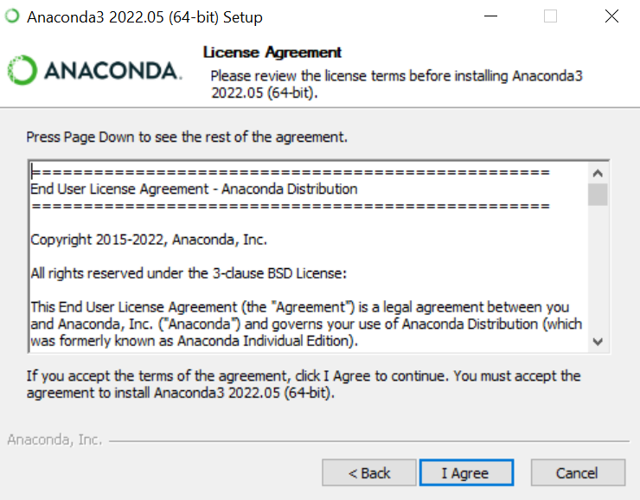
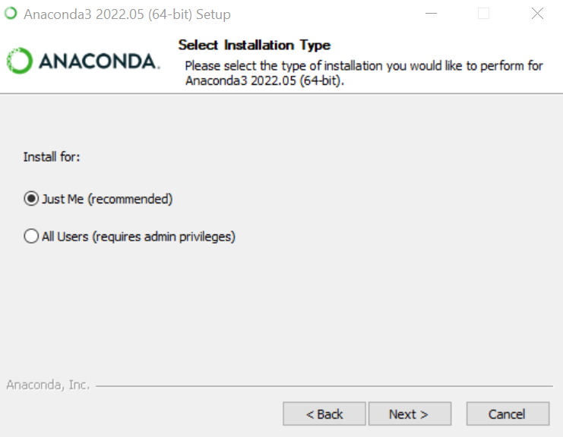
INSTALLATION
Agree license
Installation type

Slide 6
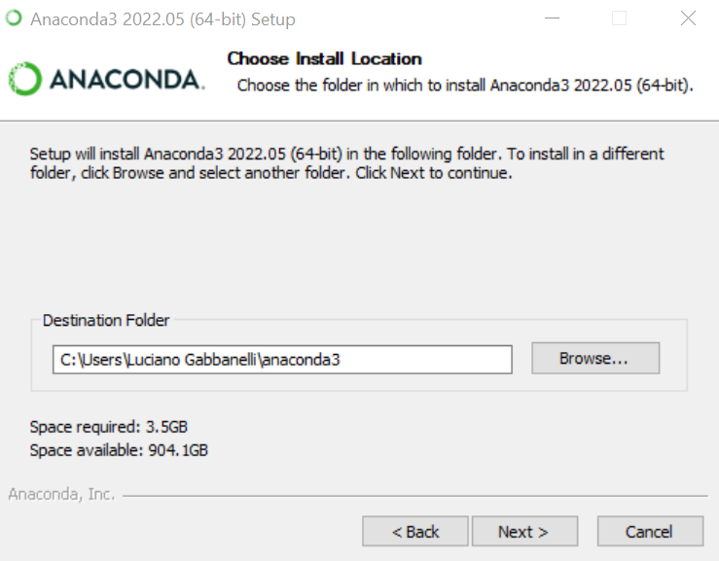
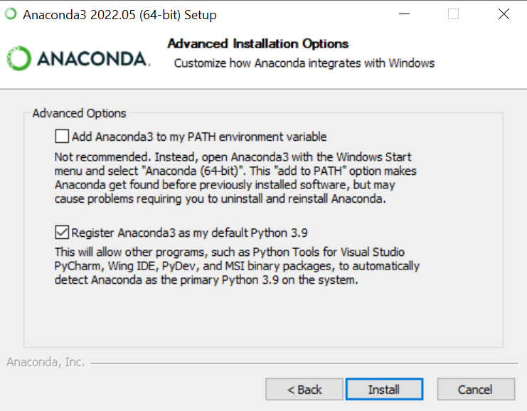
INSTALLATION
Destination Folder: “ . . . \anaconda3 ”
avoid spaces in names or replace them by “_”
Install

Slide 7
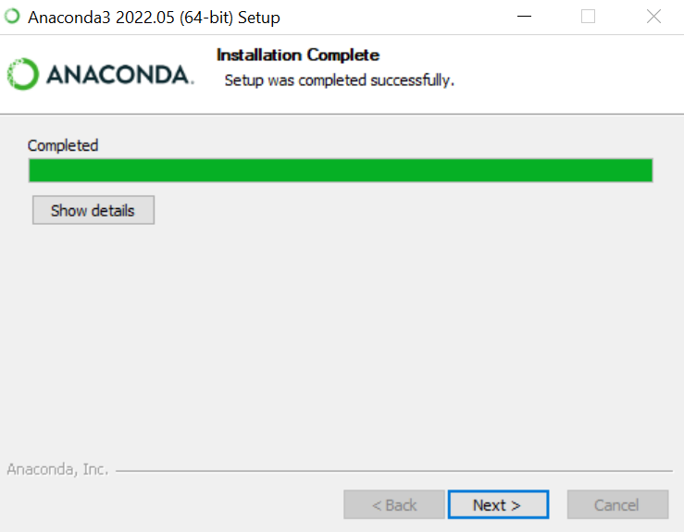
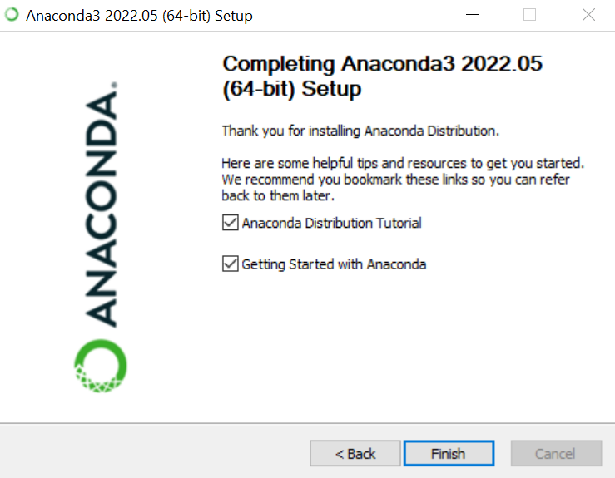
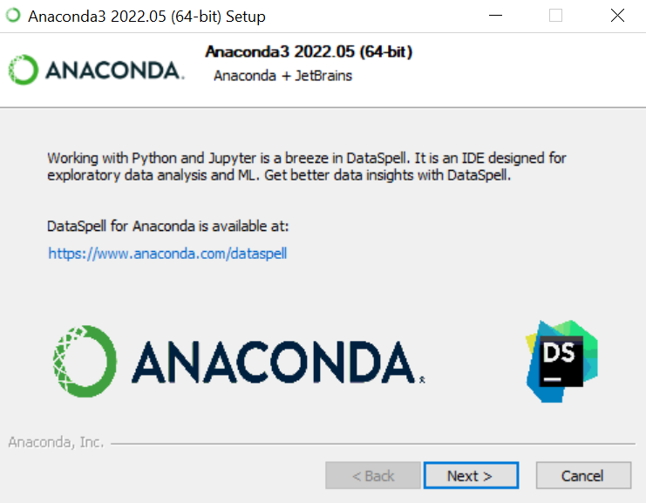
INSTALLATION COMPLETE

Slide 8
INSTALLATION COMPLETE
Let us start!

Slide 9
ÍNDICE
1
Download Anaconda / Install Python
2
What is all this stuff?
3
Built-in structures
4
Let's code!!
Go to the Jupyter notebook
2.1-Introduction_to_Python.ipynb

Slide 10
What is Python? (Welcome to Python.org)
High-level, interpreted, general-purpose programming language
First release: 1991
Python 3.0 (2008) not completely backward-compatible with earlier versions
Main objectives: simplicity and legibility
Object oriented
Open source
Large community
Large number of standard libraries (scientific computing, text and images processing, game development, etc.)
Una frase para explicar qué es lo que vamos a ver en esta sección

Slide 11
PYTHON PROGRAMMING
Project Jupyter (Project Jupyter | Home)
is a non-profit, open-source community run project (2014). It evolved to support interactive data science and scientific computing across all programming languages.
Core supported programming languages: Julia, Python, and R.
Jupyter Notebook is an open source web application (interactive interface) for creating and sharing computational documents.
It works in the localhost (127.0.0.1 this means the IP of your computer), usually in 8888 port and it starts in the tree directory
Identify the path of this directory in your computer. Usually it is in C : \ Users \ your_name
It will be useful for backups
Jupyter Notebook files are notebooks
Jupyter Notebook

Slide 12
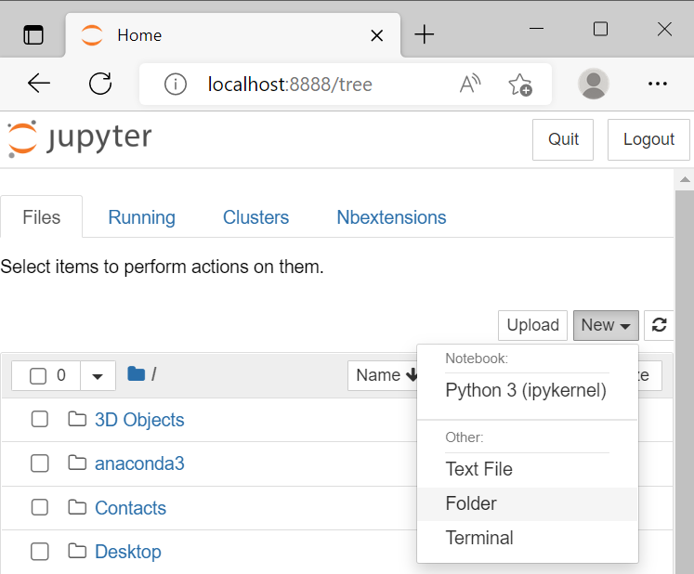
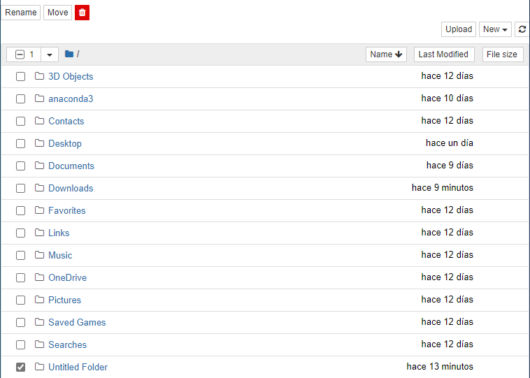
PREPARING THE WORKSPACE
Create a folder for your project
Change its name: Untitled Folder MDS
Go to the folder you created

Slide 13
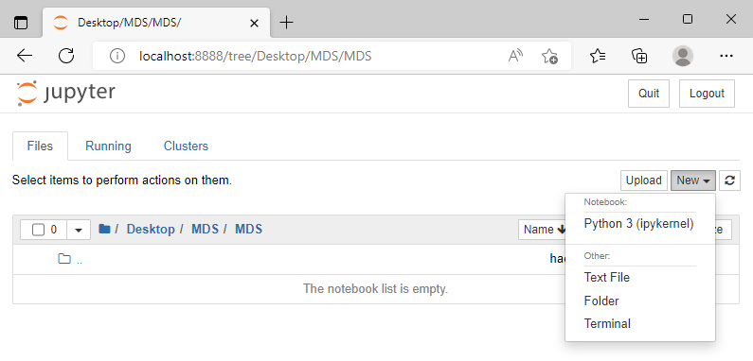
PREPARING THE WORKSPACE
Once you are inside the folder, create a notebook file. It will be created in the path : 🖿 / MDS
Other interesting possibilities:
JupyterLab (Anaconda)
Google Colaboratory (https://research.google.com/colaboratory):
similar to Google Docs / Google Sheets. Online notebooks. No need to install.
There are also .py which are regular python files, usually executed in Spyder.
It's plain text and contains just your code.
The extension of notebooks is .ipynb , which means Interactive PYthon NoteBook

Slide 14
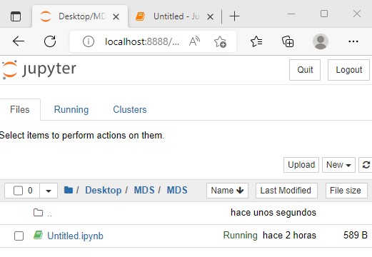
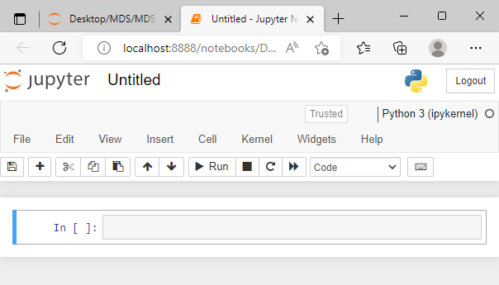
THE CLASSIC NOTEBOOK INTERFACE
¡¡¡ code here !!!
Change the name to the .ipynb file: Untitled.ipynb 1.2-First_Jupyter_Notebook.ipynb

Slide 15
ZEN OF PYTHON
Change the name of the file: Untitled.ipynb 1.2-First_Jupyter_Notebook.ipynb
Create a title for the notebook: # Introduction to Python
TIP: Code Markdown (easy-to-read text format)
Run cells using: Shift + Intro ( ≡ ) or Ctrl + Intro or Alt. + Intro. What’s the difference?
Try: Esc. and/or Intro over celles. Change between command (blue) / edit (green) mode
Efficient programming: Take advantage of the shortcuts!!!
In Esc. + M markdown Y code
(command mode) A insert cell above B insert cell below
# Tells the Python interpreter to ignore the rest of the line. Try it!
Comments are sensefull only in Code mode. Why?
Our first code: Type import this

Slide 16
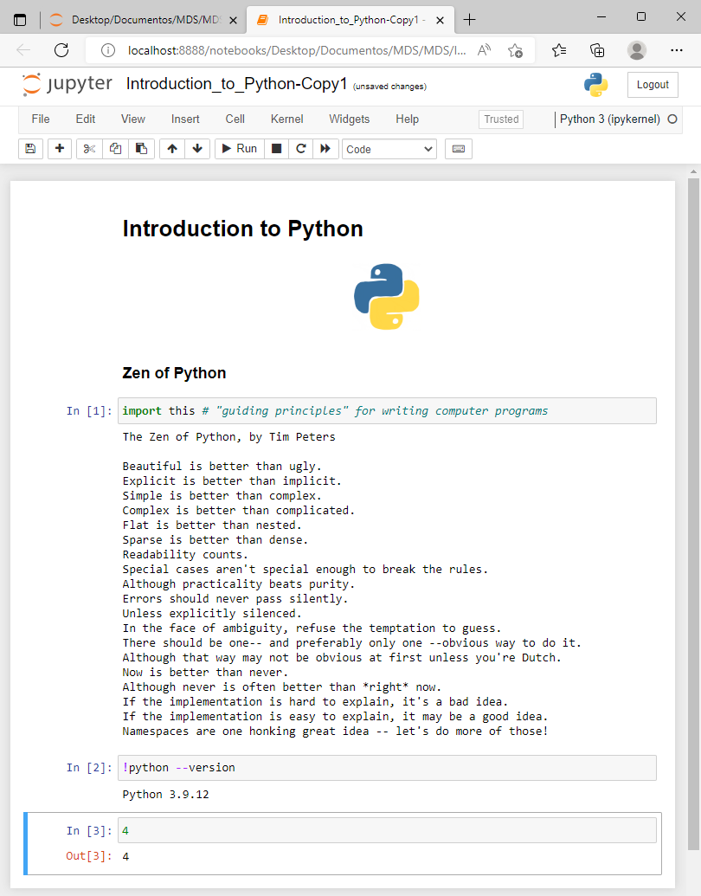

CORE PHILOSOPHY OF PYTHON
19 "guiding principles"
for writing
computer programs
Check the Python version: !python --version
The exclamation mark operator allows to execute commands on the underlying operating system (i.e. on shell)
ONLY IN JUPYTER NOTEBOOK
Introduce the number 4 and execute
When do we have “Out” and when we do not?
Remember again:
If you start doing some action with the mouse,
stop and think if there is a shortcut.
Esc. + H or Help keyboard shortcuts
start/windows + right/left keys full screen in half screen

Slide 17
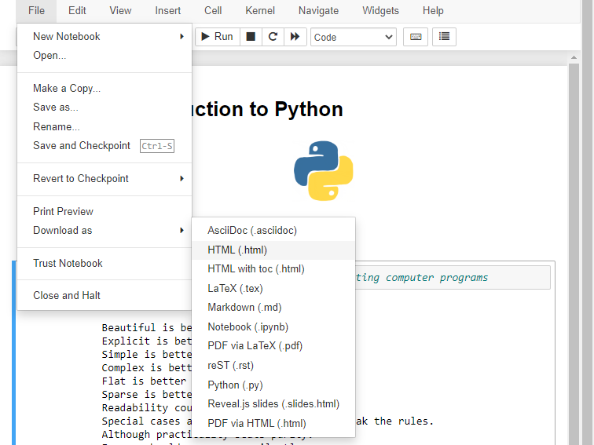
CONVERT .ipynb TO .html
Your file is probably in the download folder
Open it!

Slide 18
CONVERT .ipynb TO .pdf

Slide 19
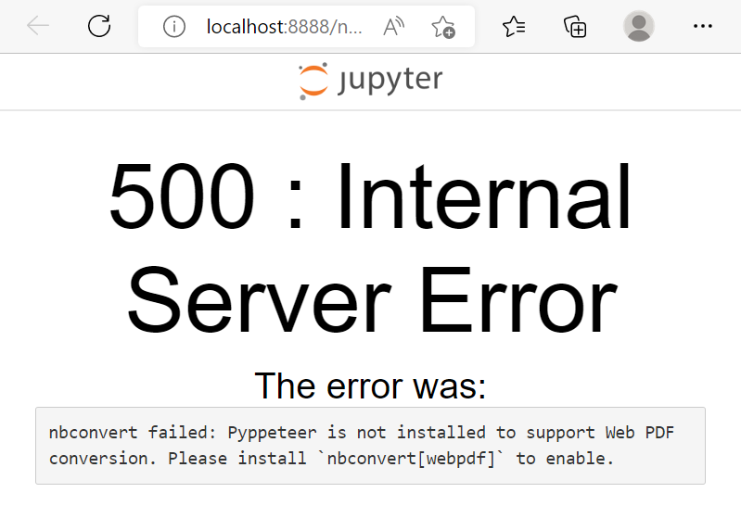
You will probably get this error
nbconvert[webpdf] Google it!!
Choose the link
Nbconvert Webpdf :: Anaconda.org
Or go directly to
https://anaconda.org/conda-forge/nbconvert-webpdf

Slide 20
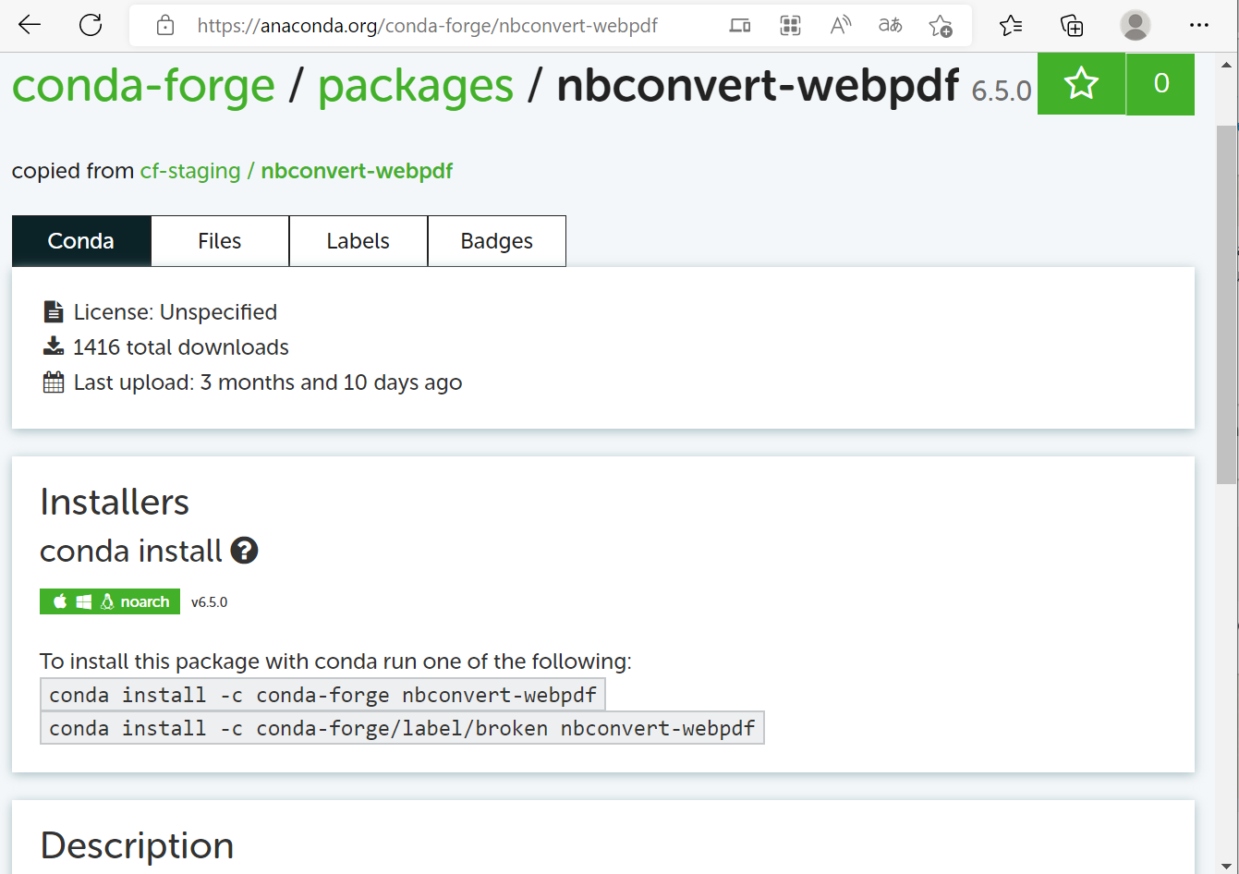
nbconvert-webpdf
Let us execute these two commands in the Powershell Prompt of Anaconda

Slide 21
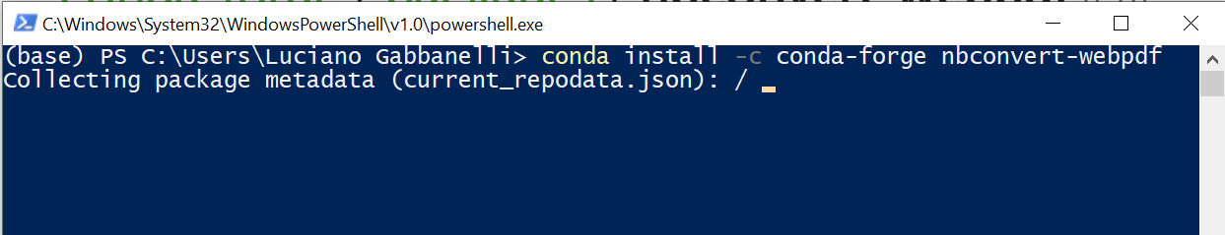
Powershell Prompt
Lunch it!
Then run the commands
When the terminal asks to proceed, say Yes :)
Try to download again: PDF via HTML (.html)

Slide 22
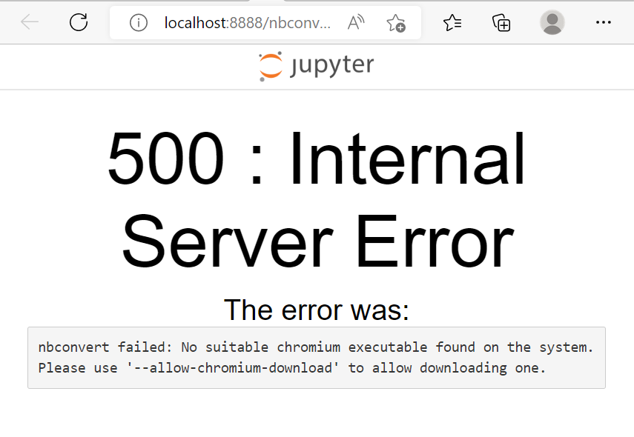
Oh, not again!! :(
Open the anaconda terminal.
Type the command
pyppeteer-install
in the terminal. This will download and install an appropriate version of chromium.
Try to download the notebook again :O
PDF via HTML (.html)
VICTORY?

Slide 23
ÍNDICE
1
Download Anaconda / Install Python
2
What is all this stuff?
3
Built-in structures
4
Let's code!!
Go to the Jupyter notebook
2.1-Introduction_to_Python.ipynb

Slide 24

WHAT IS A LANGUAGE?
Noam Chomsky: a language is a set of (finite or infinite) sentences, each finite length constructed out of a limited set of elements.
In-built objects:
int (integer): integer numbers.
float: floating point number (represent “ℝ-numbers”)
complex : complex numbers
str (string) : text or string of characters
bool: boolean. Data with only two possible values (usually True or False). Represent the two truth values of logic and Boolean algebra.
list : an ordered heterogeneous collection of objects.
tuple: an immutable ordered heterogeneous collection of objects.
set : an unordered heterogeneous collection of unique objects.
dict (dictionary) : store data values in (key : value) pairs mapping.
type( … ) will help from now on!

Slide 25
ÍNDICE
1
Download Anaconda / Install Python
2
What is all this stuff?
3
Built-in structures
4
Let's code!!
Go to the Jupyter notebook
2.1-Introduction_to_Python.ipynb

