Slide 1
IBM Hackathon 2020
AI RECRUITER – SHORTLIST A SUITABLE CANDIDATE FOR SPECIFIC ROLE

Slide 2
Team details:
Project Team: Indhumathi.V
Keerthivasan.P
Swaminathan.M
Vijayalakshmi.V
Project Duration : 17 Days
Project Deliverables: IBM Hack Challenge 2020

Slide 3
Problem Statement
AI RECRUITER – SHORTLIST A SUITABLE CANDIDATE FOR SPECIFIC ROLE
AI Recruiter – Shortlist a Suitable candidate for specific Job Role Description 52% of talent acquisition leaders say that the most difficult part of their job is to shortlist the right candidate and 3% of candidates never hear back from a company after one touchpoint.
On the flip side, it’s a challenge for employers to communicate well with all their candidates.
For high volume recruiting, this would require communicating with thousands of candidates, in addition to a recruiter’s normal screening functions and other duties.
Artificial Intelligence enabled software bots can definitely provide a solution for this problem

Slide 4
Expected solution
Expected Solution
Technologies and Tools
Software Bot enabled with Artificial Intelligence, which screens the candidate application, shortlists for interview and identify his/her skills & personality traits through conversation.
IBM Watson Assistant
IBM Watson Discovery
Node red
Cloud function

Slide 5
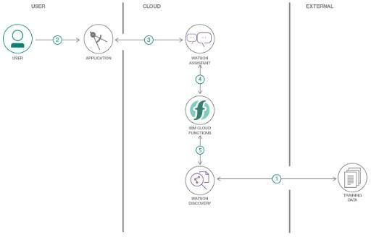
Flow chart:

Slide 6
Scope of work:
Create a recruitment process dialog skill in Watson Assistant
Use Smart Document Understanding to build an enhanced Watson Discovery collection
Create an IBM Cloud Functions web action that allows Watson Assistant to post queries to Watson Discovery
Build a web application with integration to all these services & deploy the same on IBM Cloud Platform

Slide 7
Challenges faced
The common challenges faced by the recruiters today are ,
Attracting the right candidates
Engaging qualified candidates
Hiring fast
Using data-driven recruitment
Building a strong employer brand
Ensuring a good candidate experience
Recruiting fairly
Creating an efficient recruiting process

Slide 8
Suggestive Solution
Solution to overcome the above challenges are
Automation has completely transformed the face of recruitment. The advent of artificial intelligence is changing the process of hiring candidates.
An AI-chatbot is an interactive application that automates tasks and eliminates manual intervention. AI-Chatbots interact with people and provide them with relevant information by using Natural Language Processing and AI together.
Candidates want to hear back about the status of their job application or where they stand after an interview. When they fail to get a response, it affects them negatively and reflects on the employer brand. That’s where chatbots can take over the situation.
Thus, AI-Chatbots can be used to perform a wide range of time-consuming HR functions.

