Slide 1
Computer graphics is the use of a computer to define, store, manipulate, interrogate, and represent the pictorial output

Slide 2
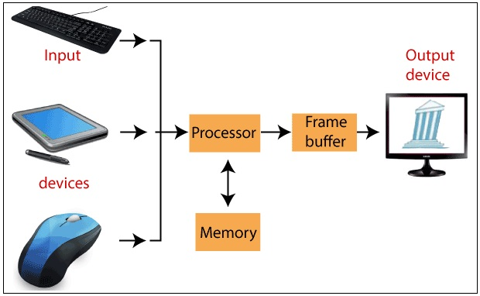

Slide 3
Computer Graphics involves technology to access. The Process transforms and presents information in a visual form. The role of computer graphics insensible. In today life, computer graphics has now become a common element in user interfaces, T.V., commercial motion pictures
Computer Graphics is the creation of pictures with the help of a computer. The end product of the computer graphics is a picture it may be a business graph, drawing, and engineering

Slide 4
Types of Computer Graphics
There are two kinds of computer graphics are–
Interactive Computer Graphics
Non-Interactive Computer Graphics

Slide 5
Interactive Computer Graphics
In interactive computer graphics, users have some controls over the image, i.e., the user can make any changes to the image produced.
Interactive Computer Graphics involves computer-user two-way communication.
For Example:
Ping-Pong game.
Drawing on touch screens.
Display weather forecast or other moving charts/graphs on the screen.
Animating pictures or graphics in movies.
Graphics animation in video games.

Slide 6
Non- Interactive Computer Graphics
Non-interactive computer graphics are also known as passive computer graphics.
It is a type of computer graphics in which the user has no control over the image.
The photo is completely controlled by the instructions of the program, not by the user.
For Example:
Screen savers
Map representation of the data
Graphic elements are used in the text, document, and PDF presentation
Business graphics are used as brochures, business cards, menu of the hotel

Slide 7
Advantages of Computer graphics
Some important benefits of Computer graphics are:
Increase Productivity
Computer graphics give us tools for creating pictures of solid objects as well as of theoretical, engineered objects.
Computer graphics also point out the moving images.
The computer can store complex drawings and display complex pictures.
Sound cards are used to make computers produce sound effects led to other uses of graphics.

Slide 8
Disadvantages of Computer graphics:
Some problems with computer graphics are:
Hardware characteristics and cost.
Technical issues.
Coupling issues (display-to-simulation).
Define the motion.
Structure of drawings (making the structure explicit).
Hidden line removal.
Program instrumentation and visualization

Slide 9
Computer Graphics has numerous applications, some of which are listed below −
Graphical user interfaces (GUIs)
Scientific and technological Applications
Visualization
Medical imaging
Engineering and Architecture
Computer Art
Education and Training
Entertainment
Simulation and modeling

Slide 10
For some training applications, particular systems are designed. For example Flight Simulator.
Flight Simulator: It helps in giving training to the pilots of airplanes. These pilots spend much of their training not in a real aircraft but on the ground at the controls of a Flight Simulator.
Advantages:
Fuel Saving
Safety
Ability to familiarize the training with a large number of the world's airports.

Slide 11
Your First Assignment
As in the previous slide you need to find an example for all applications specifying the advantages of that application
Will tell you the way in which the assignment should be submitted

