Slide 1

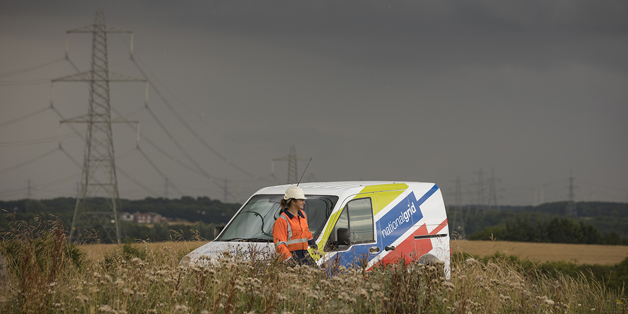
GB & EU Power Markets
April 2021
Market Fundamentals For internal use only

Slide 2
European Power Markets
Capacity Markets
Years
Capacity Markets guarantee that generation will be available in future to meet demand, main auction is 4 years out and can award contracts up to 15 years.
Forwards are used to hedge against volatility in the market by locking in prices ahead of time.
Contracts for Difference are agreements to sell for a fixed (strike) price, with the balance being set based on an index and the difference from the strike price refunded
Power Purchase Agreements are long term offtake agreements defining prices, volumes, time periods and penalties for non-compliance.
Day-Ahead Market: Wholesale power has one exclusive route to market in Europe and that is through the DAM.
Intra-Day: Three 8h auctions used to refine positions taken in the DAM based on new information, weather forecasts, plant trips, and demand shocks.
Balancing Mechanism: Each country has a unique mechanism depending on their legacy generation mix, the aim of which is to balance supply and demand on a minute by minute basis.
Forwards/CFDs/PPAs
Day-Ahead
Seasons
Months
Weeks
Intra-Day
Days
Hours
Balancing
Minutes
Seconds

Slide 3




Gas remains the key price driver in GB as growth of RES continues
GWh
Strong wind growth expected
Increased government ambition leading to large growth in offshore wind – The UK hitting the 30GW target by 2030 will be difficult.
UK government lifted ban on subsidies for new onshore wind farms.
GW
GB Capacity Outlook
GB Generation
289
110
100
Nuclear growth uncertainty
Financing problems of new plants and uncertainty around when older nuclear plants will close
Declines in nuclear output across Europe as countries ramp up their renewable generation to meet EU RES targets.
Role of gas generation changing
CCGT production falling as capacity planning sees their baseload role fall off in favour of providing backup for RES
Opportunities for more efficient peakers at intra-day and balancing stages to profit from RES intermittency
2012
2020
2020
Imports play a key part
Interconnection contributes to security of supply and keeps costs down for consumers
Allows for renewable integration and development across Europe as excess generation can be exported rather than being curtailed
Peak Demand
Peaking
Offshore Wind
Hydro
Interconnection
Solar
Nuclear
Coal
DSR
Onshore Wind
Biomass
Gas

Slide 4
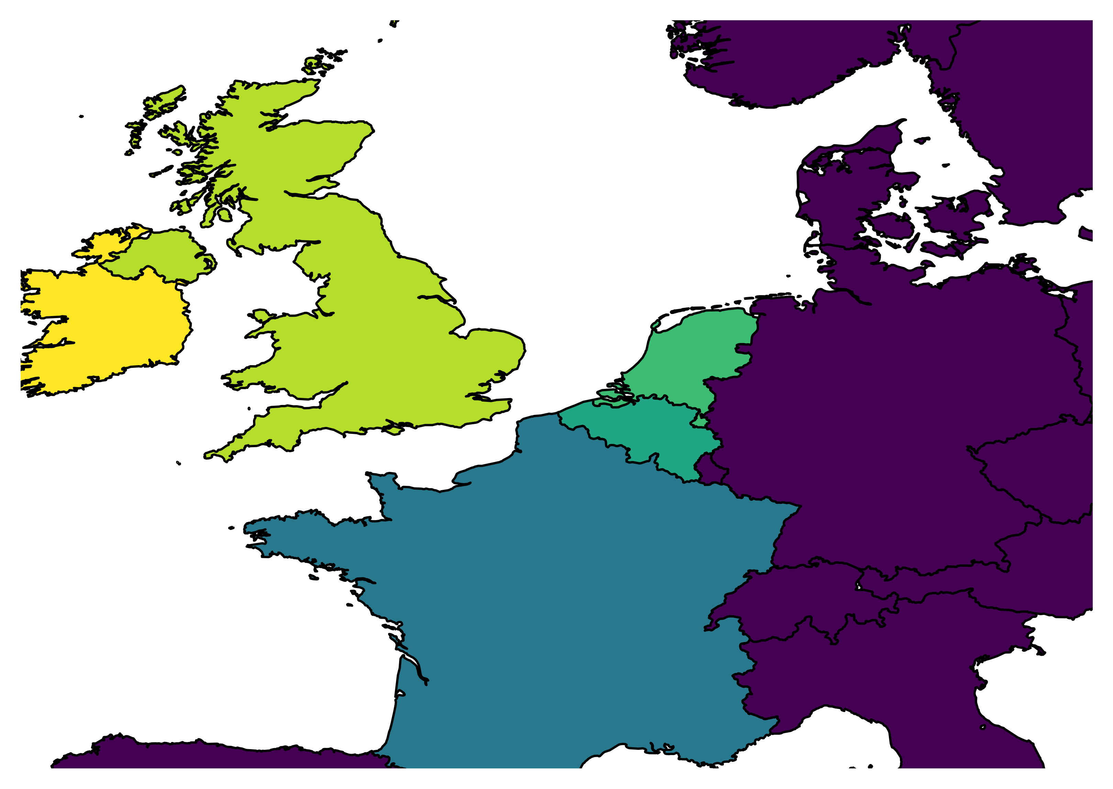
How do Interconnector flows behave? Energy flows from countries with cheaper resources to countries with more expensive resources.
Power Prices [€/MWh]
You may find periods in the data where you see flow between two countries with the same power price. This is known as a market coupling flow. Without this flow a more expensive resource would have to generate in destination country.
62.33
58.71
NL-GB
52.13
GB-IE
BE-GB
BE-NL
49.18
FR-GB
FR-BE
43.12

Slide 5


How much carbon is emitted from generating power?
Plant dependent
 | Fuel | Fuel CO₂ Production Rate [tonnes/MWh] | / | Plant Efficiency [%] | = | Plant CO₂ Intensity [tonnes/MWh]
 | Gas | 0.2043 | / | 56% | = | 0.3648
 | Coal | 0.3348 |  | 35% |  | 0.9455
 | Renewables & Nuclear | 0 |  | 33% |  | 0
 | Biomass | 0.0156* |  | 34% |  | 0.0459
*Biomass emissions are considered net-zero emissions as the carbon content of the fuel was absorbed during the plant’s growth from the atmosphere.
Source: Greenhouse gas reporting: Conversion Factors 2019

Slide 6
Project Data & Reporting Metrics
Methodology:
Extract aggregated generation by technology using Python APIs (NG)
Find share of energy consumption per fuel type for every country
Categorize energy consumption into Zero Carbon, Fossil Fuel, Biomass & Waste for every country & interconnector
Find carbon intensity of a country then carbon savings from interconnector flows

Slide 7
Example- Breakdown of GB power consumption
Categorisation of energy sources as given in the data
Imports
Waste
Biomass & Waste
Biomass
Other RES
Storage
Hydro
Zero-Carbon
Solar
Wind
Nuclear
40%
40%
37%
40%
Other Fossil
36%
30%
31%
35%
Gas
Fossil Fuel
Coal
Q1 19
Q2 19
Q3 19
Q4 19
Q1 20
Q2 20
Q3 20
Q4 20
Sources: Elexon, ESO Data Portal

Slide 8
Example – Energy flows from interconnectors
Categorisation of interconnector energy sources as given in the data
Total interconnector imports
Fossil Fuels
30.9%
33.0%
Biomass & Waste
Zero-Carbon
4.6%
4.9%
76.8%
74.5%
91.8%
91.9%
Average Carbon savings from NGV ICs
64.5%
62.1%
0.4%
IFA | NEMO | BRITNED
0.76 mTCO2e | 0.36 mTCO2e | -0.13 mTCO2e
25.1%
16.9%
IFA
NEMO 19
BritNed
IFA
NEMO 20
BritNed
Source: Elexon, ENTSOe, Electricity Map

Slide 9
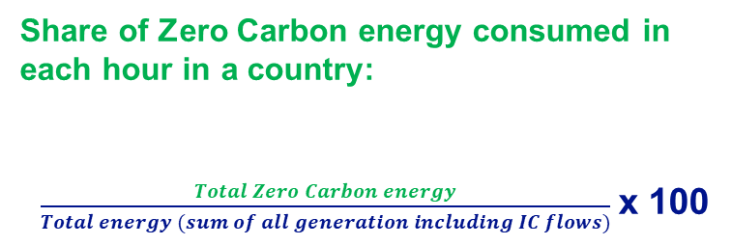
Formulas*
Share of Zero Carbon energy consumed in each hour in a country:
$\frac{Total Zero Carbon energy}{Total energy (sum of all generation including IC flows)}$ x 100
Hourly Carbon intensity of a country:
Sum of (Carbon Intensity/Index of fuel * fuel generation) in gCO2/KWh
Carbon savings from interconnectors:
(Carbon intensity of country A– Carbon intensity of country B)* flow from country B to country A in mTCO2e
Example: Carbon savings in GB from FR IC
(Carbon intensity of GB - Carbon intensity of FR)* flow from FR to GB
Share of Zero Carbon energy from IC flow:
Share of ZC energy consumed in country of origin X IC flow

