Slide 1
Documentation, and Collaborative Reproducibility
with Git, GitHub & SharePoint

Slide 2





Why and how we collaborate?
Geographically spaced team
Speed of integrating changes
Different Integrated Development Environment(IDEs) preferences i.e. RStudio, Visual Studio Code
Data security and compliance with EU -General Data Protection Regulation (GDPR)

Slide 3
Open source
Tracks file changes
Branch based non-linear workflows
local environment
speed of work
IDE integration
Notes:
Increases speed of work

Slide 4
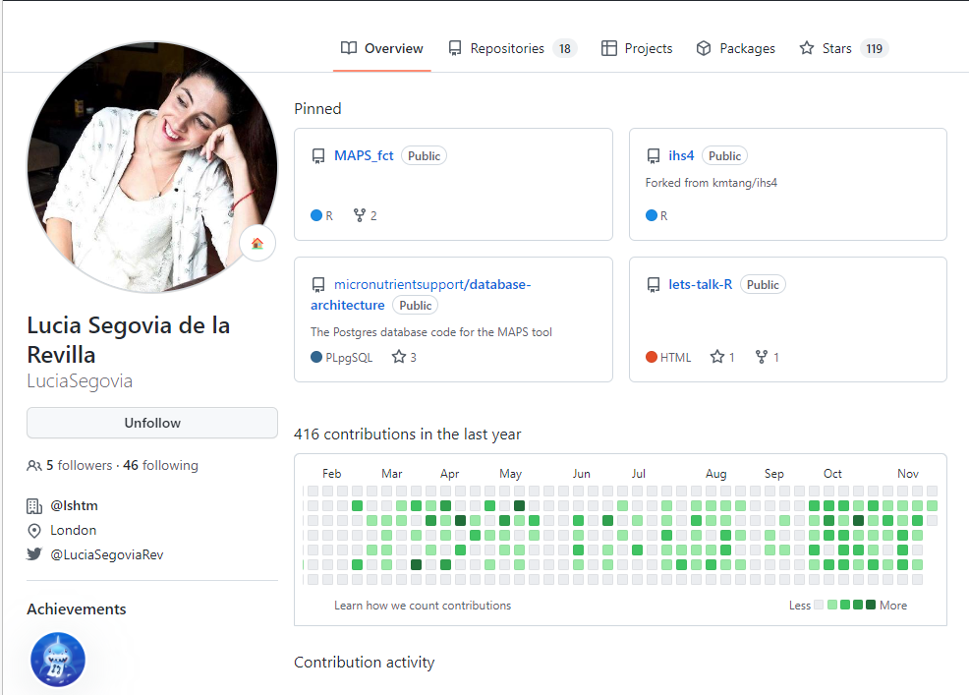

GitHub
Freemium cloud based version control using Git
Repository based (Projects)

Slide 5
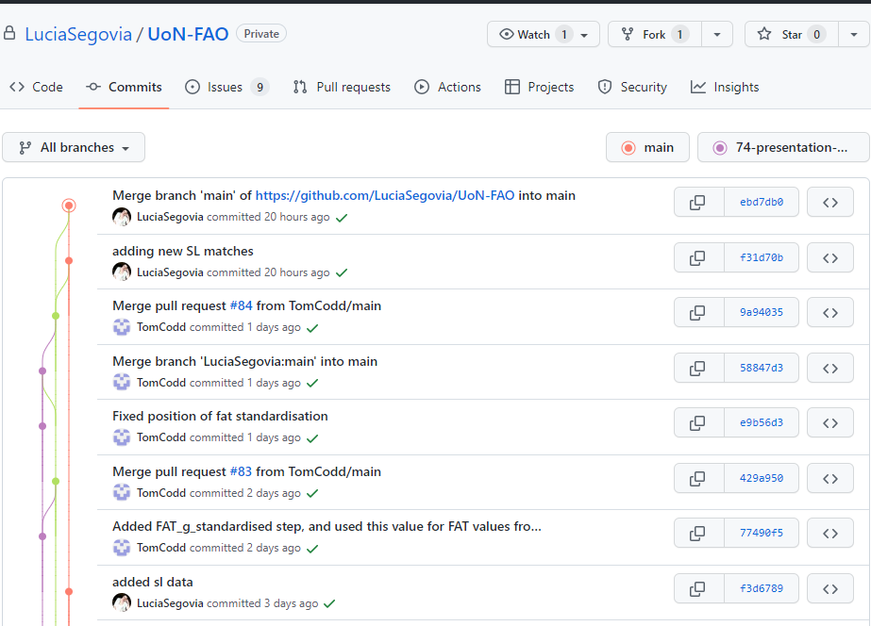
GitHub
Remote collaboration with built-in security

Slide 6
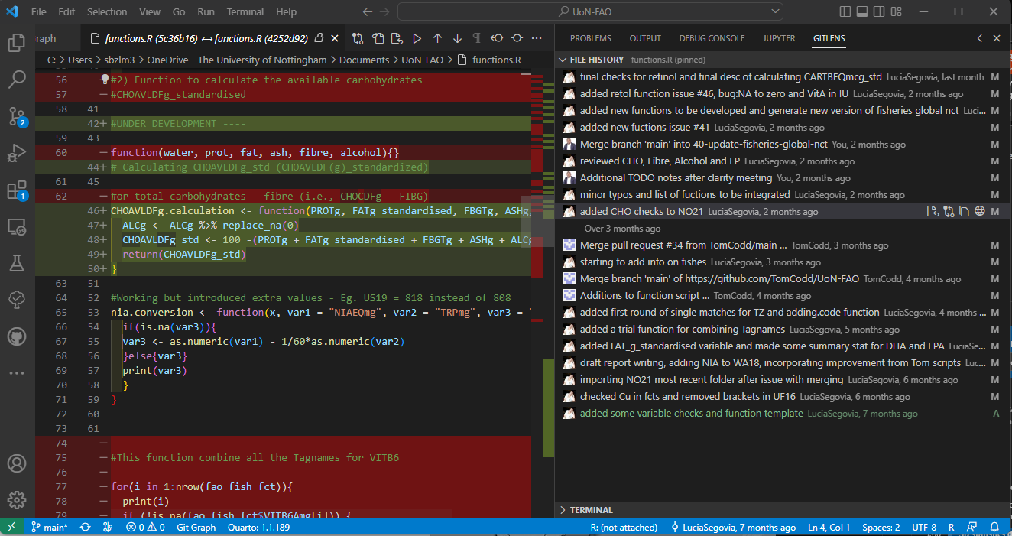
GitHu
File History Tracking

Slide 7
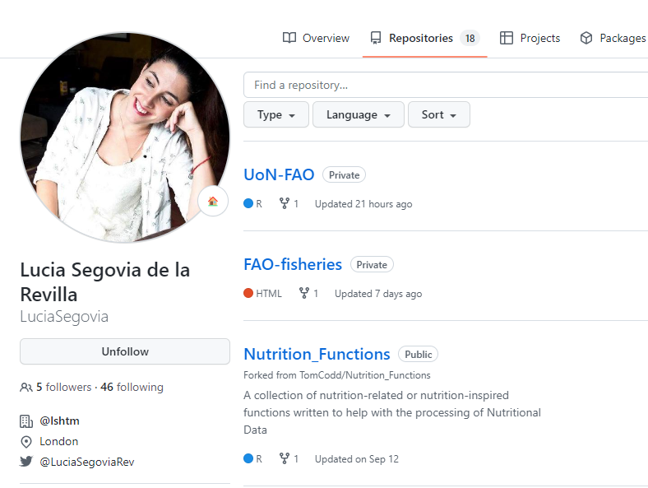
GitHub
Unlimited Public/ Private Repositories

Slide 8
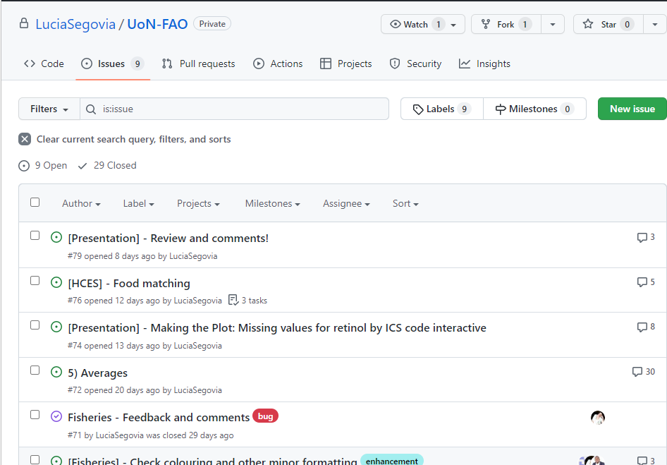
GitHub
Track issues and task progress through conversations

Slide 9
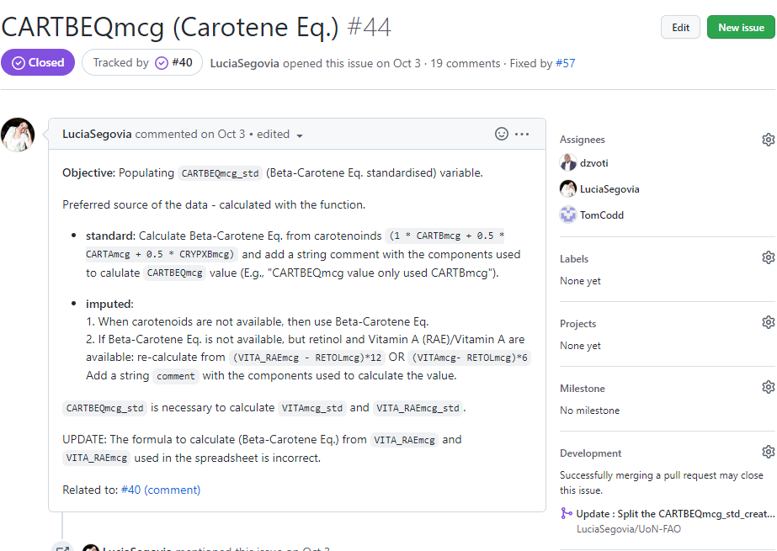
GitHub
Track issues and task progress through conversations

Slide 10
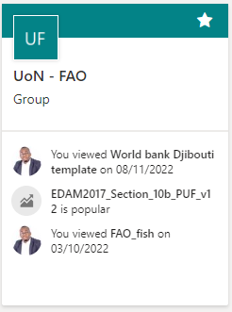
Microsoft SharePoint
Git integration with WYSIWYG files e.g. word is poor
Microsoft’s alternative to git for version control of WYSIWYG documents
GDPR compliant for data privacy and security

Slide 11
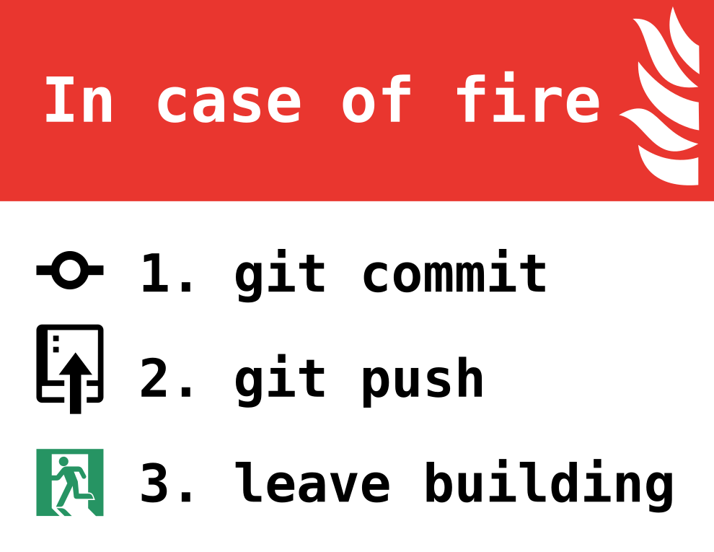
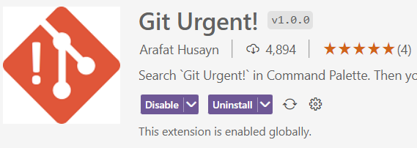
Lessons learnt in Collaboration
Cloud storage and collaboration very important and a key focus area
Reproducibility through version tracking is fundamental
Choose tools carefully to avoid security lapses
CTRL + ALT + SHIFT+F
(Git Urgent)

Slide 12
Git
Free
open-source software
Tracks changes in any set of files
Branch based non-linear workflows
Easy integration with different Interactive Development Environments e.g., RStudio and VSCode
Installed on local development environment.
Notes:
Increases speed of work

