Slide 1
Developing a reproducible approach for generating FCTs & NCTs
Technical webinar on dietary data for FAOSTAT food and diet domain. November, 2022

Slide 2
Agenda (1)
Introduction
Objectives
Development of a framework for compiling NCTs. The Extended Fisheries Global NCT (2022) as case study.
Background and starting point for the NCT
Harmonising Food Composition Tables and Databases
Visualisation for nutrient evaluation and missing values identification.
Function approach for nutrient recalculation & NCT formatting
Documentation, Reproducibility & GitHub
Agenda (2)
The Extended Fisheries Global NCT (2022)
Food composition data for fishery products: Overview
Visualisation for decision making (missing values and outliers)
How scripted approach allow for fast update and re-use of the FCT for new purposes
How collaborative coding and GitHub increases efficiency and transparency of the approach
Conclusions & Recommendation for the future
What has been completed – what needs to be further advanced?
The need of better nutrition data for decision-making
New data skills and statistical approach for better food and nutrition data.
Q&A: Discussion & Next Steps
Notes:
Speaker notes go here.

Slide 3
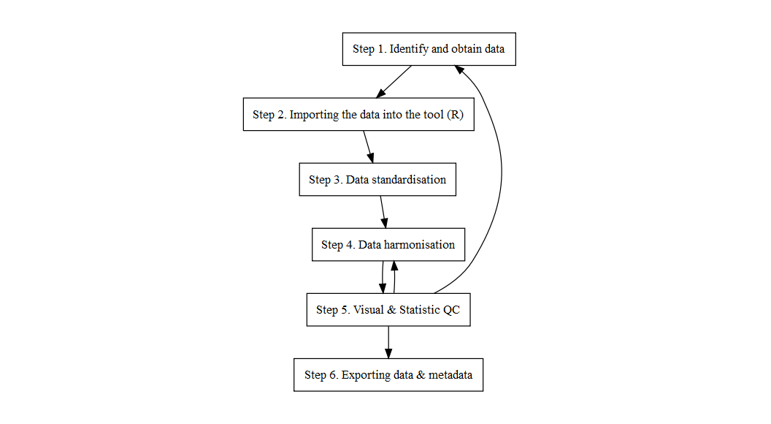
Development of a the framework for compiling NCTs
Why a framework was needed?
FCTs are available in multiple data formats
Data harmonisation requires effort, expertise, and time
Increasing the standardisation of the FCTs would…
... Lower cost of updating & generating new NCTs
... Increase reproducibility of NCTs and their survey outputs
... Increase re-usability & dissemination of FCTs
Overview of the NCT framework

Slide 4
Steps 1 & 2: Data Sources & Importing
Downloading and storing original 11 FCTs ¹ + Norwegian FCT (2021)
FCTs were imported into R(Studio) & independent scripts were generated for each FCT
All the data operations (from Step 2 to Step 6) were done in R(Studio)
Step 3: Data cleaning and standardisation of FCTs (1)
Food component names/ description standardisation using Tagnames². For example, “Vitamin B12 (mcg/100g)” -> VITB12mcg
Removing special characters (“[]”, “()”, “*”).
Food name/ description standardisation:
ASFIS List of Species for Fishery Statistics Purposes
ICS SUA Fisheries codes & categories
Step 3: Data cleaning and standardisation of FCTs (2)
Food name/ description standardisation:
ASFIS List of Species for Fishery Statistics Purposes
ICS SUA Fisheries codes & categories
Step 3: Food name/ description standardisation
Fisheries categories matching in Norwegian FCT (2021)
Scientific names were used to allocate the ‘International Standard Statistical Classification for Aquatic Animals and Plants’ (ISSCAAP) codes
ISSCAAP codes and text pattern identification were used to allocate ICS SUA Fisheries codes.
Review and final allocation of unidentified fish items were performed.
Step 4a: Data harmonisation and compilation of FCTs
Character values standardisation. For example, trace (“tr”) or below detection limit (“<LOD”) will be converted into zero (0).
Unit of measure standardisation. For example from mg/100g to g/100g.³
Harmonising Food Composition Tables and Databases. From 12 individual FCTs to a compiled FCT data library.
Step 4b: Variable recalculation and missing values
Other data transformation were performed in the harmonised data library.
Re-calculation of food components. For example, Energy, Carbohydrates by difference or Vitamin A (RAE).
Back-calculation from other components. For example, Niacin, preformed was back-calculated from Niacin, equivalents and Tryptophan.
Combining food components. For example, Vitamin B6 included: Vitamin B6 determined by analysis, determined by calculation and by unknown method.
Data imputation: For example,if a ICS SUA fishery category did not provided data for one nutrient.
Step 4b: Back-calculation
Ash by difference (g/100g)
Beta-carotene equivalents (mcg/100g)
Retinol (mcg/100g)
Back-calculation: Ash by difference
Eq.1a Carbohydrates available by difference (g/100g) = 100 - (sum of water + protein + fat + ash + alcohol + dietary fibre)
Eq.2b Ash by difference (g/100g) = 100 - (sum of water + protein + fat + available carbohydrate + alcohol + dietary fibre)
Back-calculation: Beta-carotene equivalents
Eq.6a. Beta-Carotene eq. (mcg/100g) = 1*Beta-carotene (mcg/100g) + 0.5* Alpha-carotene (mcg/100g) + 0.5* Beta-cryptoxanthin (mcg/100g)
Eq.6b. Beta-Carotene eq. (mcg/100g) = Beta-Carotene eq. (mcg/100g)
Eq.6c. Beta-Carotene eq. (mcg/100g) = 12*(Vitamin A, retinol activity eq. (RAE) (mcg/100g EP) - Retinol (mcg/100g EP))
Eq.8.1 Vitamin A, retinol activity eq. (RAE) (mcg/100g EP) = Retinol (mcg/100g EP) + 1/12* Beta-Carotene eq. (mcg/100g EP)
When implausible value (Retinol > Vitamin A)
Eq.6c. Beta-Carotene eq. (mcg/100g) = 0
Back-calculation: Retinol
Eq.9a. Retinol (mcg/100g EP) = Vitamin A, retinol activity eq. (RAE) (mcg/100g) - 1/12* Beta-Carotene eq. (mcg/100g EP)
Eq.8.1 Vitamin A, retinol activity eq. (RAE) (mcg/100g EP) = Retinol (mcg/100g EP) + 1/12* Beta-Carotene eq. (mcg/100g EP)
Eq.9b Retinol (mcg/100g EP) = Vitamin A, retinol eq. (RE) (mcg/100g EP) + 2*Vitamin A, retinol activity eq. (RAE) (mcg/100g EP)
Eq.8.1 Vitamin A, retinol activity eq. (RAE) (mcg/100g EP) = Retinol (mcg/100g EP) + 1/12* Beta-Carotene eq. (mcg/100g EP)
Eq.8.2 Vitamin A, retinol eq. (RE) (mcg/100g EP) = Retinol (mcg/100g EP) + 1/6* Beta-Carotene eq. (mcg/100g EP)
Step 5: Visual and statistical quality checks
Visualisation was performed in the harmonised data library for nutrient evaluation and missing values identification. Including:
Identification of data gaps & errors. Systematically non-reported fishery products and/or food components
Identification of missing values. For example, fishery products and food components were reported but high number of missing values were found.
Outliers. Values were extremely low or high compared within the same ICS SUA fishery category.
Step 6: Data formatting & exporting
Food component values were calculated for each ICS SUA fishery category.
Mean or re-calculation of food components were computed & evaluated
Fishery data library was exported to excel.
Formatting and re-calculation were done using functions.
Generating functions for data transformation
Functions: Re-calculation
Functions were developed to re-calculate:
SOP_std_creator() - Sum of Proximate
ENERCKcal_standardised() - Energy (kcal)
CHOAVLDFg_std_creator() - Carbohydrates by difference VITA_RAEmcg_std_creator() - Vitamin A (REA) CARTBEQmcg_std_creator() - Beta-Carotene Eq.
Functions: Energy
Code
Functions: Re-calculation
Functions were developed to re-calculate:
SOP_std_creator() - Sum of Proximate ENERCKcal_standardised() - Energy (kcal) CHOAVLDFg_std_creator() - Carbohydrates by difference VITA_RAEmcg_std_creator() - Vitamin A (REA)
CARTBEQmcg_std_creator() - Beta-Carotene Eq.
Functions
Back-calculation
Examples of back-calculation functions
nia_conversion_creator() - Niacin from Tryptophan RETOLmcg_Recalculator() - Retinol from Vitamin A and Beta-Carotene Eq.
Combination
Combining variables
THIAmg_std_creator() - Thiamin and Thiamin hydrochloride
Documentation, Reproducibility & GitHub
Fully reproducible data & documentation is provided within the repository. Available in GitHub
A report covering: data curation steps, variable description, reference to external resources used, and describing any assumptions and challenges.(Available also in pdf)
All these steps would allow to replicate the process and to re-generate the table with the same format for future updates.
Notes:
In our FCT data library the following variables were recombined: FAT_g_standardised, FIBTGg_standardised*, THIAmg_standardised and VITB6_mg_standardised
Thirteen FCTs were selected for the Food Global NCT, of which two were excluded, and one new was added for its relevance to the Fisheries Global NCT (i.e. to fill some data gaps for DHA and EPA).
We focused on the 10 fish-relevant food components for inclusion + 21 food components. For the future, a way of keeping that information should be found (e.g, how can we record and account for those low quality values within the dataset?, can we generate a score with the number of “low quality” values per food item?).
For example, fish description mentioning “cured, smoked, salted or dried” were allocated to the fish preparation type “cured” Therefore, a fish entry that was matched to the ISSCAAP code == “39” and to the fish preparation type “cured” would be assigned to the ICS SUA category “1544”, which corresponds to “Marine fish, other, cured”.
The data library used for the Fisheries Global NCT. The steps outlined thus far were performed by individual script for each FCT, and were performed not only for fisheries but for the whole FCT. This is important as the burden of compilation of any other commodity from those data sources would be significantly decreased. As, we would see later in the presentation.
-Food components were recalculated using functions generated based on FAO/ INFOODS equations standards. For example, Energy, Carbohydrates by difference or Vitamin A (RAE). -Food components with different definitions were combined to increase availability of the data. For example: Total fats, dietary fibre, thiamine, and Vitamin B6. -Food components were back-calculated using adaptation of standard equations. For example, Ash, B-Carotene eq., Retinol, or Niacin.
We checked the number of missing values per food component using data visualisation packages. We used the package naniar(@ref-naniar) for visualising missing values by ICS SUA fishery category and by FCT. This allowed us to identify any typos or mistakes when renaming the food components, and also to identify potential food components that could be excluded due to the high number of missing values Similarly, we used visuals to identify data gaps and completeness for final inclusion of nutrients. Histograms and boxplots were used to check the data variability and identify outliers.
SOP own
Energy (kcal)
Energy (kJ)
Carbohydrates by difference (g)
Vitamin A RAE (mcg)
Vitamin A RA (mcg)
As proof of concept, after we expanded the Fisheries Global NCT for the 6 food components, due to some discrepancies, we agreed to compile the previous 20 food components from all the FCTs. This was done in a much more efficient way, as FCTs were already cleaned and ready to be checked and formatted.

Slide 5
The Extended Fisheries Global NCT (2022)
Food composition data for fishery products: Overview

Slide 6
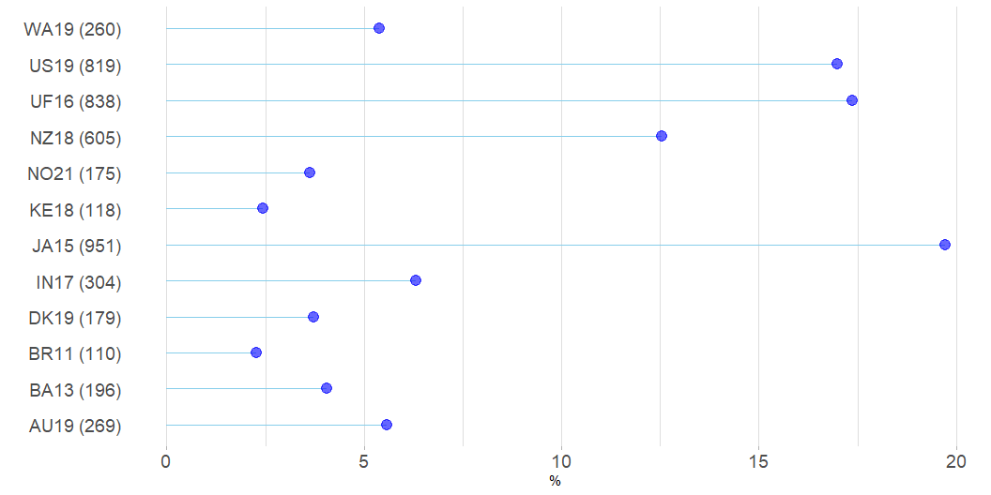
4824* fish and fishery products were compiled from 12FCTs.
9 FCTs were open and freely accessible and cleaned for all foods.
20 food components were reported from more than 100 compiled variables.
*including duplicated items
Fishery products per FCT

Slide 7
Harmonisation of the data
Tagname re-naming was needed in all FCTs,
4 FCTs did not report Tagnames (DK19, NZ18, BA13 & NO21)
“Lower quality values” were reported in 3 FCTs (JA15, KE18, WA19 and UF1)
Trace and/or below limit of detection values were transformed to zero in 6 FCTs (IN17 (“<LOD”), BA13, BR11, JA15 (“Tr”), KE18 & WA19 (“tr”)).
Measurement units transformation was needed for Tryptophan,Vitamin A, DHA and EPA in 3 FCTs (US19, IN17 & JA15).
Fisheries categories matching in Norwegian FCT (2021)
ISSCAAP code was allocated to 79% (183/232) of the fish items in NO21, of which
89% (n=164) of the matches which were using the scientific names
10% (n=19) were done manually using scientific name/ food description.
ICS SUA fishery category was matched to 234 fish and fishery products for use in the NCT (183 unique fish items).

Slide 8
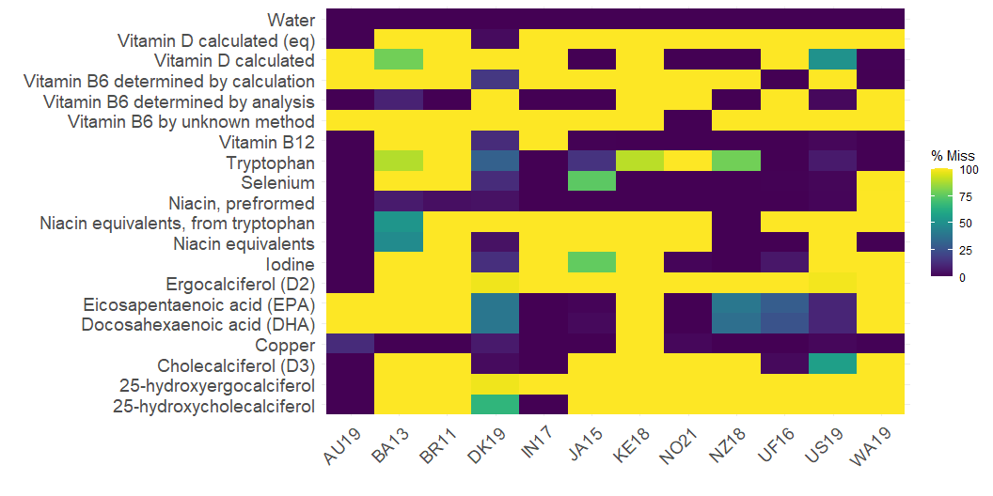
Transformation & Harmonisation
7 food components (SOP, Energy (kcal, kJ), Carbohydrates by difference, Vitamin A (RAE, RE) and Beta-Carotene Eq.) were re-calculated.
4 food components (Ash, Beta-Carotene Eq., Retinol, and Niacin) were back-calculated.
4 food components (Fat, Thiamine and Vitamin B6) were combined.
Visualisation for decision making (missing values and outliers)
Data Availability

Slide 9

Data Availability

Slide 10

Data Availability

Slide 11

Data Availability

Slide 12
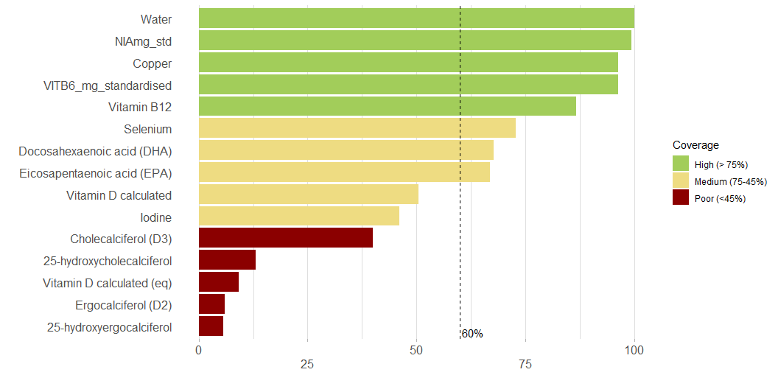
Selecting nutrient values based on data availability
Figure 1: Availability of data: Percentage (%) of fish entries with values of selected components.
Notes:
From the 10 food components that we reviewed we decided to include 6 of them, because they had a overall coverage of more than 60%.

Slide 13
Fish categories | Data available (count) per fish category and nutrient
 | Water | Vitamin B6 | Vitamin B12 | Selenium | Niacin | DHA | EPA | Copper
Aquatic animals nei, cured | 3 | 3 | 3 | 0 | 3 | 3 | 3 | 3
Aquatic animals nei, fresh | 8 | 8 | 8 | 5 | 8 | 5 | 5 | 5
Aquatic animals nei, preparations nei | 2 | 2 | 2 | 0 | 2 | 2 | 2 | 2
Aquatic mammals, meat | 15 | 4 | 4 | 4 | 7 | 4 | 4 | 7
Aquatic mammals, oils | 5 | 2 | 3 | 3 | 5 | 3 | 3 | 3
Aquatic mammals, preparations nei | 5 | 3 | 3 | 2 | 4 | 3 | 3 | 3
Aquatic plants | 9 | 9 | 9 | 9 | 9 | 8 | 8 | 9
Aquatic plants, dried | 24 | 24 | 24 | 12 | 24 | 8 | 18 | 24
Aquatic plants, preparations nei | 10 | 9 | 9 | 5 | 10 | 4 | 5 | 10
Cephalopods, canned | 1 | 1 | 1 | 0 | 1 | 1 | 1 | 1
Cephalopods, cured | 4 | 4 | 4 | 0 | 4 | 4 | 4 | 4
Cephalopods, fresh | 32 | 32 | 27 | 27 | 32 | 24 | 24 | 30
Cephalopods, frozen | 33 | 33 | 28 | 28 | 33 | 25 | 25 | 31
Cephalopods, preparations nei | 41 | 41 | 41 | 38 | 41 | 26 | 26 | 39
Crustaceans, canned | 7 | 7 | 7 | 5 | 7 | 5 | 5 | 7
Crustaceans, cured | 2 | 2 | 2 | 0 | 2 | 1 | 1 | 2
Crustaceans, fresh | 88 | 80 | 69 | 70 | 81 | 45 | 42 | 87
Crustaceans, frozen | 89 | 81 | 70 | 71 | 82 | 46 | 43 | 88
Crustaceans, preparations nei | 116 | 114 | 114 | 100 | 116 | 59 | 53 | 113
Demersal fish, body oils | 3 | 3 | 3 | 3 | 3 | 3 | 3 | 3
Demersal fish, canned | 3 | 3 | 3 | 3 | 3 | 2 | 2 | 3
Demersal fish, cured | 13 | 12 | 12 | 11 | 13 | 10 | 10 | 11
Demersal fish, fresh | 154 | 152 | 107 | 108 | 154 | 146 | 146 | 153
Demersal fish, fresh fillets | 86 | 85 | 85 | 81 | 86 | 57 | 57 | 85
Demersal fish, frozen, fillets | 89 | 88 | 88 | 84 | 89 | 59 | 59 | 88
Demersal fish, frozen, whole | 155 | 153 | 108 | 109 | 155 | 146 | 146 | 154
Demersal fish, liver oils | 6 | 5 | 5 | 5 | 6 | 2 | 2 | 5
Demersal fish, preparations nei | 248 | 242 | 235 | 204 | 248 | 177 | 178 | 240
Diadromous fish, body oils | 1 | 1 | 1 | 1 | 1 | 1 | 1 | 1
Diadromous fish, canned | 20 | 19 | 20 | 18 | 19 | 15 | 15 | 20
Diadromous fish, cured | 21 | 20 | 20 | 19 | 20 | 17 | 17 | 20
Diadromous fish, fresh | 60 | 56 | 53 | 47 | 59 | 52 | 52 | 56
Diadromous fish, fresh fillets | 32 | 32 | 30 | 30 | 32 | 14 | 13 | 32
Diadromous fish, frozen fillets | 32 | 32 | 30 | 30 | 32 | 14 | 13 | 32
Diadromous fish, frozen, whole | 60 | 56 | 53 | 47 | 59 | 52 | 52 | 56
Diadromous fish, liver oils | 6 | 5 | 5 | 5 | 6 | 2 | 2 | 5
Diadromous fish, preparations nei | 116 | 110 | 111 | 96 | 116 | 70 | 70 | 110
Freshwater & diadromous fish, body oils | 1 | 1 | 1 | 1 | 1 | 1 | 1 | 1
Freshwater & diadromous fish, canned | 21 | 20 | 21 | 19 | 20 | 16 | 16 | 21
Freshwater & diadromous fish, cured | 25 | 24 | 24 | 23 | 24 | 21 | 21 | 24
Freshwater & diadromous fish, fresh | 127 | 122 | 83 | 78 | 125 | 88 | 88 | 123
Freshwater & diadromous fish, fresh fillets | 79 | 75 | 64 | 56 | 79 | 32 | 29 | 75
Freshwater & diadromous fish, frozen fillets | 85 | 81 | 68 | 60 | 85 | 36 | 33 | 81
Freshwater & diadromous fish, frozen, whole | 129 | 124 | 83 | 78 | 127 | 88 | 88 | 125
Freshwater & diadromous fish, liver oils | 6 | 5 | 5 | 5 | 6 | 2 | 2 | 5
Freshwater & diadromous fish, preparations nei | 241 | 228 | 231 | 185 | 241 | 144 | 138 | 227
Freshwater fish, body oils | 1 | 1 | 1 | 1 | 1 | 1 | 1 | 1
Freshwater fish, canned | 1 | 1 | 1 | 1 | 1 | 1 | 1 | 1
Freshwater fish, cured | 21 | 20 | 20 | 19 | 20 | 17 | 17 | 20
Freshwater fish, fresh | 60 | 59 | 23 | 24 | 59 | 29 | 29 | 60
Freshwater fish, fresh fillets | 47 | 43 | 34 | 26 | 47 | 18 | 16 | 43
Freshwater fish, frozen fillets | 52 | 48 | 37 | 29 | 52 | 21 | 19 | 48
Freshwater fish, frozen, whole | 62 | 61 | 23 | 24 | 61 | 29 | 29 | 62
Freshwater fish, liver oils | 6 | 5 | 5 | 5 | 6 | 2 | 2 | 5
Freshwater fish, preparations nei | 114 | 107 | 109 | 79 | 114 | 63 | 57 | 107
Marine fish nei, preparations nei | 294 | 282 | 279 | 207 | 294 | 183 | 184 | 278
Marine fish nei, body oils | 4 | 4 | 4 | 4 | 4 | 3 | 3 | 4
Marine fish nei, canned | 67 | 66 | 65 | 40 | 67 | 51 | 51 | 65
Marine fish nei, cured | 26 | 25 | 25 | 12 | 26 | 23 | 23 | 24
Marine fish nei, fresh | 153 | 147 | 148 | 84 | 153 | 131 | 131 | 148
Marine fish nei, fresh fillets | 136 | 135 | 133 | 119 | 136 | 87 | 84 | 135
Marine fish nei, frozen fillets | 139 | 138 | 136 | 122 | 139 | 89 | 86 | 138
Marine fish nei, frozen, whole | 154 | 148 | 149 | 85 | 154 | 131 | 131 | 149
Marine fish nei, liver oils | 6 | 5 | 5 | 5 | 6 | 2 | 2 | 5
Molluscs, excluding cephalopods, canned | 9 | 9 | 9 | 5 | 9 | 8 | 8 | 9
Molluscs, excluding cephalopods, cured | 8 | 8 | 8 | 6 | 8 | 8 | 8 | 8
Molluscs, excluding cephalopods, fresh | 82 | 82 | 77 | 63 | 82 | 49 | 49 | 82
Molluscs, excluding cephalopods, frozen | 81 | 81 | 76 | 62 | 81 | 48 | 48 | 81
Other pelagic fish, body oils | 3 | 3 | 3 | 3 | 3 | 3 | 3 | 3
Other pelagic fish, canned | 30 | 30 | 29 | 20 | 30 | 23 | 23 | 30
Other pelagic fish, cured | 2 | 2 | 2 | 1 | 2 | 2 | 2 | 2
Other pelagic fish, fresh | 29 | 28 | 21 | 22 | 29 | 23 | 23 | 27
Other pelagic fish, fresh fillets | 21 | 21 | 19 | 14 | 21 | 14 | 13 | 21
Other pelagic fish, frozen fillets | 21 | 21 | 19 | 14 | 21 | 14 | 13 | 21
Other pelagic fish, frozen, whole | 29 | 28 | 21 | 22 | 29 | 23 | 23 | 27
Other pelagic fish, liver oils | 6 | 5 | 5 | 5 | 6 | 2 | 2 | 5
Other pelagic fish, preparations nei | 22 | 19 | 22 | 11 | 22 | 11 | 11 | 19
Pelagic fish, body oils | 3 | 3 | 3 | 3 | 3 | 3 | 3 | 3
Pelagic fish, canned | 75 | 74 | 73 | 48 | 75 | 60 | 60 | 73
Pelagic fish, cured | 22 | 22 | 22 | 10 | 22 | 22 | 22 | 21
Pelagic fish, fresh | 98 | 94 | 64 | 75 | 98 | 83 | 83 | 94
Pelagic fish, fresh fillets | 50 | 50 | 48 | 38 | 50 | 31 | 28 | 50
Pelagic fish, frozen fillets | 50 | 50 | 48 | 38 | 50 | 31 | 28 | 50
Pelagic fish, frozen, whole | 98 | 94 | 64 | 75 | 98 | 83 | 83 | 94
Pelagic fish, liver oils | 6 | 5 | 5 | 5 | 6 | 2 | 2 | 5
Pelagic fish, preparations nei | 103 | 97 | 101 | 60 | 103 | 63 | 63 | 95
Small pelagic fish, body oils | 3 | 3 | 3 | 3 | 3 | 3 | 3 | 3
Small pelagic fish, canned | 35 | 34 | 34 | 18 | 35 | 27 | 27 | 33
Small pelagic fish, cured | 15 | 15 | 15 | 4 | 15 | 15 | 15 | 15
Small pelagic fish, fresh | 61 | 58 | 35 | 46 | 61 | 53 | 53 | 59
Small pelagic fish, fresh fillets | 30 | 30 | 30 | 25 | 30 | 17 | 15 | 30
Small pelagic fish, frozen fillets | 30 | 30 | 30 | 25 | 30 | 17 | 15 | 30
Small pelagic fish, frozen, whole | 61 | 58 | 35 | 46 | 61 | 53 | 53 | 59
Small pelagic fish, liver oils | 6 | 5 | 5 | 5 | 6 | 2 | 2 | 5
Small pelagic fish, preparations nei | 72 | 69 | 70 | 40 | 72 | 43 | 43 | 67
Checking for ICS SUA category data gaps

Slide 14
food_desc | SEmcg | source_fct | comment
Crustacean, Sakura shrimp, dried | 101.69 | JA15 | SEmcg value from water adjusted value JA15 (10325)| CARTBEQmcg_std imputed with CARTBEQmcg
Mollusks, firefly squid, seasoned and smoked | 131.19 | JA15 | SEmcg value from water adjusted, median values JA15(10342, 10345)| CARTBEQmcg_std imputed with CARTBEQmcg
Mollusks, processed squid, "Surume" dried squid | 135.96 | JA15 | SEmcg value from water adjusted, median values JA15(10342, 10345) | CARTBEQmcg_std calculated from CARTBmcg, CARTAmcg and CRYPXBmcg
Mollusks, processed squid, "Saki-ika" dried, seasoned and shredded squid | 125.39 | JA15 | SEmcg value from water adjusted, median values JA15(10342, 10345)| CARTBEQmcg_std imputed with CARTBEQmcg
Mollusks, processed squid, seasoned and smoked | 96.26 | JA15 | SEmcg value from water adjusted, median values JA15(10342, 10345)| CARTBEQmcg_std imputed with CARTBEQmcg
Sea urchin, "Tsubu-uni" salted whole gonads | 228.64 | JA15 | SEmcg value from water adjusted value JA15(10372)| CARTBEQmcg_std imputed with CARTBEQmcg
Sea urchin, "Neri-uni" salted whole gonad paste | 222.47 | JA15 | SEmcg value from water adjusted value JA15(10372)| CARTBEQmcg_std imputed with CARTBEQmcg
Jellyfish, Salted, desalted | 27.51 | JA15 | CHOAVLDFg_std assumed zero,SEmcg value from water adjusted value JA15(10372) | CARTBEQmcg_std calculated from CARTBmcg, CARTAmcg and CRYPXBmcg
Sea cucumber, "Konowata" salted and fermented viscera | 93.92 | JA15 | SEmcg value from water adjusted value JA15(10372)| CARTBEQmcg_std imputed with CARTBEQmcg
Sea squirt, "Shiokara" salted and fermented meat and viscera [Syn. Ascidian] | 96.29 | JA15 | SEmcg value from water adjusted value JA15(10372)| CARTBEQmcg_std imputed with CARTBEQmcg
Shrimp (crayfish), whole, dried | 153.20 | WA19 | SEmcg value from water adjusted, median values UF16(092001, 092002, 092003, 092004) | CARTBEQmcg_std calculated from CARTBmcg, CARTAmcg and CRYPXBmcg
Se imputation and documentation (1)
Only Se in four ICS SUA category were missing
Imputation was performed and documented in R(studio) (missing.R).
Documentation can be found in comment variable in the Fisheries Global NCT.
Se imputation and documentation (2)

Slide 15
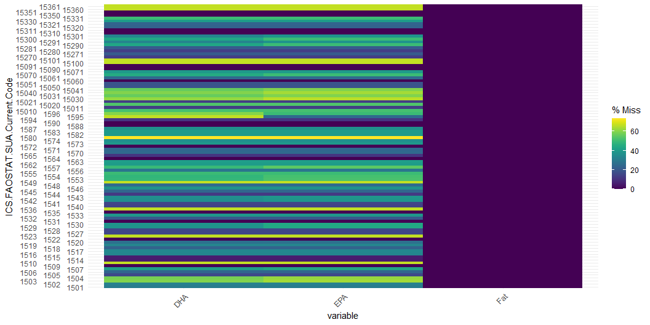
Missing values for DHA and EPA by ICS SUA Fishery Category
Notes:
DHA & EPA were reported to a lesser extent than fat. This may lead to inconsistencies/ inaccuracies in the final data. Imputation was discouraged due to lack of accurate data for the missing values and variability of this nutrients in fish.

Slide 16
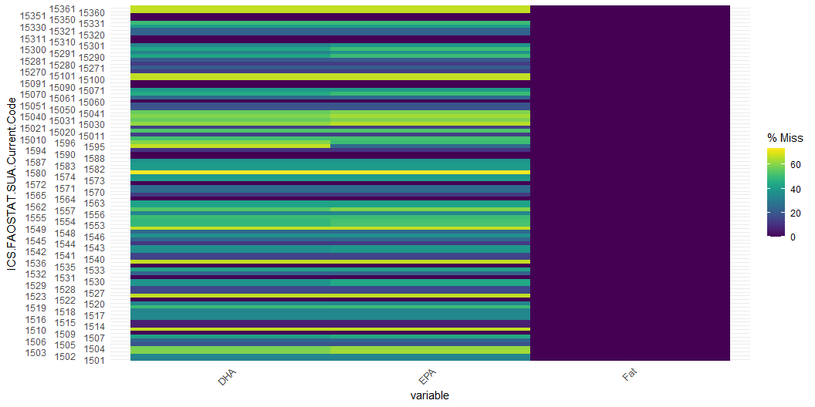
Missing values for DHA and EPA by ICS SUA Fishery Category
Notes:
DHA & EPA were reported to a lesser extent than fat, contribution from NO21. This may lead to inconsistencies/ inaccuracies in the final data. Imputation was discouraged due to lack of accurate data for the missing values and variability of this nutrients in fish.

Slide 17
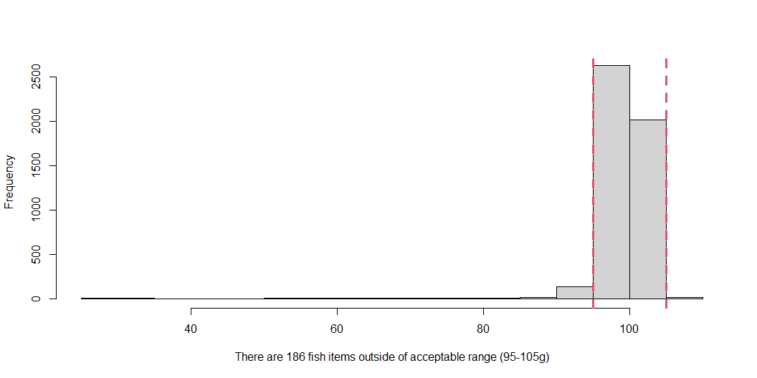
Visual & Quality checks
subset(fao_fish_fct, str_detect(food_desc, " dry| dried")& !str_detect(food_desc, "stewed|cooked")& WATERg>30, select = c(source_fct, food_desc, WATERg)) %>% distinct()
Sum of Proximate

Slide 18
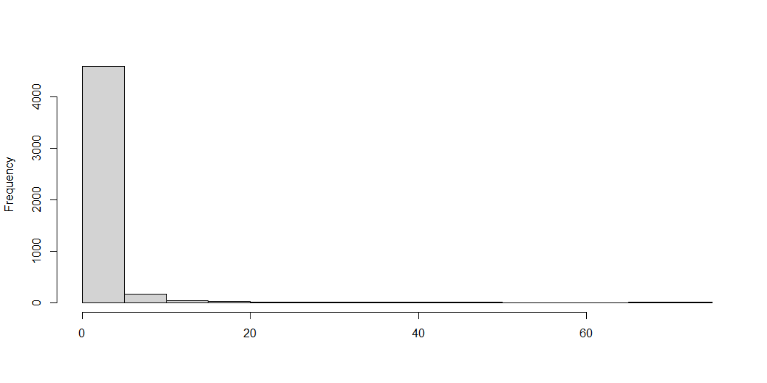
Carbohydrates by difference

Slide 19
38% of the carbohydrates by difference values were negative values and replaced with zero (“assumed zero”)
Documentation
A document with all the decisions and assumptions was generated.
In the NCT, “comments” were added as a separted column with all the data transformations: imputation, assumed zero, calculated, etc.
Scripts are provided to fully reproduce the approach and/or to update if needed.
How scripted approach allow for fast update and re-use of the FCT for new purposes
How collaborative coding and GitHub increases efficiency and transparency of the approach
Notes:
The documentation of these changes are important as they would have an impact of the final estimates, particularly as this variable is used to calculate SOP, and more importantly the total energy. If total energy is calculated using negative values it would lead to a underestimation of the total energy supplied by the foods
this is important to 1) identify data gaps, and 2) flagging potential issues with the data.
This is an stand-alone script that allows for: reproducibility, transparency and future review. In addition, it would allow excluding the imputed values (by not running that script when re-compiling the dataset) when new data is available.

Slide 20
Recommendations for the future
Nutrition
Important data gaps were found,…
More food composition analysis are required, particularly for some fishery categories & nutrients.
- "Aquatic Animals nei", and fish oils in general. - DHA, EPA, I & Se
For some fishery categories and food components, the number of data were far fewer than for other.
Some of those fishery category with low number of values were very variable, and hard to know if this is the true range of chemical variability or analytical differences.
Fisheries ICS categories for nutrition. For example, rethinking some groups. For example, “Aquatic animals, nei”.
Data quality
Imputation techniques and their overall impact on mean values should be evaluated.
Food component description and combination of different methods of analysis (i.e., used for Vitamin B6)
Other data management practices and their impact on final results (i.e., using “low quality values”, assuming zero for trace values, etc.)
Better data documentation for reproducibility and efficiency is needed.
Notes:
Eg., Is it still relevant the use of three Tagnames if we are combining the results? What does it happen when there is an average of multiple values from different methods of analysis? Wouldn’t it be better other reporting system. Eg., providing adequate metadata (both in content and in format) that allow users and machines to identify the method used for each value.
2.e.g, how can we record and account for those low quality values within the datasets/ FCTs? can we generate a score with the number of “low quality” values per food item?

Slide 21
Notes
1. FCTs and food components that were already identified & compiled in the Fisheries Global NCT.
2. FAO/INFOODS, 2013. https://www.fao.org/infoods/infoods/standards-guidelines/food-component-identifiers-tagnames/en/
3. FAO/INFOODS, 2012. Guidelines for Converting Units, Denominators and Expressions Version 1.0

