Slide 1

Sprint 1
Liquor Store Profits Prediction
Lucia Zou
Nov.10th, 2023

Slide 2
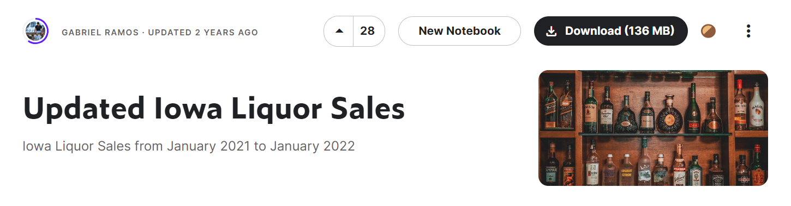
Introduction
The Dataset contains Iowa class E liquor holders data from Jan 2021 to Jan 2022. It has high potential with a lot of data to dig in. It contains 2805307 rows and 24 columns, 14 numeric and 9 categorical.

Slide 3

Overview
Objective:
Using machine learning, the project aims to predict future profits for liquor stores.
Problem Statement:
Can we use machine learning models to predict
future profits of liquor?

Slide 4

Potential Impact
Set pricing strategies: Adjust pricing based on predicted demand and seasonality to promote revenue
Marketing and promotions: Plan effective marketing campaigns and promotions to boost sales during peak periods or slow seasons.

Slide 5

Solve the Problem
Step1: Get the Data (Kaggle)
Step2: Data Cleaning
(Fill in NA, duplicates, formatting)
Step3: EDA (Distributions, correlations)
Step4: Feature Engineering
Step5: Modeling

Slide 6

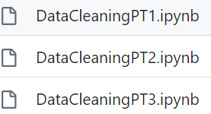
Data Cleaning

Slide 7


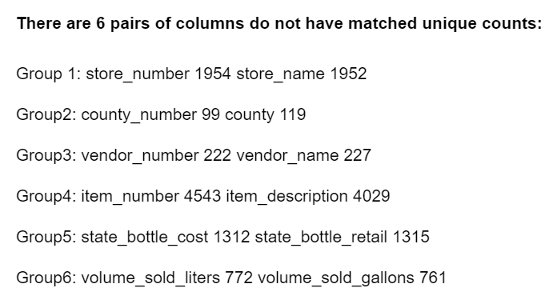
Data Cleaning

Slide 8
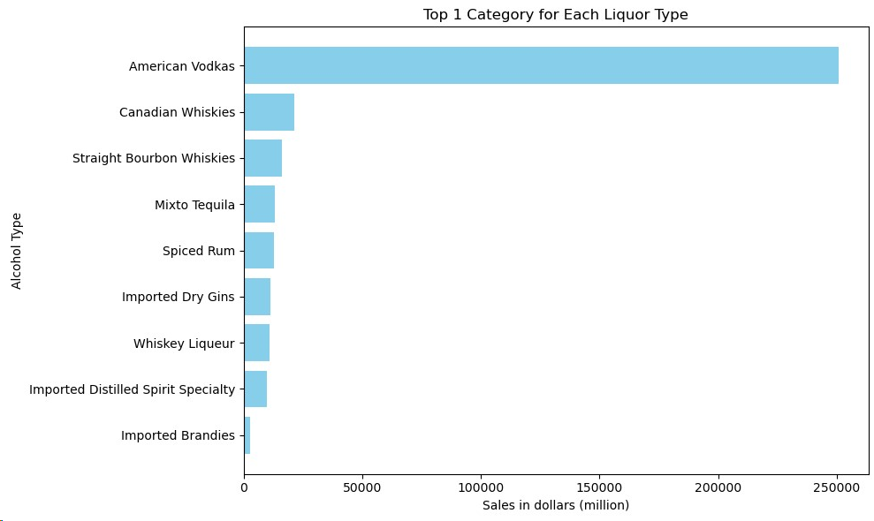
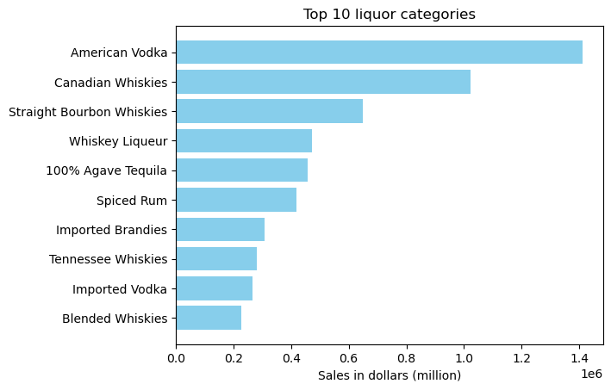
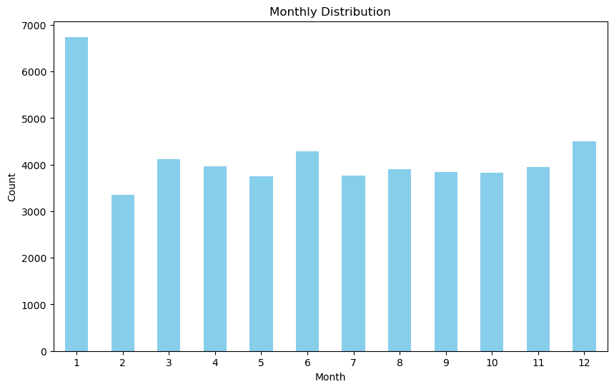
EDA

Slide 9
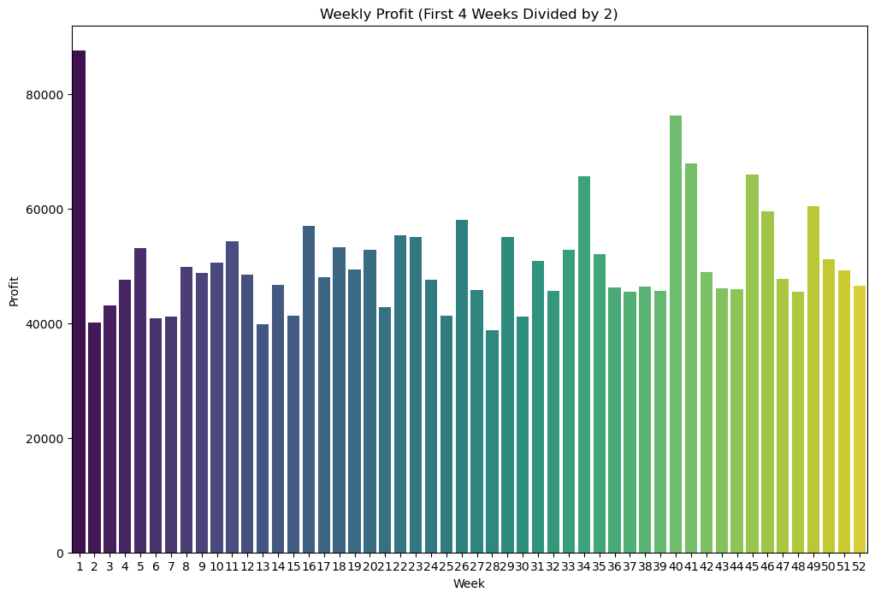
Feature Engineering
New columns:
Profit
Alcohol type
dummies

Slide 10
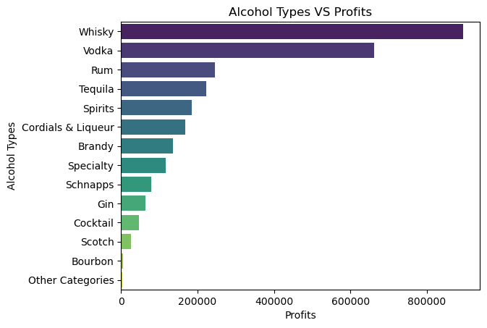
Feature Engineering
Ex: American Vodka to Vodka

Slide 11
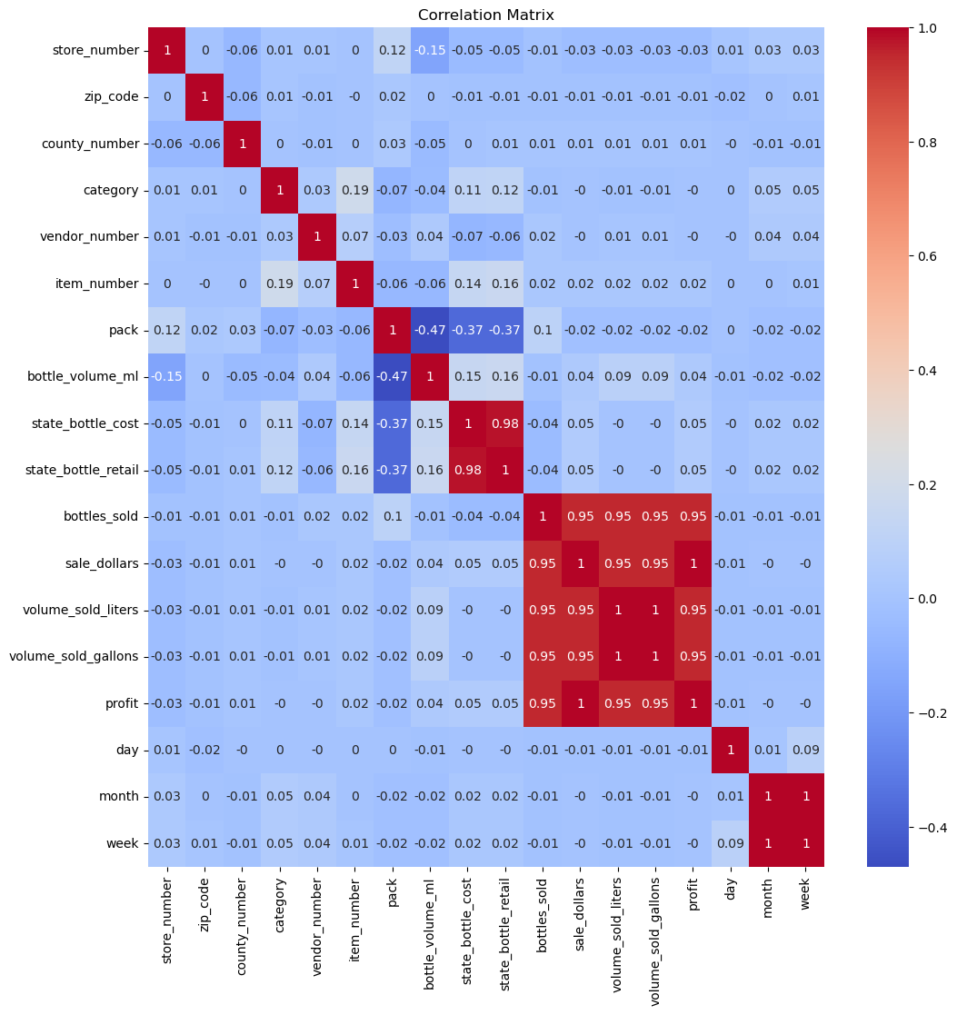
Feature Engineering
Convert Volume_bottle_liters into dummies:
Volume_1: 0-10 liters
Volume_2: 10.01-50.0 liters
Volume_3: 50.01-100.0 liters
Volume_4: 100.01-200.0 liters
Volume_5: more than 200 liters

Slide 12
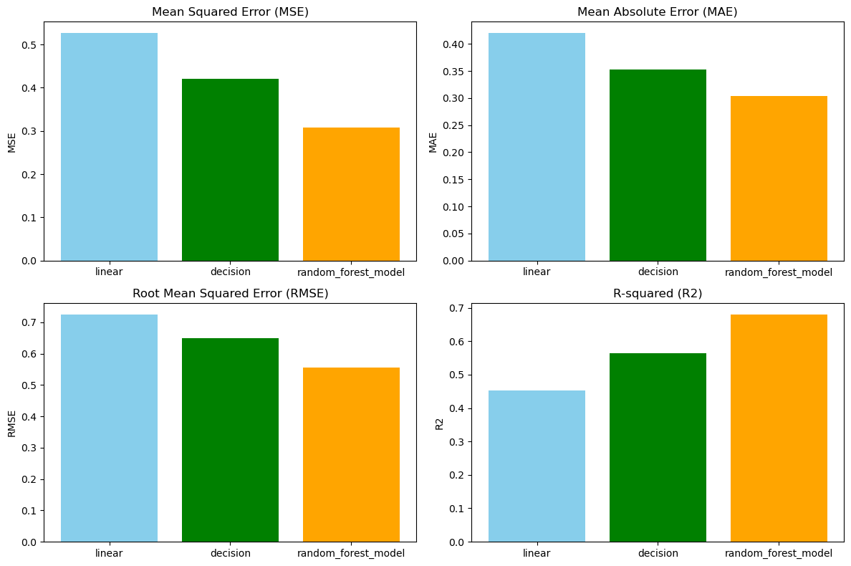

Baseline Models
Linear Regression
Decision Tree
Random Forest

Slide 13


Best Model

Slide 14
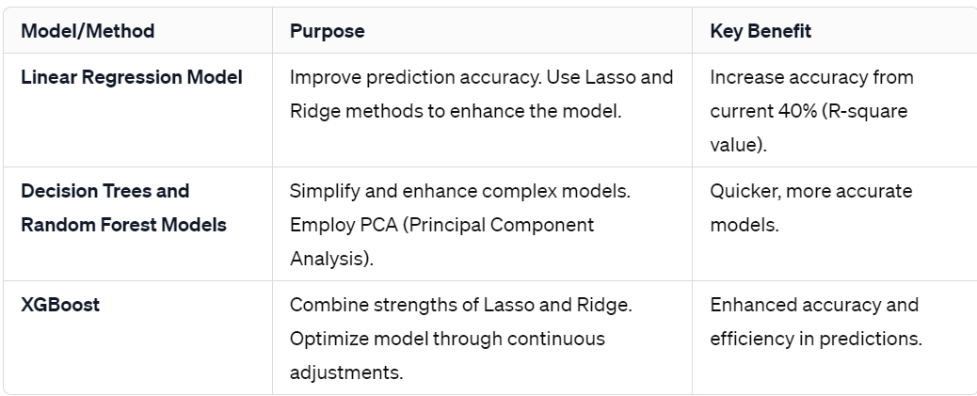
Furthermore…
Advanced Models
Lasso, Ridge
PCA
XGBoost
Back Up plan:
change to classification
More Feature engineering:
Calculate total cost
More dummies

Slide 15

What I learned?
Never trust your dataset

Slide 16


Questions?
Thank you for listening!

