Slide 1

Sprint 2
Liquor Store Profits Prediction
Lucia Zou
Nov.10th, 2023

Slide 2
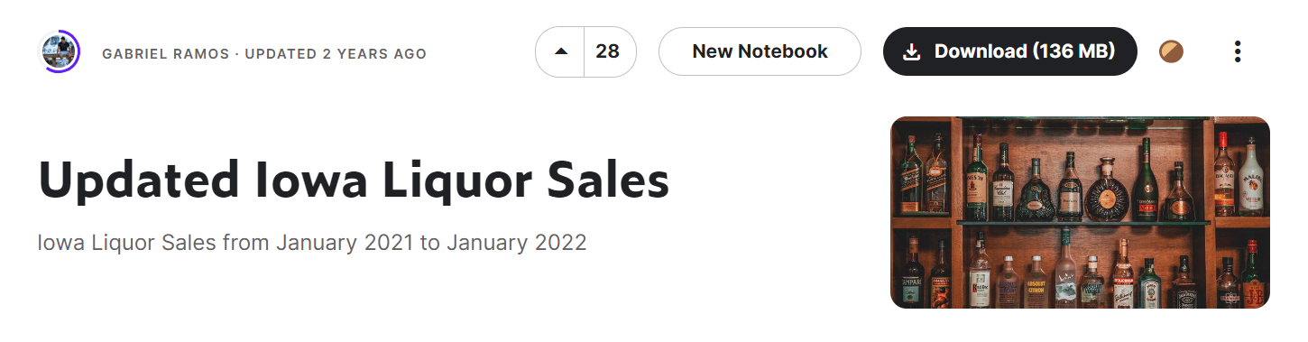
Introduction
The Dataset contains Iowa class E liquor holders data from Jan 2021 to Jan 2022. It has high potential with a lot of data to dig in. It contains 2805307 rows and 24 columns, 14 numeric and 9 categorical.

Slide 3

Overview
Objective:
To predict future profits for liquor stores in Iowa
Problem Statement:
Can we use machine learning models to predict
future profits of liquor?

Slide 4

Potential Impact
Set pricing strategies: Adjust pricing based on predicted demand and seasonality to promote revenue
Marketing and promotions: Plan effective marketing campaigns and promotions to boost sales during peak periods or slow seasons.

Slide 5

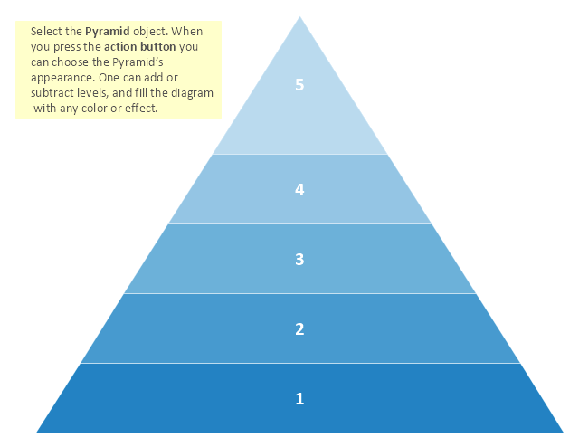
Solve the Problem
Step5: Modeling
Step4: Feature Engineering
Step3: EDA (Distributions, correlations)
Step2: Data Cleaning
(Fill in NA, duplicates, formatting)
Step1: Get the Data (Kaggle)

Slide 6


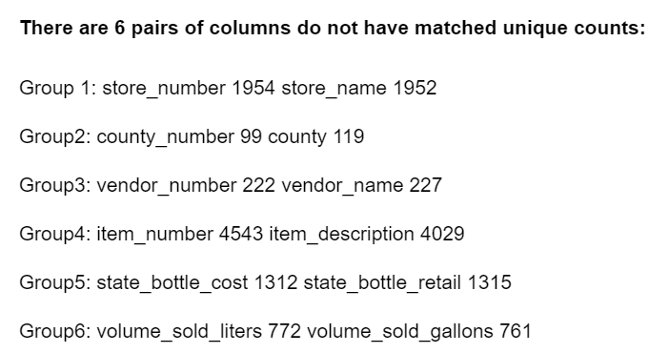
Data Cleaning

Slide 7
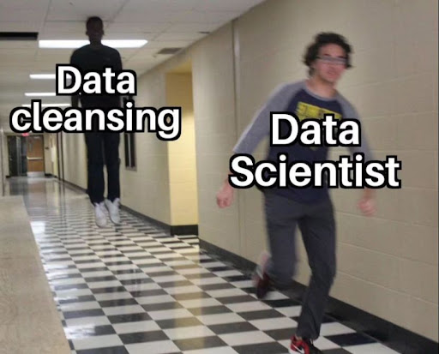
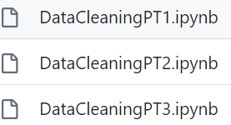
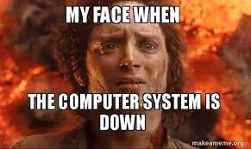
Data Cleaning

Slide 8
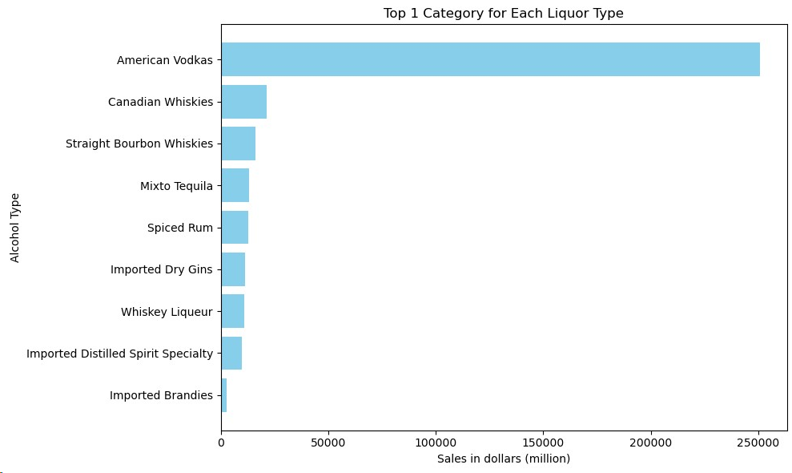
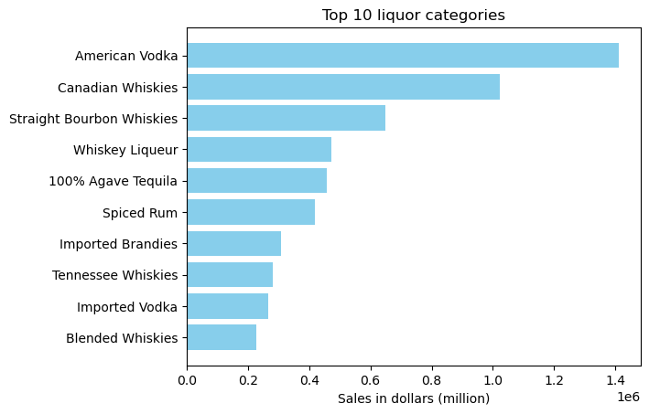
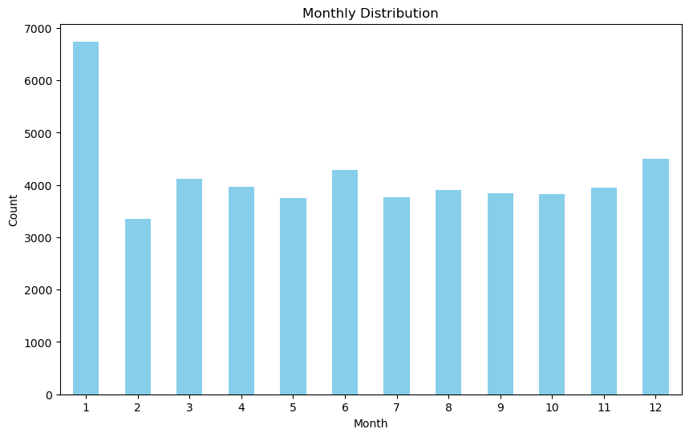
EDA

Slide 9
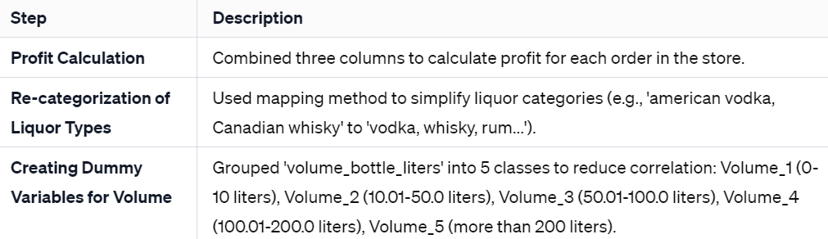
Feature Engineering
New columns:
Profit (target variable)
Alcohol type
dummies

Slide 10
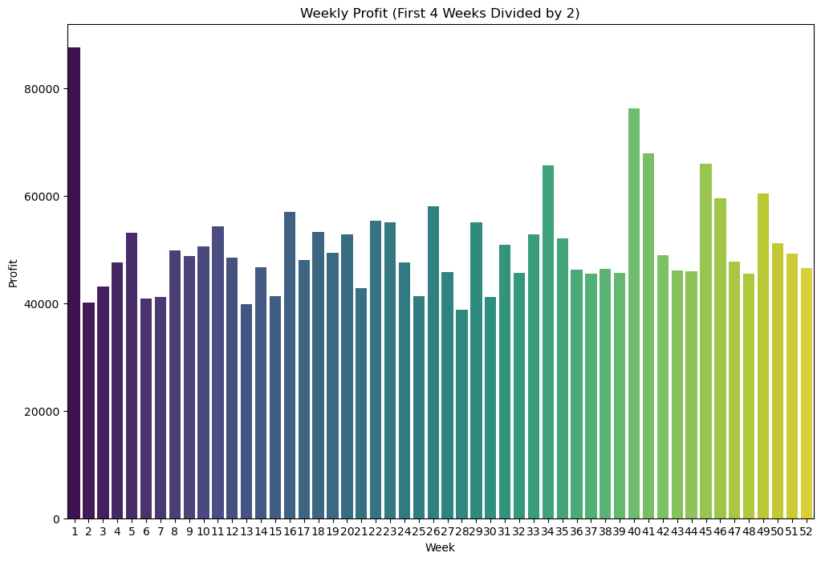
Feature Engineering
Profit is now my y-variable (target)

Slide 11
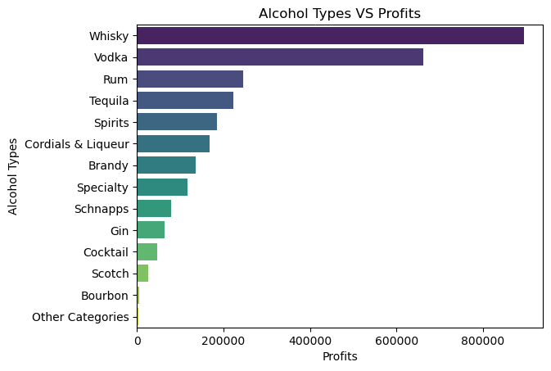
Feature Engineering
New column: Alcohol-Type
Made by re-categorizing
(EX: American Vodka to Vodka
Canadian Whisky to WHisky)

Slide 12
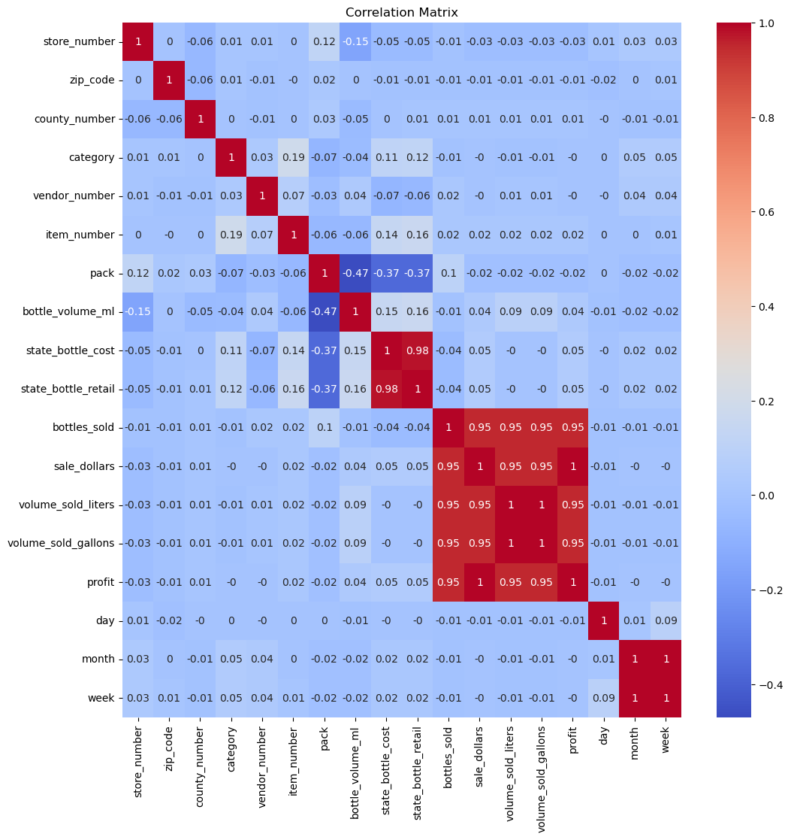
Feature Engineering
Convert Volume_bottle_liters into dummies:
Volume_1: 0-10 liters
Volume_2: 10.01-50.0 liters
Volume_3: 50.01-100.0 liters
Volume_4: 100.01-200.0 liters
Volume_5: more than 200 liters

Slide 13
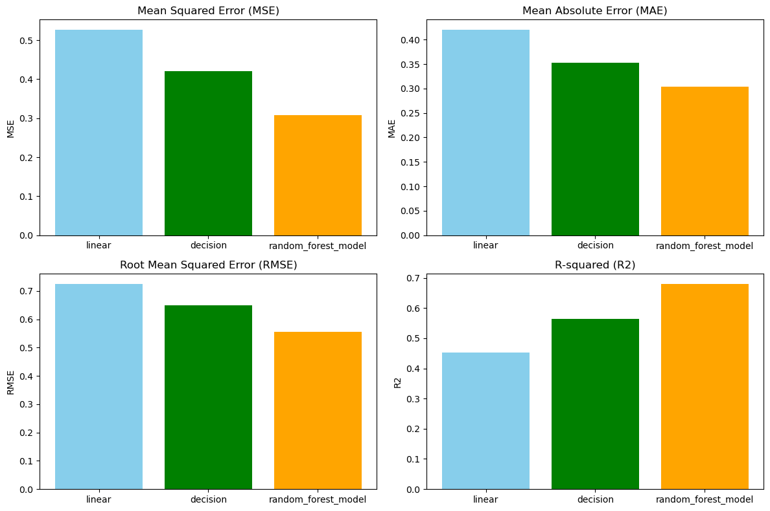
Baseline Models
Linear Regression
Decision Tree
Random Forest

Slide 14



Best Model

Slide 15
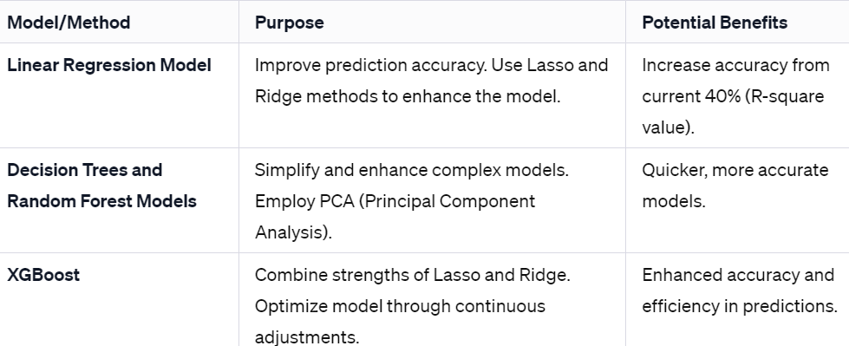
Furthermore…
Advanced Models
Lasso, Ridge
PCA
XGBoost
3. Back Up plan:
change to classification
2. More Feature engineering:
More dummies

Slide 16
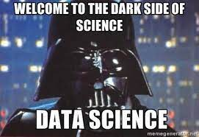
What I learned?
Never trust your dataset

Slide 17


Questions?
Thank you for listening!

