Slide 1

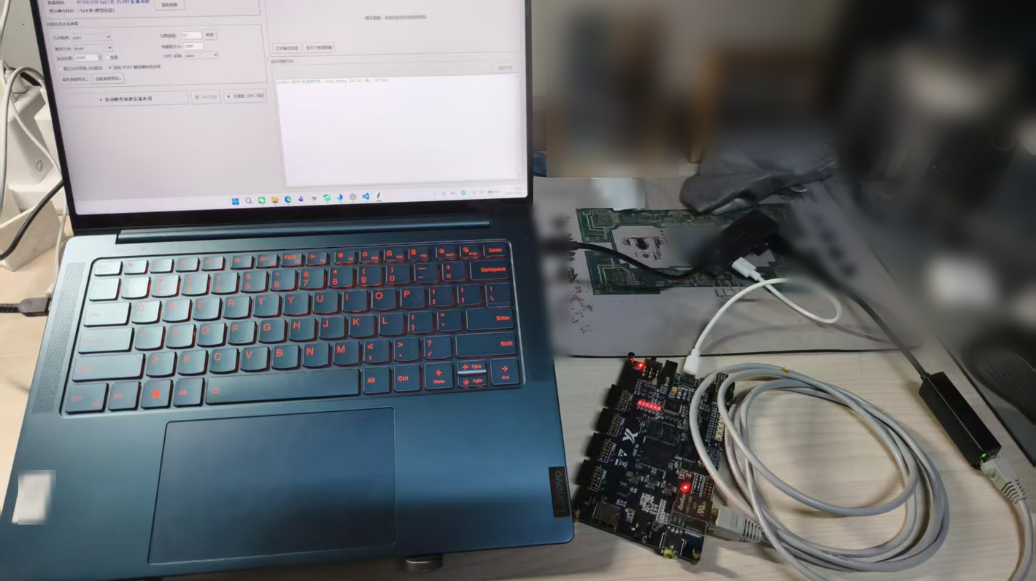
DNA Information Storage
Readout Hardware Acceleration System
2026 Embedded Design
Competition
BKB220 / Zynq-7000 XC7Z020 · PL 100 MHz · Vivado/Vitis 2026.1
SYSTEM OVERVIEW
SYSTEM ARCHITECTURE
RESULTS
A PC client streams sequenced reads to an on-board Zynq system. The PS coordinates the pipeline; the PL performs matching, voting, bit restoration and LDPC decoding.
The board returns an 8,100 B codeword; the PC re-checks the syndrome and SHA-256.
HOST PC
PC client
TCP :7
PS · ARM Cortex-A9
bare-metal lwIP · AXI DMA
Gigabit Ethernet
Stage 2.5: watermark XOR
5.12 s
2026.1 release · t_result median
P4→P16 | K=1, 3-run median: 26.54 s → 8.95 s · 2.97×
K=1→K=2 / same-hour A/B: 9.08 s → 6.06 s · 1.50×
Upload stage · measured separately
4.27 s → 0.40 s · 10.7×
2026.1 scope: 2 h · 262 runs · 103,616 records/run
AXI DMA · AXI-Lite
TARGET USE CASES
PL · XC7Z020 · 100 MHz
STAGE 1 · SLIDING-WINDOW MATCH
Cold-data archiving
Remote sensing imagery
Astronomical data
Medical imaging
Rarely accessed datasets
16-way × 2 bases/cycle (K=2) · BATCH=64
Pipelined selection tree: 16→8→4→2→1
VALIDATION
STAGE 2 · DIFFERENTIAL VOTING
81,000 × 10-bit signed counters
1 bit/cycle · 6 beats per record
81,000-bit output → PS watermark XOR
Architecture criterion: board syndrome 0/10,800
System criterion: payload SHA-256 match
42 cases (simulated): 26 PASS / 16 SAFE_NOCONV
0 silent errors · score_min=67
v1.1 soak: 8 h · 1,736 runs · 173 recovery probes
BKB220 board under test
PIPELINE DESIGN
STAGE 3 · DESPARSIFICATION
5b→4b XOR
81,000 → 64,800 bit · 16,200 groups
8 groups per conversion
RESOURCES / TIMING
Frame: 64 reads · 2,560 B
Stage1 record: 326 bit → 6 × 64-bit beats
Stage1 · 16-way sliding-window match + pipelined tree
Stage2 · differential voting
Stage2.5 · PS watermark XOR
Stage3 · 5b→4b XOR desparsification
On-chip LDPC · hard-decision flooding Min-Sum
LUT 36,731 · FF 38,437
RAMB36 89 · RAMB18 2 · DSP 6
WNS +0.089 ns · WHS +0.030 ns
0 / 95,487 endpoints failing (setup, hold)
post-route · 100 MHz
ON-CHIP LDPC · DVB-S2 R=5/6
64,800-bit codeword
Hard-decision flooding Min-Sum
Early exit at syndrome = 0; else SAFE_NOCONV
≤50 iterations
BOARD ACCEPTANCE · 2026.1 SOAK
2 h · 262 runs · 26 recovery probes

