Slide 1
Vessel Schedule Recovery Problem
Extensions, Benchmarking & Regulatory Compliance
①
②
③
④
Baseline Completion
CO₂ & Regulatory
Solver Benchmarking
CFA Policy

Slide 2
Agenda
1
Problem Background
Maritime disruption context, VSRP definition, recovery strategies
2
Mathematical Model
MIP formulation, variables, constraints, objective function
3
Implementation
Solver-agnostic architecture, swap groups, transshipment logic
4
Sensitivity Analysis
Alpha trade-off frontier, delay sweep, green recovery tension
5
Emissions & Regulation
EU ETS, IMO CII, FuelEU Maritime, stochastic carbon price
6
Solver Benchmarking
Xpress vs HiGHS vs CBC — solution quality, runtime, stability
7
CFA Policy
Additive, decay, SPSA update rules — tail risk and service reliability
8
Penalty Sensitivity
Swap and speed-up penalty thresholds across random seeds
9
Conclusions
Key findings, limitations, future work
TJL Optimization | VSRP Extensions & Benchmarking | 2026

Slide 3
Problem Background
Maritime transportation and schedule disruptions
Maritime Context
Trans-Pacific Case Study Route
• 80% of global trade volume moves by sea
KWY
Kwangyang ← Origin
• Liner shipping: fixed routes, public schedules
↓
BUS
Busan
• 70–80% of voyages experience delays
↓
• Just-in-time supply chains demand reliability
QIN
Qingdao
↓
NAG
Nagoya
Common Disruption Causes
↓
• Adverse weather conditions
YOK1
Yokohama (out)
↓
• Port congestion and labour strikes
LGB
Long Beach
• Mechanical failures
↓
OAK
Oakland
• Geopolitical disturbances
↓
DHB
Dutch Harbor
↓
YOK2
Yokohama (ret)
↓
KWY2
Kwangyang ← Sink
TJL Optimization | VSRP Extensions & Benchmarking | 2026

Slide 4
Recovery Strategies
Four strategy types, applied individually or in combination
Speed Adjustment
Expedited Handling
SLOW 15kn / NORMAL 20kn / FAST 25kn
STANDARD 12h → EXPEDITED 8h
Fuel cost ∝ v²·d (cubic model) Fast speed recovers time at high fuel cost
Saves 4h per port call Additional resource cost: $200 vs $100
Port Omission
Port Swapping
Skip one or more consecutive planned ports
Reorder two port visits (non-adjacent, max distance 2)
Saves travel + handling time Penalty: $1,000 per omitted port
Three-leg swap group: Leg A → Leg B → Leg C Ordering variables enforce sequence consistency
TJL Optimization | VSRP Extensions & Benchmarking | 2026

Slide 5







Mathematical Model
Mixed-Integer Program on a time-space network
Objective Function
$$min⁡ (1 − α) · C_{op} + α · C_{svc}$$
α ∈ [0,1] controls the service / cost trade-off
Decision Variables
Key Constraint Groups
$$x_{\left\{e,d\right\}}$$
1 if edge e sailed with duration mode d
Flow conservation
Origin: Σ x = 1 | Sink: Σ x = 1 | Interior: flow in = flow out
$$w_{\left\{p,d\right\}}$$
1 if port p visited with duration mode d
Port-call consistency
$w_{\left\{p,d\right\}} ≤ Σ x_{\left\{e,d\right\}}$for edges arriving at p
$$b_{\left\{p,s\right\}}$$
1 if strategy s applied at port p
Swap group integrity
All 3 legs of group g active$⟺$ swap_active_g = 1
$$y_{c}$$
1 if container c arrives late
Ordering (antisymmetry)
$z_{\left\{i,j\right\}}+ z_{\left\{j,i\right\}} = 1$for all interior pairs
$$o_{c}$$
1 if container c misses connection
Ordering (transitivity)
$z_{\left\{i,j\right\}} + z_{\left\{j,k\right\}} − z_{\left\{i,k\right\}} ≤ 1$for all triples
$$z_{\left\{i,j\right\}}$$
1 if port i visited before port j (swap ordering)
Delay classification
$y_{c} ≥ 1 − Σ_{\left\{on−time edges\right\}} x_{\left\{e,d\right\}}$
$$sa_{g}$$
1 if swap group g is active
Misconnection logic
$o_{c} ≥ x_{\left\{e,d\right\}}$ for non-connecting transshipment edges
TJL Optimization | VSRP Extensions & Benchmarking | 2026

Slide 6
Implementation Architecture
Solver-agnostic, modular, fully reproducible
Experiments
benchmark.py
sensitivity.py
cfa.py
penalty_sensitivity.py
stochastic_ets.py
Model
xpress_solver.py
highs_solver.py
cbc_solver.py
mip_builder.py (PuLP)
Core
entities.py
network.py
costs.py
emissions.py
simulation.py
validation.py
Data
base_instance.py
instance_generator.py
TJL Optimization | VSRP Extensions & Benchmarking | 2026

Slide 7
Port Swap: Three-Leg Group Mechanism
Brouer et al. (2013) extended to non-adjacent pairs
Planned route:
YOK1(4)
→
LGB(5)
→
OAK(6)
→
DHB(7)
→
YOK2(8)
Leg A
Leg B
Leg C
YOK1(4) → DHB(7)
DHB(7) → LGB(5)
LGB(5) → YOK2(8)
Vessel goes directly to DHB, skipping LGB Skipped: OAK(6) swap_group_id = 9
Vessel backtracks to LGB after serving DHB Identifies swap pair: from > to swap_group_id = 9
Vessel resumes forward from LGB succ(DHB) = YOK2 swap_group_id = 9
Recovered route:
YOK1(4)
→
DHB(7)
→
LGB(5)
→
YOK2(8)
Enforcement constraints
• $Σ x_{\left\{e,d\right\}} = swap_active_{g}$ for each leg type (all-or-nothing integrity)
• $z_{\left\{5,7\right\}} ≤ 1 − swap_active_{g}$(DHB visited before LGB when swap fires)
• $Σ swap_active_{g} ≤ 1$(at most one swap in the entire route)
• $b_{\left\{5,3\right\}} = b_{\left\{7,3\right\}} = swap_active_{g}$(both ports classified PORT_SWAP)
TJL Optimization | VSRP Extensions & Benchmarking | 2026

Slide 8
Emissions & Regulatory Compliance Model
Single-fuel VLSFO assumption — CO₂, EU ETS, IMO CII, FuelEU Maritime
Cubic Fuel Model
EU ETS (Regulation EU 2023/957)
F = F₀ · (v/v₀)³ · d/(v·24)
C_ETS = CO₂ × φ_year × P_carbon
• F₀ = 100 t/day at v₀ = 20 kn
• 2024: φ = 40% | 2025: φ = 70% | 2026+: φ = 100%
• Fuel cost ∝ v² · d (quadratic in speed)
• Baseline carbon price: €65/tCO₂
• 15 kn uses 2.78× less fuel than 25 kn
• CO₂ = F × 3.114 (VLSFO emission factor)
• Stochastic: TN(65, 15², [30, 130]) in CFA
IMO CII (Carbon Intensity Indicator)
FuelEU Maritime (corrected formula)
Attained = CO₂[g] / (DWT · distance)
Penalty = (g−g*)/g · F_total · LHV / LHV · 2400 · FX
Required = 1984 · DWT⁻⁰·⁴⁸⁹
• g = 91.16 gCO₂eq/MJ (VLSFO, always non-compliant from 2025)
A (≤0.85×req) B (≤0.95×) C (≤1.05×) D (≤1.15×) E (>1.15×)
• g* ≈ 88.61 gCO₂eq/MJ (2026 limit, interpolated)
Result: Rating A in all scenarios (attained/required ≈ 0.51)
• LHV = 40,500 MJ/tonne (energy-based formula, corrected)
• Penalty ≈ €72.5/tonne fuel | VLSFO always non-compliant
TJL Optimization | VSRP Extensions & Benchmarking | 2026

Slide 9
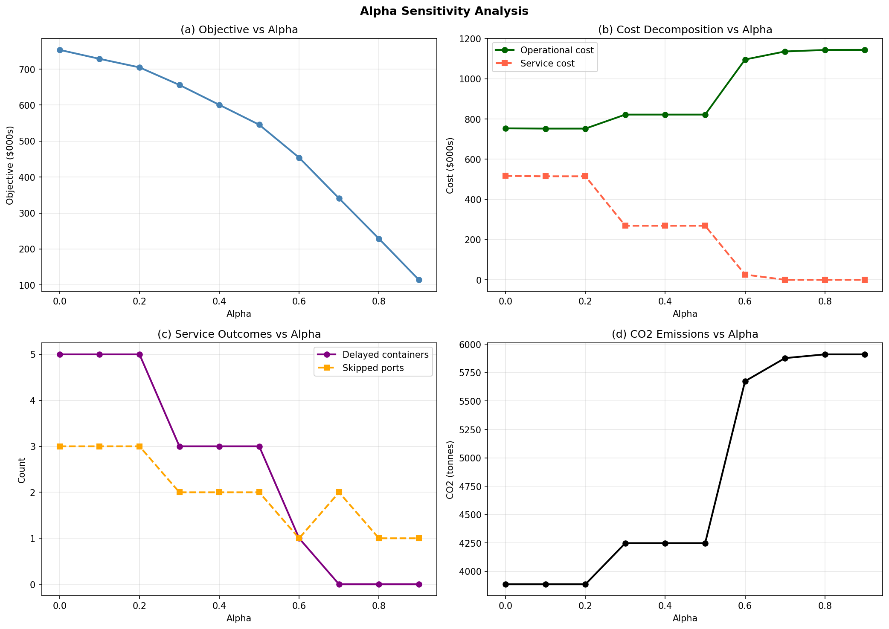
Alpha Sensitivity Analysis
How the cost–service trade-off shifts across α values
Sharp transition at α=0.6
Operational cost jumps from ~$820k to ~$1,100k as model switches from swap+omission to fast full-visit routes
CO₂ increases with service focus
Emissions rise ~50% above α=0.6 — faster speeds to avoid delays burn significantly more fuel
5 → 0 delayed containers
Full range from maximum delay (α=0) to zero delay (α=0.7+) across the sweep
TJL Optimization | VSRP Extensions & Benchmarking | 2026

Slide 10
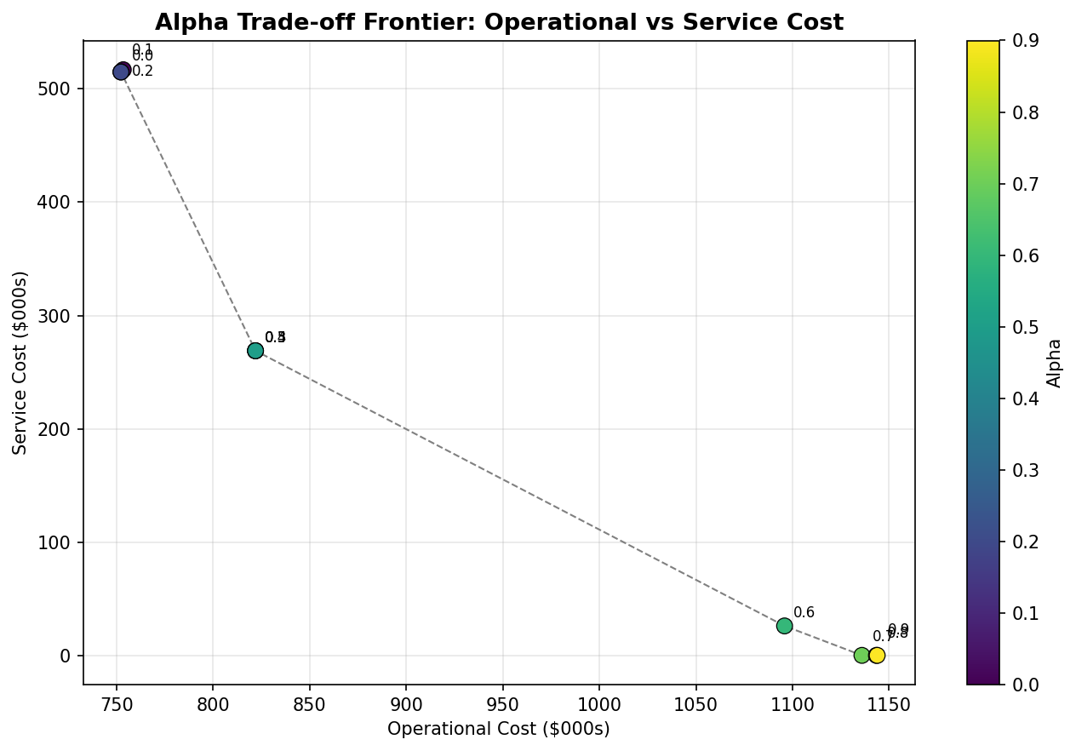
Cost–Service Pareto Frontier
Each point is the optimal solution at a given α value
Low α (0.0–0.2)
Operational cost ~$750k Service cost ~$515k 5 containers delayed, 3 ports skipped
Mid α (0.3–0.5)
Operational cost ~$820k Service cost ~$269k 3 delayed, swap activated
High α (0.6–0.9)
Operational cost ~$1,100k Service cost ~$0 0 delayed, fast full-visit routes
TJL Optimization | VSRP Extensions & Benchmarking | 2026

Slide 11
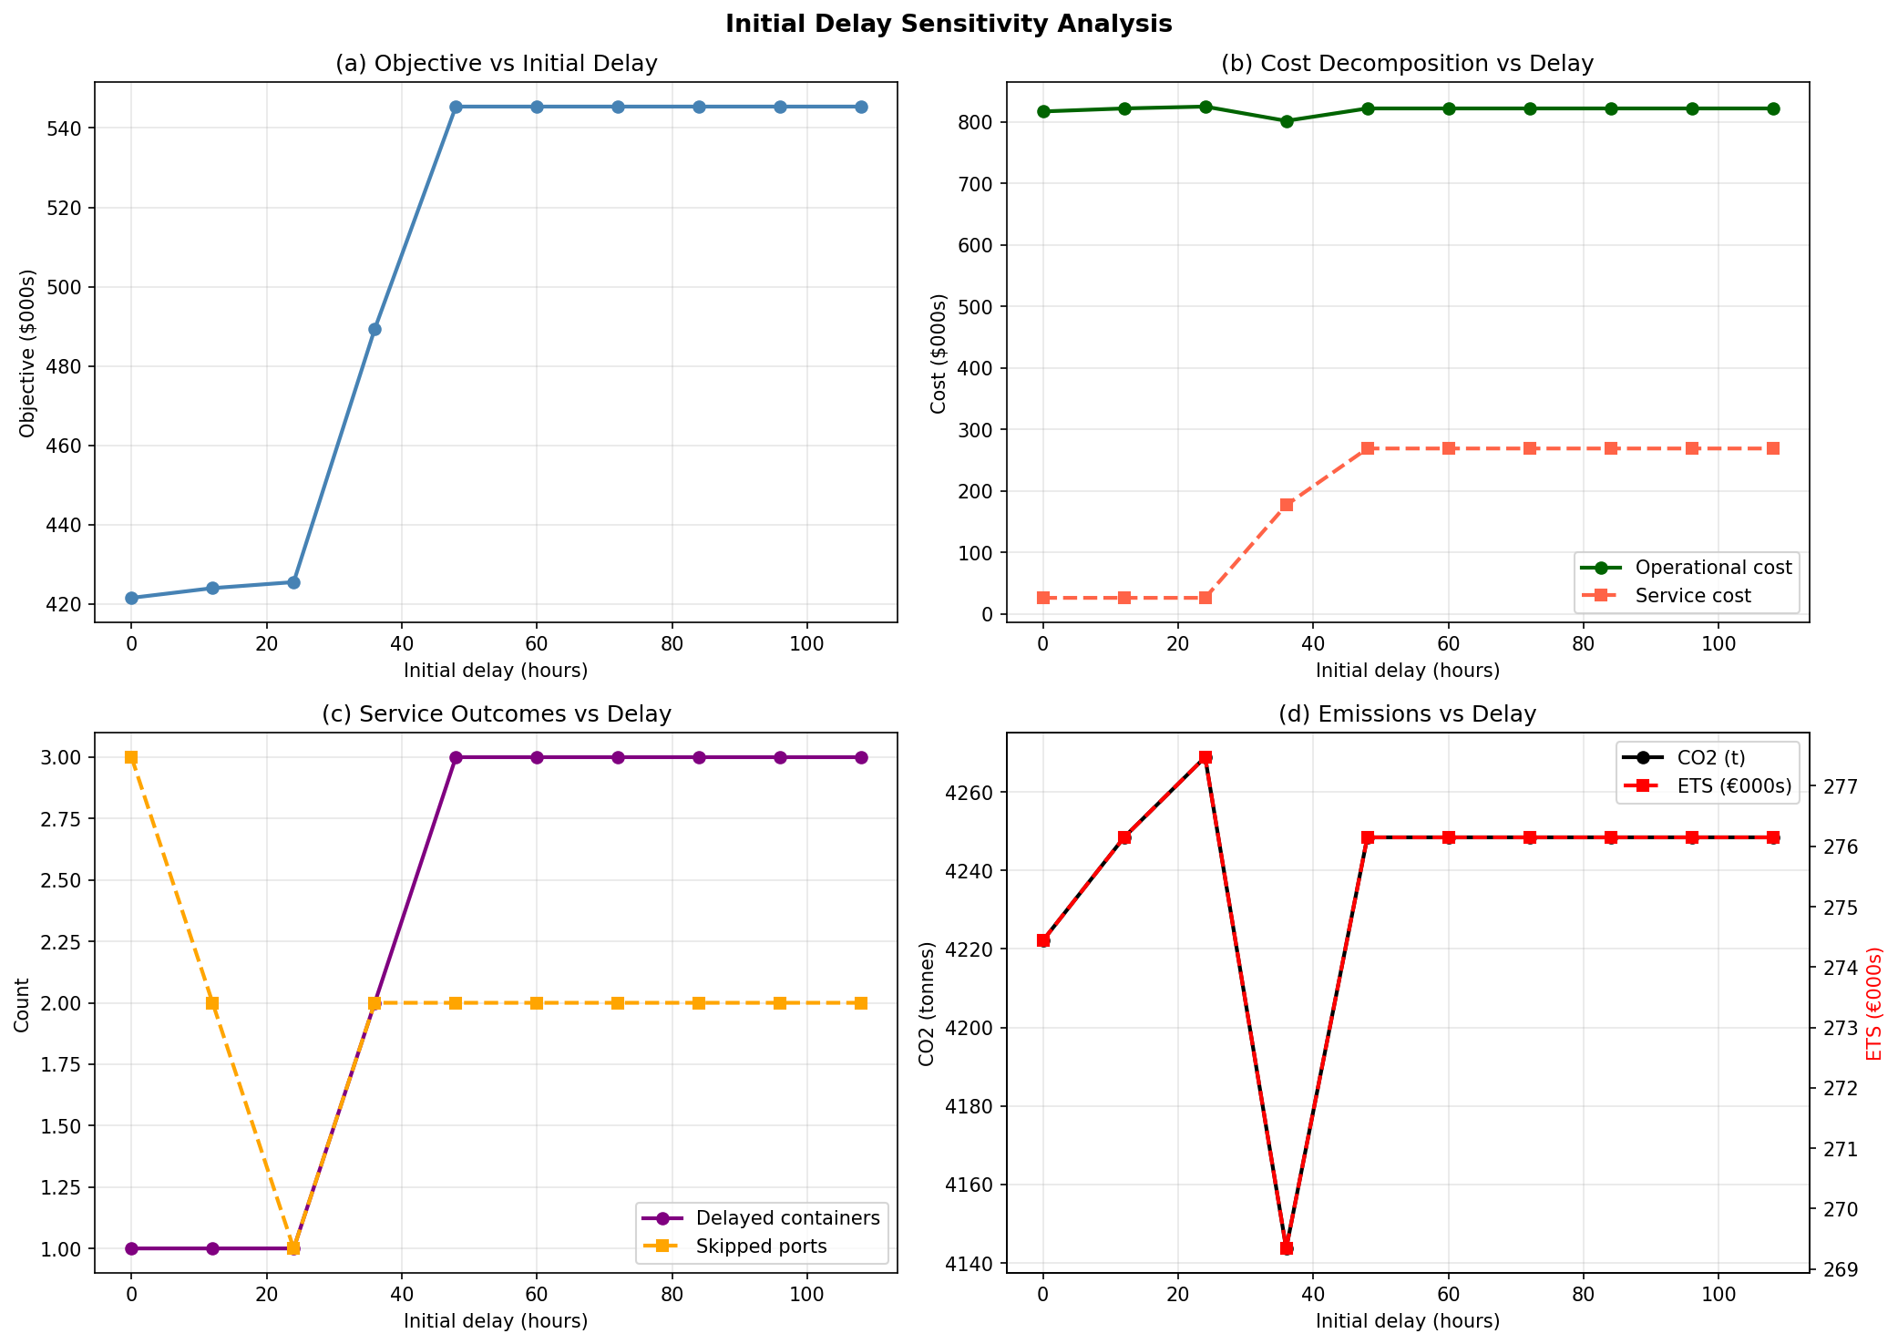
Initial Delay Sensitivity Analysis
Recovery cost scales non-linearly with disruption severity
Threshold at 36h
Objective jumps from $425k to $489k — second container crosses its promised arrival threshold
Plateau above 48h
Objective stabilises at $545k — same 3 containers always delayed. Promises calibrated to 48h expected delay.
Emissions dip at 36h
CO₂ drops as model switches to a more fuel-efficient route (different port omission), then recovers
TJL Optimization | VSRP Extensions & Benchmarking | 2026

Slide 12
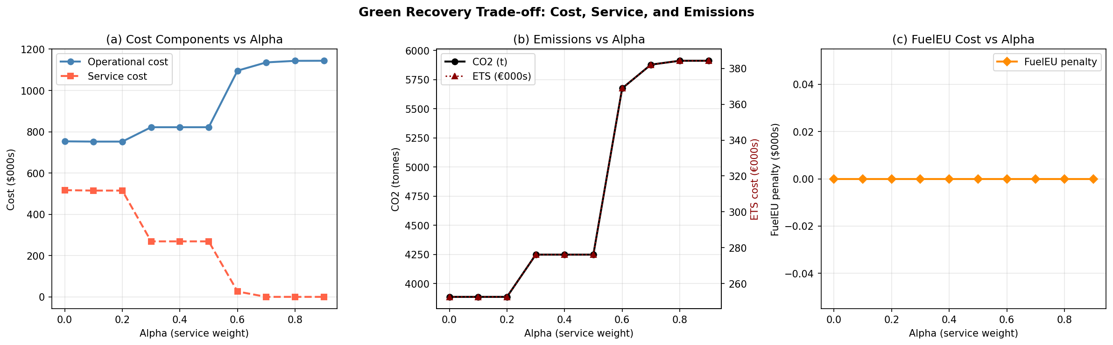
The Green Recovery Tension
Prioritising service increases emissions — a fundamental trade-off
Key Insight: The Green Recovery Tension
• At α ≤ 0.5: slow steaming minimises fuel and CO₂ — but accepts container delays
• At α ≥ 0.6: fast speeds eliminate delays — but CO₂ increases by ~50% and ETS exposure rises proportionally
• FuelEU penalty = $0 throughout (flag=False) — under VLSFO, always non-compliant regardless of speed
• CII Rating A in all scenarios — slow steaming produces attained/required ratio of 0.51
TJL Optimization | VSRP Extensions & Benchmarking | 2026

Slide 13
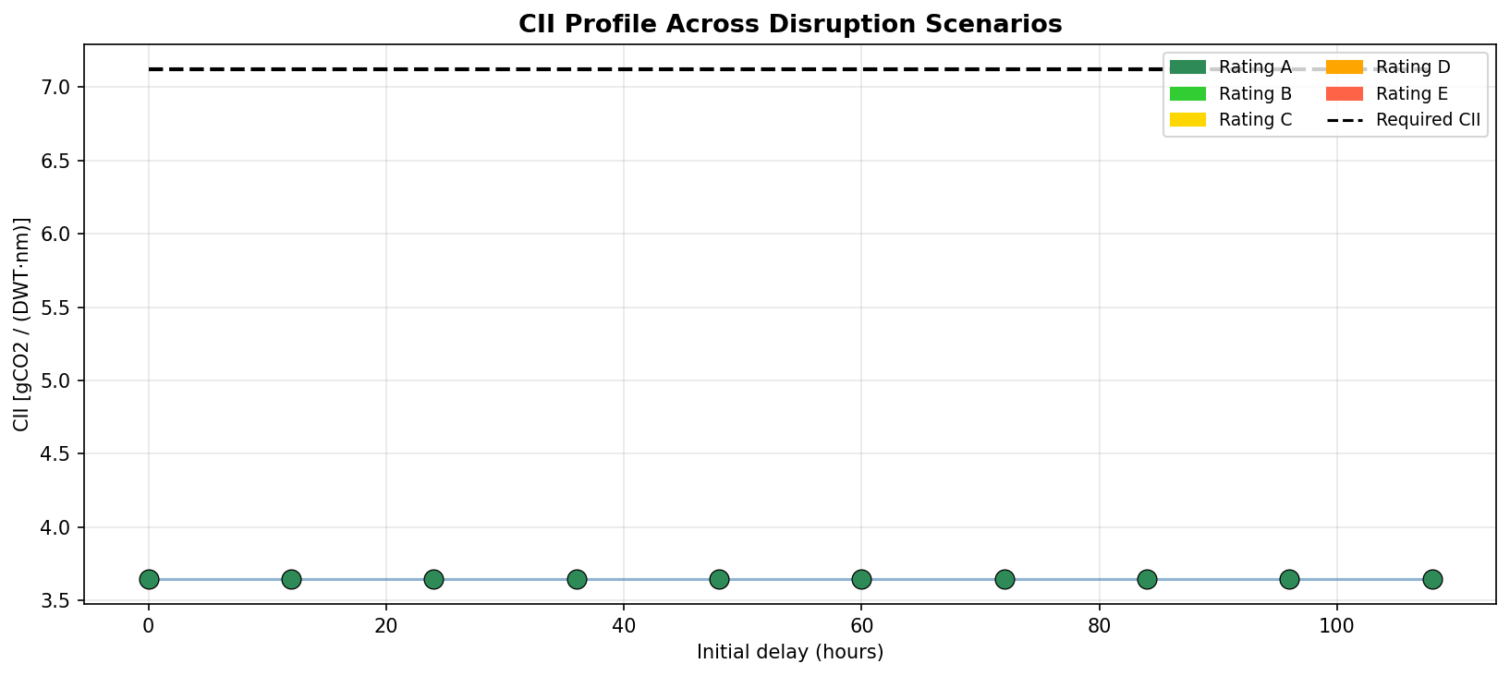
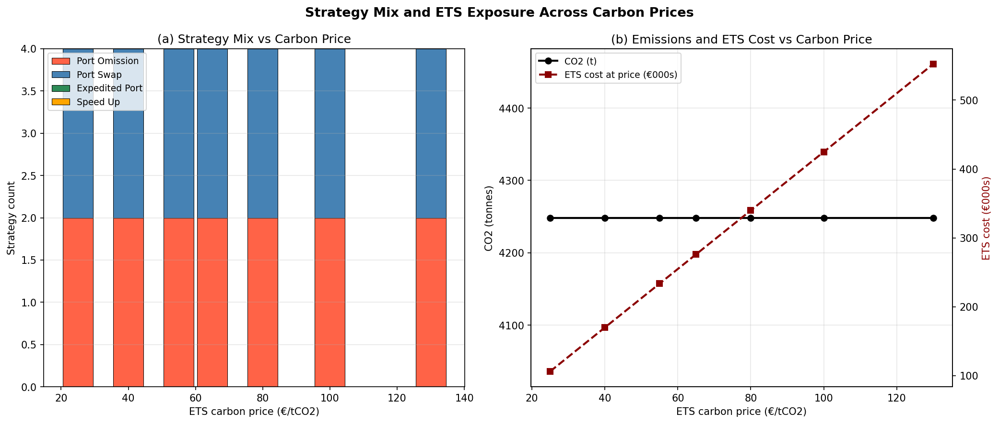
CII Profile and ETS Exposure
IMO CII Rating A across all scenarios — ETS cost linear in carbon price
CII Finding
ETS Strategy Finding
Attained CII ≈ 3.65 gCO₂/(DWT·nm) across all delay scenarios. Required CII = 7.12. Ratio = 0.51 → Rating A in every scenario. Slow steaming (15 kn) dramatically reduces CO₂ per transport work unit. The CII reference line is calibrated to nominal-speed operations.
Strategy mix (2 omissions + 1 swap) is invariant to carbon price. ETS carbon price does not enter the MIP objective — only FuelEU does. ETS cost is perfectly linear in carbon price: slope = 4,248 t CO₂ × 1.0 phase-in = 4,248 EUR per EUR/tCO₂. At €130/tCO₂ → ETS exposure reaches €552k per voyage.
TJL Optimization | VSRP Extensions & Benchmarking | 2026

Slide 14
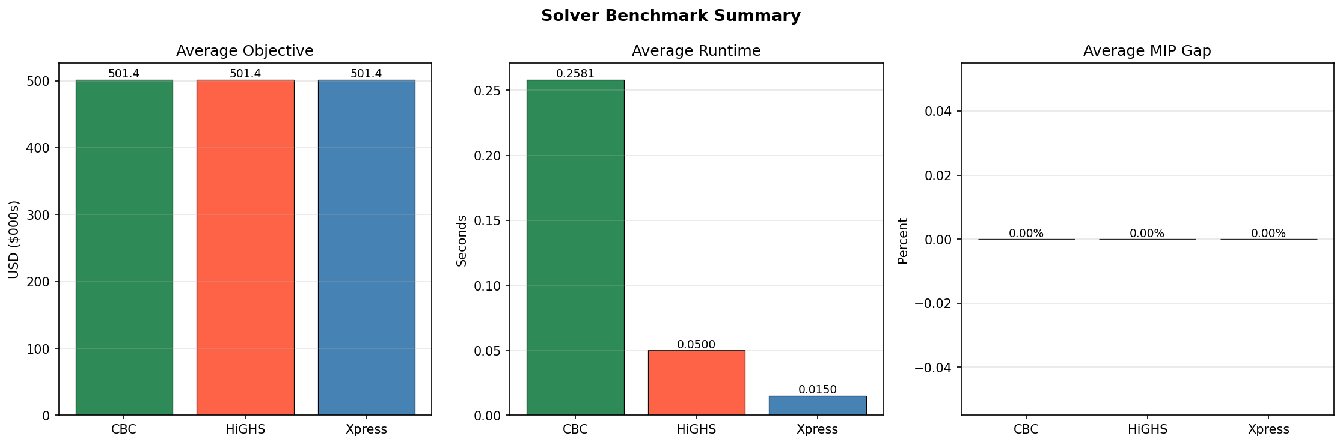
Solver Benchmark: Xpress vs HiGHS vs CBC
All three solvers find identical optimal solutions
Solution quality
All three solvers find the same optimal objective — PuLP MIP builder produces identical formulation to Xpress
Speed advantage
Xpress is 3.3× faster than HiGHS and 17× faster than CBC on these instances
Solver independence
Solver
Avg Objective
Avg Runtime
MIP Gap
Feasible
Optimal
HiGHS and CBC operate with no Xpress dependency — PuLP exports to MPS format
Xpress
$501,429
0.015s
0.0%
100%
100%
HiGHS
$501,429
0.050s
0.0%
100%
100%
CBC
$501,429
0.258s
0.0%
100%
100%
TJL Optimization | VSRP Extensions & Benchmarking | 2026

Slide 15
Cost Function Approximation — The Learning Loop
Powell (2022) framework: parametric optimisation + simulator + parameter update
1
2
3
Sample estimated delay μ_est = 48h, σ = 12h
→
Apply theta tightening to container promises
→
Solve MIP → fixed route
4
5
6
Sample realised scenario delay, weather, handling, prices
→
Simulate realised outcome which containers missed?
→
Update theta at ports with misses
↑ repeat for n_episodes ↑
Key asymmetry — why CFA works:
MIP sees tightened promises (theta applied) → solver builds in buffer → simulator evaluates against ORIGINAL promises → more containers arrive on time → theta updated to reinforce what worked
TJL Optimization | VSRP Extensions & Benchmarking | 2026

Slide 16
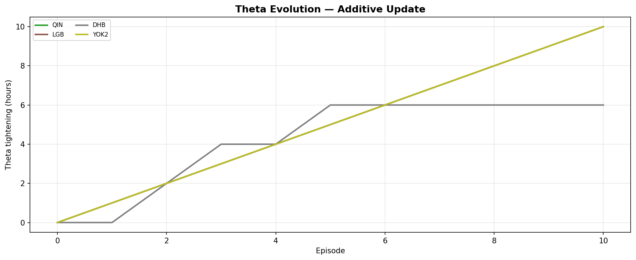
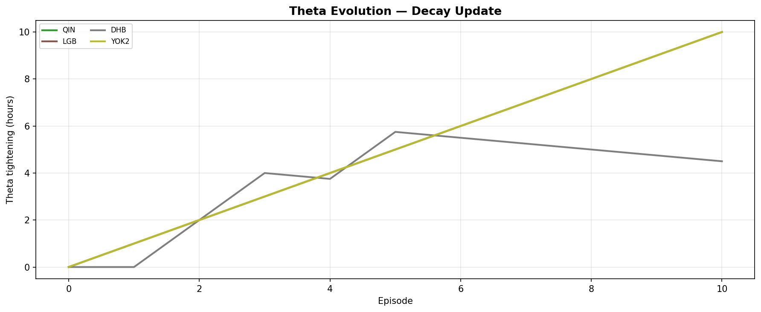
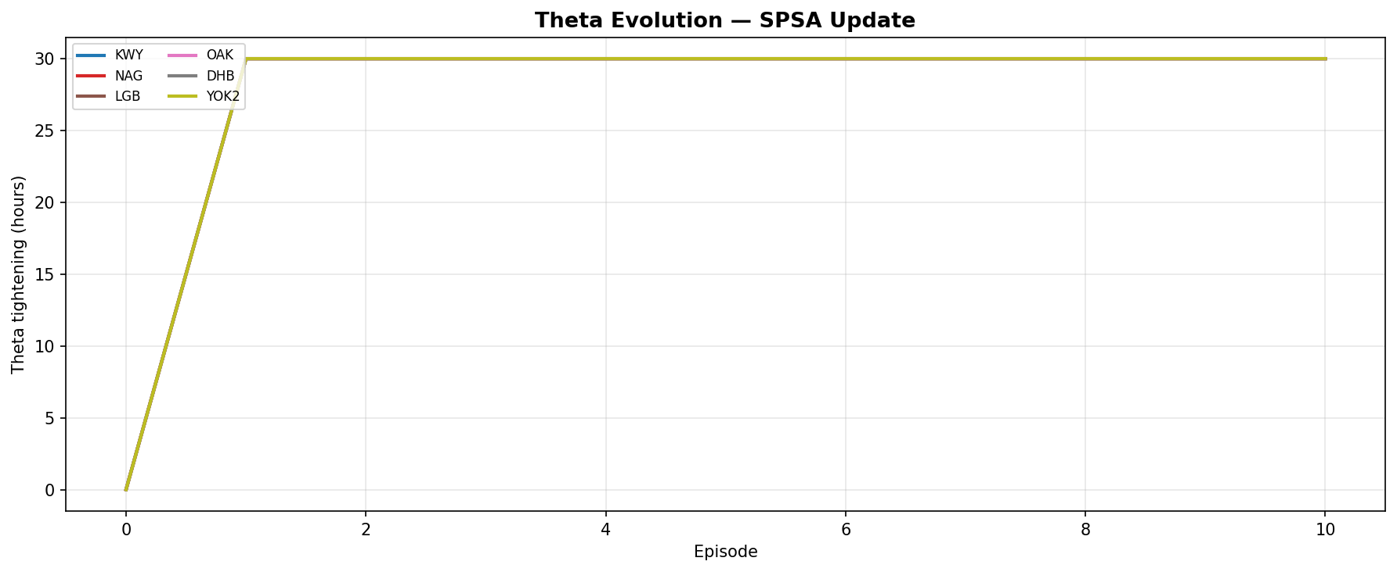
Theta Evolution During Training
How each update rule learns to tighten container promises
Observations
Additive:
QIN, LGB, YOK2 increase linearly. DHB slower (fewer misses). Never decreases.
Decay:
Same ports increase but DHB shows two-sided behaviour — rises with misses, falls without.
SPSA:
Jumps to cap (30h) at 6 ports in episode 1. Gradient-guided — finds optimal in one step.
TJL Optimization | VSRP Extensions & Benchmarking | 2026

Slide 17
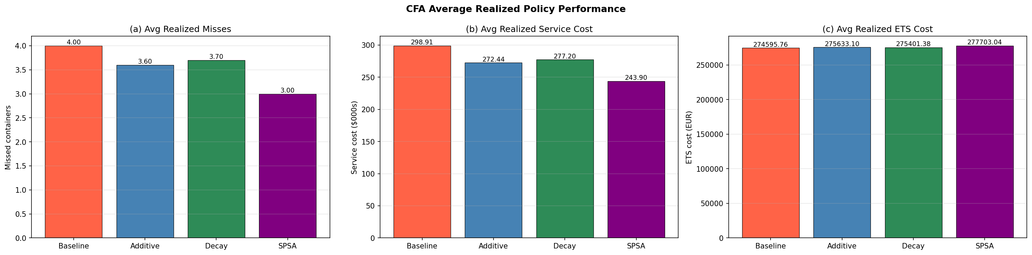
CFA Policy Performance
Realised metrics only — MIP objectives not directly comparable across policies
SPSA Key Result
−18.4% average service cost Zero variance: p90 = p95 = mean = $243,900 std = $0 Converges in 1 episode: Gradient-guided update identifies maximum tightening at 6 ports as optimal immediately. 3 MIP solves per update (1 main + 2 perturbations) vs 1 for additive/decay
Policy
Avg missed
Avg svc cost
vs Baseline
p95 tail risk
Baseline
4.00
$298,912
—
$346,477
Additive
3.60
$272,439
−8.9%
$339,030
Decay
3.70
$277,196
−7.3%
$339,030
SPSA
3.00
$243,900
−18.4%
$243,900
TJL Optimization | VSRP Extensions & Benchmarking | 2026

Slide 18
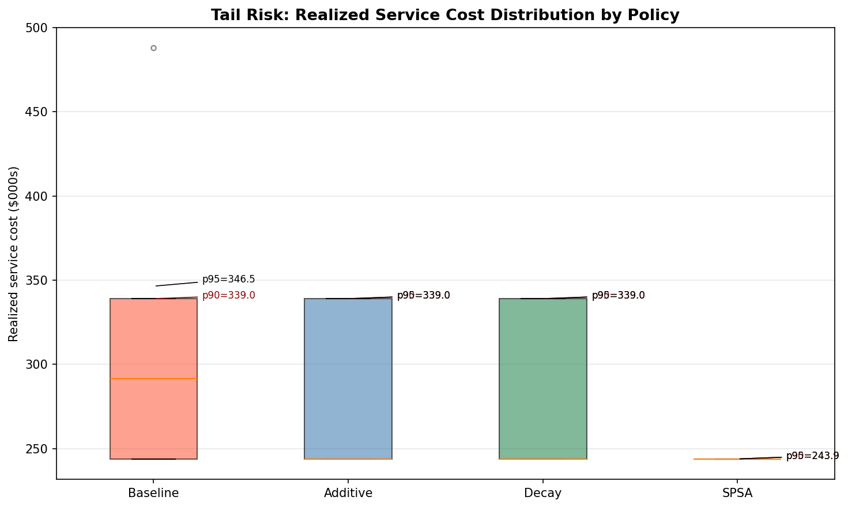
Tail Risk: SPSA Eliminates Worst-Case Scenarios
Distribution of realised service cost across 20 test episodes
Baseline
Wide distribution p95=$346k, outlier at $485k Significant tail exposure
Additive & Decay
Similar to each other p95=$339k Modest improvement, tail unchanged
SPSA
Degenerate distribution All 20 episodes = $243,900 Zero variance, zero tail risk
TJL Optimization | VSRP Extensions & Benchmarking | 2026

Slide 19
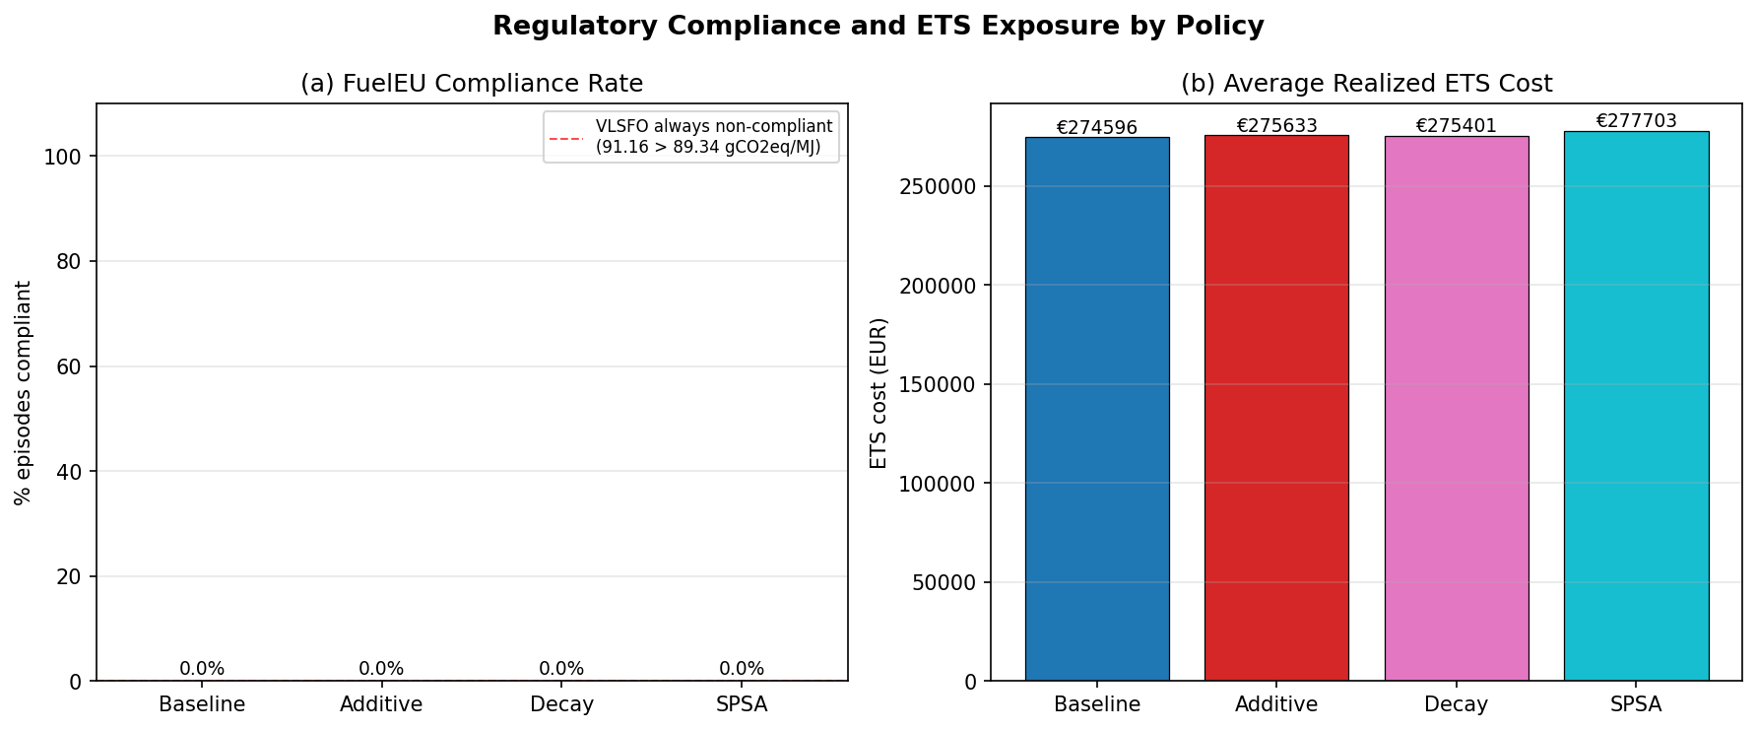
Regulatory Exposure by CFA Policy
FuelEU compliance and ETS cost across policies
FuelEU: 0% compliance — expected
ETS: similar across policies
Under single-fuel VLSFO, GHG intensity (91.16 gCO₂eq/MJ) always exceeds the 2026 FuelEU limit (88.61 gCO₂eq/MJ). Compliance requires switching to alternative fuels — outside current scope.
Average realised ETS cost: €274k–€278k across all policies. SPSA slightly higher (€277,703) because aggressive tightening forces faster routes that burn more fuel. Trade-off: −18.4% service cost vs +1.1% ETS exposure.
TJL Optimization | VSRP Extensions & Benchmarking | 2026

Slide 20
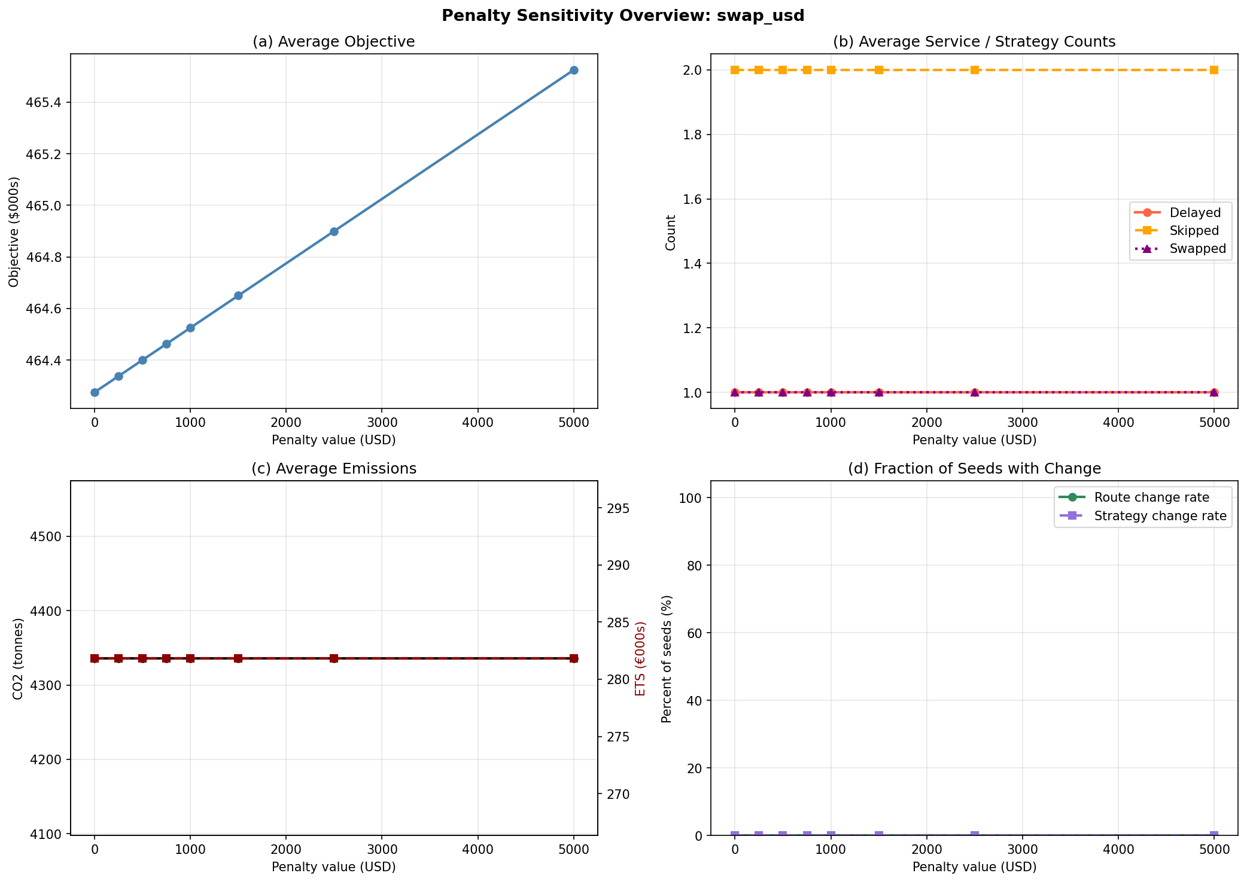
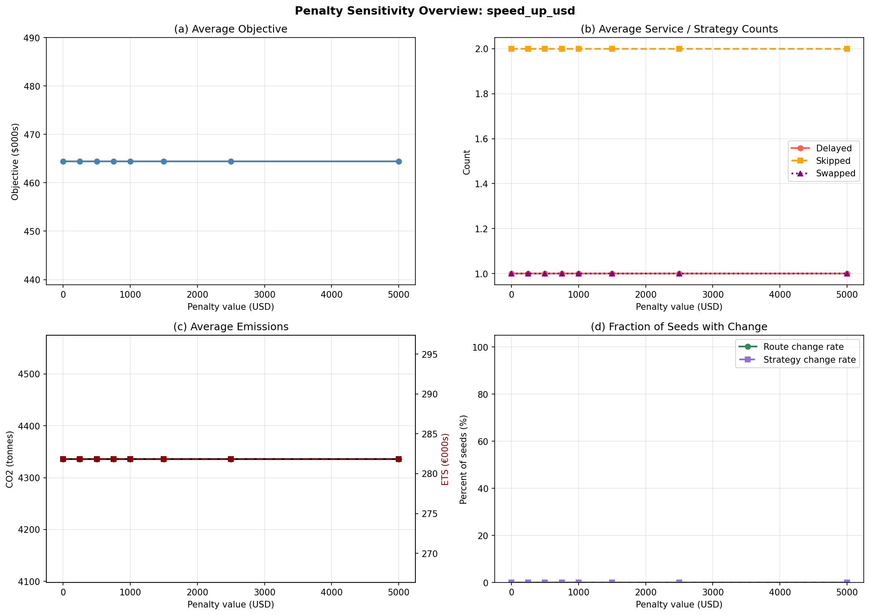
Penalty Sensitivity Analysis
Swap and speed-up penalties swept across four random seeds
Swap: objective increases linearly with penalty — route unchanged $0–$5,000
Speed-up: completely flat — fast speed never optimal for this container set
TJL Optimization | VSRP Extensions & Benchmarking | 2026

Slide 21
Key Findings
Pareto frontier is non-linear
①
Two distinct regimes: swap-based recovery (α ≤ 0.5, ~$820k operational) and fast-speed full-visit recovery (α ≥ 0.6, ~$1,100k). The transition is sharp.
Green recovery tension is real
②
Prioritising service (α ≥ 0.6) increases CO₂ by ~50% and ETS exposure proportionally. Slow steaming achieves CII Rating A — but only when service quality is sacrificed.
All solvers find identical solutions
③
Xpress, HiGHS, and CBC all find the same optimal objective. Xpress is 3.3× faster than HiGHS and 17× faster than CBC.
SPSA dominates all CFA policies
④
−18.4% average service cost. Zero variance (p95 = mean = $243,900, std = $0). Converges in one episode via simultaneous gradient estimation.
Swap activation is demand-dependent
⑤
Swap activated in 2 of 4 seeds, robust to penalties up to $5,000. For other seeds, no swap is ever beneficial — confirms Brouer et al. (2013).
TJL Optimization | VSRP Extensions & Benchmarking | 2026

Slide 22
Limitations and Future Work
Current Limitations
Natural Extensions
• Single-fuel VLSFO
• Multi-fuel model
FuelEU always non-compliant; no fuel-switching decisions possible
LNG/methanol switching variables; fuel-choice per leg
• Per-voyage FuelEU
• Annual CII compliance
Regulation is annual; per-voyage approximation is standard in literature
Multi-voyage constraint linking CII across the fleet
• Delay constraint approximation
• Larger instances
Uses nominal speed on prior legs; big-M formulation would be exact
25+ containers to show richer delay sweep variation and strategy diversity
• Delay sweep plateau above 48h
• SPSA with diminishing step size
Structural property of 5-container test set; more containers needed
Theoretical convergence guarantees via a_k = a/(k+A)^α schedule
• time_to_first_feasible
• Port hoteling emissions
Unavailable on Xpress community license
Add at-berth emissions to the CO₂ accounting module
• Swap rarely activates
Demand-dependent; larger instances with more containers needed to show broader activation
TJL Optimization | VSRP Extensions & Benchmarking | 2026

Slide 23
References
1.
Brouer, B.D. et al. (2013). The Vessel Schedule Recovery Problem (VSRP).
European Journal of Operational Research, 224(2), 362–374.
2.
Li, S. et al. (2023). Vessel schedule recovery strategy in liner shipping.
Ocean and Coastal Management, 237, 106514.
3.
Hu, Liu, Jin, Wang (2024). Liner disruption recovery with emission control area policies.
Transportation Research Part D, 132, 104227.
4.
Zhou et al. (2024). Schedule recovery under ECA regulation.
Journal of Marine Science and Engineering.
5.
Li, S. & Wang, T. (2025). ETS effects on liner disruption recovery.
Transport Policy, 169, 191–208.
6.
Powell, W.B. (2022). Reinforcement Learning and Stochastic Optimization.
Wiley. [CFA framework]
7.
IMO MEPC.338(76) — CII reference lines for container ships.
8.
Regulation (EU) 2023/957 — EU ETS maritime phase-in schedule.
9.
FuelEU Maritime Regulation — GHG intensity limits and Article 23 penalty.
TJL Optimization | VSRP Extensions & Benchmarking | 2026

Slide 24
Thank You
Vessel Schedule Recovery Problem Extensions, Benchmarking & Regulatory Compliance
Code: python -m scripts.smoke_test
Figures: results/figures/
Tables: results/tables/

