Slide 1
Mpi
Luciano Laratelli
Notes:
OK Hello everybody, I'm luciano laratelli and today I will be talking to you about the message passing interface, MPI, which is another method of accomplishing parallelization in software that isn't coda based

Slide 2
Presentation goals
Explaining what MPI is
Overview of fundamental concepts
Installing, compiling, and running MPI
Code samples
Notes:
So for today's presentation I'd like to start with explaining what MPI is, how you can use it on your own machine (compiling, etc.) and then I'm going to run through the fundamental concepts and show examples therein. the idea is that after today's presentation you can write useful parallel programs, without being an MPI expert

Slide 3
MPI; what is it?

Slide 4
Mpi is a specification
MPI Forum defines which operations must be implemented with an LIS (Language Independent Specification)
Must be implemented for C, Fortran -- many other APIs exist (Python, C++, C#, etc.)
Over 20 notable implementations exist
Notes:
MPI defines a method of CPU-based parallelism that involves mostly message-passing between different processes
forum was formed in 1991 in austria; first implementation came only a year later
collaborative effort between research, government, and industry
MPI is not adopted by any official standards body (think ISO or IEEE,) but it is the de-facto standard for parallel CPU computing in every one of the top 500 supercomputers in the world, and by extension every super computer in the world
MPI is fundamentally about the sending and receive of data (messages) between different parts of a large, distributed system

Slide 5
MPI vs cuda
MPI and CUDA both implement the SPMD programming model
CPU vs GPU
MPI can take advantage of distributed (non-shared) memory
MPI is hardware-independent
Notes:
SINGLE PROGRAM MULTIPLE DATA
From the book: """Note that SPMD is not the same as SIMD (Single Instruction Multiple-Data) [Flynn 1972]. In an
SPMD system, the parallel processing units execute the same program on multiple parts of the data.
However, these processing units do not need to be executing the same instruction at the same time. In
an SIMD system, all processing units are executing the same instruction at any instant."""

Slide 6
mpi versions
MPI-1: original version, static runtime
MPI-2: parallel I/O, dynamic processes
MPI-3: non-blocking operations, other extensions
Notes:
MPI-1 is universally supported.
MPI-2 support is mainly being held up by the fact that common schedulers do not handle dynamic process creation easily, which is a big subset of the changes introduced by MPI 2
MPI-3 is supported by the biggest implementations but is not in wide use among top supercomputing facilities

Slide 7
Popular implementations
MPICH - initial implementation from ANL, implements MPI-3
Open MPI - merger between three well-known implementations, implements MPI-3
Boost.MPI - C++ interface, implements MPI-1; easy to interface with other MPI implementations
Intel MPI Library - proprietary extension of MPICH optimized for Intel processors
Notes:
3/4 available on CIRCE; boost MPI easiest to code with but hardest to compile
Argonne National Labs

Slide 8
installing
compiling
Running

Slide 9
Getting mpi
System package manager, under names like:
open-mpi
mpich
USF CIRCE:
module load mpi/openmpi/1.4.1
module load mpi/mpich2/3.1.4

Slide 10
the mpi compiler
Just like nvcc, MPI implementations provides compiler wrappers which compiles source code with the proper libraries:
mpicc (C)
mpic++/mpicxx (C++)
mpif/mpif90/mpifort (Fortran)
Notes:
MPICC basically works the same way as gcc et. al; it has very few flags to avoid conflicting with the underlying compiler flags, so any flags it doesn't recognize are actually passed to the main compiler along with the MPI- specific flags

Slide 11
running mpi
Use mpiexec
-n flag specifies number of processes
mpiexec -n 4 ./a.out <programArgs>
Notes:
You may also see mpirun being used in many examples -- mpirun is a non-standard script that was used by many implementations. mpiexec was added to the standard (relatively) recently, and should be preferred

Slide 12
Debugging mpi
gdb/lldb can be attached to MPI programs with mpiexec:
mpiexec -np 4 xterm -e gdb ./a.out
tmux users can take advantage of tmpi

Slide 13
Fundamentals: Communicators

Slide 14
communicators
A communicator is an object containing every MPI process -- it handles communication between processes
Each process in a communicator is numbered -- this is called the process' rank
Default communicator (MPI_COMM_WORLD) fine for many use cases, but user can create communicators at runtime as needed
Notes:
The initialization of the communicator should be one of the first things the program does, though doing some things before is fine
The finalization of the communicator should be as close to the last thing that happens as possible - what happens after the finalization command is called is completely undefined behavior

Slide 15
#include <mpi.h>
int main(int argc, char ** argv){
MPI_Init(&argc, &argv);
//ALL OTHER MPI CALLS GO HERE
MPI_Finalize();
}
Notes:
lmaaaaaooooooooo
ok but yeah anyways we gotta drive the point home -- MPI_Init must be almost the first line, and MPI_Finalize must be the last one
only rank 0 will actually call MPI_Init and MPI_finalize -- the others exhibit undefined behavior before MPI_Init and after MPI_Finalize

Slide 16
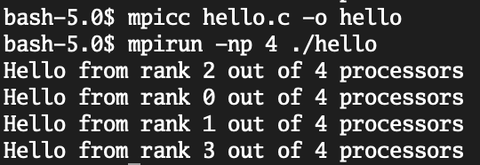
#include <mpi.h>
#include <stdio.h>
int main(int argc, char ** argv) {
MPI_Init(&argc, &argv);
int worldSize;
int rank;
MPI_Comm_size(MPI_COMM_WORLD, &worldSize);
MPI_Comm_rank(MPI_COMM_WORLD, &rank);
printf("Hello from rank %d out of %d processors\n", rank, worldSize);
MPI_Finalize();
}
Notes:
OK, maybe still a useless example but certainly one that illustrates some functions we will see used quite often -- MPI_COMM_size and MPI_Comm_rank.

Slide 17
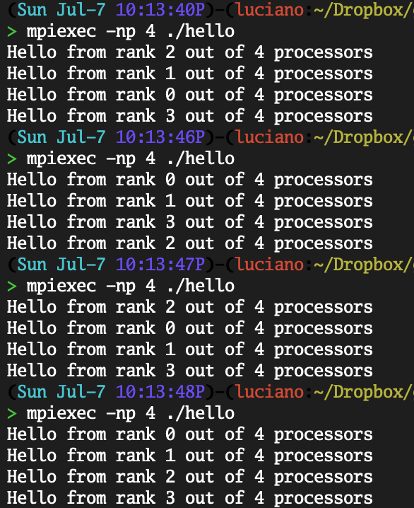
Notes:
Same code as last time, just showing the lack of guarantees in terms of which rank will run.
Just like how we can't say in which order CUDA multiprocessors will run, we can similarly not make any guarantees about the order in which MPI ranks will execute.

Slide 18
Fundamentals:
Mpi datatypes

Slide 19
mpi datatypes
MPI datatypes are implementation-provided macros
They denote the type of data that is being handled by an MPI function when it is called
User can define custom datatypes at runtime
Notes:
Before we can talk about MPI functions, we gotta talk about MPI datatypes. These are implementation-provided macros that stand in for the generic types provided by the programming language. They exist for a few reasons: 1. C can't pass types as parameters to functions, 2. Different types have different sizes on different systems

Slide 20
why do mpi datatypes exist?
Nodes can be split between machines with different architectures
MPI functions are designed to know what they are working with
Allows for implementation to deal with type details

Slide 21
common mpi datatypes
MPI Datatype | C Type
MPI_CHAR | char
MPI_INT | int
MPI_UNSIGNED | unsigned int
MPI_FLOAT | float
MPI_DOUBLE | double
Notes:
There's generally an MPI datatype for each of the standard types in C and C++

Slide 22
Rolling your own
Derived data types are user-defined data structures that are sequences of existing MPI datatypes
Several variants:
Vector
Struct
Indexed
Notes:
Obviously parallel computing is going to involve more complicated data structures than just single types; structs are very common and not too hard to understand so we'll be working through constructing one of our own

Slide 23
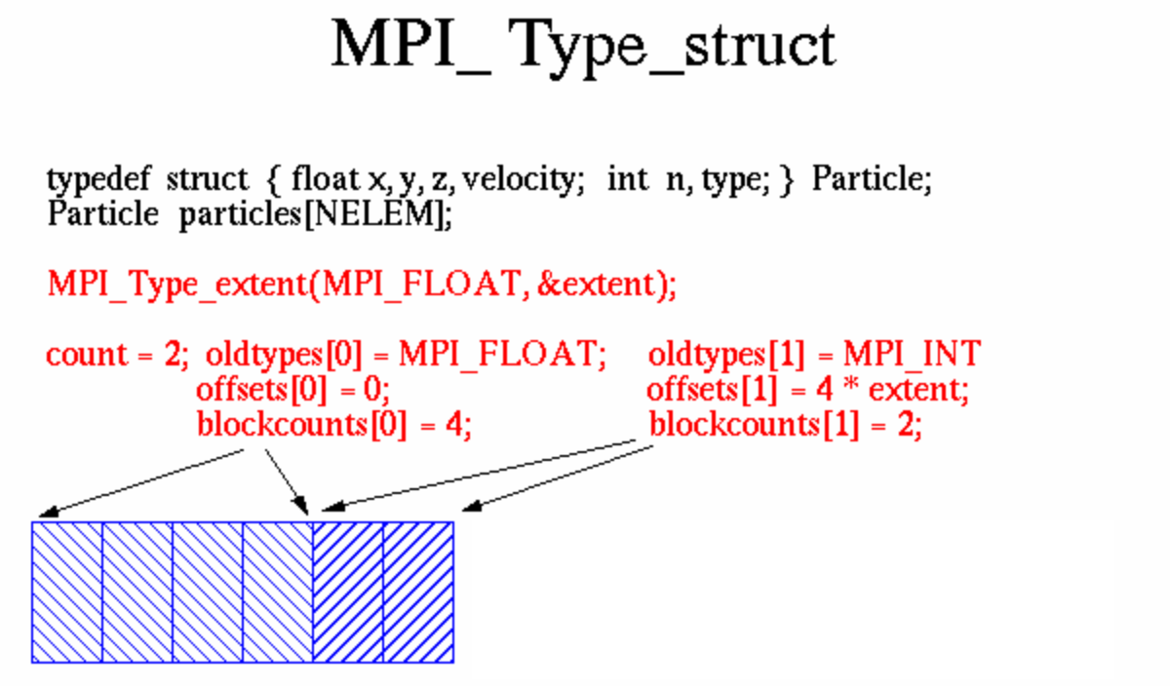
Notes:
Image: https://computing.llnl.gov/tutorials/mpi/images/MPI_Type_struct.gif

Slide 24
typedef struct {
float x, y, z, velocity;
int n, type;
} Particle;
MPI_Datatype particletype; // variable that will hold our new type
MPI_Datatype oldtypes[2]; // types from which we derive the new type
int blockcounts[2]; // amount of variables of a certain type
MPI_Aint offsets[2]; // after what amount of bytes does the current type start
MPI_Aint extent; // size of the MPI datatype
offsets[0] = 0; // floats start at byte 0 of the type
oldtypes[0] = MPI_FLOAT; // first block is MPI_FLOATs
blockcounts[0] = 4; // the block contains 4 MPI_FLOATs
MPI_Type_extent(MPI_FLOAT, &extent); // get size of MPI_Float
offsets[1] = 4 * extent; // ints start at byte 4 * extent of the type
oldtypes[1] = MPI_INT; // second block is MPI_INTs
blockcounts[1] = 2; // this block contains 2 MPI_INTs
MPI_Type_struct(2, // number of blocks
blockcounts, // elements in each block [array]
offsets, // byte displacement from 0 for each block [array]
oldtypes, // type of eleements in each block [array]
&particletype // new data type);
MPI_Type_commit(&particletype);
// free datatype when done using it
MPI_Type_free(&particletype);
Notes:
OK so this is the most complicated example we'll be going through -- defining a struct derived type
example from https://computing.llnl.gov/tutorials/mpi/#Derived_Data_Types (under Examples: Struct Derived Data Type)

Slide 25
Fundamentals:
point-To-Point Operations

Slide 26
p2p operations
Direct communication between two ranks: one sends and the other receives
Serial or asynchronous variants
Notes:
So point to point operations involve the direct communication between any two processes in the MPI communicator. We'll talk more in a little bit about what the arguments mean, but the main takeaway is that point to point operations work only if one node is sending and another node is receiving -- you can send to a node that isn't receiving and your data will never make it to the other node!

Slide 27
(non)blocking calls
Blocking calls do not return until their underlying process has executed completely
MPI_Send, MPI_Recv, etc.
Non-blocking calls return immediately (can lead to performance improvements)
MPI_ISend, MPI_IRecv, etc.
Notes:
so in the parlance of MPI, sequential calls are "blocking", while asynchronous calls are "nonblocking"
The I stands for "Immediate" -- the function returns immediately but the process may (probably is) still be running in the background

Slide 28
int main(int argc, char ** argv) {
MPI_Init(&argc, &argv);
int rank; MPI_Comm_rank(MPI_COMM_WORLD, &rank);
int size; MPI_Comm_size(MPI_COMM_WORLD, &size);
int number = rank * 72;
MPI_Send(&number, 1, MPI_INT, 0, 0, MPI_COMM_WORLD);
if(rank == 0){
for(int i = 0; i < size; i++){
MPI_Recv(&number, 1, MPI_INT, i, 0,
MPI_COMM_WORLD, MPI_STATUS_IGNORE);
printf("received %d from process with rank %d\n", number, i);
}
}
MPI_Finalize();
return 0;
}
Notes:
here's a small example that shows blocking send and receive being used
MPI_Send(void* buf, int count, MPI_Datatype datatype, int dest, int tag, MPI_Comm comm)
MPI_Isend(void* buf, int count, MPI_Datatype datatype, int dest, int tag, MPI_Comm comm, MPI_Request *request)
MPI_Recv(void* buf, int count, MPI_Datatype datatype, int source, int tag, MPI_Comm comm, MPI_Status * status)
MPI_IRecv(void* buf, int count, MPI_Datatype datatype, int source, int tag, MPI_Comm comm, MPI_Request *request)

Slide 29
fundamentals:
Collective operations

Slide 30
collective operations
Moving data from one rank to many ranks, or vice-versa
Semantically equivalent to doing many MPI_Sends and MPI_RECVs, but faster via implementation tricks
Notes:
We saw parallels to these functions in CUDA a week and a half ago or so

Slide 31
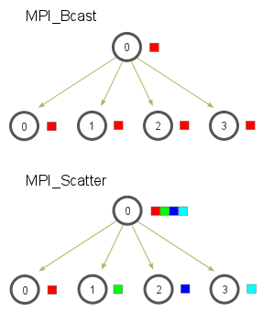
broadcast / Scatter
Notes:
Broadcast takes a piece of information and sends it to all of the child processes
Scatter takes an array and splits it based on child process rank
Graphic taken from https://mpitutorial.com/tutorials/mpi-scatter-gather-and-allgather/

Slide 32
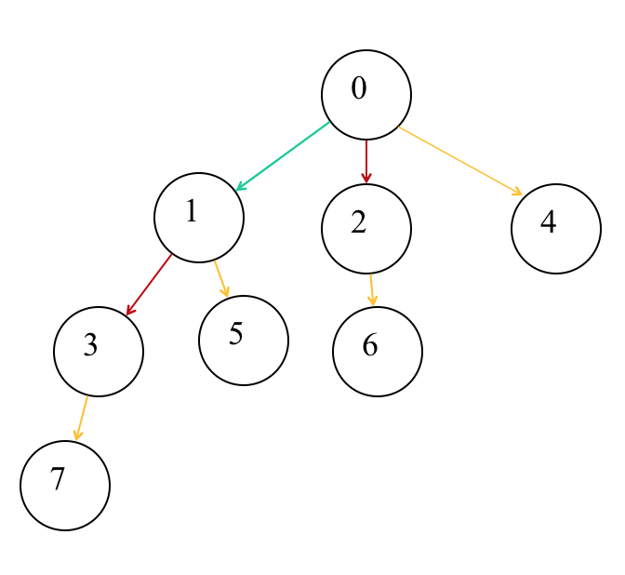
Implementation: Broadcast
Notes:
So, yeah, broadcast is basically just a fancy send/receive chain, but it's significantly faster -- how?
Well, we have a bunch of processes! let's use them to make 🅱️ cast much faster
[walk through the tree]s
Binomial trees of order 0 to 3: Each tree has a root node with subtrees of all lower ordered binomial trees

Slide 33
#include <mpi.h>
#include <stdio.h>
int main(int argc, char** argv) {
int rank, buf;
MPI_Init(&argc, &argv);
MPI_Comm_rank(MPI_COMM_WORLD, &rank);
if(rank == 0) {
buf = 777;
}
printf("rank %d, buf is %d\n", rank, buf);
// everyone calls bcast, data is taken from root and ends up in everyone's buf
MPI_Bcast(&buf, 1, MPI_INT, 0, MPI_COMM_WORLD);
printf("rank %d, buf is %d\n", rank, buf);
MPI_Finalize();
return 0;
}
Notes:
simple broadcast example; useful for when some quantity needs to be calculated at runtime and it's either too complicated to be worth parallelizing so you let one rank handle it or if it's a trivial computation that can be handled by one rank
taken from https://stackoverflow.com/a/7867789/5692730

Slide 34
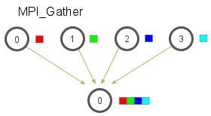
gather
Notes:
Pull all data from every rank into a buffer on one rank (the 'root' rank)
Graphic taken from https://mpitutorial.com/tutorials/mpi-scatter-gather-and-allgather/

Slide 35
int *localA = (int*)malloc(sizeof(int) * vecSize / size);
int *localB = (int*)malloc(sizeof(int) * vecSize / size);
int *localResult = (int*)malloc(sizeof(int) * vecSize / size);
int *a = NULL, *b = NULL, *result = NULL;
if(rank == 0) {
a = (int*)malloc(vecSize * sizeof(int));
b = (int*)malloc(vecSize * sizeof(int));
result = (int*)malloc(vecSize * sizeof(int));
for(int i = 0; i < vecSize; i++){
a[i] = i;
b[i] = i * 2;
}
}
MPI_Scatter(a, vecSize/size, MPI_INT, localA, vecSize/size, MPI_INT, 0, MPI_COMM_WORLD);
MPI_Scatter(b, vecSize/size, MPI_INT, localB, vecSize/size, MPI_INT, 0, MPI_COMM_WORLD);
vecAdd(localResult, localA, localB, vecSize/size);
MPI_Gather(localResult, vecSize/size, MPI_INT, result, vecSize/size, MPI_INT, 0, MPI_COMM_WORLD);
Notes:
Collective operations are called by EVERY rank; the function call specifies which node the information is coming from (in this case, it's 0)
notice that local variables are allocated by every rank, but the main array is allocated and filled only by rank 0 -- this saves us some memory; regardless we're still using 2 * vecSize memory for this process
This program probably isn't even all that faster than just doing it serially, given the overhead of the MPI calls-- it's mostly just to illustrate the scatter and gather calls
int MPI_Scatter(const void *sendbuf, int sendcount, MPI_Datatype sendtype,
void *recvbuf, int recvcount, MPI_Datatype recvtype, int root,
MPI_Comm comm)
int MPI_Gather(const void *sendbuf, int sendcount, MPI_Datatype sendtype,
void *recvbuf, int recvcount, MPI_Datatype recvtype,
int root, MPI_Comm comm)

Slide 36
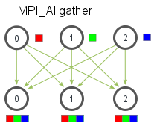
all-gather
Notes:
Just like gather but every rank gathers all the information from every other rank -- no root rank is specified in the function call
useful for situations where some intermediate result from a computation is needed by every rank before further computation can proceed (can imagine a situation where a calculation is running only while the whole dataset has some property, and once that property is satisfied, every rank should stop [e.g. some iterative computational physics methods for electrostatics computations])

Slide 37
common errors

Slide 38
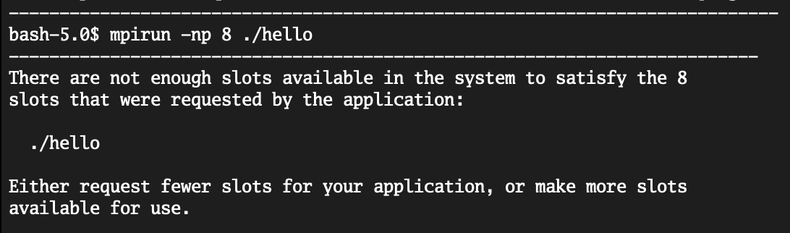
asking for too many cores
You can request only up to the number of physical cores available
Notes:
MPI does not give a shit about virtual cores

Slide 39
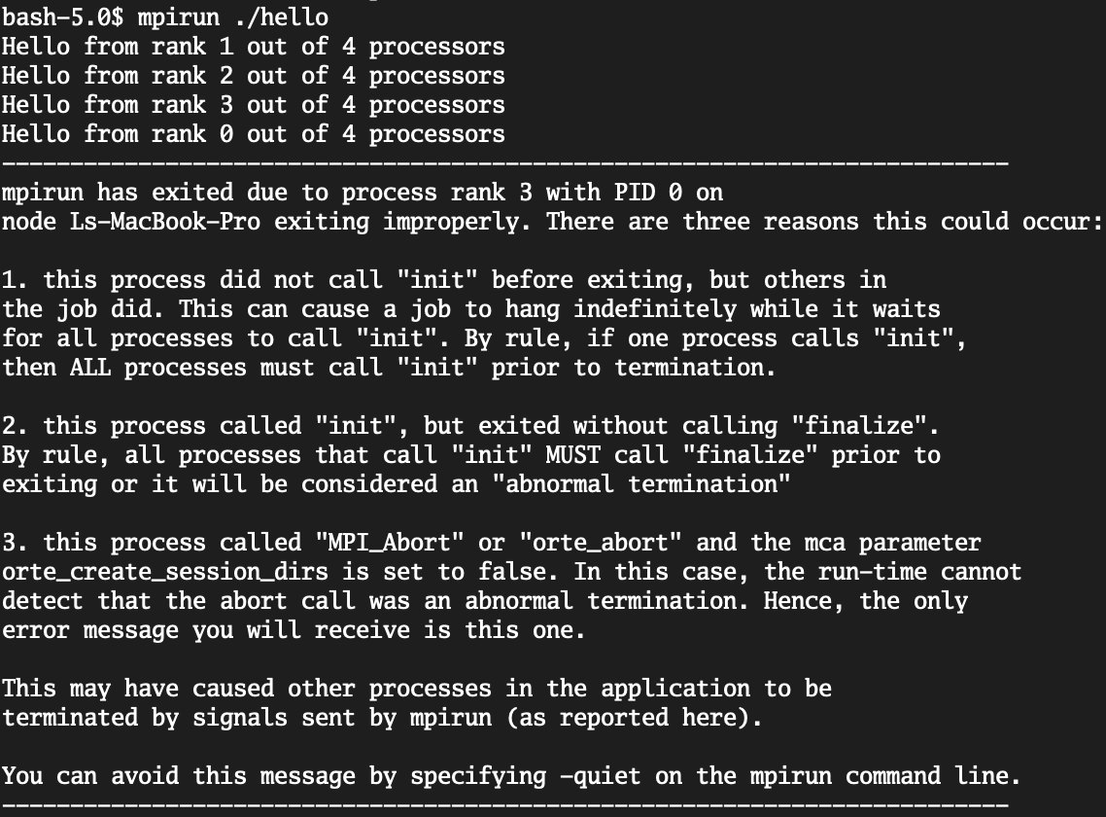
not calling mpi_finalize
MPI communicators must be destroyed before the program exits (think of it like the malloc/free idiom)
Notes:
Program may still run properly, but we want to always exit cleanly (important when we start getting to dynamically spawned processes, which mirror dynamic parallelism in CUDA)

Slide 40
Mismatched SEND/RECV
#include <mpi.h>
int main(int argc, char ** argv){
MPI_Init(&argc, &argv);
int size; MPI_Comm_size(MPI_COMM_WORLD, &size);
int rank; MPI_Comm_rank(MPI_COMM_WORLD, &rank);
MPI_Recv(&rank, 1, MPI_INT, 0, 0, MPI_COMM_WORLD, 0);
MPI_Finalize();
}
Notes:
recv will just wait... and wait... and wait forever. program doesn't finalize!
of course we could use Irecv and the program wouldn't hang, but we would still never receive anything because nothing is being sent!

Slide 41
Bcast/gather from one rank
int* localBuf = malloc(sizeof(int) * 4);
int *buf = NULL, *res = NULL;
if (rank == 0) {
buf = malloc(sizeof(int) * 16);
res = malloc(sizeof(int) * 16);
for (int i = 0; i < 16; i++) {
buf[i] = i + 1;
}
}
MPI_Scatter(buf, 4, MPI_INT, localBuf, 4, MPI_INT, 0, MPI_COMM_WORLD);
for (int i = 0; i < 4; i++) {
localBuf[i] *= 2;
}
if (rank == 0) {
MPI_Gather(localBuf, 4, MPI_INT, res, 4, MPI_INT, 0, MPI_COMM_WORLD);
for (int i = 0; i < 16; i++) {
printf("%d ", res[i]);
}
}
Notes:
Similar to the previous error, we get a situation where the program hangs -- Gather is only being called by rank 0! of course we could change this behavior a little by saying "hey gather, grab from rank 1" but we still wouldn't be using gather properly

Slide 42
MPI alternatives
POSIX Threads
OpenMP
PNL's ComEx
GASnet

Slide 43
questions
Do you have any?

Slide 44
Resources
LLNL MPI Tutorial
MPICH Documentation
OpenMPI Documentation
MPITutorial.com
OpenMPI Debugging FAQ

