Slide 1
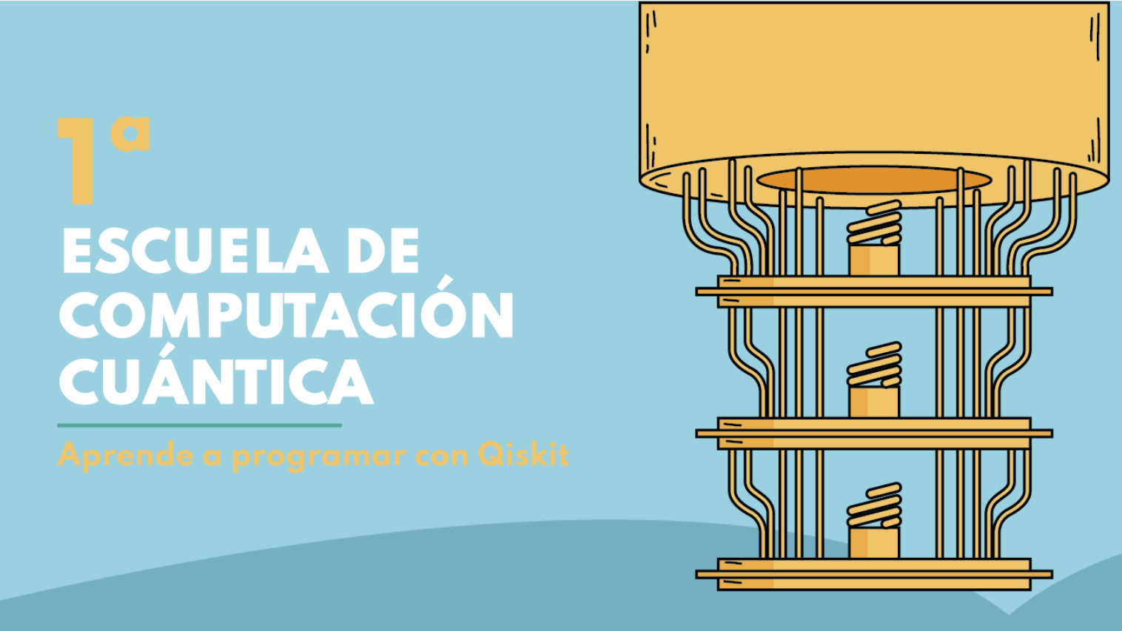

Slide 2


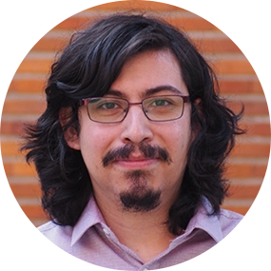
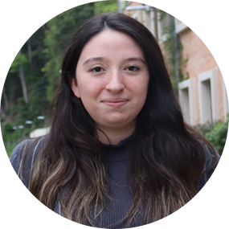
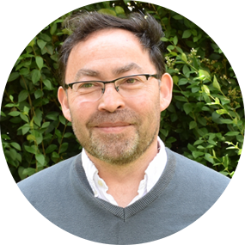
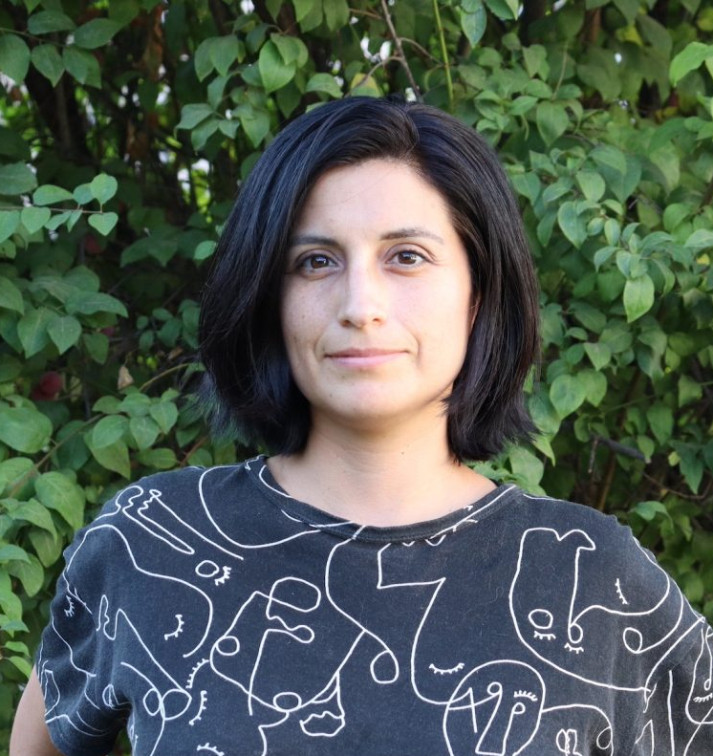
Luciano Pereira
Barbara Candia
Aldo Delgado
Paulina Andrade

Slide 3
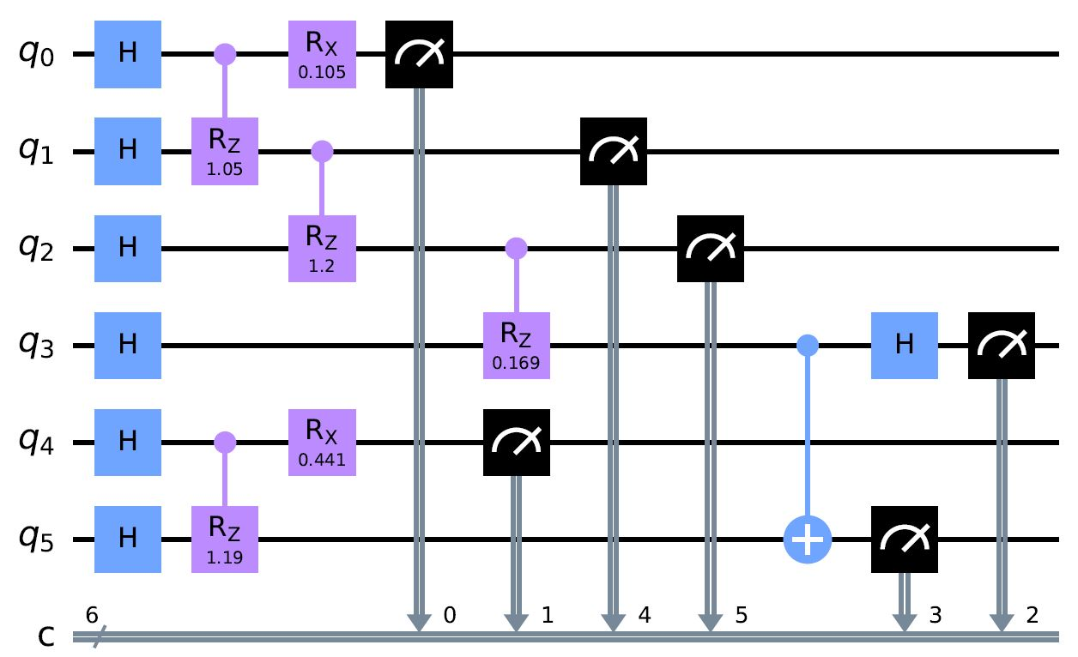
Computación
Cuántica

Slide 4
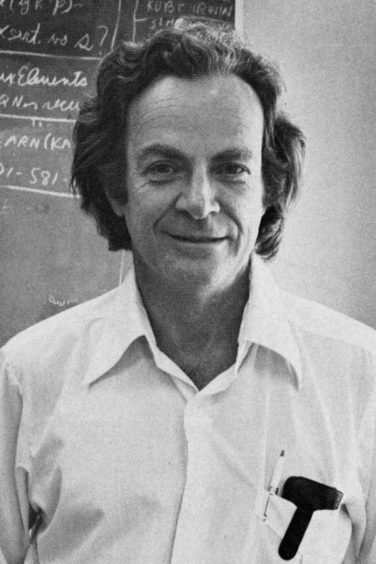
Richard Feynman
“Nature isn't classical, dammit, and if you want to make a simulation of nature, you'd better make it quantum mechanical, and by golly it's a wonderful problem, because it doesn't look so easy.”

Slide 5
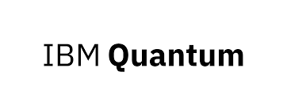
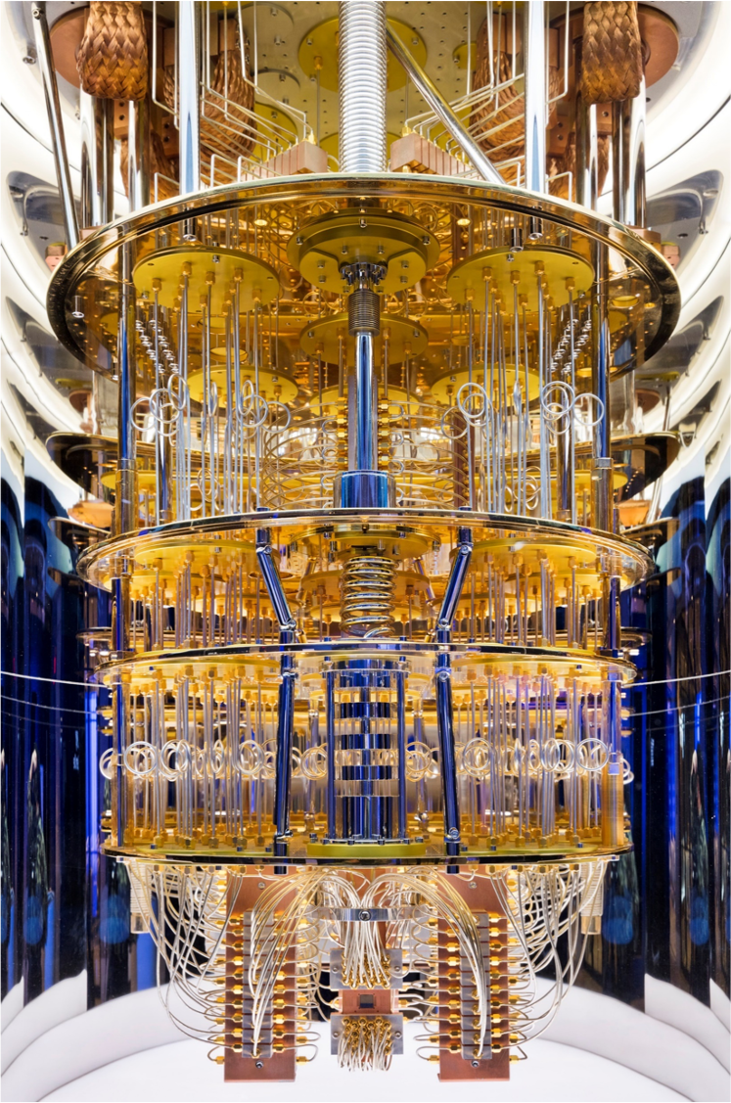








Slide 6
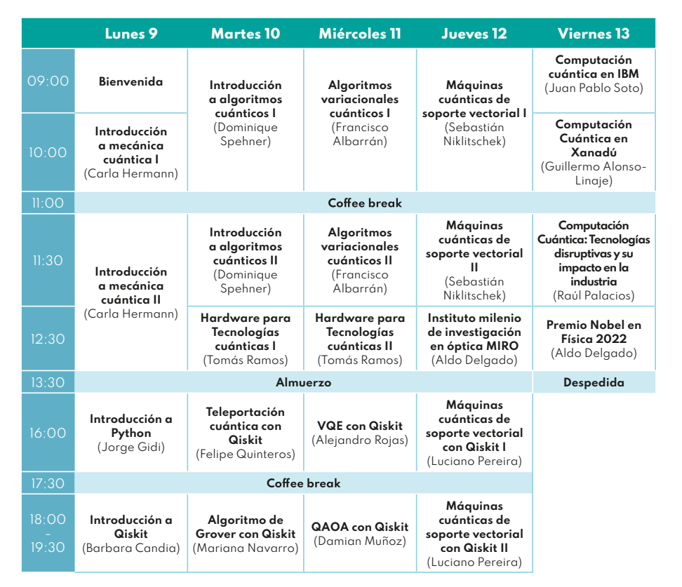
Más de 150
Postulaciones!
Físicos, matemáticos,
ingenieros, astrónomos,
programadores, geofísicos,
Etc…
Estudiantes, profesionales y docentes

Slide 7


Slide 8
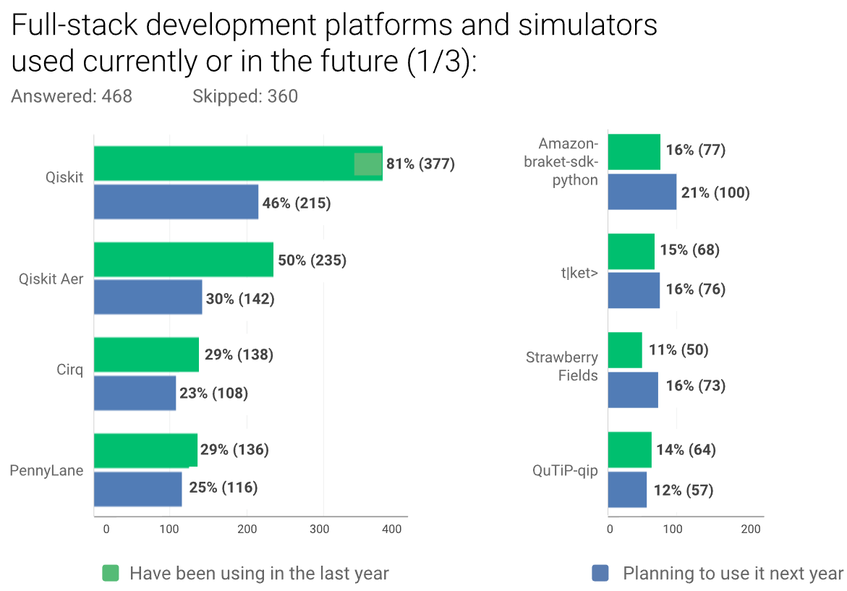


Slide 9
