Slide 1
Exploration vs. Exploitation
When curiosity gets stuck on noise
The fundamental RL trade-off — try new actions vs. exploit the current best policy.
The sparse-reward bottleneck. When extrinsic rewards are rare, naive exploration fails. The classical fix is intrinsic motivation — give the agent a self-generated bonus for visiting novel states.
Family | Intrinsic bonus | Known issue
ε-greedy / Softmax | none (random) | Undirected — fails on long-horizon / sparse tasks
UCB / Thompson Sampling | uncertainty-driven | Hard to scale to deep nets without approximation
RND / ICM (curiosity) | dynamics-model prediction error | Noisy-TV problem
The noisy-TV failure mode.
A curiosity-driven agent placed near an inherently random source (TV static, dice, sensor noise) becomes permanently fixated — prediction error never falls, the bonus never decays, the agent never moves on. This is the failure mode our project will study.

Slide 2
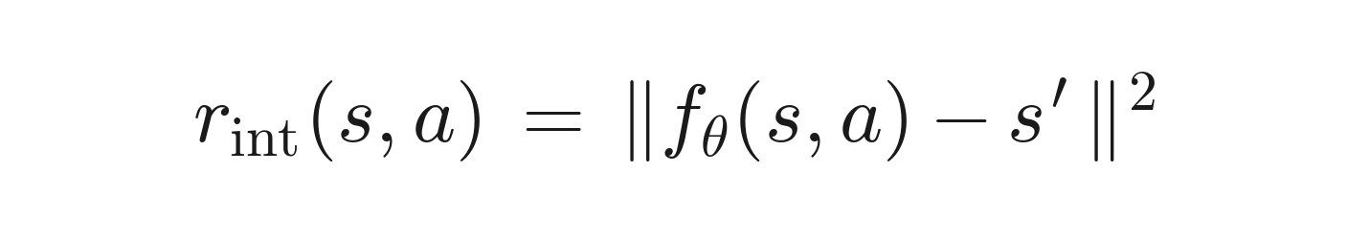
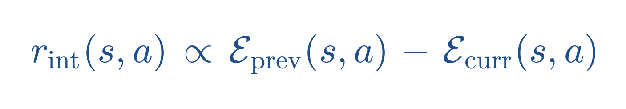
Paper: Learning Progress Monitoring (LPM)
Hou, An, Du — UC Merced — ICLR 2026 — arXiv:2509.25438
Key conceptual shift — reward improvement, not prediction error:
Curiosity (RND, ICM):
LPM (this paper):
Why it escapes noisy-TVs.
Unlearnable transitions never get more predictable, bonus gets 0, agent ignores the noise source. Learnable transitions keep improving, positive bonus, agent explores them.
The pathology is removed by changing what we reward, not by patching the symptoms.

Slide 3
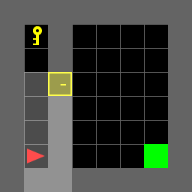
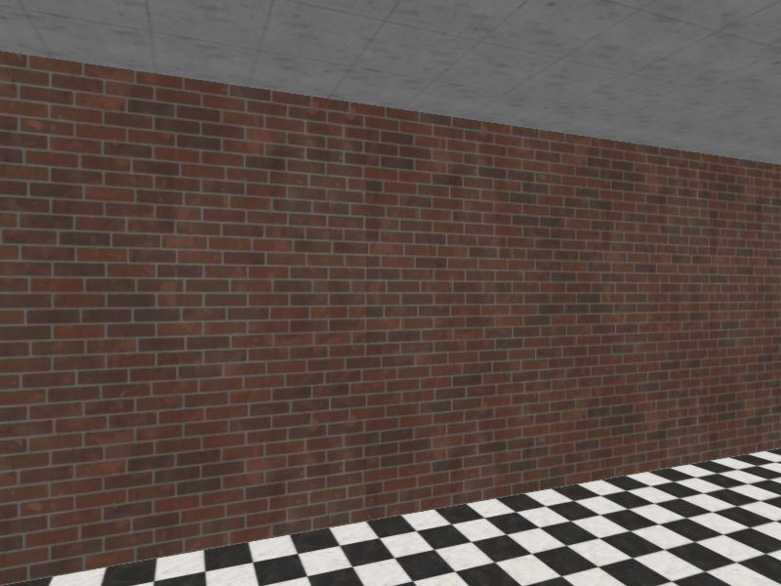
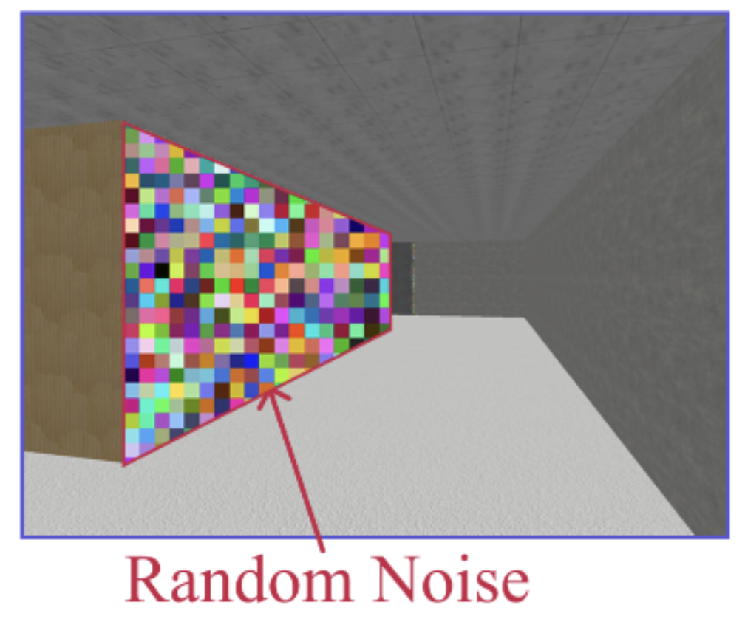
Experimental Environments
MiniGrid (our extension) ◆ MiniWorld (paper's main env)
MiniGrid — 2D top-down gridworld
MiniWorld — 3D first-person maze
MiniGrid-DoorKey-8x8-v0
MiniWorld-MazeS3-v0 (rendered 160×120 RGB in paper)
• Symbolic obs (or 7×7 partial RGB cone)
• Sparse-reward, no noise
• Pixel obs (RGB) — first-person camera
• Paper's main env — supports noisy-wall / action-noise demos

Slide 4
Project Plan
Stage 1 — Reproduction
• Reproduce the noisy-TV problem on previous learning algorithms.
• Run LPM on Noisy-MNIST and MiniWorld 3D maze.
• Match published curves within seed variance against baselines.
Stage 2 — Controlled Study
1. Extension to MiniGrid — does LPM still help on a cleaner sparse-reward env, or is its advantage noise-specific?

