Slide 1
FIFA WORLD CUP | 1930 – 2022
WORLD CUP
ANALYSIS
Performance, Goals & Hosting Effects
22
2,720
964
Brazil
Tournaments
Total Goals
Matches
Most Wins (5x)
The Beautiful Game — A Data Story

Slide 2
Contents
01
Objectives
What this analysis aims to uncover
02
Tournament Overview
Key stats — matches, goals, teams, attendance
03
Champions History
Who won, how many times, and when
04
Goals Analysis
Goal trends from 1930 to 2022
05
Hosting Advantage
Does playing at home actually help?
06
Attendance Trends
How fan turnout has evolved across 9 decades
07
Top Scorers
Golden Boot winners across all tournaments
08
Key Insights
Data-driven findings from the analysis
09
Recommendations
Lessons for teams, hosts & governing bodies
FIFA World Cup Analysis | Performance, Goals & Hosting Effects | 1930–2022
2

Slide 3
Objectives
What This Analysis Sets Out to Uncover
1
Track Goal Trends
Analyse how total goals scored per tournament have changed across 92 years of World Cup football from 1930 to 2022.
2
Identify Dominant Teams
Determine which nations have dominated the tournament, with a focus on Champions, Runner-Ups and consistent performers.
3
Measure Hosting Impact
Evaluate whether hosting the World Cup provides a tangible competitive advantage to the host nation in matches and titles.
4
Explore Attendance Growth
Understand how global interest in the World Cup has grown over the decades through attendance data across all 22 editions.
5
Surface Key Insights
Deliver clear, data-backed insights that teams, governing bodies and football analysts can learn from and act on.
FIFA World Cup Analysis | Performance, Goals & Hosting Effects | 1930–2022
3

Slide 4
Tournament Overview | 1930 – 2022
92 Years of the World's Biggest Football Event
22
2,720
964
44M+
Tournaments Held
All-Time Goals
Total Matches
Total Attendance
Brazil
13 Goals
3.59M
Most Titles (5×)
Just Fontaine 1958
Highest Attendance '94
Tournament Evolution at a Glance
1930
1950
1966
1982
1994
1998
2022
First ever
World Cup
Uruguay
Record
attendance
173,850 fans
First live
global TV
broadcast
Expanded
to 24 teams
Record total
attendance
3.59 million
Expanded
to 32 teams
First Middle
East host
Qatar
FIFA World Cup Analysis | Performance, Goals & Hosting Effects | 1930–2022
4

Slide 5
World Cup Champions | Who Dominated the Tournament?
Wins by Country — Brazil Leads with 5 Titles
Brazil
5 titles
Germany
4 titles
Italy
4 titles
Argentina
3 titles
France
2 titles
Uruguay
2 titles
England
1 title
Spain
1 title
Notable: Germany (4) includes 2 wins as West Germany (1954, 1974). Argentina's 3rd title came in 2022 under Lionel Messi. Only 8 nations have ever lifted the trophy.
FIFA World Cup Analysis | Performance, Goals & Hosting Effects | 1930–2022
5

Slide 6
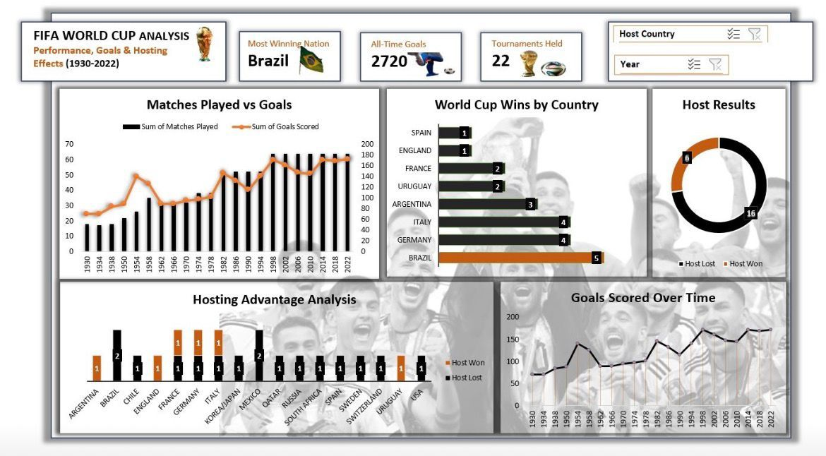

Slide 7
Goals Analysis | Scoring Trends 1930 – 2022
Total Goals Scored Per Tournament — All 22 Editions
Goals Scored Per Tournament
172
Goals in 2022
Highest single tournament total
115
Goals in 1990
Lowest in modern era (post-1982)
2,720
All-Time Goals
Across all 22 tournaments
Matches Played Per Tournament
4.3
Goals Per Match
Average across all tournaments
FIFA World Cup Analysis | Performance, Goals & Hosting Effects | 1930–2022
6

Slide 8
Hosting Advantage Analysis | Does Home Turf Help?
Of 22 Tournaments — Host Nations Won Only 5 Times
5
17
22.7%
Host Nations Won
Host Nations Lost
Host Win Rate
Host Result Breakdown
Hosts That Won Their Tournament
1930
Uruguay
First ever World Cup on home soil
1934
Italy
Mussolini-era Italy dominates at home
1966
England
Only World Cup win in England's history
1974
W. Germany
Hosts beat Netherlands 2-1 in the final
1998
France
Zidane's France wins 3-0 vs Brazil
Verdict: Hosting alone does not guarantee success. 77% of host nations failed to win despite home advantage, crowd support and reduced travel.
FIFA World Cup Analysis | Performance, Goals & Hosting Effects | 1930–2022
7

Slide 9
Attendance Trends | How Fan Turnout Has Evolved
Total Tournament Attendance Has Grown 6× Since 1930
3.59M
1994 USA
All-time record attendance
363K
1934 Italy
Lowest total ever recorded
3.40M
2022 Qatar
Highest in modern era
45.7K
Avg/Match
Average across all editions
Key Trend: Attendance dipped sharply in 2002 (Japan/Korea) and 2010 (South Africa) due to travel costs and stadium capacity constraints — but recovered strongly by 2014 and 2022.
FIFA World Cup Analysis | Performance, Goals & Hosting Effects | 1930–2022
8

Slide 10
Top Scorers | Golden Boot Winners Across the Decades
Tournament Top Scorers — 1930 to 2022
1930
Guillermo Stábile
8 goals
2002
Ronaldo
8 goals
Argentina
Brazil
1954
Sándor Kocsis
11 goals
2006
Miroslav Klose
5 goals
Hungary
Germany
1958
Just Fontaine
13 goals
2014
James Rodríguez
6 goals
France
Colombia
1970
Gerd Müller
10 goals
2018
Harry Kane
6 goals
West Germany
England
1990
Salvatore Schillaci
6 goals
2022
Kylian Mbappé
8 goals
Italy
France
Record: Just Fontaine's 13 goals in 1958 (France) remains the all-time single-tournament record and has stood for over 65 years. Kylian Mbappé scored 8 goals in 2022 including a hat-trick in the final.
FIFA World Cup Analysis | Performance, Goals & Hosting Effects | 1930–2022
9

Slide 11
Key Insights from the Data
What the Numbers Tell Us About 92 Years of World Cup Football
01
Brazil Stands Alone at the Top
04
Attendance Peaked in 1994
With 5 titles, Brazil has won the World Cup more than any other nation. Their dominance spans 7 decades — from their first win in 1958 to their last in 2002. No other nation has been as consistently excellent across all eras.
The 1994 USA World Cup holds the record for highest total attendance at 3.59 million. Despite expansions to 32 teams, no subsequent tournament has matched this total — reflecting stadium size and geographic demand differences.
02
Goals Are at an All-Time High
05
Just 8 Nations Have Ever Won
The 2022 Qatar World Cup produced 172 goals — the highest in tournament history. Modern football's high press, improved fitness and attacking strategies are driving an upward trend in goals per match in recent editions.
In 22 tournaments, only 8 countries — all European or South American — have ever lifted the World Cup trophy. Africa, Asia, North America and Oceania are yet to produce a World Cup winner, highlighting regional power gaps.
03
Hosting Does Not Guarantee Victory
06
1990 Was the Least Entertaining on Paper
Only 5 of 22 host nations have won the tournament on home soil — a 22.7% win rate. Being the host provides logistical and crowd advantages, but elite football quality ultimately determines the winner.
The 1990 Italy World Cup produced just 115 goals in 52 matches — a goals-per-match ratio of 2.21, the lowest in the modern era. Defensive tactics dominated, leading FIFA to introduce rule changes to encourage more attacking play.
FIFA World Cup Analysis | Performance, Goals & Hosting Effects | 1930–2022
10

Slide 12
Recommendations | Lessons for Teams, Hosts & Governing Bodies
Strategic Actions Based on the Analysis
1
Invest in Long-Term Youth Development
4
Expand Development Investment to New Regions
All 5 champions won the World Cup at home. But across 9 decades, Brazil, Germany, Italy and Argentina built winning cultures through elite youth academies. Nations must invest in grassroots football 10–15 years before targeting a title.
Only European and South American teams have ever won the World Cup. FIFA and continental bodies should redirect funding and coaching infrastructure to Africa, Asia and North America to create genuine global competition by 2030+.
2
Host Nations Must Prepare Holistically
5
Use Data Analytics for Opponent Preparation
Of 22 hosts, only 5 won. Hosting success requires more than infrastructure — nations must align tournament hosting with a peak squad generation to maximise competitive chances on home soil.
With 92 years of match data available, national teams can leverage historical patterns — goal timing, host advantages, high-pressure moments — to build data-driven tactical frameworks for upcoming tournaments.
3
Prioritise Attacking Football Strategies
6
Plan Stadium Capacity to Break Attendance Records
Goal tallies have trended upward in modern tournaments. Nations that embrace attacking, high-press football (like France 2018 and Argentina 2022) achieve both results and fan engagement — a dual competitive advantage.
The 1994 attendance record of 3.59M has not been broken in 30 years. Future hosts like 2026 USA/Canada/Mexico should leverage large-capacity NFL stadiums and multi-city formats to finally surpass this milestone.
FIFA World Cup Analysis | Performance, Goals & Hosting Effects | 1930–2022
11

Slide 13
Thank You
The Beautiful Game — A Data Story
Data Source: FIFA World Cup Dataset | Period: 1930 – 2022 | 22 Tournaments | 964 Matches
2,720
964
5×
22.7%
Total Goals
Total Matches
Brazil's Titles
Host Win Rate
The World Cup is not just football — it is history, culture and data.

