Slide 1
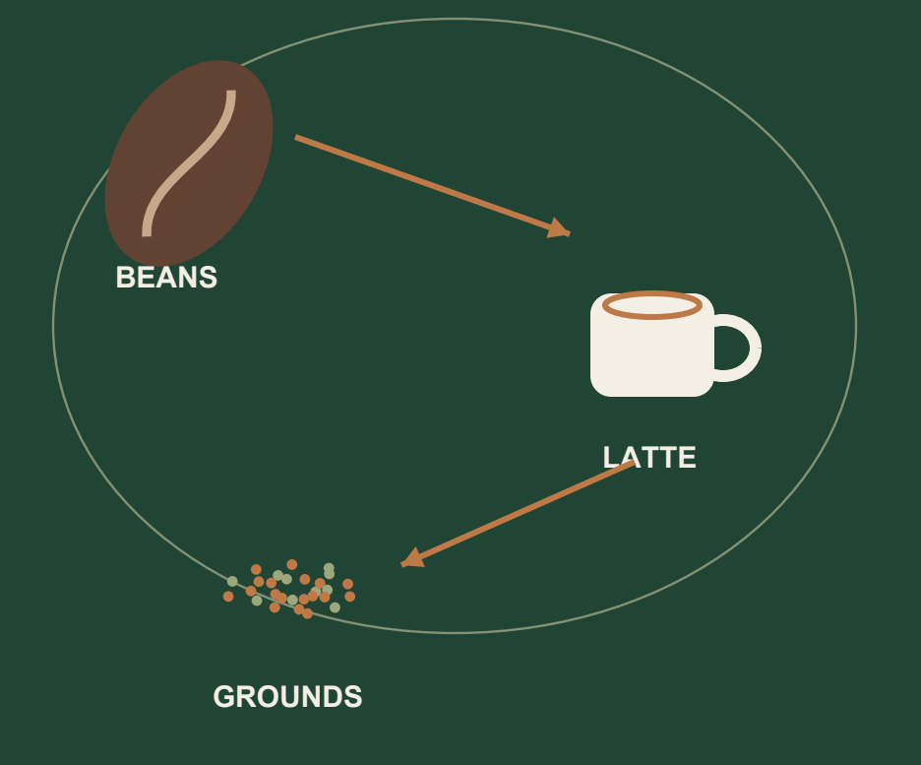
nile.
COFFEE INTO CLIMATE ACTION
Give coffee
a next life.
Surplus beans and coffee by-products.
Compatible recipients. Clear value. Easier collection.
~75,000 tonnes / year
Spent coffee grounds generated in Australia.
RMIT estimate, 2023. Context, not Nile impact.
One engine for coffee materials
at different stages.
Zero Waste & Methane Reduction / Green Industrialisation / Awareness
Source: RMIT, Coffee offers performance boost for concrete, 23 August 2023
1 / 11
Notes:
Opening composition and bean/latte/grounds illustration restored from the original Nile_Submission_Presentation.pdf. The cropped original illustration is an image; other cover text and the context card are native editable objects. RMIT (23 August 2023), https://www.rmit.edu.au/news/all-news/2023/aug/coffee-concrete, estimates around 75,000 tonnes of grounds generated in Australia annually. This is dated context, not Nile impact. All three requested event priorities remain visible. Slides 2–11 retain the research, hypothetical scenarios and evidence boundaries from v3.

Slide 2
NILE / PROBLEM & EARLY EVIDENCE
The barrier is reliable reuse, every week.
A cafe needs an accepting destination, workable costs and a dependable handover.
4
Recurring spent grounds
Grounds commonly go in bins; actual disposal destinations need checking.
Occasional surplus beans
cafes interviewed
Usable leftovers sometimes need another buyer or cafe before freshness declines.
Team-reported
qualitative feedback
Inconsistent arrangements
Some cafes already use agricultural collection; others lack a repeatable system.
Early problem evidence only: no measured volumes, verified landfill routes or commitments to pay.
Nile • Climate Hack-tion • 4 October 2026
02
Notes:
Team-reported qualitative interviews with four cafes, supplied in conversation 4 October 2026. No transcripts, names, dates, weights or disposal audits supplied. Some cafes already have collection for agriculture. No direct quotations reproduced.

Slide 3
NILE / COP31 ALIGNMENT
Three priorities. One practical workflow.
For Australian cafes, accepting processors and collectors: make coffee circularity easier to adopt and measure.
01
02
03
Zero Waste &
Methane Reduction
Green
Industrialisation
Awareness
Keep usable beans circulating; redirect eligible grounds from landfill.
Help suitable growers and processors use coffee by-products as inputs.
Explain reuse routes, preparation rules and climate estimates in plain language.
Test: additional accepted mass and the actual disposal baseline.
Test: processor acceptance, actual use and input substitution.
Test: understanding and correct preparation before and after use.
Nile • Climate Hack-tion • 4 October 2026
03
Notes:
User-supplied event priority descriptions. Original UNFCCC URL could not be fetched in this update; global numeric targets are not independently asserted. Farm/weather/satellite advice remains a future extension. Current awareness function is preparation guidance and understandable reuse/climate evidence.

Slide 4
NILE / WORKING PROTOTYPE
List. Match. Collect. Confirm.
One engine demonstrates spent grounds and usable surplus roasted beans.
01 Describe the batch
30 kg
Type, condition, quantity, packaging and availability.
02 Compare eligible matches
proposed
Check acceptance rules first; compare net value, distance and timing.
27 kg
03 Agree collection
accepted
Shared preparation and pickup brief; recipient accepts the current version.
25 kg
04 Record what happened
Actual accepted weight, supplier confirmation and separate reported use.
reported used
Demo example • separate evidence states
Nile • Climate Hack-tion • 4 October 2026
04
Notes:
Local implementation: README.md, docs/build-status.md, docs/adoption-tools.md. Recipients and quotes are fictional fixtures. 30 kg proposed -> 27 kg accepted -> 25 kg reported used is a testable software demonstration, not achieved physical diversion. Chaff, pulp and farm/mill husks are wider catalogue pathways requiring recipient validation.

Slide 5
NILE / WHY PEOPLE WOULD USE IT
Less uncertainty. Clearer value.
The adoption hypothesis: reduce coordination effort without hiding handling or collection costs.
For the cafe
For recipients / collectors
A reason to return
Repeat listings, understandable net value and a clear preparation checklist.
Agree material, container, access, time and collection responsibility before pickup.
Usage / sales CSVs help plan bean purchases against stock, goals and budget.
Net benefit = sale revenue + documented avoided costs
− extra handling, collection and platform costs.
Nile • Climate Hack-tion • 4 October 2026
05
Notes:
Local features verified in docs/adoption-tools.md. Net benefit formula does not guarantee income, realized savings, payment processing or free collection. All sample quotes and buyer capacities are fictional. CSV planner is browser-only and does not place orders. Nile participation records are not certification.

Slide 6
NILE / ALTERNATIVES & DIFFERENTIATION
Reground proves collection is valuable.
Nile proposes batch-level choice, usable-bean matching and coordination; the commercial advantage needs testing.
Dimension | Reground: documented service | Nile: local prototype
Material routes | Grounds and chaff collection; wider circular projects. | Grounds + usable beans to sample cafes; wider catalogue unvalidated.
Collection | Bins and physical pickups. | Compatibility, cost comparison and shared collection brief; no fleet.
Evidence | Pickup/destination tracking, online reporting and updates. | Accepted weights, two-party receipts and separate reported use.
Business adoption | Education, consultancy and Circular Coffee ESG/certification. | Repeat listings, batch economics and CSV purchase planning.
Potential collector partner only; no agreement or proven price/climate advantage.
Sources: reground.com.au/collection/ground-coffee/ • /collection/chaff/ • /collection/circular-coffee/ • /consultancy/
Nile • Climate Hack-tion • 4 October 2026
06
Notes:
Reground reviewed 4 October 2026. Grounds service: https://reground.com.au/collection/ground-coffee/. Chaff: https://reground.com.au/collection/chaff/ . Consultancy: https://reground.com.au/consultancy/ . Circular Coffee: https://reground.com.au/collection/circular-coffee/. Remote partner systems: https://reground.com.au/remote/ . Reviewed service pages do not explicitly advertise a usable surplus roasted-bean marketplace; this is not proof none exists. Nile has no collection fleet, real buyer demand, agreed partner or proven cost advantage.

Slide 7
NILE / ILLUSTRATIVE POTENTIAL — NOT ACHIEVED
What could 100 cafes contribute?
Assumed one-year cohort; only materials that would otherwise go to landfill are eligible.
83.2
4.16
~6.2
tonnes of grounds
tonnes of usable beans
tonnes of methane
diverted per year
redirected per year
lifetime avoidance from
that year’s grounds
Assumptions: 20 kg grounds + 1 kg beans/cafe/week • 52 weeks • 80% additional diversion • compost route • no landfill gas capture.
Generic food-waste methane proxy; no bean methane credit. Source: DCCEEW, NGA Factors 2026, Tables 15, 44 and 38.
Nile • Climate Hack-tion • 4 October 2026
07
Notes:
Assumptions: 100 cafes, 20 kg grounds + 1 kg eligible usable surplus beans/cafe/week, 52 weeks, 80% additional diversion. Grounds=83.2 t; beans=4.16 t. Grounds landfill -> compost, zero gas capture. Lifetime methane=83.2*(2.1-0.021)/28=6.1776 t CH4, not annual methane savings. Source DCCEEW 2026 NGA Tables 15/44/38: https://www.dcceew.gov.au/sites/default/files/documents/national-greenhouse-accounts-factors-2026.pdf. Generic food-waste proxy; coffee-specific composition/wet mass unvalidated. No methane credit for beans. Existing diversion excluded. Transport/treatment energy/substitution excluded. See method appendix.

Slide 8
NILE / BUILD & DEPLOYMENT
Working locally. Cloud setup comes next.
GCP is not configured. Intended route: Next.js on Vercel + Supabase; neither is deployed.
Experience
API & decisions
Data & explanations
Cafe workspace
Recipient workspace
Network view
Zod validation
Eligibility + ranking
Collection + receipts
SQLite transactions
Optional OpenAI adapter
Supabase SQL prepared
→
→
Next.js • React • TypeScript
Rules control bookings and maths
Live OpenAI access unverified
Documented local validation: 48 unit/database + 13 browser/API checks. Live AI, cloud Auth and real recipients remain unverified.
Nile • Climate Hack-tion • 4 October 2026
08
Notes:
Current local implementation checked against README.md, docs/build-status.md and backend setup. SQLite with demo role switching, not cloud Auth. OpenAI adapter implemented with a nonempty local API key; live model access remains unverified in this update. Supabase migration/read policies locally tested, hosted repository/Auth/Storage unwired. Production hosting cannot use this local SQLite repository. Documented checks at commit 759f893: 48 unit/database and 13 browser/API tests. No deployment provisioned.

Slide 9
NILE / PROTOTYPE → REAL-WORLD USE
A small pilot can test the whole promise.
Proposed: 3–5 nearby cafes • 1–2 accepting recipients • 4 weeks. No participants are confirmed.
1 Establish the baseline
2 Agree a practical route
3 Run and record
Check bin destinations, existing collectors, weekly weights and current costs.
Confirm recipient rules, storage, pickup windows, access and charges.
Track accepted kg, reported use, failures, staff time, costs and understanding.
Suggested pass gates
≥80% pickups completed • ≤2 min median repeat listing • ≥60% repeat participation
Median net benefit ≥$0 after actual costs; additional diversion checked against baseline.
Nile • Climate Hack-tion • 4 October 2026
09
Notes:
Proposed pilot: week 1 baseline and agreements, weeks 2–4 collections. Suggested gates: 80% pickups completed, median repeat listing <=2 minutes, 60% cafes choosing another cycle, median documented net benefit >=0. Not performed. Actual accepted mass is additional diversion only with verified baseline landfill. Track use and virgin-input substitution separately; use reports are self-reports. Awareness test: correct preparation and interpretation of evidence before/after. Methane remains estimated, not directly measured. No climate-resilient farming test is claimed.

Slide 10
NILE / APPENDIX / SCENARIO METHOD
Assumptions stay visible and adjustable.
The four interviews did not measure these quantities. The 100-cafe case is a planning illustration.
Input / calculation | Assumed value / result
Cohort and period | 100 cafes × 52 weeks × 80% additional successful diversion
Eligible grounds and usable beans | 20 kg grounds + 1 kg beans per cafe per week
Annual material | 83.2 t grounds + 4.16 t beans = 87.36 t
Grounds-only methane formula | 83.2 × (2.1 × (1 − capture) − 0.021) ÷ 28
Assumed landfill methane capture | 0%: 6.2 t CH₄ | 50%: 3.1 t | 70%: 1.8 t
Methane is a lifetime comparison, not a measured annual saving. Generic food-waste proxy; beans receive no methane credit. Transport and processing energy are excluded.
Source: DCCEEW 2026, Australian National Greenhouse Accounts Factors, Tables 15, 44 and 38 (CC BY 4.0).
Nile • Climate Hack-tion • 4 October 2026
10
Notes:
DCCEEW 2026 Australian National Greenhouse Accounts Factors: https://www.dcceew.gov.au/sites/default/files/documents/national-greenhouse-accounts-factors-2026.pdf, Tables 15/44/38. Lifetime food-waste methane proxy 2.1 t CO2e/t without capture; compost methane 0.021, separate N2O excluded; GWP100 CH4=28. Formula grounds_t*(2.1*(1-capture)-0.021)/28. Alternatives 0%=6.1776, 50%=3.0576, 70%=1.8096 t CH4, not confidence interval. Effective capture is illustrative. Coffee-specific composition/wet mass, transport, treatment energy and substitution unvalidated/excluded. Beans no methane credit, later grounds not double-counted. Existing reuse excluded.

Slide 11
NILE / APPENDIX / TOOLS DISCLOSURE
What we used, and what is still planned.
Full disclosure, setup instructions and source links are included in the repository.
AI assistance
OpenAI Codex: planning, research, writing, coding, review and documentation.
Application
Next.js, React, TypeScript, Tailwind, Zod, Radix/CVA, Recharts, Lucide and SQLite.
Validation & coordination
Vitest, Playwright, PGlite, ESLint, Prettier, agent-browser, GitHub and Notion.
Submission materials
Artifact Tool, LibreOffice, pypdf and pypdfium2; earlier PDF used ReportLab.
Prepared, not live
OpenAI adapter/key locally configured; live access unverified. Supabase SQL only; no cloud deployment.
Nile • Climate Hack-tion • 4 October 2026
11
Notes:
OpenAI Codex assistance for planning/research/writing/code/review/docs/materials. App stack checked against package.json. Optional OpenAI adapter locally configured, no live API calls made for these materials. Supabase SQL/read policies tested with PGlite locally only. Artifact Tool editable PowerPoint; LibreOffice PDF conversion; pypdf/pypdfium2 checks. Earlier PDF ReportLab. No Figma/Canva use reported. Sources https://reground.com.au/collection/ground-coffee/, https://reground.com.au/collection/circular-coffee/, https://www.dcceew.gov.au/sites/default/files/documents/national-greenhouse-accounts-factors-2026.pdf. No certification, independently assured impact or actual adoption claimed.

