Slide 1
Life Expectancy Analysis
Aditi Mishra, Patricia Afable, Vaibhav Rastogi, Vishu Gupta, Xiao Kuang, Yijie Zhang

Slide 2
Overview
02
04
01
03
05
Organization and Dataset
Key Findings
Descriptive analysis and Data Preparation
The Resultant Model to predict Life Expectancy
Research Problem
Methodology
Conclusion
Overview of the Case study, the methodology, expected results
Anova and Regression Models
How is the final model useful, the future considerations

Slide 3

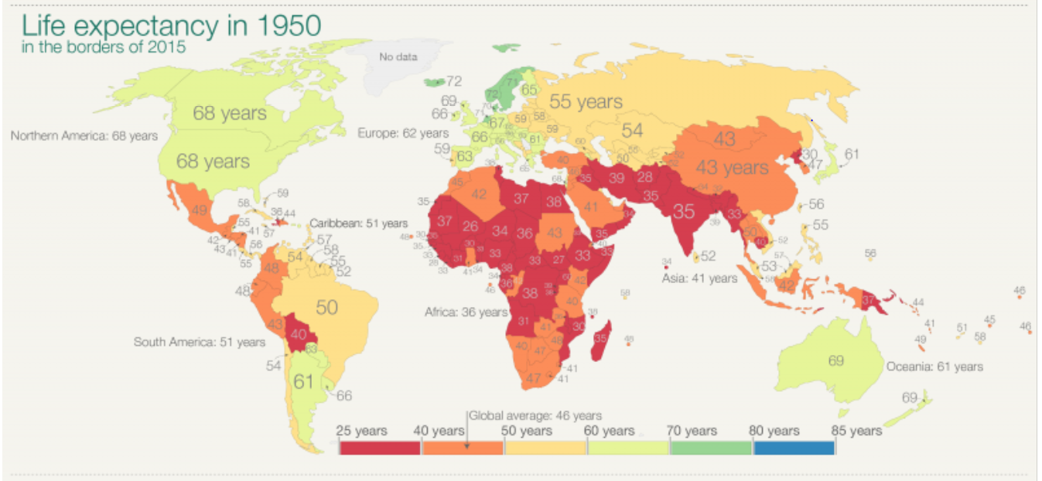
Life Expectancy in 1950
Image: Our World In Data

Slide 4

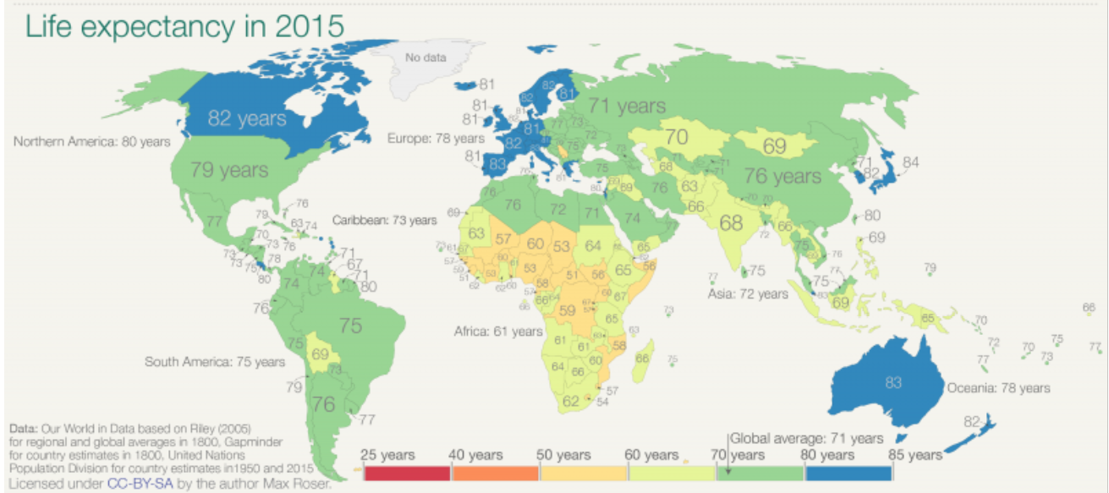
Life Expectancy in 2015
Image: Our World In Data

Slide 5
Research Problem
Over the past century the life expectancy around the world has greatly improved. However, the improvement in life expectancy has not been consistent amongst different regions of the world.
This research explores the effects of indicators across health, economic, environmental and educational factors on life expectancy across the globe.
Using significant indicators, our research goal is to study the relationship of these predictors with the life expectancy of a new-born child.
Through this study, we aim to aid the policy-makers and organizations that address the health of new-born children. The role of significant indicators will provide a better understanding to address the key issues surrounding global life expectancy.
Average Life Expectancy
1950 46 years | 2015 71 years

Slide 6


Organization and Dataset
1
2
3
6
11
12
Data for 217 countries in the world was extracted from the World Bank's agencies. With Life Expectancy as the target variable 14 indicators were chosen spanning across economic, educational, environmental and health factors.
Indicators was merged to create train and test datasets and cleaned by imputing missing values with regional averages.
The Explanatory Predictors
4
5
7
Incidence of Tuberculosis (per 1,00,000 people)
Incidence of Tuberculosis (per 1,00,000 people)
DPT Immunization
Measles Immunization
Death by Non-Communicable diseases (% of the total deaths)
Prevalence of Anemia among children (% of children under 5 years old)
Total Alcohol Consumption per capita
Road Traffic Injury (per 100,000 people)
8
9
10
13
14
Access to Electricity (% of the population)
Basic Sanitation Services( % of the Population)
Waged and Salaried Workers (% of total employment)
PM2.5 Air Pollution
Current Health Expenditure (% of GDP)
GDP per capita
Primary Gross Enrolment

Slide 7
Descriptive Summary of Life Expectancy
Moments
N | 217 | Sum Weights | 217
Mean | 72.5578295 | Sum Observations | 15745.049
Std Deviation | 7.51498035 | Variance | 56.4749297
Skewness | -0.7288796 | Kurtosis | -0.117662
Uncorrected SS | 1154625.17 | Corrected SS | 12198.5848
Coeff Variation | 10.3572287 | Std Error Mean | 0.51015011
Extreme Observations
Lowest |  | Highest
Value | Obs | Value | Obs
51.593 | 216 | 83.3293 | 40
52.059 | 175 | 83.6024 | 85
53.438 | 185 | 83.8540 | 35
53.444 | 193 | 83.9849 | 34
53.541 | 205 | 84.2268 | 27
Distribution of Life Expectancy is normal, slightly skewed to the left, with most of the population falling in the range of 70-82 years.

Slide 8
ANOVA on Life Expectancy for Region
Source | DF | Sum of Squares | Mean Square | F Value | Pr > F
Model | 6 | 7765.22970 | 1294.20495 | 61.30 | <.0001
Error | 210 | 4433.35512 | 21.11121
Corrected Total | 216 | 12198.58482
On testing the assumptions for the normal one-way ANOVA, we fail to satisfy the equal variance assumption, thus we proceeded to use Welch’s ANOVA.
Welch's ANOVA for LifeExpectancy
Source | DF | F Value | Pr > F
Region | 6.0000 | 51.55 | <.0001
Error | 24.1113
Since, the null hypothesis of Equal means is rejected since the P value is less than α, we conclude that Life expectancy is significantly different for at least one region.

Slide 9
ANOVA on Life Expectancy for Region
Least Squares Means for effect Region Pr > |t| for H0: LSMean(i)=LSMean(j) Dependent Variable: LifeExpectancy
i/j | 1 | 2 | 3 | 4 | 5 | 6 | 7
1 |  | 0.0083 | 0.9714 | 0.9975 | 0.2410 | 0.4940 | <.0001
2 | 0.0083 |  | 0.1065 | 0.2376 | 0.9322 | 0.0022 | <.0001
3 | 0.9714 | 0.1065 |  | 1.0000 | 0.4270 | 0.1904 | <.0001
4 | 0.9975 | 0.2376 | 1.0000 |  | 0.4184 | 0.3307 | <.0001
5 | 0.2410 | 0.9322 | 0.4270 | 0.4184 |  | 0.0314 | <.0001
6 | 0.4940 | 0.0022 | 0.1904 | 0.3307 | 0.0314 |  | <.0001
7 | <.0001 | <.0001 | <.0001 | <.0001 | <.0001 | <.0001
After using Tukey’s adjustment for comparison of different regions based on life expectancy, we notice that the regions of Sub-Saharan Africa and South Asia differ significantly from other regions.

Slide 10
ANOVA on Life Expectancy for Income Group
Source | DF | Sum of Squares | Mean Square | F Value | Pr > F
Model | 3 | 7942.64322 | 2647.54774 | 132.50 | <.0001
Error | 213 | 4255.94159 | 19.98095
Corrected Total | 216 | 12198.58482
On testing the assumptions for the normal one-way ANOVA, we fail to satisfy the equal variance assumption, thus we proceeded to use Welch’s ANOVA.
Welch's ANOVA for LifeExpectancy
Source | DF | F Value | Pr > F
Income_group | 3.0000 | 133.39 | <.0001
Error | 84.3683
Since, the null hypothesis of Equal means is rejected since the P value is less than α, we conclude that Life expectancy is significantly different for at least one of the income group.

Slide 11
ANOVA on Life Expectancy for Income Group
Least Squares Means for effect Income_group Pr > |t| for H0: LSMean(i)=LSMean(j) Dependent Variable: Life_Expectancy
i/j | 1 | 2 | 3 | 4
1 |  | <.0001 | <.0001 | <.0001
2 | <.0001 |  | <.0001 | <.0001
3 | <.0001 | <.0001 |  | <.0001
4 | <.0001 | <.0001 | <.0001
After using Tukey’s adjustment for comparison of different income groups based on life expectancy, we notice that all the income groups differ significantly from each other.

Slide 12
Correlation of Diseases and Immunization related predictors with Life Expectancy
Pearson Correlation Coefficients, N = 217 Prob > |r| under H0: Rho=0
LifeExpectancy Life Expectancy | NonCommunicableDisease 0.87189 <.0001 | Anemia -0.85911 <.0001 | TuberculosisPer100k -0.64436 <.0001 | MeaslesImmunization 0.55377 <.0001 | DPT_Vaccine 0.54650 <.0001

Slide 13
Correlation of Infrastructure related predictors with Life Expectancy
Pearson Correlation Coefficients, N = 217 Prob > |r| under H0: Rho=0
LifeExpectancy Life Expectancy | SanitationBasic 0.83960 <.0001 | AccessToElectricity 0.81493 <.0001 | MortalityRoadTraffic -0.72325 <.0001

Slide 14
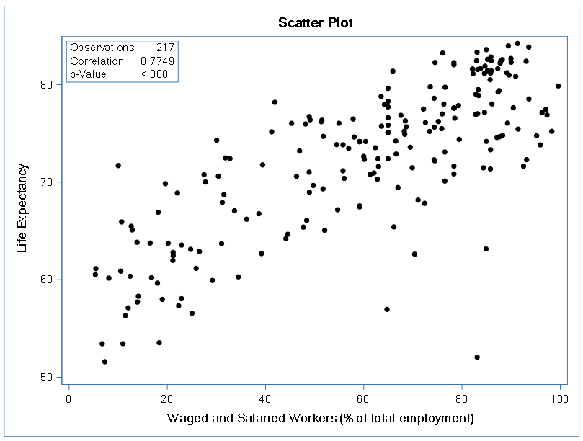
Correlation of Economic predictors with Life Expectancy
Pearson Correlation Coefficients, N = 217 Prob > |r| under H0: Rho=0
LifeExpectancy Life Expectancy | WagedSalariedEmployees 0.77494 <.0001 | GdpPerCapita 0.54826 <.0001 | HealthExpenditurePercent 0.31922 <.0001

Slide 15
Correlation of Environment and Education related predictors with Life Expectancy
Pearson Correlation Coefficients, N = 217 Prob > |r| under H0: Rho=0
LifeExpectancy Life Expectancy | PollutionPM -0.45474 <.0001
Pearson Correlation Coefficients, N = 217 Prob > |r| under H0: Rho=0
LifeExpectancy Life Expectancy | PrimaryGrossEnrollment -0.04568 0.5032

Slide 16
Regression Analysis
2014
Checking Outliers & Collinearity
Linearity & Fit Assessment
Prediction Scoring
Model Selection

Slide 17
Linearity & Fit Assessment
Checking Outliers & Collinearity
Prediction Scoring
Model Selection
We used the Backward Elimination technique to select our regression model and set the slstay to 0.05. Variables with p-value > 0.05 were eliminated in each iteration.
2014
Analysis of Variance
Source | DF | Sum of Squares | Mean Square | F Value | Pr > F
Model | 6 | 10522 | 1753.68871 | 219.67 | <.0001
Error | 210 | 1676.45257 | 7.98311
Corrected Total | 216 | 12199
The selected model has Adj R-Sq of 0.8586 and contains 6 explanatory variables.
Root MSE | 2.82544 | R-Square | 0.8626
Dependent Mean | 72.55783 | Adj R-Sq | 0.8586
Coeff Var | 3.89405
Following variables were eliminated:
Primary Gross Enrollment, Measles Immunization, Sanitation Basic, Health Expenditure, Waged/Salaried Employees, PollutionPM, Alcohol Consmption, Mortality Road Traffic.
Variable | Parameter Estimate | Standard Error | Type II SS | F Value | Pr > F
Intercept | 61.42363 | 2.56214 | 4588.15227 | 574.73 | <.0001
AccessToElectricity | 0.05461 | 0.01501 | 105.60798 | 13.23 | 0.0003
Anemia | -0.13623 | 0.02289 | 282.81506 | 35.43 | <.0001
DPT_Vaccine | 0.05825 | 0.01694 | 94.35292 | 11.82 | 0.0007
GdpPerCapita | 0.00004316 | 0.00001006 | 146.89068 | 18.40 | <.0001
NonCommunicableDisease | 0.08930 | 0.02319 | 118.32089 | 14.82 | 0.0002
TuberculosisPer100k | -0.00815 | 0.00169 | 185.58997 | 23.25 | <.0001

Slide 18
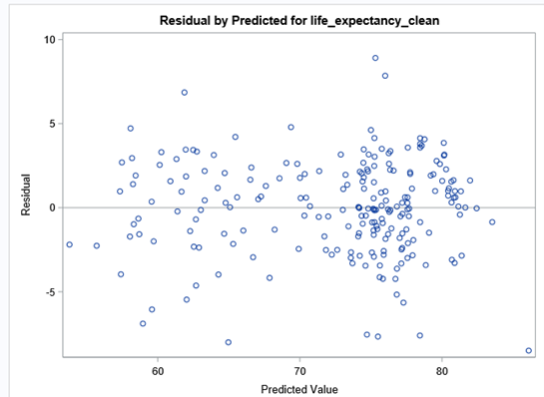
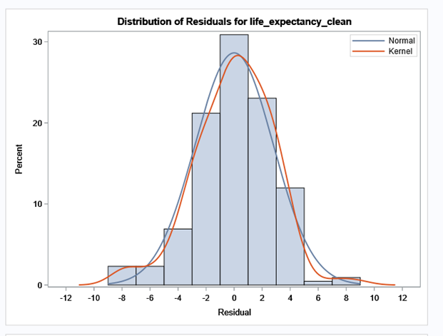
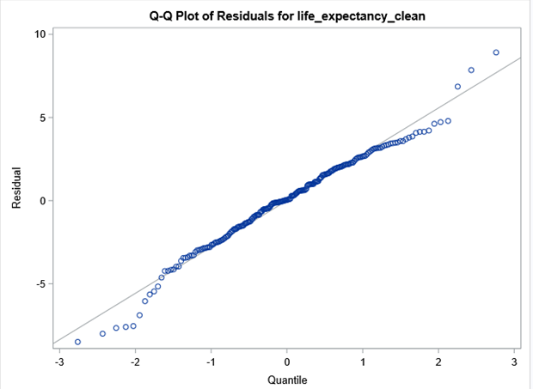
Linearity & Fit Assessment
Checking Outliers & Collinearity
Prediction Scoring
Model Selection
The first plot satisfies the assumption of mean of residuals being zero and equal variance across zero with no pattern formation.
The second and third plot satisfy the assumption of residual errors being normally distributed.

Slide 19
Linearity & Fit Assessment
Checking Outliers & Collinearity
Prediction Scoring
Model Selection
We choose this model because of low complexity and sufficiently high R-Square Value.
The Model satisfies all the Assumptions for multiple regression.
2014
We use SBC to finalize the model, even though this model does not have the best values for AIC and BIC, it is very close to the best values of other respective criterion.
The Adjusted R-Square does not vary significantly from the best model evaluated.

Slide 20
Linearity & Fit Assessment
Checking Outliers & Collinearity
Prediction Scoring
Model Selection
We use the R-Student Residuals, Cook’s D and DFFITS statistics to identify influential observations.
Obs | Country_Name | rstudent | cooksd | dffits | cutcooksd | cutdffits | rstudent_i | cooksd_i | dffits_i
1 | Korea, Dem. People_s Rep. | 1.02475 | 0.02734 | 0.43753 | 0.018433 | 1.28084 | 0 | 1 | 0
2 | Timor-Leste | 2.53684 | 0.05781 | 0.64430 | 0.018433 | 1.28084 | 0 | 1 | 0
3 | Marshall Islands | 1.74810 | 0.02244 | 0.39828 | 0.018433 | 1.28084 | 0 | 1 | 0
4 | Hong Kong SAR, China | 3.24599 | 0.01918 | 0.37467 | 0.018433 | 1.28084 | 1 | 1 | 0
5 | Macao SAR, China | 2.86019 | 0.02761 | 0.44710 | 0.018433 | 1.28084 | 0 | 1 | 0
6 | Monaco | -3.90862 | 1.18845 | -2.98073 | 0.018433 | 1.28084 | 1 | 1 | 1
7 | Greenland | -2.75820 | 0.02084 | -0.38788 | 0.018433 | 1.28084 | 0 | 1 | 0
8 | Yemen, Rep. | 1.24940 | 0.02531 | 0.42149 | 0.018433 | 1.28084 | 0 | 1 | 0
9 | Lesotho | -2.62332 | 0.11979 | -0.92844 | 0.018433 | 1.28084 | 0 | 1 | 0
10 | Eswatini | -2.96389 | 0.06754 | -0.70023 | 0.018433 | 1.28084 | 0 | 1 | 0
11 | Cote d'Ivoire | -1.99166 | 0.02617 | -0.43104 | 0.018433 | 1.28084 | 0 | 1 | 0
12 | Nigeria | -2.21342 | 0.03409 | -0.49299 | 0.018433 | 1.28084 | 0 | 1 | 0
13 | Gabon | 1.29382 | 0.02742 | 0.43879 | 0.018433 | 1.28084 | 0 | 1 | 0
We eliminate Monaco from the dataset since it is flagged for all the three statistics.

Slide 21
Linearity & Fit Assessment
Checking Outliers & Collinearity
Prediction Scoring
Model Selection
After eliminating the outlier “Monaco”, the resulting R-Square value is improved to 0.868.
Model After Outlier Removal
Parameter Estimates
Parameter | DF | Estimate | Standard Error | t Value
Intercept | 1 | 59.385635 | 2.533481 | 23.44
AccessToElectricity | 1 | 0.056173 | 0.014534 | 3.86
Anemia | 1 | -0.112557 | 0.022962 | -4.90
DPT_Vaccine | 1 | 0.060300 | 0.016405 | 3.68
GdpPerCapita | 1 | 0.000071782 | 0.000012183 | 5.89
NonCommunicableDisea | 1 | 0.095417 | 0.022499 | 4.24
TuberculosisPer100k | 1 | -0.007564 | 0.001641 | -4.61

Slide 22
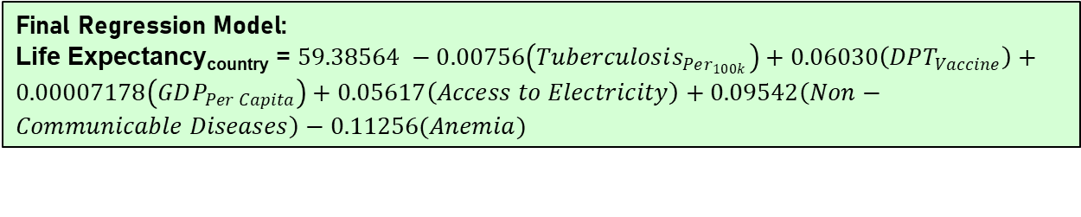
Linearity & Fit Assessment
Checking Outliers & Collinearity
Prediction Scoring
Model Selection
We check for collinearity in our model using the Variance Inflation Factor – VIF.
Parameter Estimates
Variable | Label | DF | Parameter Estimate | Standard Error | t Value | Pr > |t| | Variance Inflation
Intercept | Intercept | 1 | 59.38564 | 2.53348 | 23.44 | <.0001 | 0
TuberculosisPer100k | Incidence of Tuberculosis (per 1,00,000 people) | 1 | -0.00756 | 0.00164 | -4.61 | <.0001 | 1.64474
DPT_Vaccine | DPT Immunization | 1 | 0.06030 | 0.01640 | 3.68 | 0.0003 | 1.37449
GdpPerCapita | GDP Per Capita | 1 | 0.00007178 | 0.00001218 | 5.89 | <.0001 | 1.61531
AccessToElectricity | Access to Electricity (% of the population) | 1 | 0.05617 | 0.01453 | 3.86 | 0.0001 | 3.92552
NonCommunicableDisease | Death by Non-Communicable diseases (% of the total deaths) | 1 | 0.09542 | 0.02250 | 4.24 | <.0001 | 6.21610
Anemia | Prevalence of Anemia among children (% of children under 5 years old) | 1 | -0.11256 | 0.02296 | -4.90 | <.0001 | 4.50247
Since all VIF values are well below 10, we can safely conclude that there is no significant presence of multicollinearity in our model.
Final Regression Model:
Life Expectancy_{country} = $59.38564 −0.00756\left(Tuberculosis_{Per_{100k}}\right)+0.06030\left(DPT_{Vaccine}\right)+0.00007178\left(GDP_{Per Capita}\right)+0.05617\left(Access to Electricity\right)+0.09542\left(Non−Communicable Diseases\right)−0.11256(Anemia)$

Slide 23
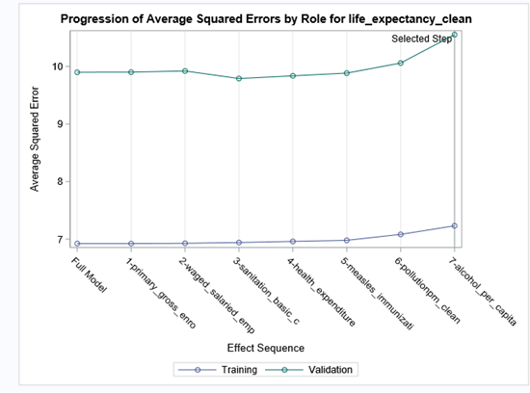
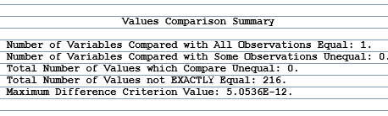
Linearity & Fit Assessment
Checking Outliers & Collinearity
Prediction Scoring
Model Selection
We further score and validate the model externally using dataset from the year 2010.
The plot shows the mean squared error for the test and train datasets.
The value for MSE for test(validation) dataset is very similar so we are not overfitting our dataset by eliminating variables that are statistically significant using backward selection method.

Slide 24
Conclusion and Future Recommendations
Future
Recommendations
Conclusion
Income class based comparison within a country to see if these same factors are prevalent in determining Life Expectancy.
Going forward policy makers can identify the areas of improvement with the help of this analysis to increase the life expectancy.
We have established that there are significant differences in Life expectancy within regions and income groups.
Control of Diseases, vaccination and basic amenities are key to improving Life Expectancy globally.

Slide 25

QUESTIONS?

