Slide 2
13
thirteen

Slide 3
In
Alphabetical
Order
Riccardo Cavasin
Andrea Gasparini
Simone Gregori
Andrea Polese
Thanks to Alvise Bruniera

Slide 4

Presents

Slide 5

Space Invaders 1978

Slide 6


Slide 7


Slide 8
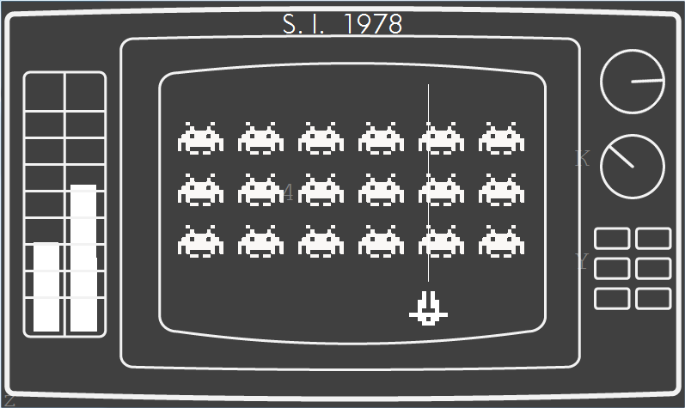
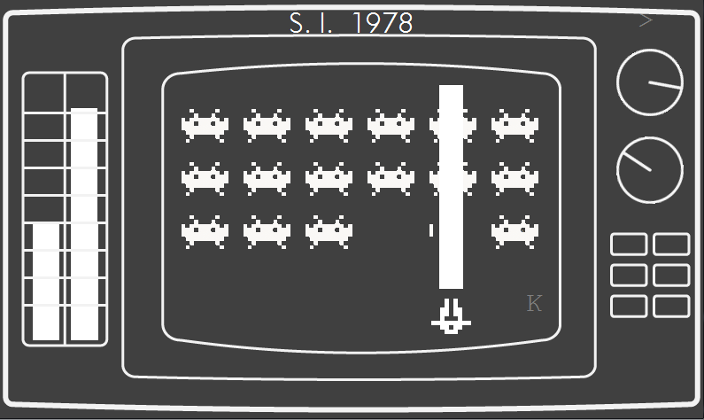
Client Interface

Slide 9
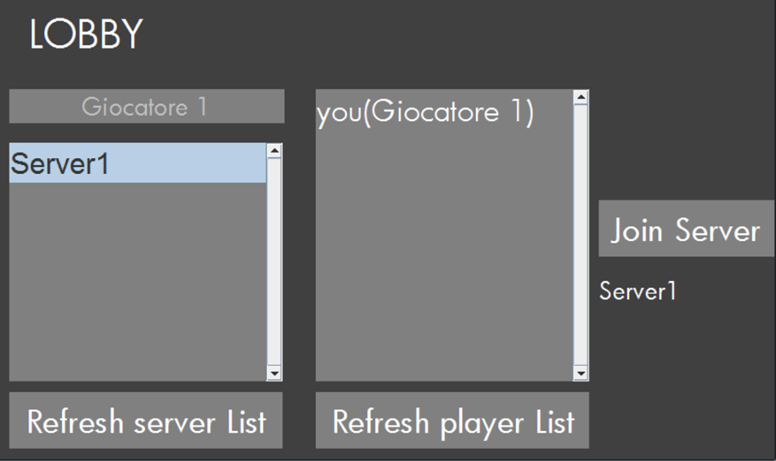
Client Lobby Interface

Slide 10
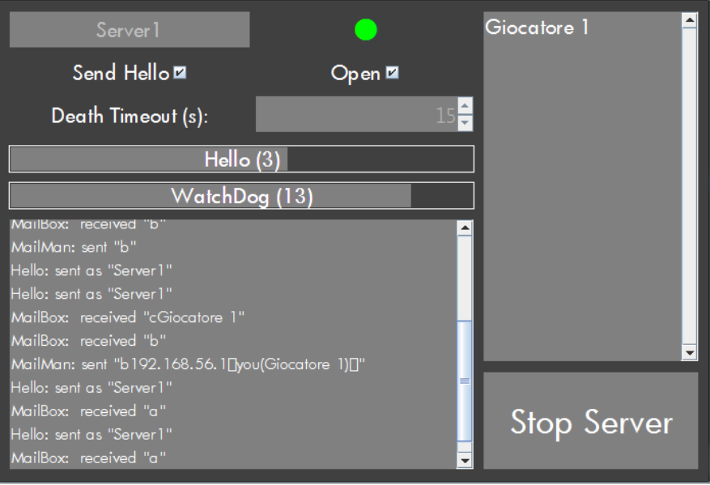
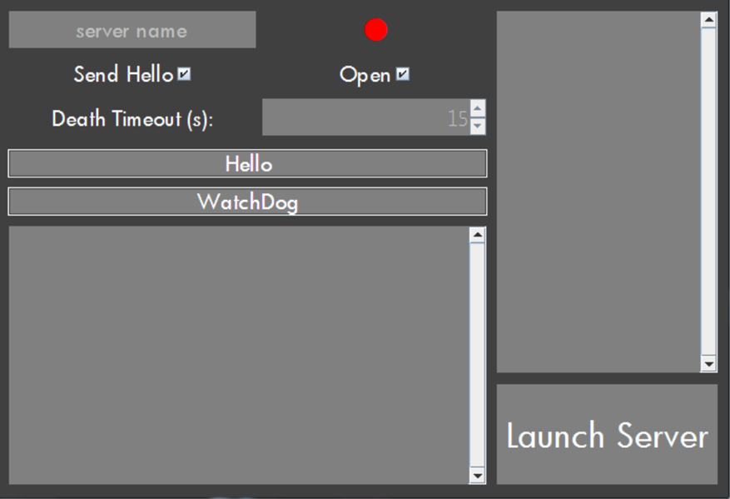
Server Interface

Slide 11
Thank you for your attention
13
thirteen

