Slide 1


DATA SCIENCE CA3 : MINI – PROJECT (PPT) Guided By:- Dr. Piyush Chauhan

Slide 2


A Comprehensive Analysis of Indian Assembly Electoral Dynamics
By:
Name: Himanshu Sayankar PRN: 22070521025

Slide 3
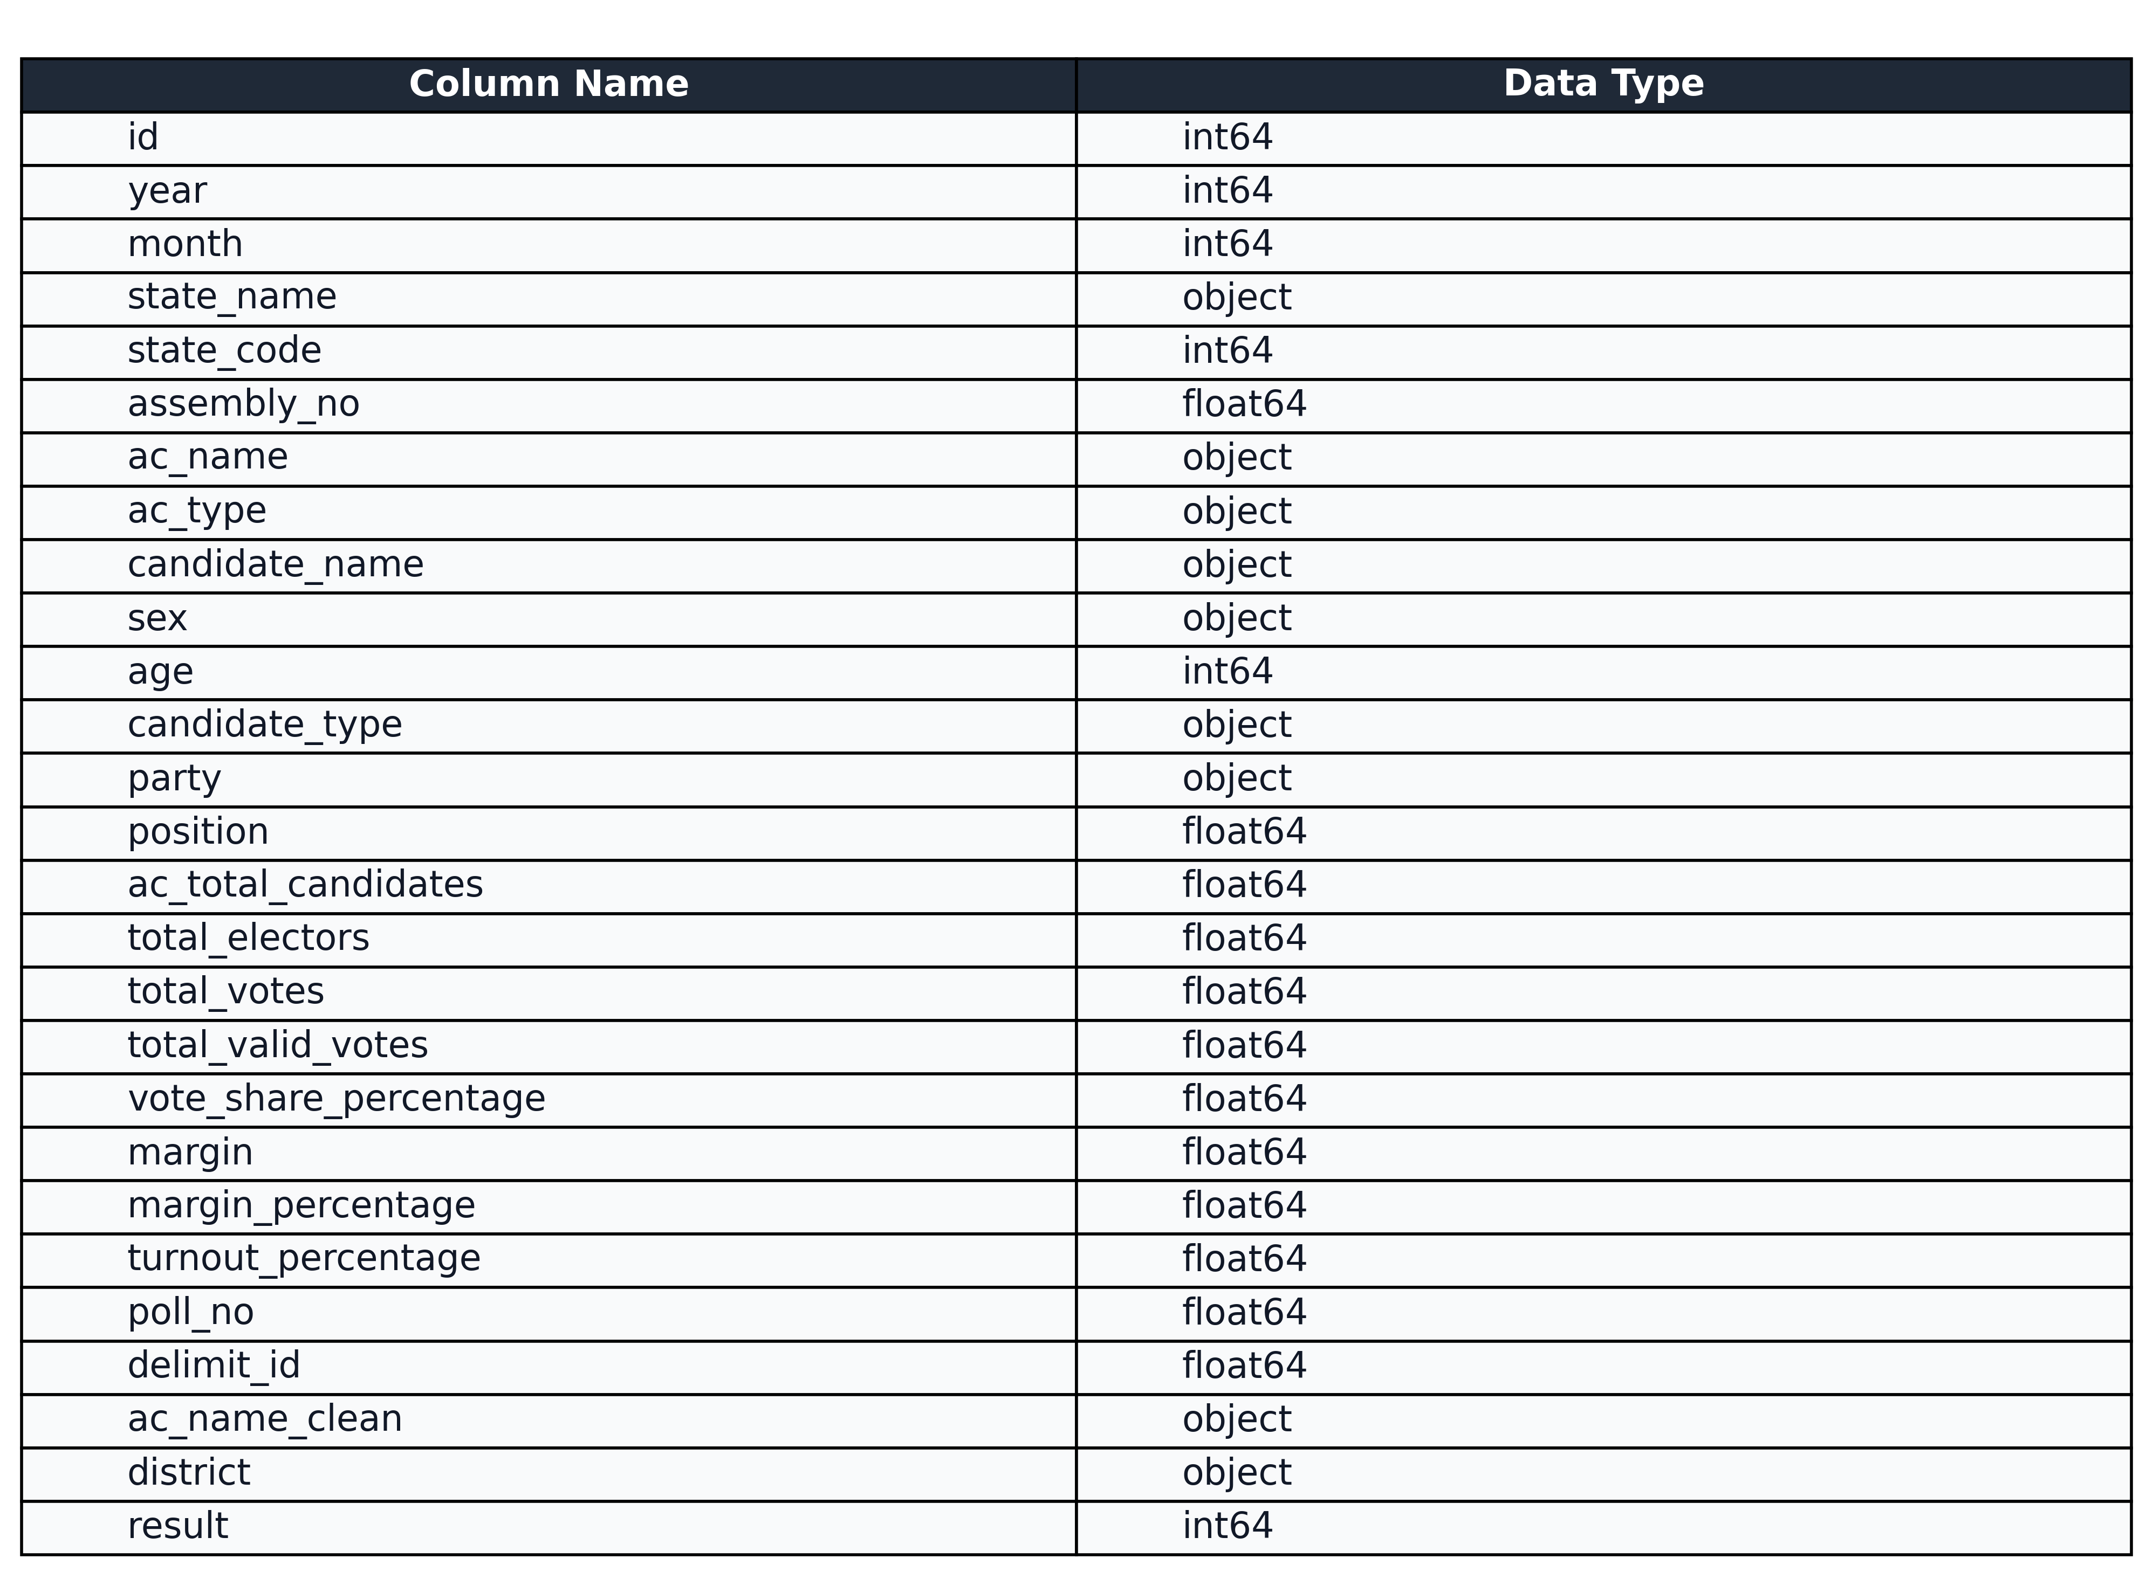
About the Dataset:
Source: India Data Portal (CSV Format)
Rows: 115,854 (This is the final count used for modeling after dropping rows with no outcome)
Columns: 27
Key attributes: year, state_name, party, age, sex, ac_type, candidate_type, total_electors, ac_total_candidates, turnout_percentage, and the target variable result.
Data Type: Contains both numerical (like age, year, total_electors) and categorical (like state_name, party, sex) data.

Slide 4
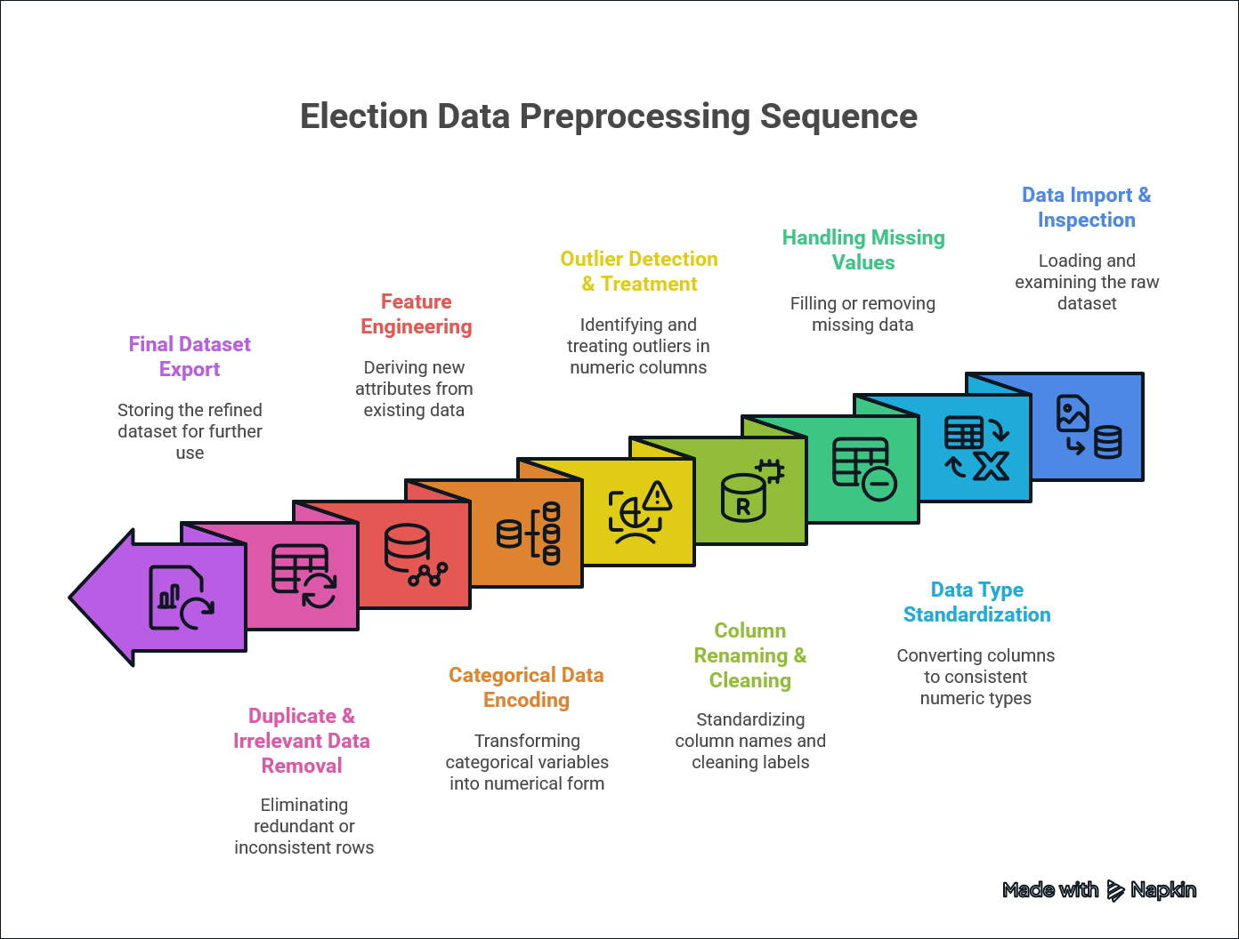
The Data Preprocessing Performed on the Dataset

Slide 5


Univariate Analysis

Slide 6
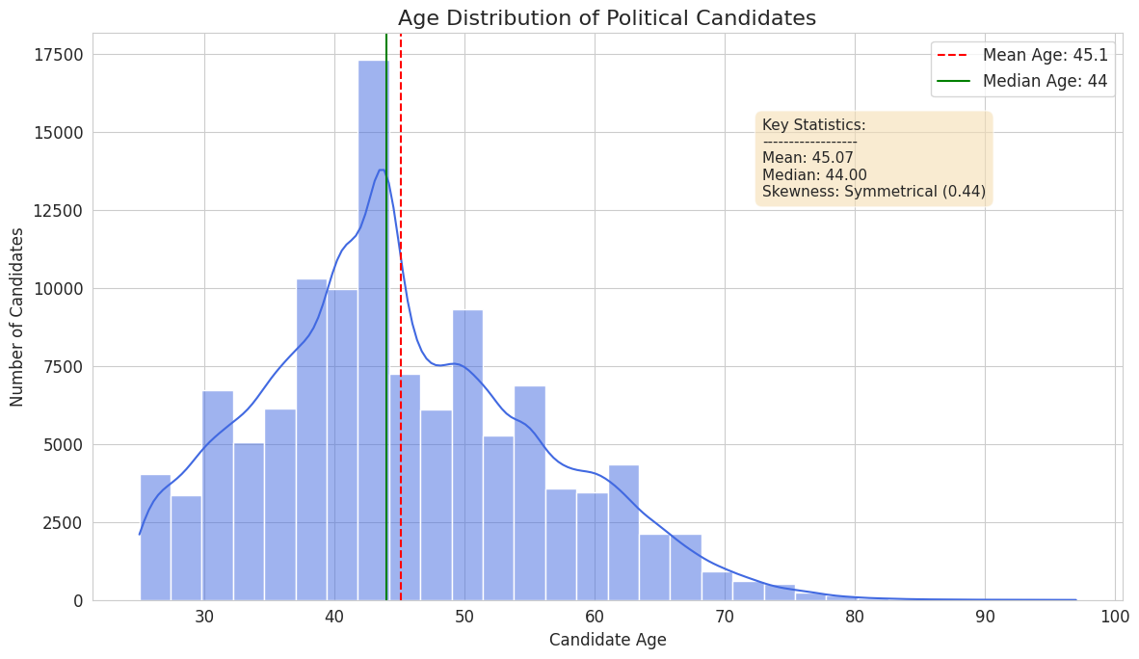
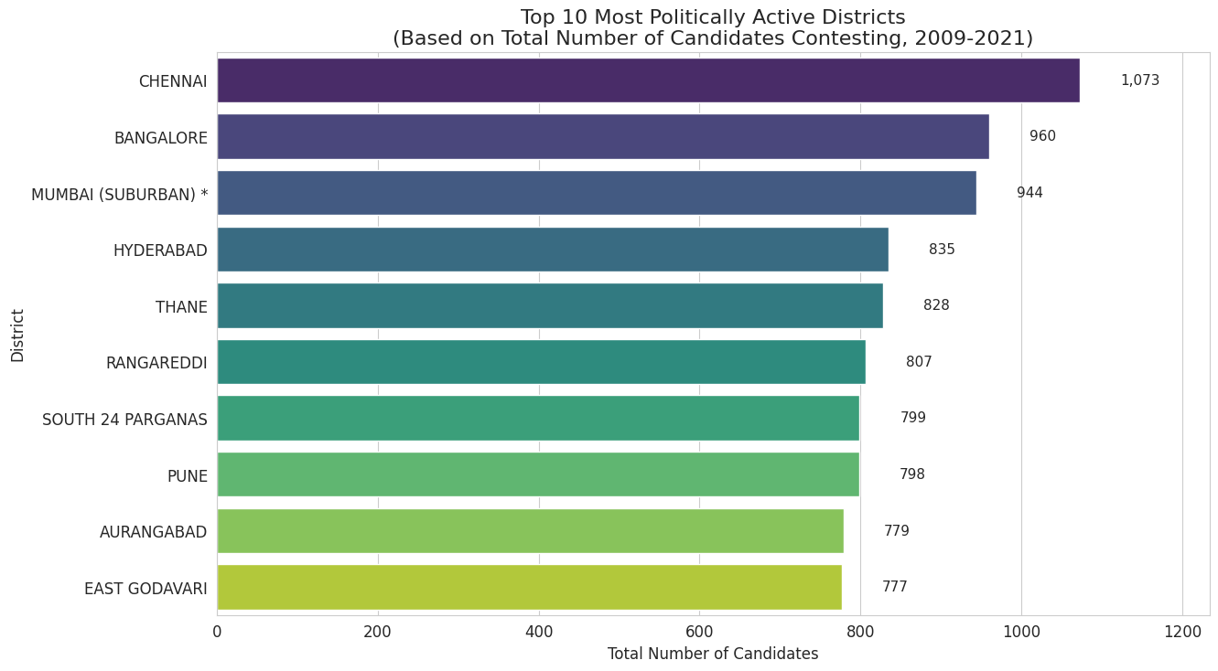
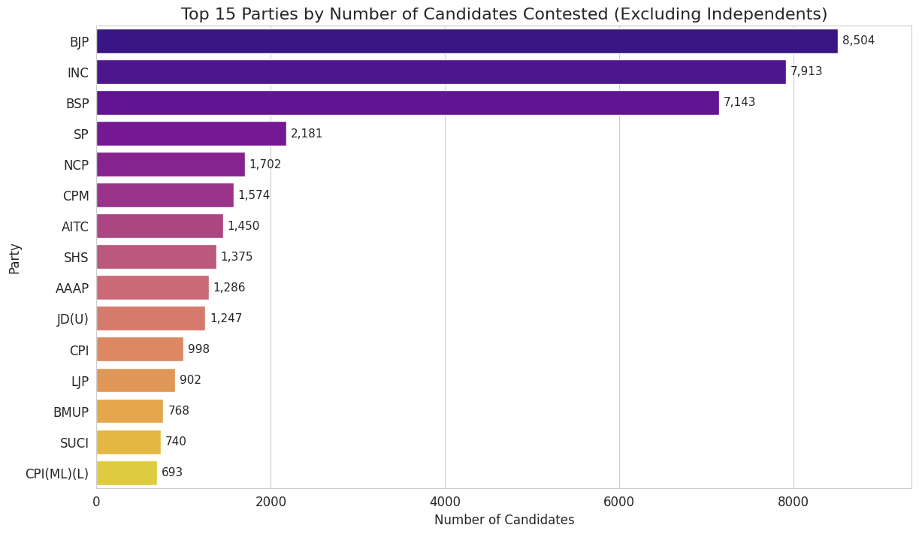
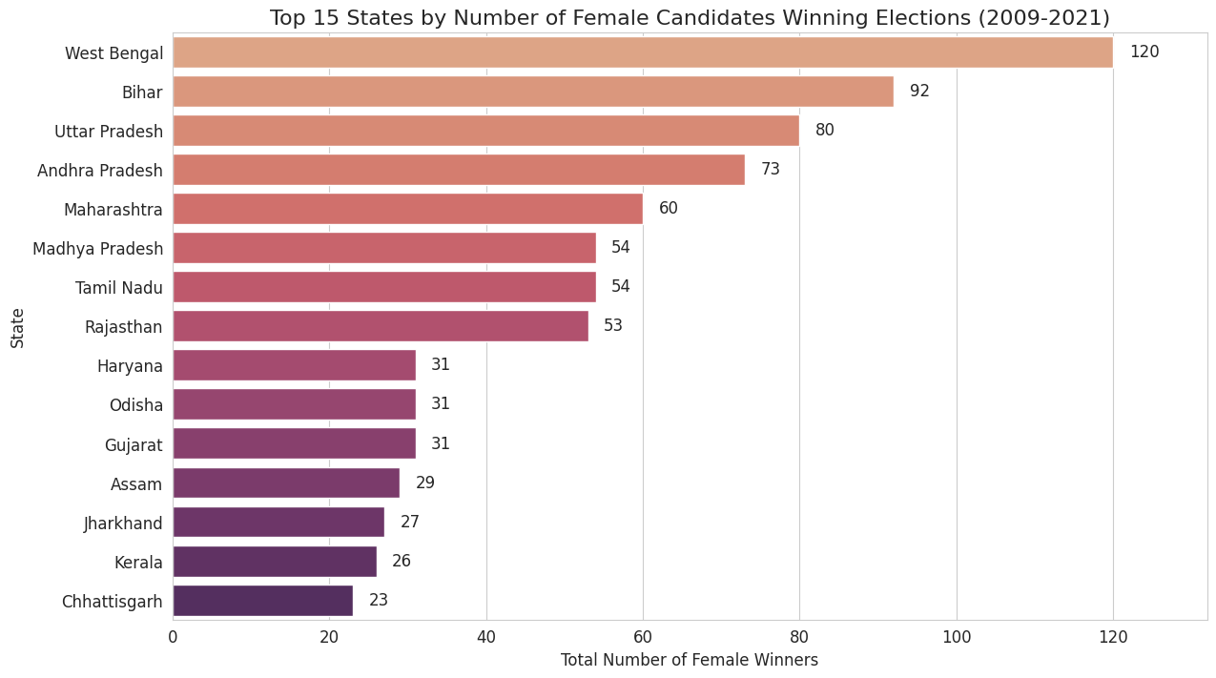

Slide 7
Bivariate Analysis

Slide 8
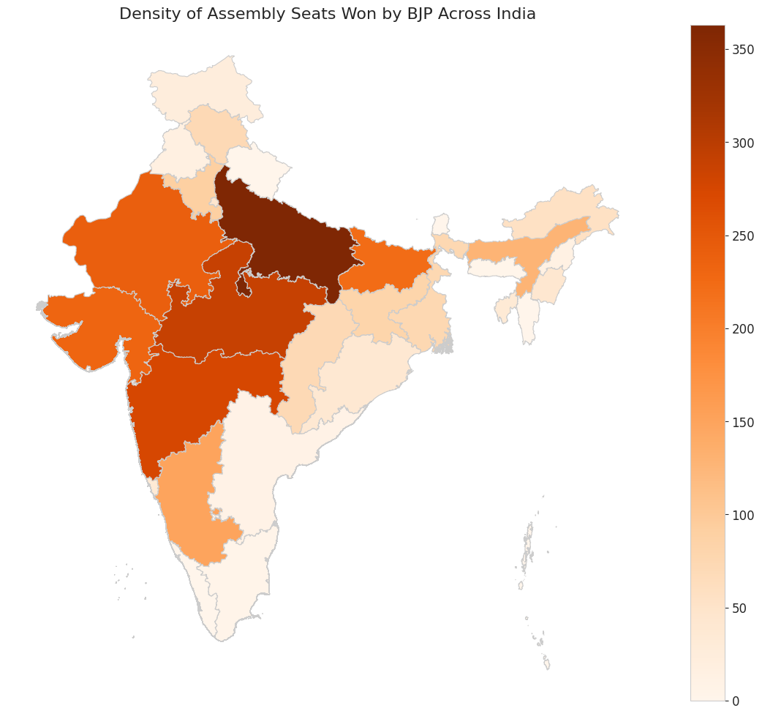
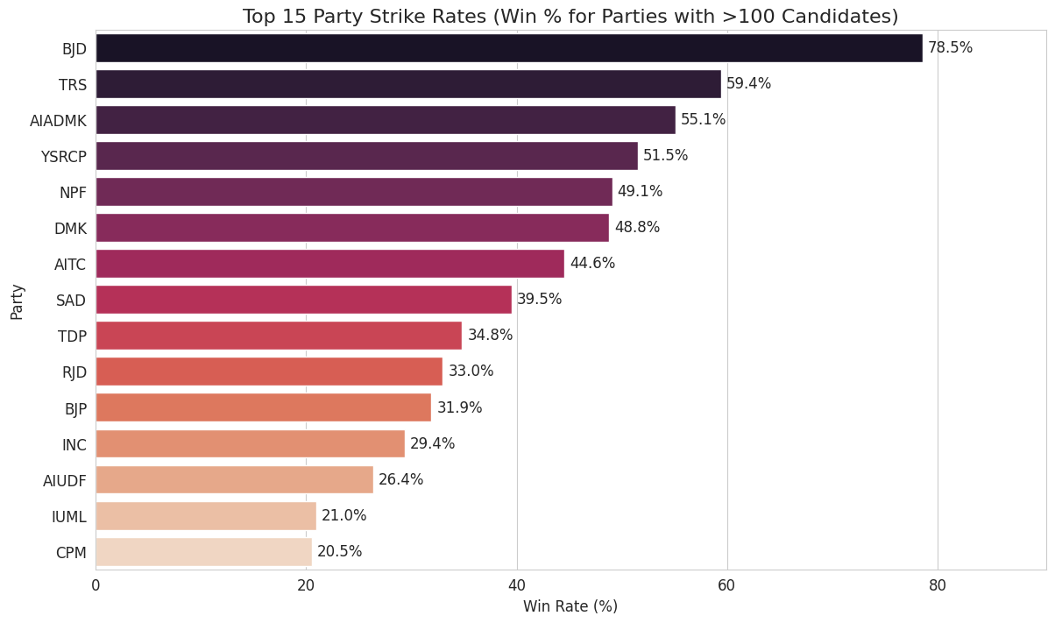
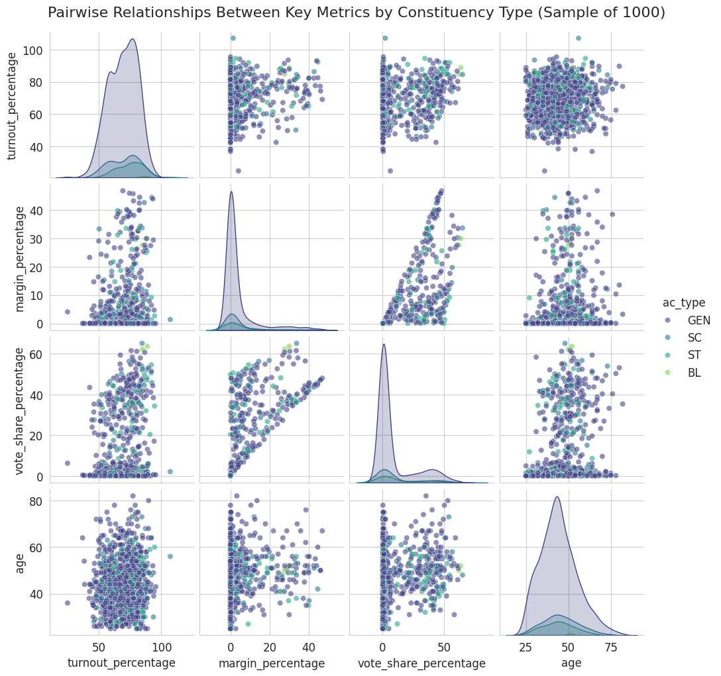
From 2009-2021

Slide 9
Multivariate Analysis

Slide 10
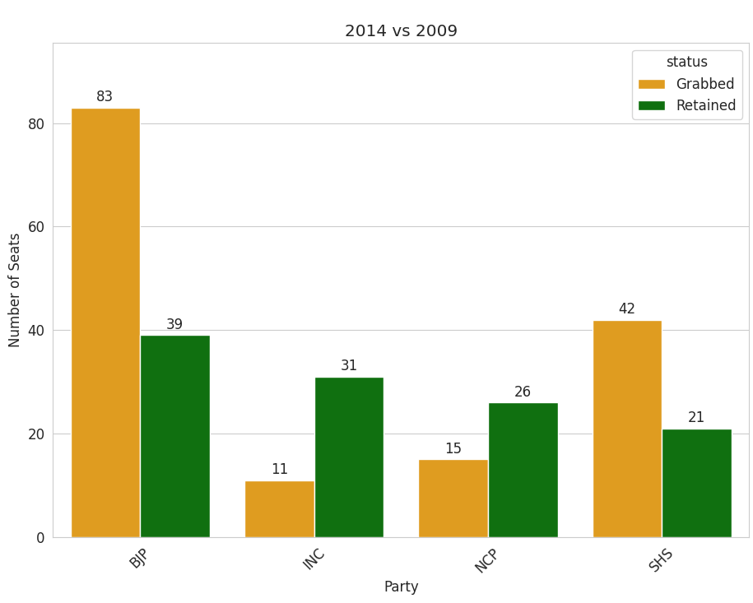
Seat Retention vs. Gains for Top Parties in Maharashtra

Slide 11
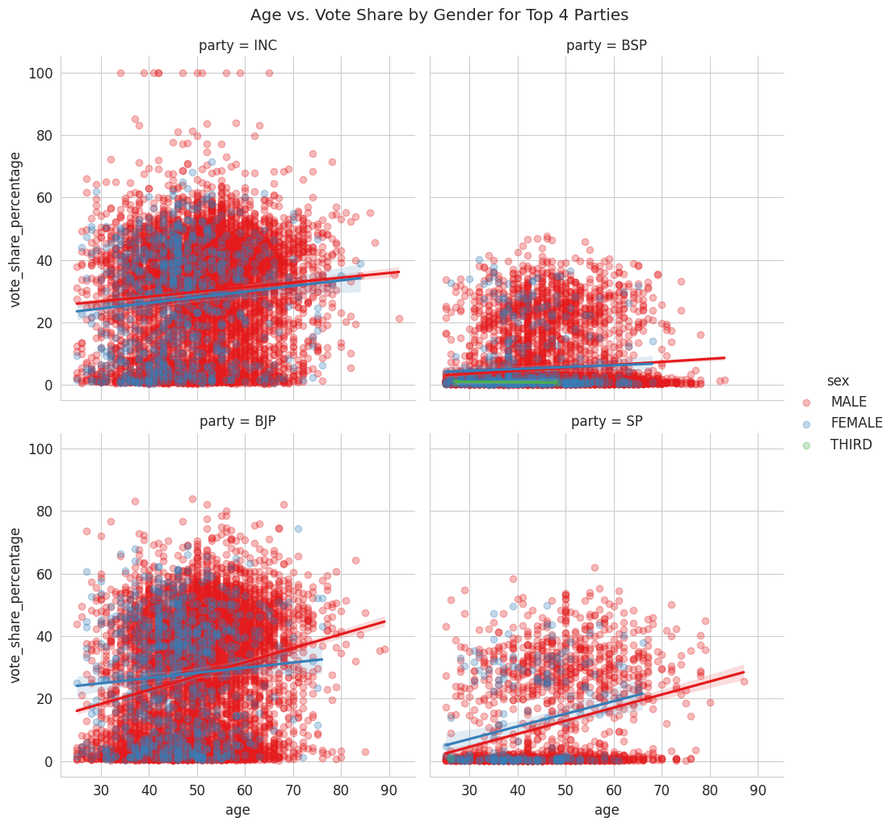
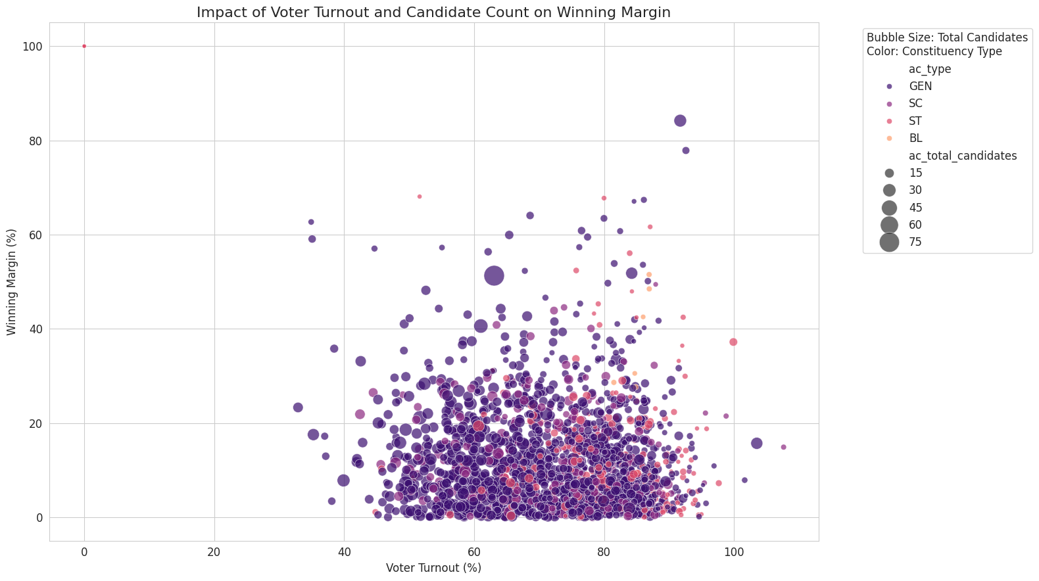

Slide 12
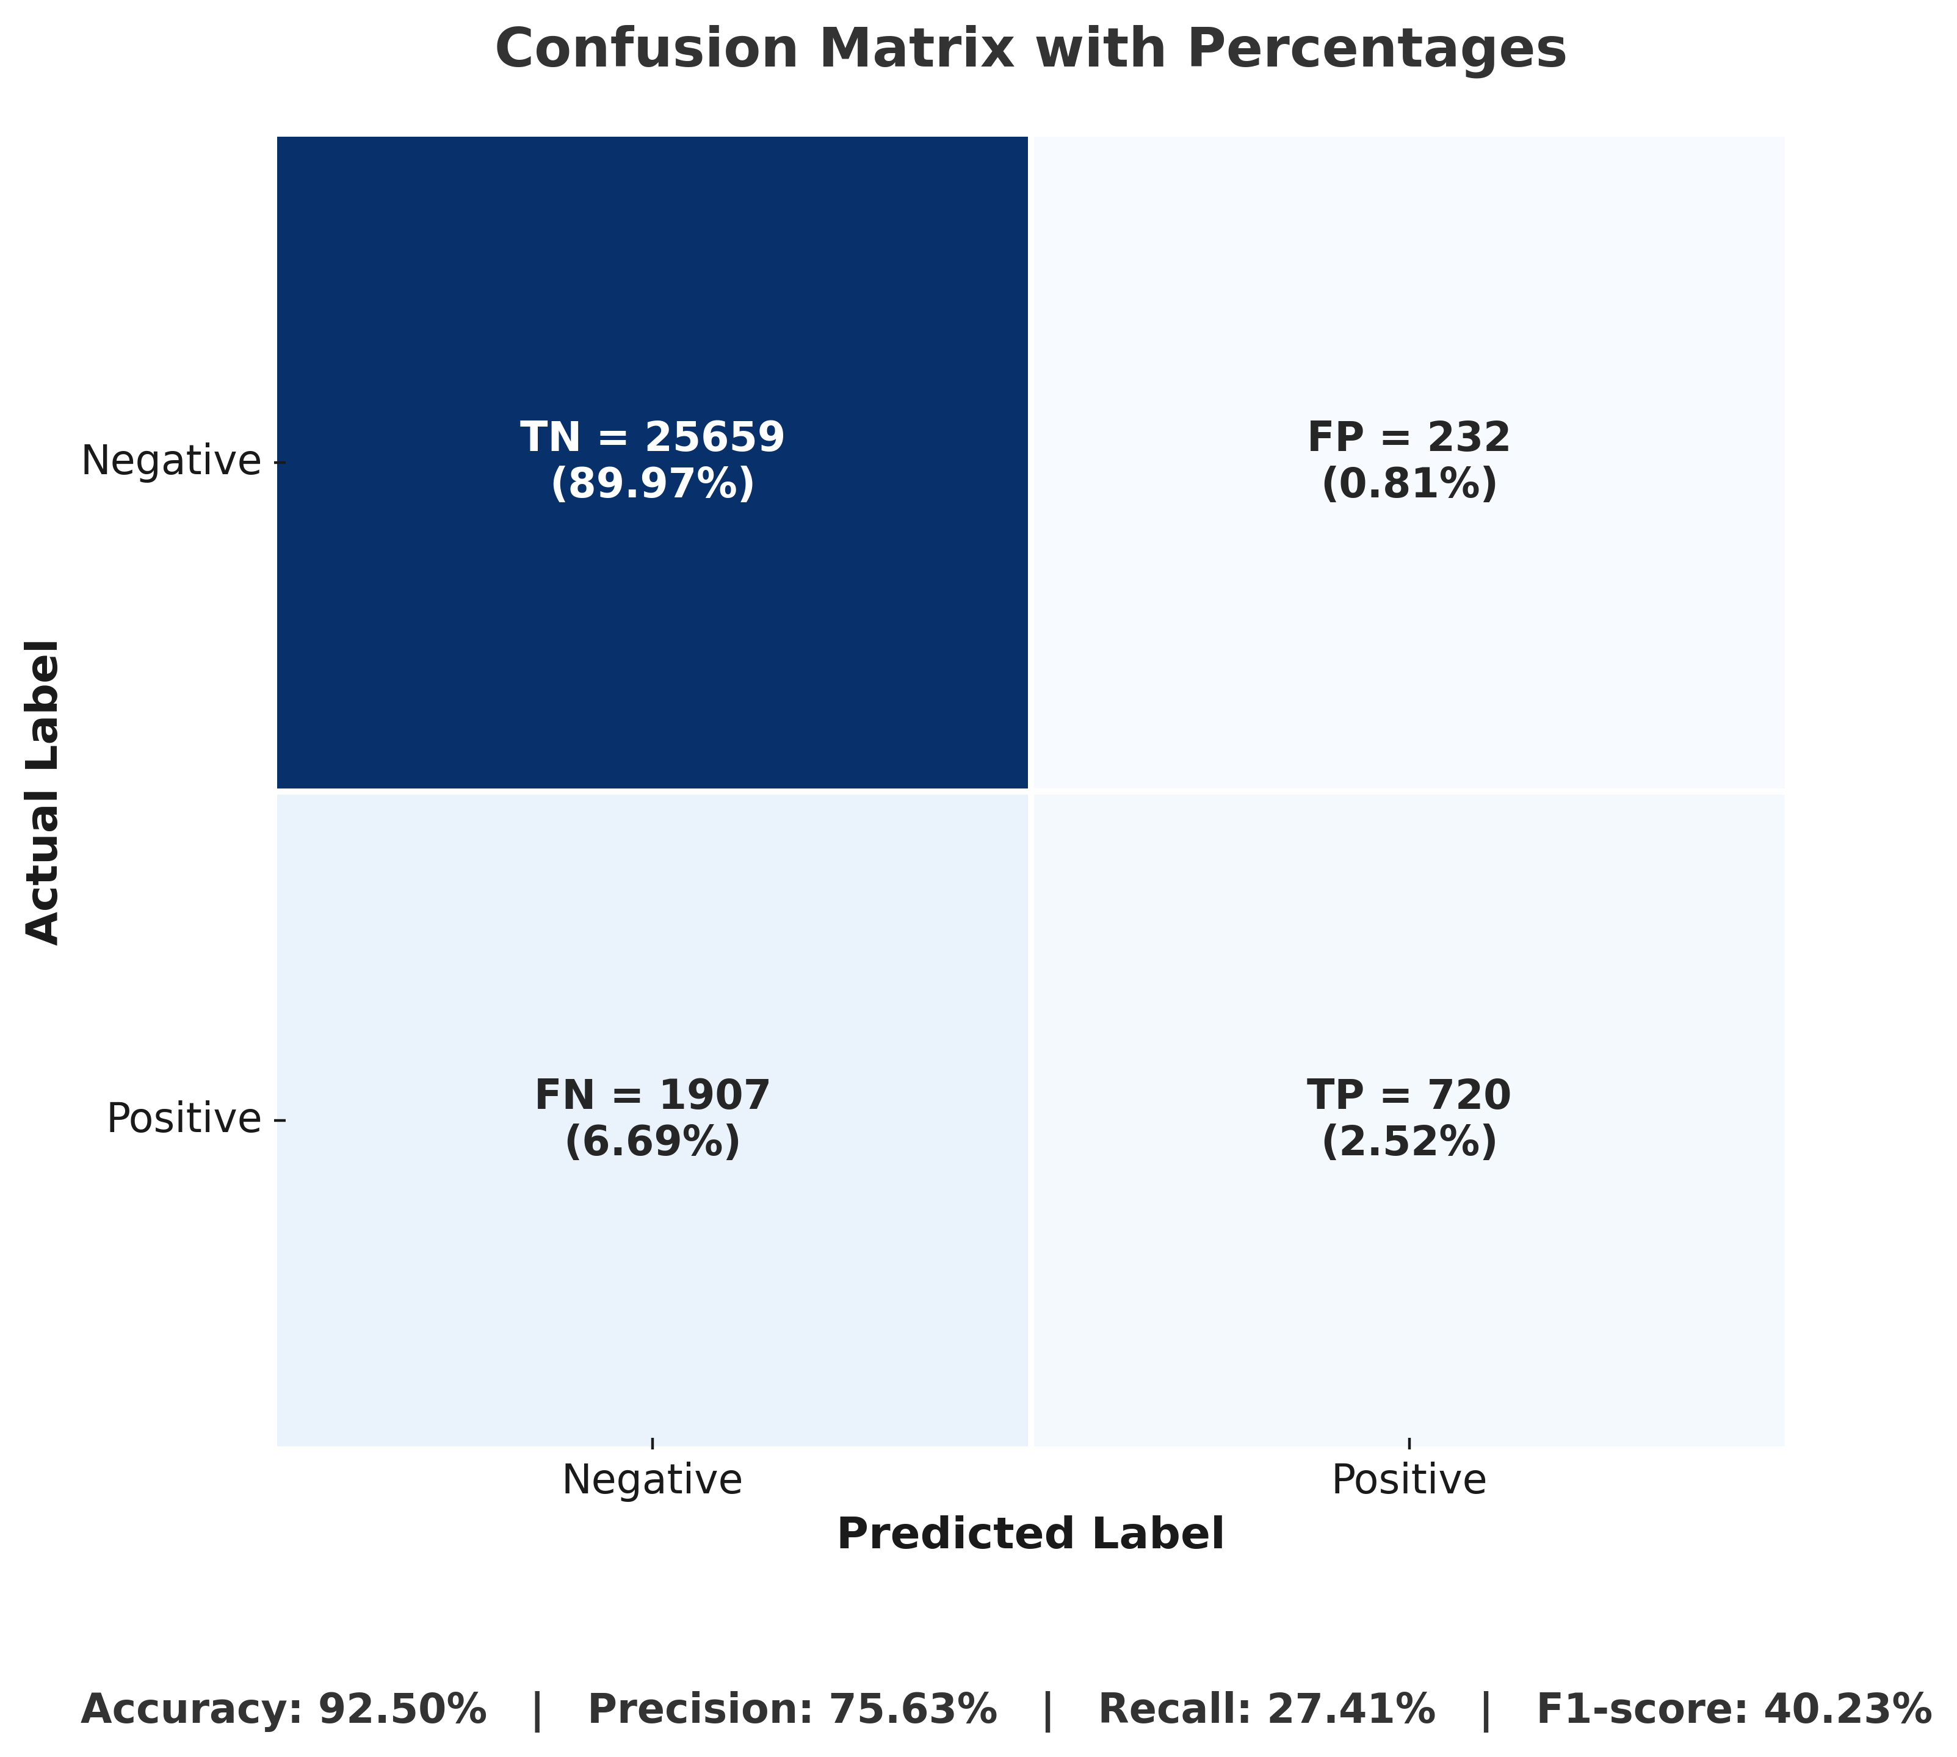
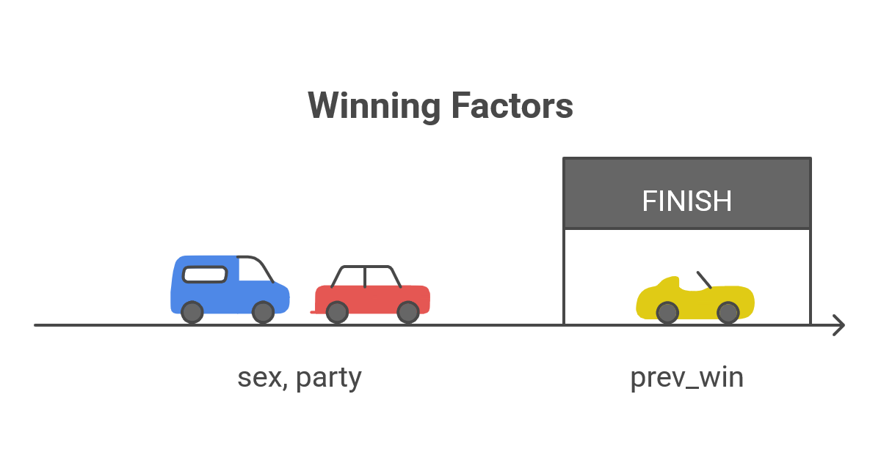
Logistic Regession

Slide 13
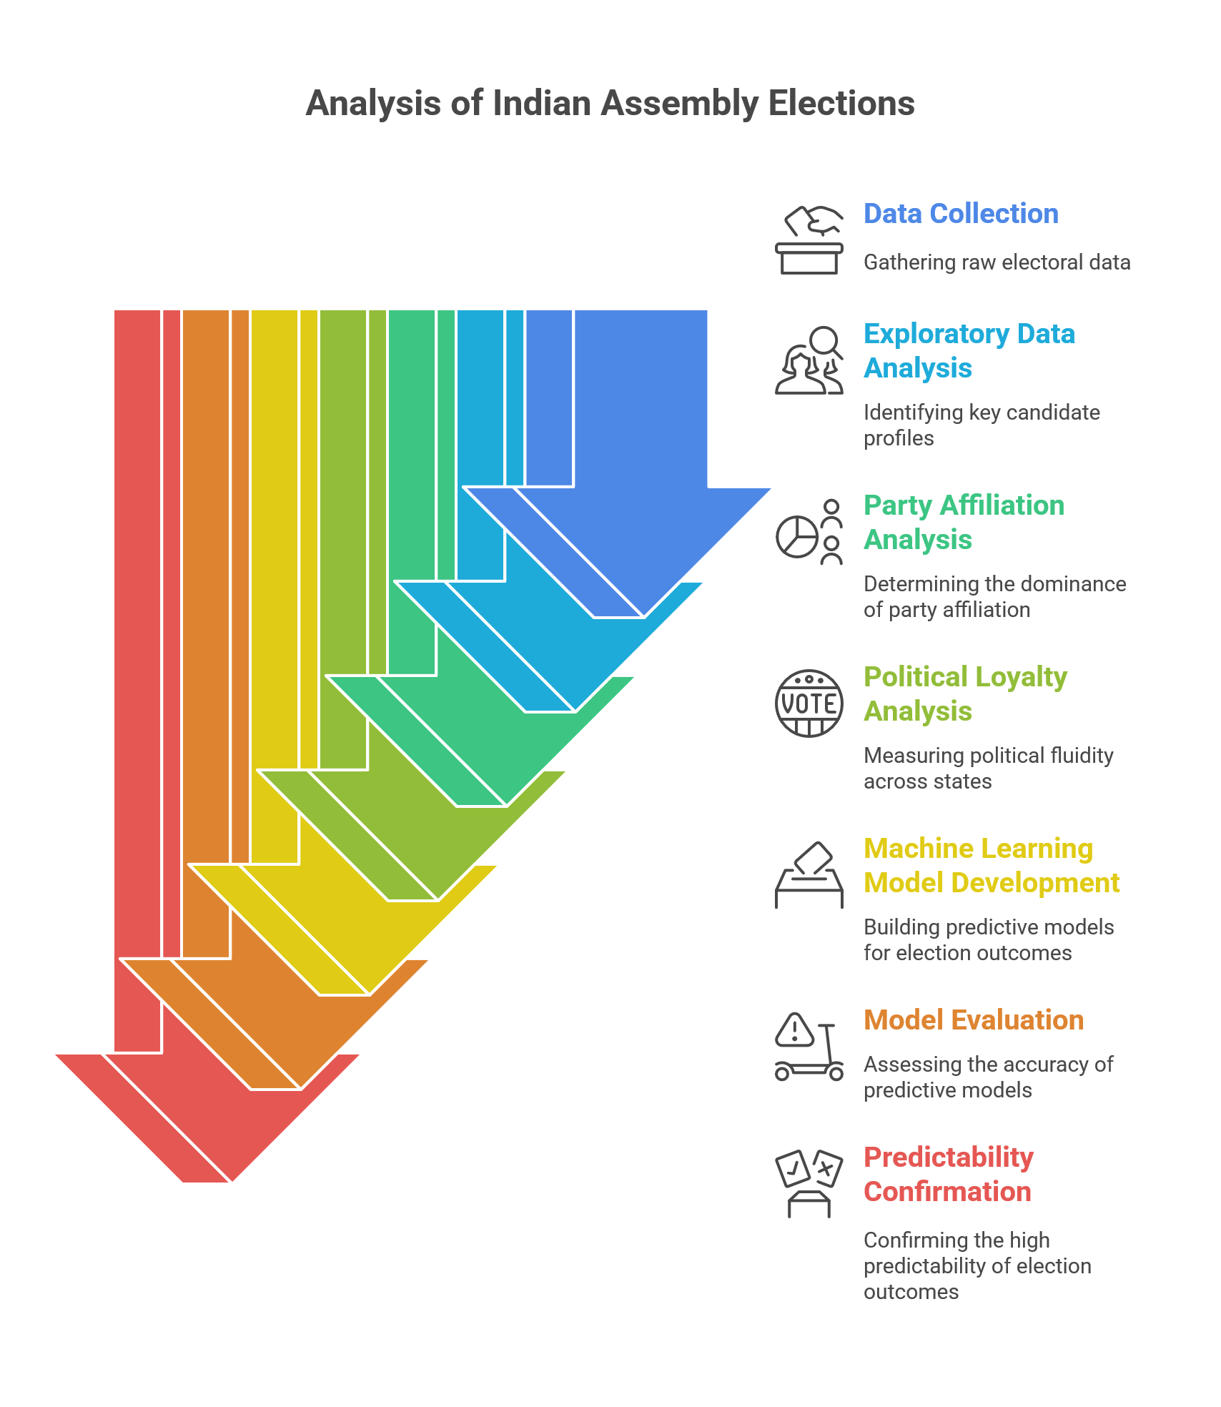

Steps used to perform the analysis

Slide 14


Thank You!
"चुनाव का Analysis ज़रूरी है, क्योंकि आँकड़ों में ही छिपी है असली जीत की कहानी!"

