Slide 1
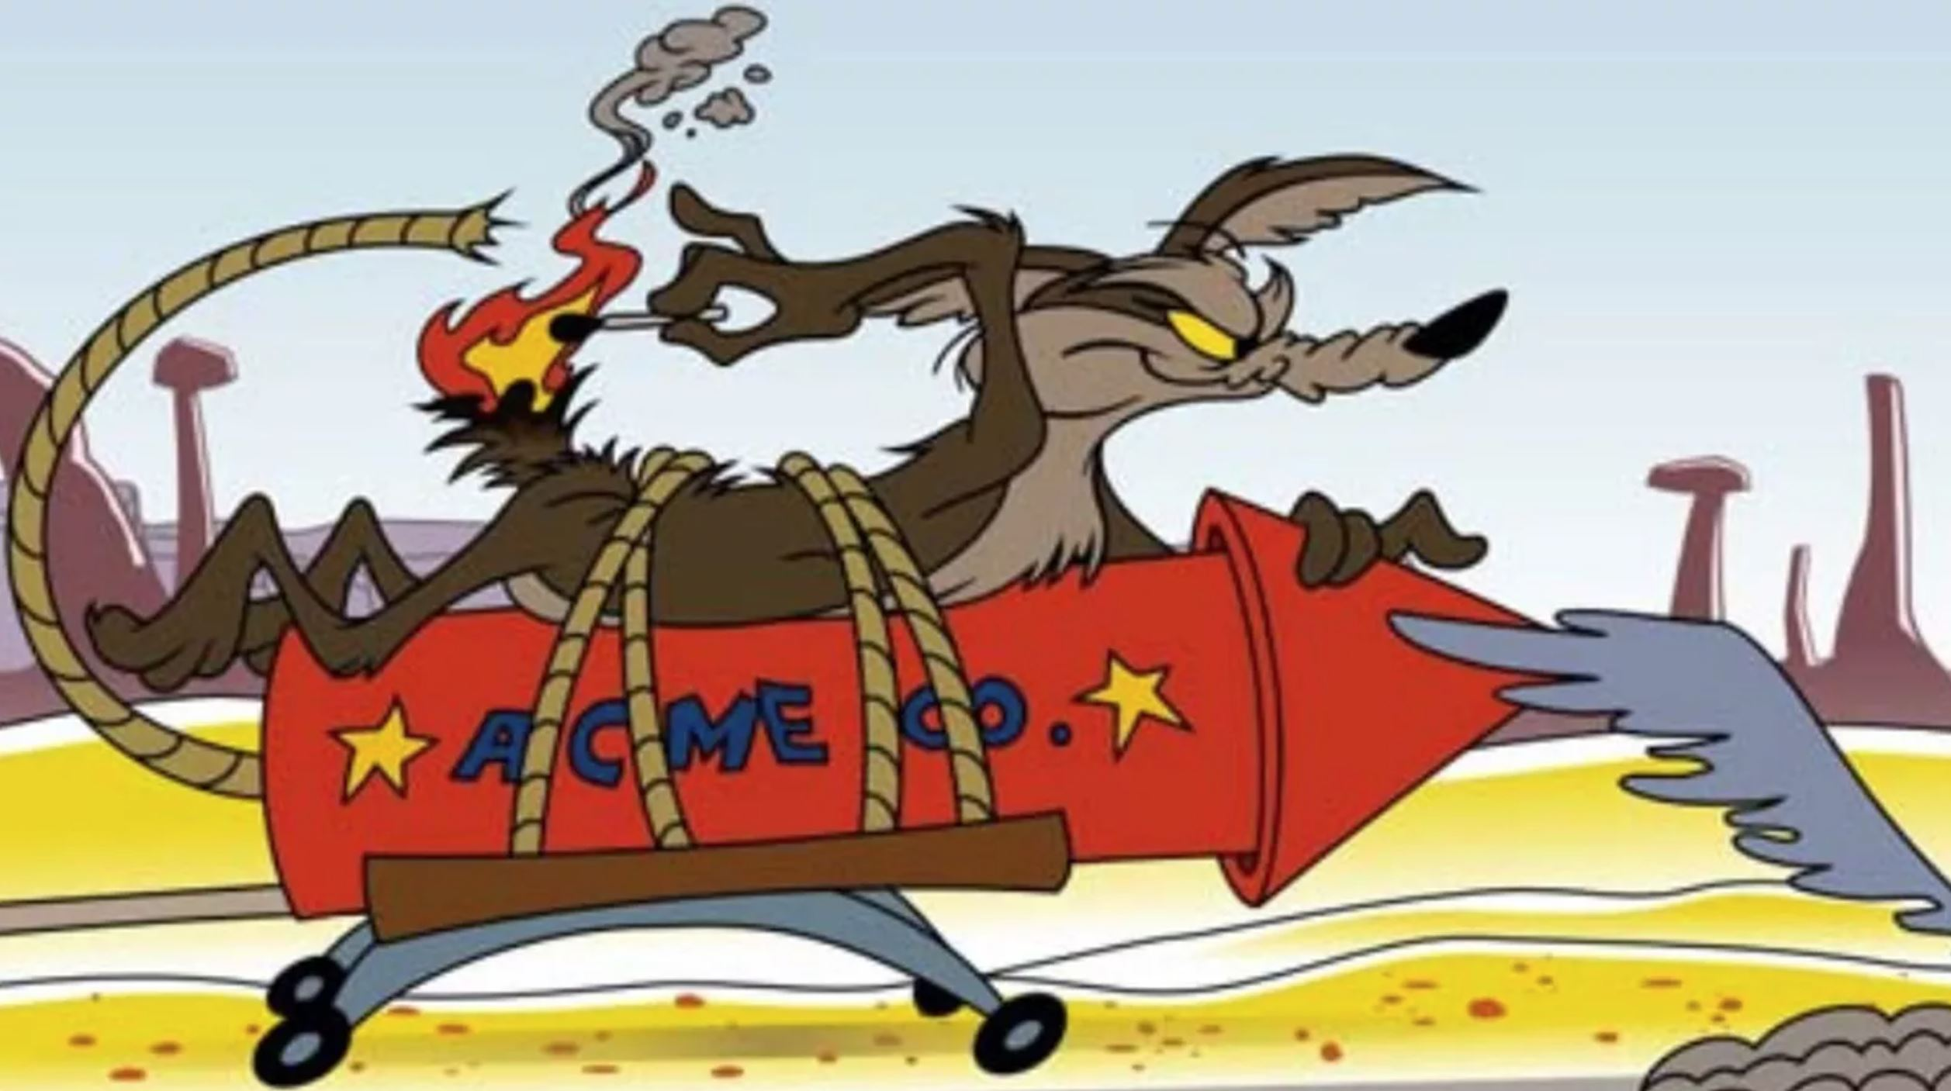
How to detect and handle assumptions
January 2023
Lucidio Kuhn

Slide 2
Agenda
Taxonomy.
Workflow to handle assumptions.
Pre-Mortem.
Assessment spreadsheet.
Why we need to handle assumptions.
Resources.
What are assumptions

Slide 3
Why?
However, around 67% projects fail due to communications.
Assumptions are the base of failed communications.
We want to deliver value to our customers.
So let’s attack the source of most issues.
As engineers, we focus on the technical aspects of our projects.
By bringing assumptions to the surface, we can plan for challenges early on.

Slide 4
What are assumptions?
The issue, with Software Development, are the implicit or hidden nature of assumptions.
It is what I believe it is true.
Not all assumptions are bad. Imagine how traffic would be if we could not assume that most people obey most traffic laws.

Slide 5
Exercises
Team T are the expert in area A. They said they will deliver feature F in 2 months. Should we trust?
I am thinking of a number between 1 and 1000. Which number is it?
What has 7 letters, wheels, and starts with a B?

Slide 6
Workflow to spot and treat assumptions
Map (no thinking yet, just trace):
Plot the User Story, trace it back from the final result to the current situation
Identify all components and data flows between components.
Identify / Brainstorm (for each data flow):
Start with the most common issues listed in the next slide.
Fix:
Create a work item for investigation.
Follow up on the work item.
Communicate to all stakeholders, make sure all understand the assumption.
When assumption is addressed (fixed or mitigated), document the solution.
Perform a Pre-Mortem to find other possible issues.

Slide 7
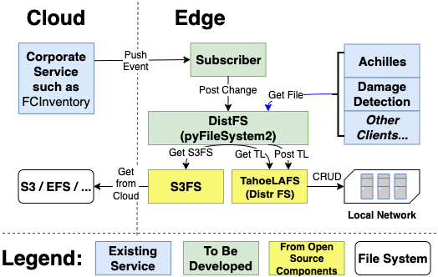
Map the User Story
Components | Q1 | Q2 | Q3 | Q4 | Q5
Corporate Service
Subscriber
DistFS
S3FS
TahoeLAFS
Local Network
Customer Services
Data Flows | q1 | q2 | q3 | q4 | q5
Push Event
Post Change
Get S3FS
Get from Cloud
Get TL
Post TL
CRUD
Get File
Q1..Qn start with next slide on taxonomy, plus what will be uncovered during Pre-Mortem.

Slide 8
Taxonomy by source
 | Source | Such as | Mitigation
Gen | Optimism | Oh, this is soooo easy to do! | Planning poker, follow up, popcorn.
Gen | Wrong understanding of customer needs | . . . | Validation with customer, BDD
Gen | Previous Knowledge | This works on TensorFlow, so it will work on PyTorch | Red-Flag and communicate previous knowledge.
Gen | Long Dives | Spending weeks investigating without follow-up. | Constant contact, pomodoro, rules.
Gen | Just Code vs Whole Cycle | Estimates that consider only code effort. | Rules, buffering estimates, team maturity.
Gen | Believing in Promises / Docs | Taking promises (including documentation) at face value. | Prototype, test, keep testing.
Gen | Unclear ownership | Hey, I thought you would do that! | Assign clear ownership, grooming.
Tech | We know concept XXX by DDD | We master Soteria Damage Detection by 22/10/15 | Spikes, prototypes, training, tech-talks.
Tech | We know underlying tech ZZZ | We master ReactJS before starting the project. | Early assessment, training, tech-talks.
Tech | It works on my machine… | So it should work on the production environment. | Allocate time, realistic test environments.
Cross | Different Terminologies | Teams employs the same words with different meanings. | Cross team glossary, BDD.
Cross | Different Priorities / Schedule | Expecting that another team will have the same priorities. | Open disclosure, formal agreement, follow up.
Cross | Different Maturity Levels / Distorted Vision | Bad if teams are unaware of their capabilities or lack of. | Open disclosure.
Cross | Different SLC / DoD | Team considers a project done when coding is starting. | Formal agreement, follow up.
Cross | Believing in Continuity | Reorgs, layoffs, key people moving. | Constant contact, documentation.
Other | Other Assumptions |  | Pre-Mortem

Slide 9
Assumption assessment spreadsheet
One per Epic.

Slide 10
Pre-Mortem
Free-form
Dynamic
Simple
Fun!
Impact
Tech Possibly Needed:
ReactJS
SageMaker
Large DynamoDB
SLT Priority Changes
No buy-in from group XYZ
Concepts Needed:
Another pandemic.
Fragility
Active Learning
Procurement Fails
Library ABC does not work.
Partner Teams:
Team #1
Team #2
Some other issue…
Probability

Slide 11
Resources
https://sloanreview.mit.edu/article/how-to-test-your-assumptions/
https://www.csus.edu/indiv/d/dowdenb/60/implicit-assumptions.html
http://web.cs.wpi.edu/~dcb/Papers/DCC06-DR-wkshp.pdf
https://resources.sei.cmu.edu/library/asset-view.cfm?assetid=6941
https://resources.sei.cmu.edu/asset_files/TechnicalNote/2004_004_001_14327.pdf
Creating risk management strategies based on uncertain assumptions and aspects from assumption-based planning
Evaluation of a process for architectural assumption management in software development
Integrating Agile Practices into Architectural Assumption Management: An Industrial Survey
Product Manager view on Practical Assumption Management Lifecycle about System Use
Assumptions and their management in software development: A systematic mapping study
Review and Challenges of Assumptions in Software Development
Managing assumptions during agile development
How to Use Retrograde Analysis to Solve Problems

