Slide 1
Design Patterns
The 5 important ones.
Plus some “free” patterns that comes with C#
And interesting patterns for continuing studies.
LucidioK

Slide 2
Agenda
This is a QUICK introduction to Design Patterns.
Therefore it is in no way comprehensive nor “by the book”
First we’ll What and Why.
Basic Tenets.
Creational Patterns.
Structural Patterns.
Behavioral Patterns.

Slide 3
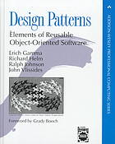
What are design factors?
Recurring solutions to common problems in software design: many are so obvious that you have already seen them all over!
Gang of Four (GoF): Erich Gamma, Richard Helm, Ralph Johnson and John Vlissides.
Best book: Design Patterns Explained: A New Perspective on Object-Oriented Design by Allan Shalloway.
23 classic software design patterns.
Many other defined later, such as Distributed Design Patterns, Interaction Design Patterns, Enterprise DP...
There are also Anti-Patterns: typical patterns to avoid such as “Big Ball of Mud”, “Not Invented Here” and others.

Slide 4
Why Design Patterns?
Common vocabulary;
Higher level of abstraction;
Language independent;
Best practices, just get the code!
Goes hand in hand with Commonality Variability Analysis;
Easy to refactor and maintain;
Skeleton == Design Pattern, Meat == Business Logic.

Slide 5
Basic Tenets
Program to an interface, not an implementation.
Favor class composition over class inheritance.
Design for change.
Loose coupling
Use interface
Composition

Slide 6
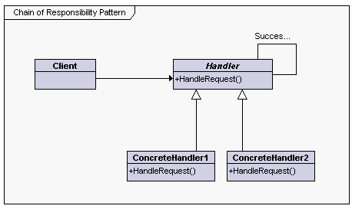
Class Factory / Create Method
class WIMExtractor : IWIMExtractor
{
public static IWIMExtractor Create()
{
WIMExtractor extractor = null;
try
{
extractor = new WIMExtractor();
extractor.WimInit();
}
catch (Exception e)
{
Utils.AddFailure(e);
extractor = null;
}
return extractor;
}
. . .
Use them to create objects that implement same interface or derive from same class.
Create Method: typical for when one class implements one interface:
Class Factory: whenever there are decisions to create the proper object:
class RegistryGetterFactory
{
public RegistryGetterFactory() { }
public SingleRegistryGetter Create(String partition, String key)
{
SingleRegistryGetter item = null;
if (partition == "MainOS" && key == "HKLM")
item = (SingleRegistryGetter)new OnlineGetter(regObject);
else if (partition == "MainOS" && key == "HKCU")
item = (SingleRegistryGetter)new HKCUGetter(regObject);
else if (Common.CurrentPartition == "UpdateOS")
item = (SingleRegistryGetter)new UpdateOSGetter(regObject);
return item;
}
}

Slide 7
Structural Patterns
Adapter
Proxy

Slide 8
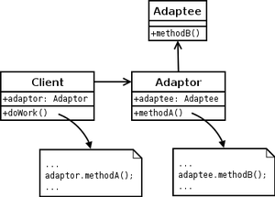
Adapter
public interface IOfflineRegistry
{
UInt32 OpenHive(String hivePath, out IntPtr hiveHandle);
UInt32 OpenKey(String subKeyName, out IntPtr keyHandle);
UInt32 GetValue(String valueName, string subKey, out Object value, out String type);
. . .
}
internal static class OfflineRegNativeMethods
{
[DllImport("Offreg.dll", SetLastError = true, . . .
CharSet = CharSet.Unicode)]
public static extern int OROpenHive(
. . .
public class OfflineRegistryAdapter : IDisposable, IOfflineRegistry
{
public uint GetValue(string valueName, string subKey, out object value, out string type)
{
uint hr = Common.S_OK;
try
{
if (!OffRegGetValue(valueName, subKey, out value, out type))
{
hr = Common.E_UNEXPECTED;
}
}
catch (Exception ex){ . . . }
return hr;
}
public IntPtr OpenKey(string subKeyName)
{
. . .
}
A.k.a. Wrapper: translate one interface into another.

Slide 9
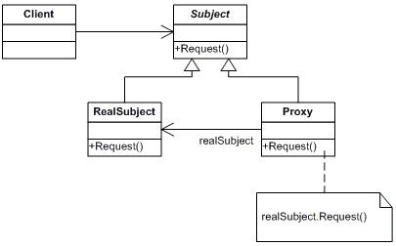
Proxy
A class functioning as an interface to something else.
Also used for delayed loading.
Interesting to create mock-ups:
Suppose we need to test a component that receives requests and send responses, but it is not ready yet.
Create a mock component, with the same request interface and start developing immediately.
When component is ready for testing, the proxy should target to the real component.
Keep the mock component! This way we can switch between “real” and “mock” at run time and see if the problem is at the test code or the component.

Slide 10
Behavioral Patterns
Chain of Responsibility;
Strategy;

Slide 11
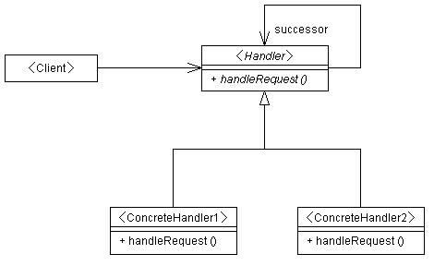
Chain of Responsibility
interface IVerifStrategy()
{
bool Verify();
}
public class VerifCOR
{
private List<IVerifStrategy> Strategies = new List<IVerifStrategy>();
private PopulateList()
{
Strategies.Add(new BasicVerifications());
Strategies.Add(new DSMVerifications());
Strategies.Add(new SomeOtherVerification());
}
public bool Execute()
{
bool succeeded = true;
foreach (IVerifStrategy strat in Strategies)
{
if (!strat.Execute())
{
succeeded = false;
break;
}
}
return succeeded;
}
Executes a list of commands or Strategies.
New items can be added to the list as needed.

Slide 12
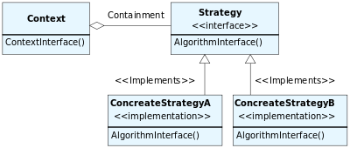
Strategy
An algorithm that can be selected at run time.
public interface IHasher
{
byte[] Hash(byte[] input);
}
public class MD5Hasher : IHasher
{
public byte[] Hash(byte[] input)
{
MD5 hasher = MD5.Create();
return hasher.ComputeHash(input);
}
}
public class StoopeedHasher : IHasher
{
public byte[] Hash(byte[] input)
{
byte[] output = new byte[1];
foreach (byte b in input) output[0] ^= b;
return output;
}
}
public class TestHash
{
public byte[] Hash(string input, IHasher hasher)
{
return hasher.Hash(Encoding.Default.GetBytes(input));
}
public void Test()
{
byte[] hmd5 = Hash("abcd", new MD5Hasher());
byte[] hstp = Hash("abcd", new StoopeedHasher());
}
}

Slide 13
If we have time:
Design patterns that come “for free” with C#
Iterator
Template
Interesting patterns for future learning
Observer
Visitor
Composite

Slide 14
Design patterns that come “for free” with C#
Iterator
Template

Slide 15
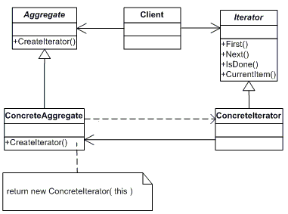
Iterator
Iterator is used to traverse a container and access the container's elements
In C#: implement IEnumerable interface. List<T> implements it.
The foreach statement requires Ienumerable.
public uint GetFileEntries(out IEnumerable<IDSMFileEntryData> fileEntries)
{
. . .
}
. . .
IEnumerable<IDSMFileEntryData> fileEntries;
Dsm.GetFileEntries(out fileEntries);
foreach (IDSMFileEntryData fileEntry in fileEntries)

Slide 16
Interesting Pattern for Future Learning
Observer
Visitor
Composite

Slide 17
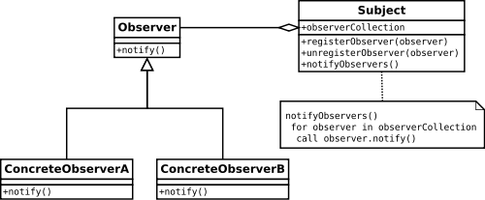
Observer (or Publish/Subscribe)
An Observer subscribes to and then is notified of events that happen in another object.
It is a way to inject code that inspect data as an algorithm is being executed.

Slide 18
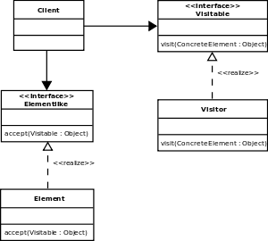
Visitor
Separating an algorithm from an object structure on which it operates.
Example: MSCRM Resource Scheduling.

Slide 19
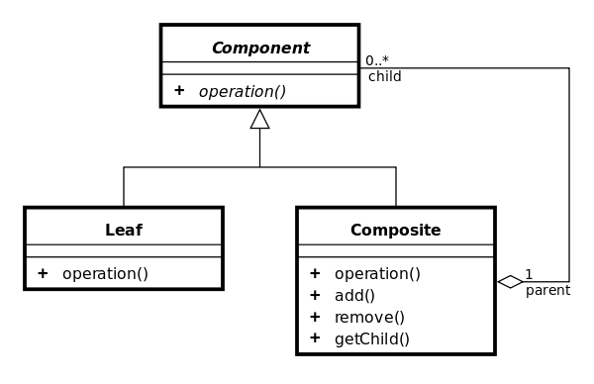
Composite
Compose objects into tree structures.
Typical example: XmlNode.

