Slide 1
Ideas for the final task and the formative assessment

Slide 2
Logbook of a life
Look at the person as a whole and how we generate informations
Or look at a whole family on the same data with their profiles
Collect different personal data for a period of time
Migraines, weight, mood, food intake, temperature, number of step…
Internet data

Slide 3
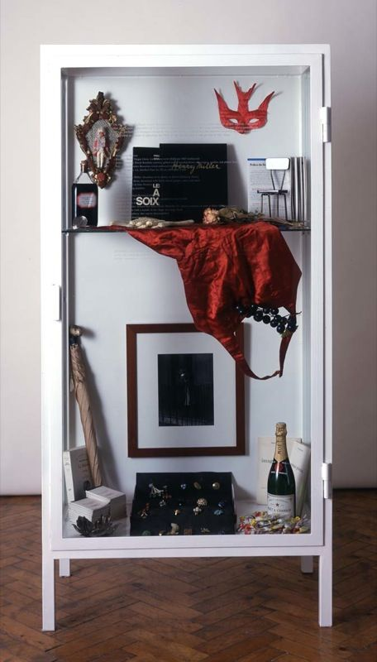
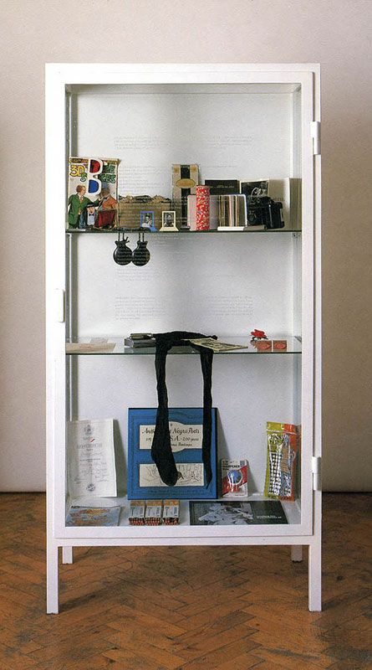
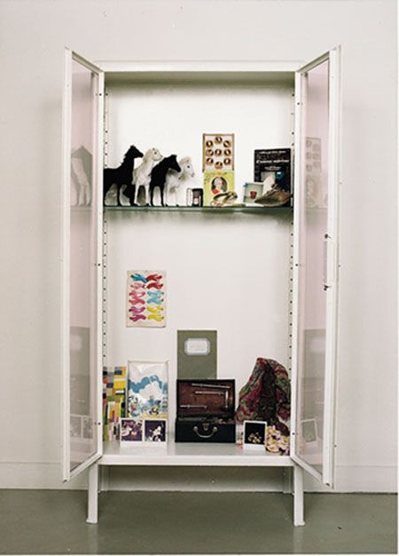
Le rituel d’anniverssaire – Sophie Calle

Slide 4
Possible presentation
Comparison of 2 data collected

Slide 5
Formative assessment
Take 3 data source over 3 days, analyse it and synthetize it in a straight forward graph using D3.

Slide 6
Other Ideas
The two dancing robots : 2 Arduino projects with each of them senser will react to each other ‘physical’ capabilities (ex : one with a light another with a light sensor, the light flickers, the other one react to it). It create a dance. At the end the movement of both is collected and it create a randomize sketch
Disease visualization – from global to micro. And you can visualize how it affect each aspect (like the game pandemic)

