Slide 1

Final project
Group 5

Slide 2

Visio
Waterfall model

Slide 3

Waterfall methodology
Small Project
Only 5 pages need
Development environment fixed
Don't need to go back previous stage
Notes:
This is a small project for making a Personal CV Website.
It is possible to predict what kind of development environment is needed, how many developers are needed, and how much time we need to spend on this project.
We analyze the document Finalproject.pdf and plan the development process.
We chose the waterfall model because we already know clearly what our project wants, so there will be

Slide 4
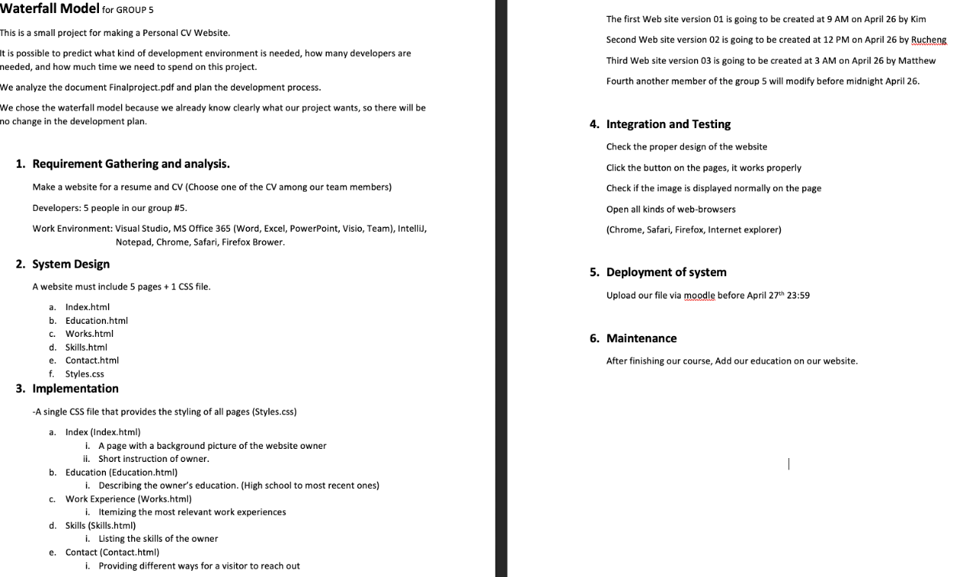

Specification document (SDLC.doc)

Slide 5
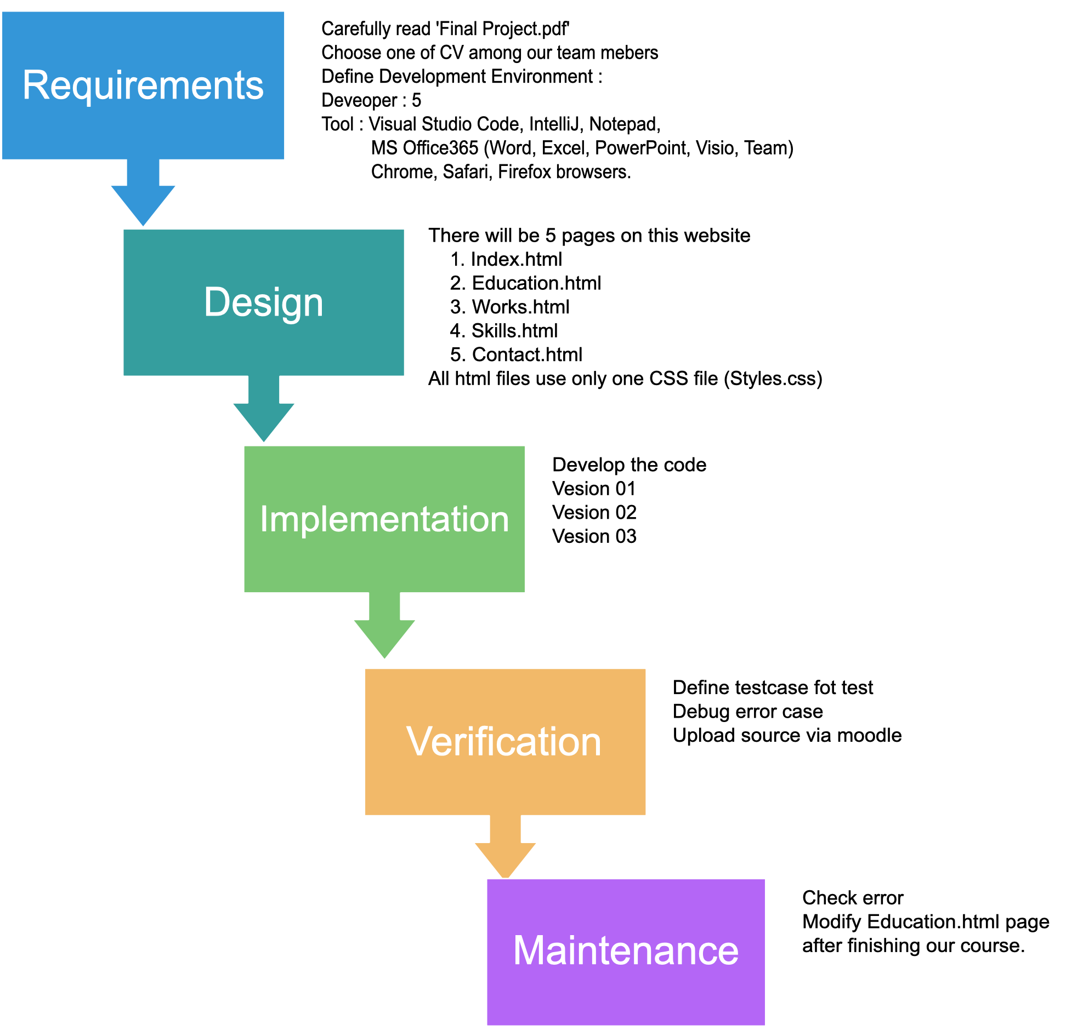
Visio Diagram
Waterfall methodology diagram

Slide 6
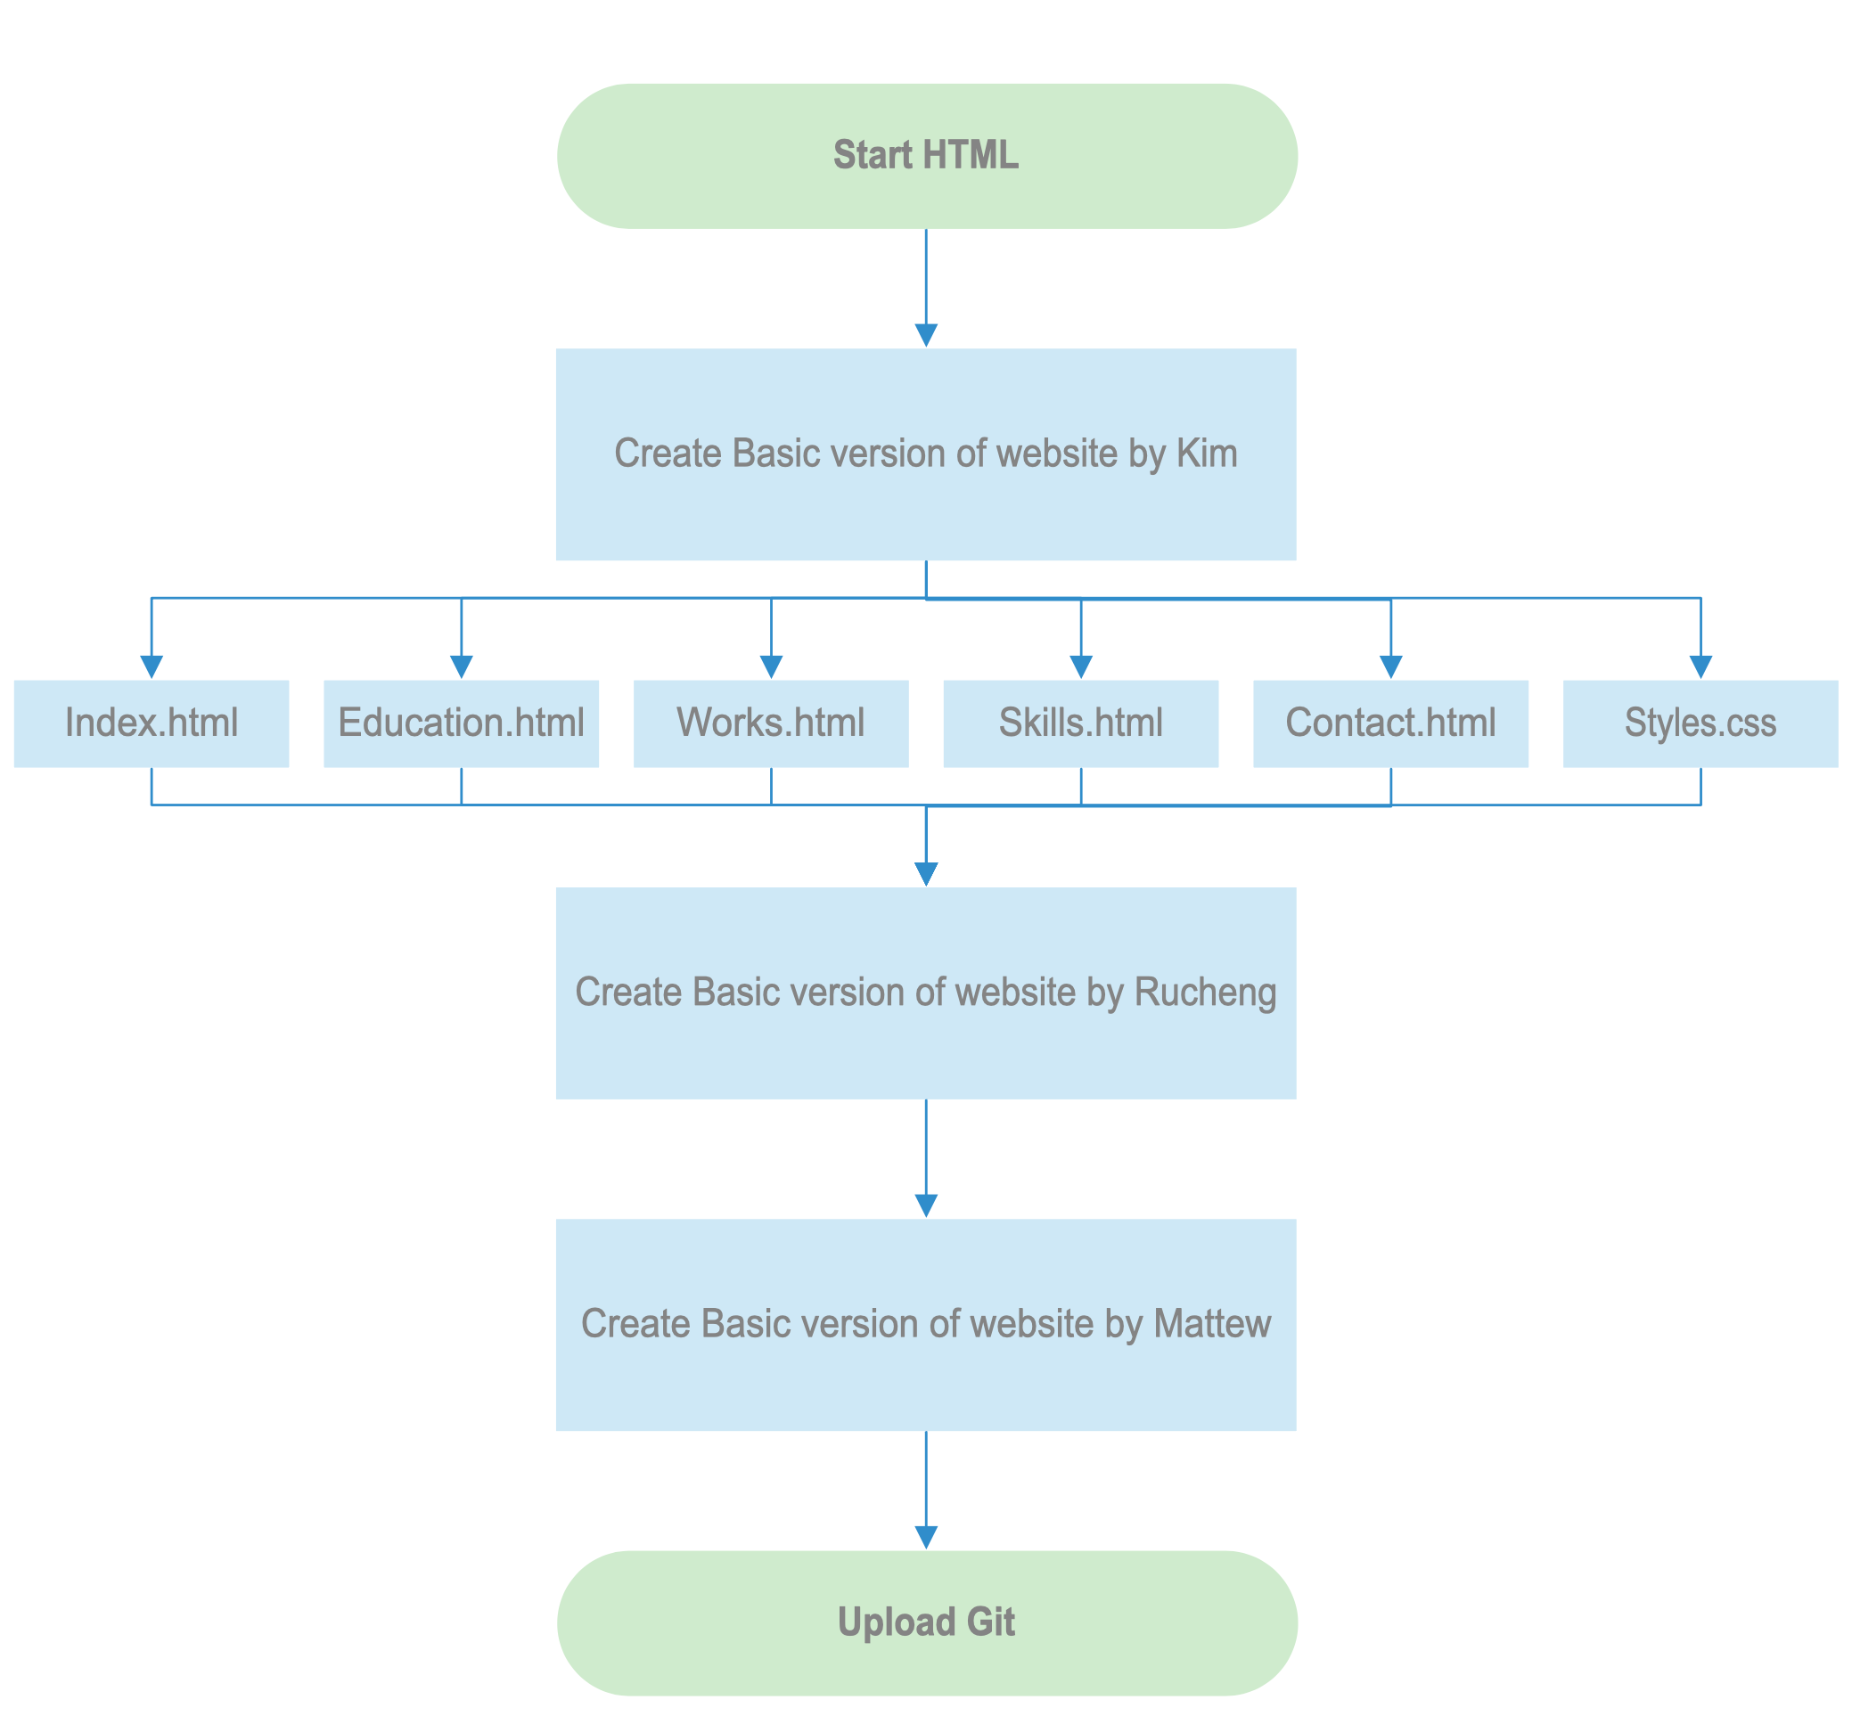
Implementation Diagram
Detail
Implementation Visio Diagram

Slide 7
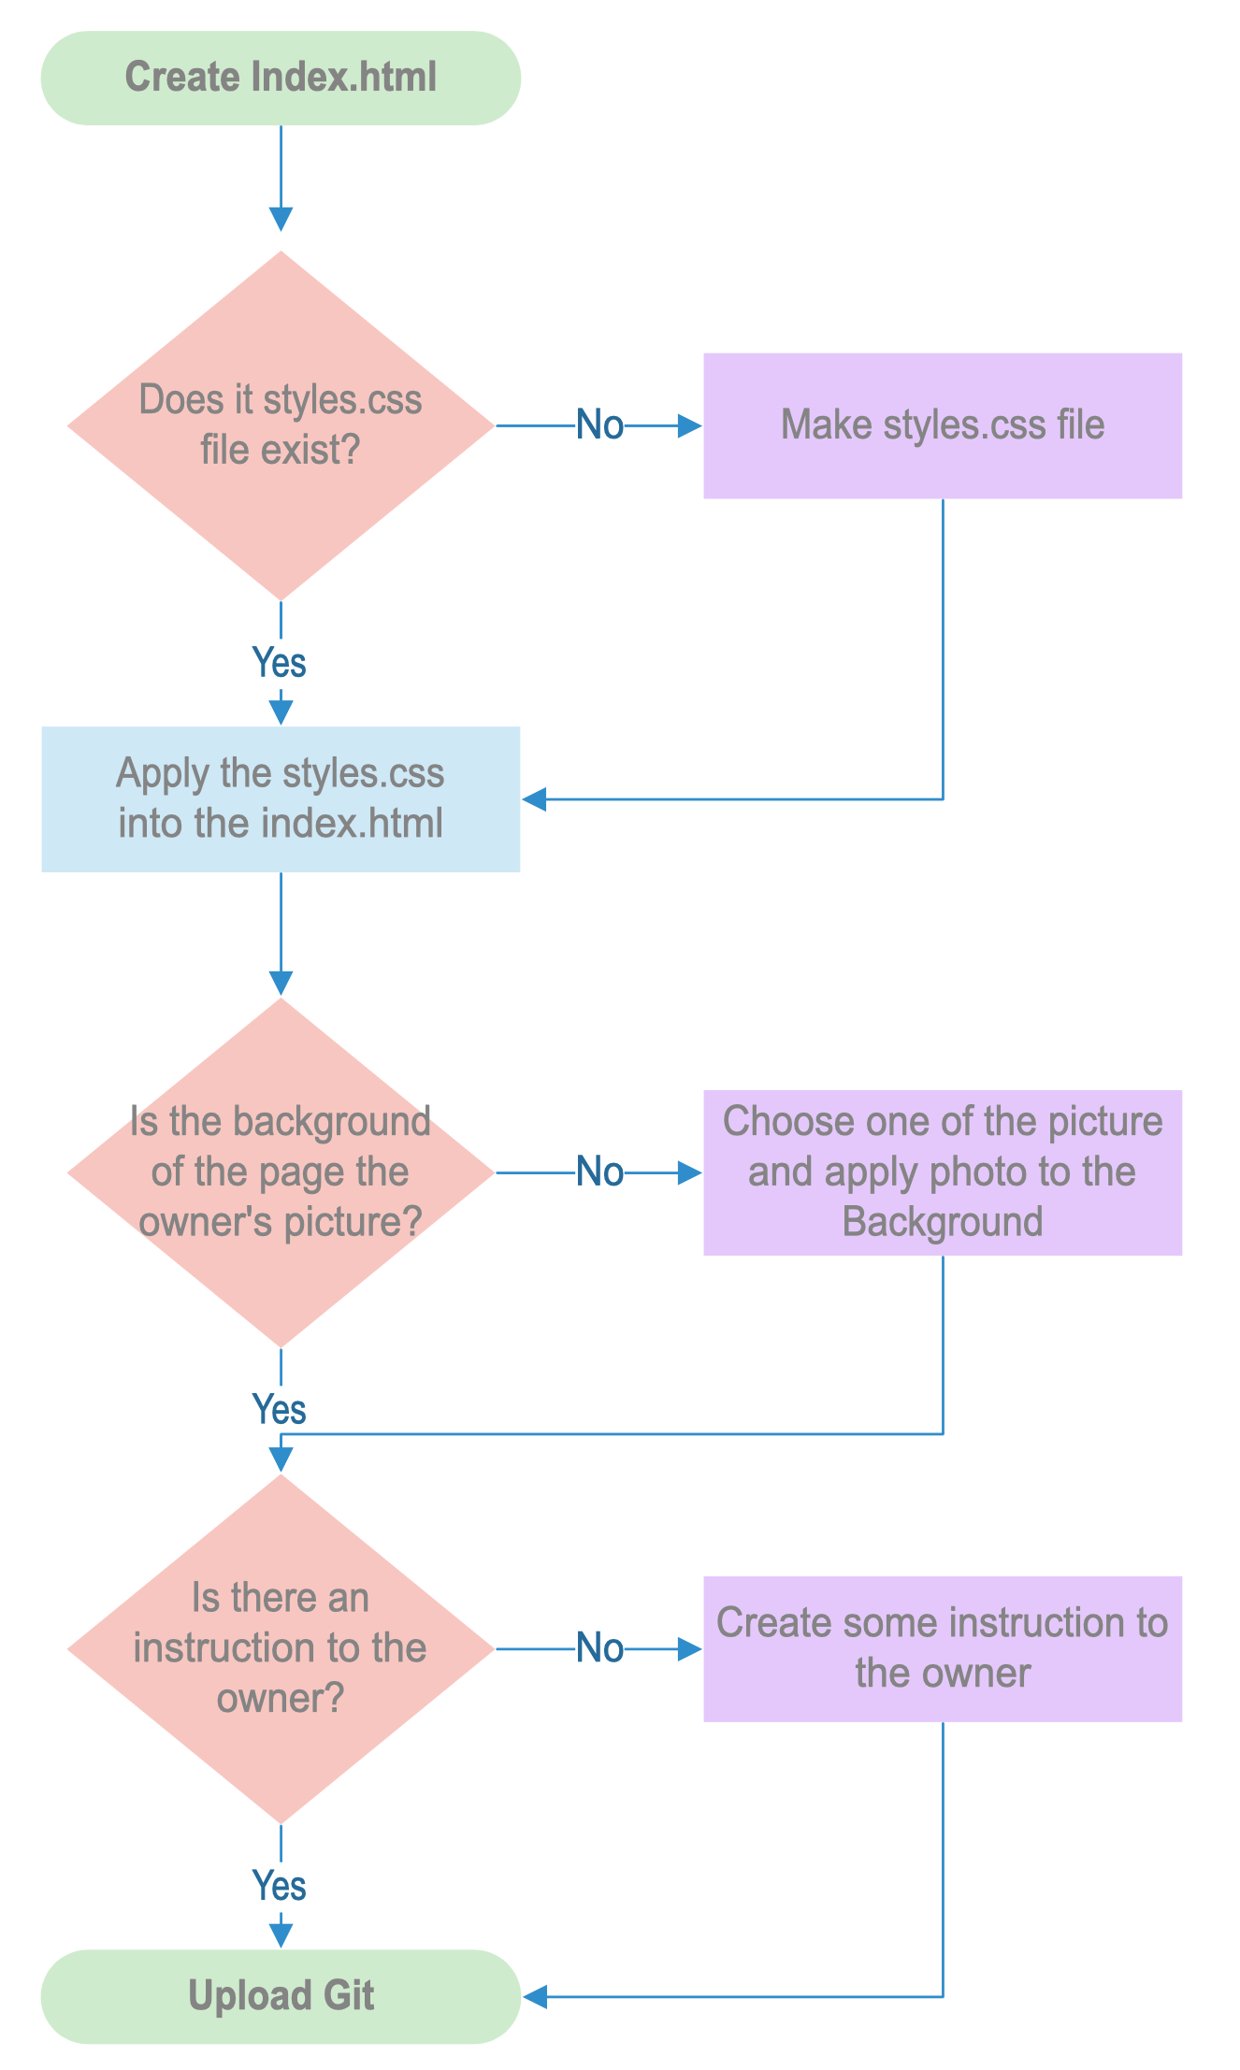

Index.html Diagram
Implementation Diagram more detail for development on the index.html

Slide 8
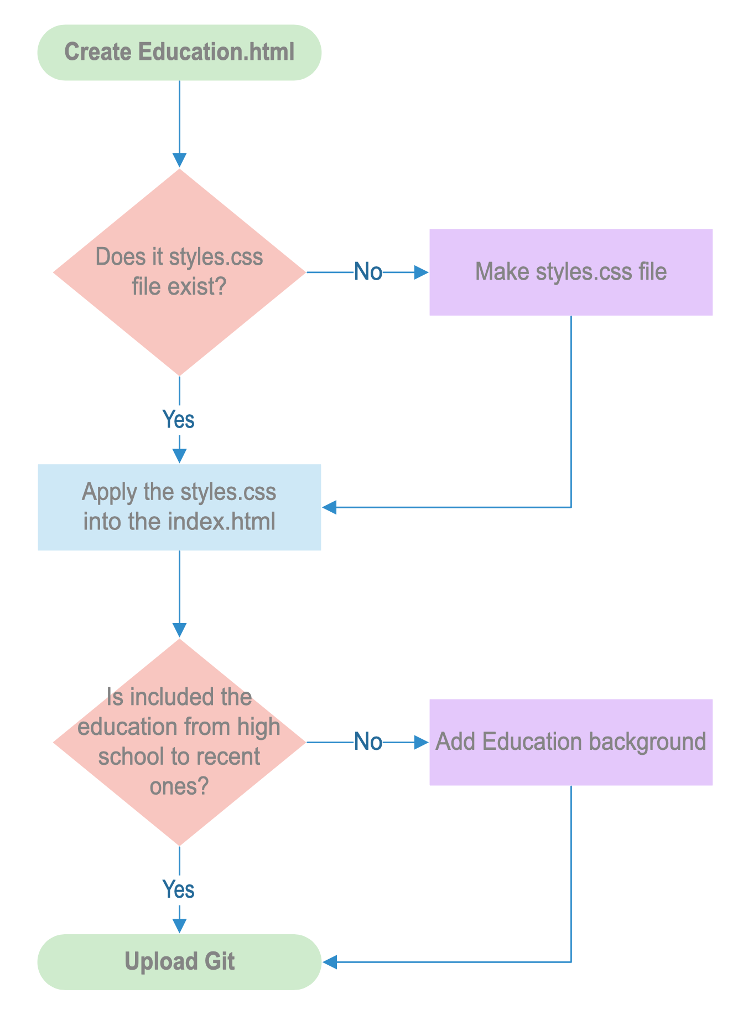
Education.html Diagram
Implementation Diagram more detail for development on the Education.html

Slide 9
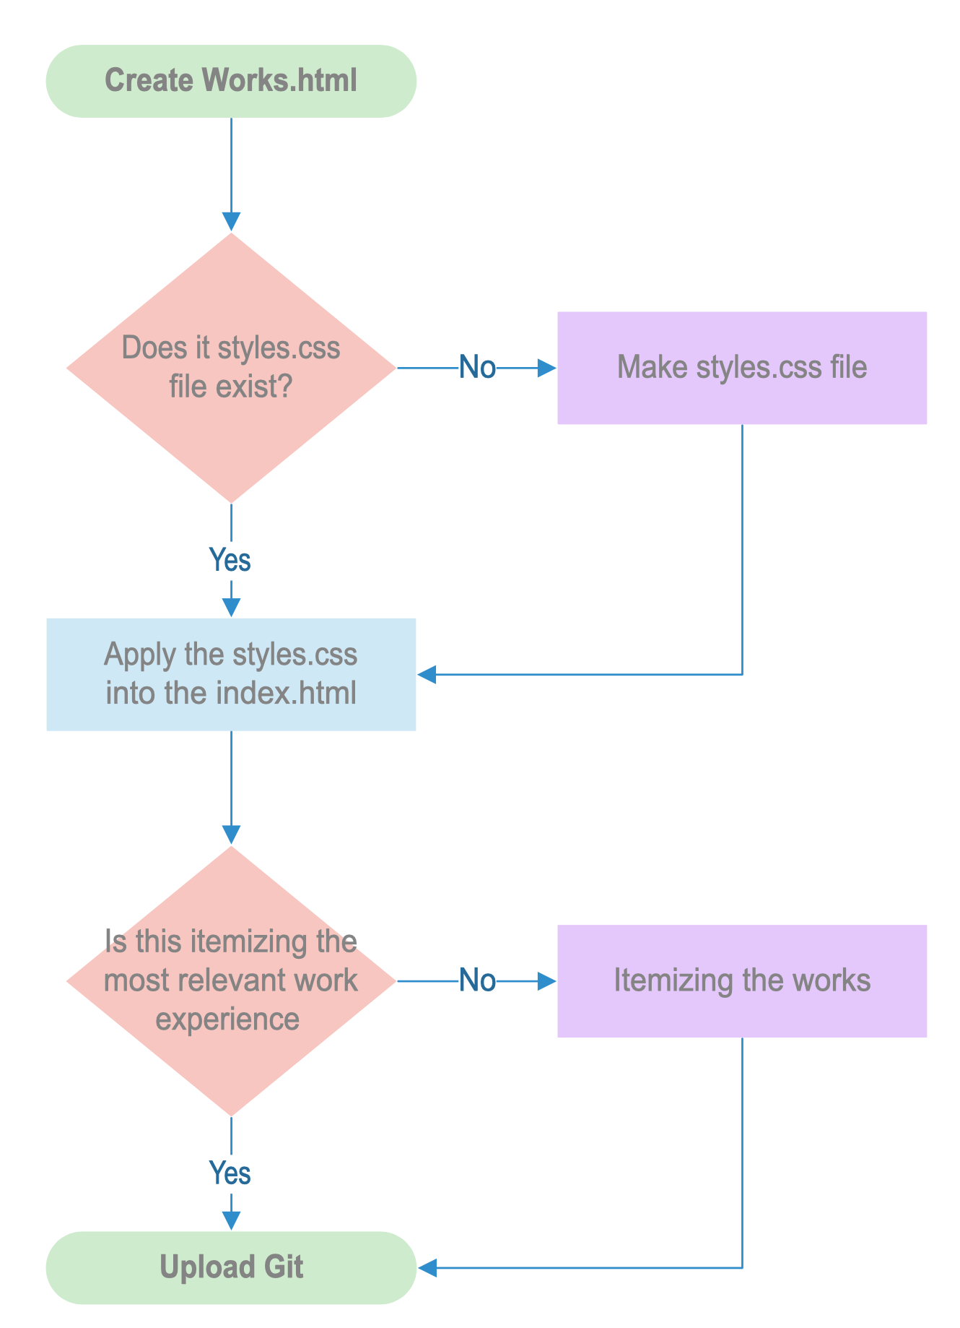
works.html Diagram
Implementation Diagram more detail for development on the works.html

Slide 10
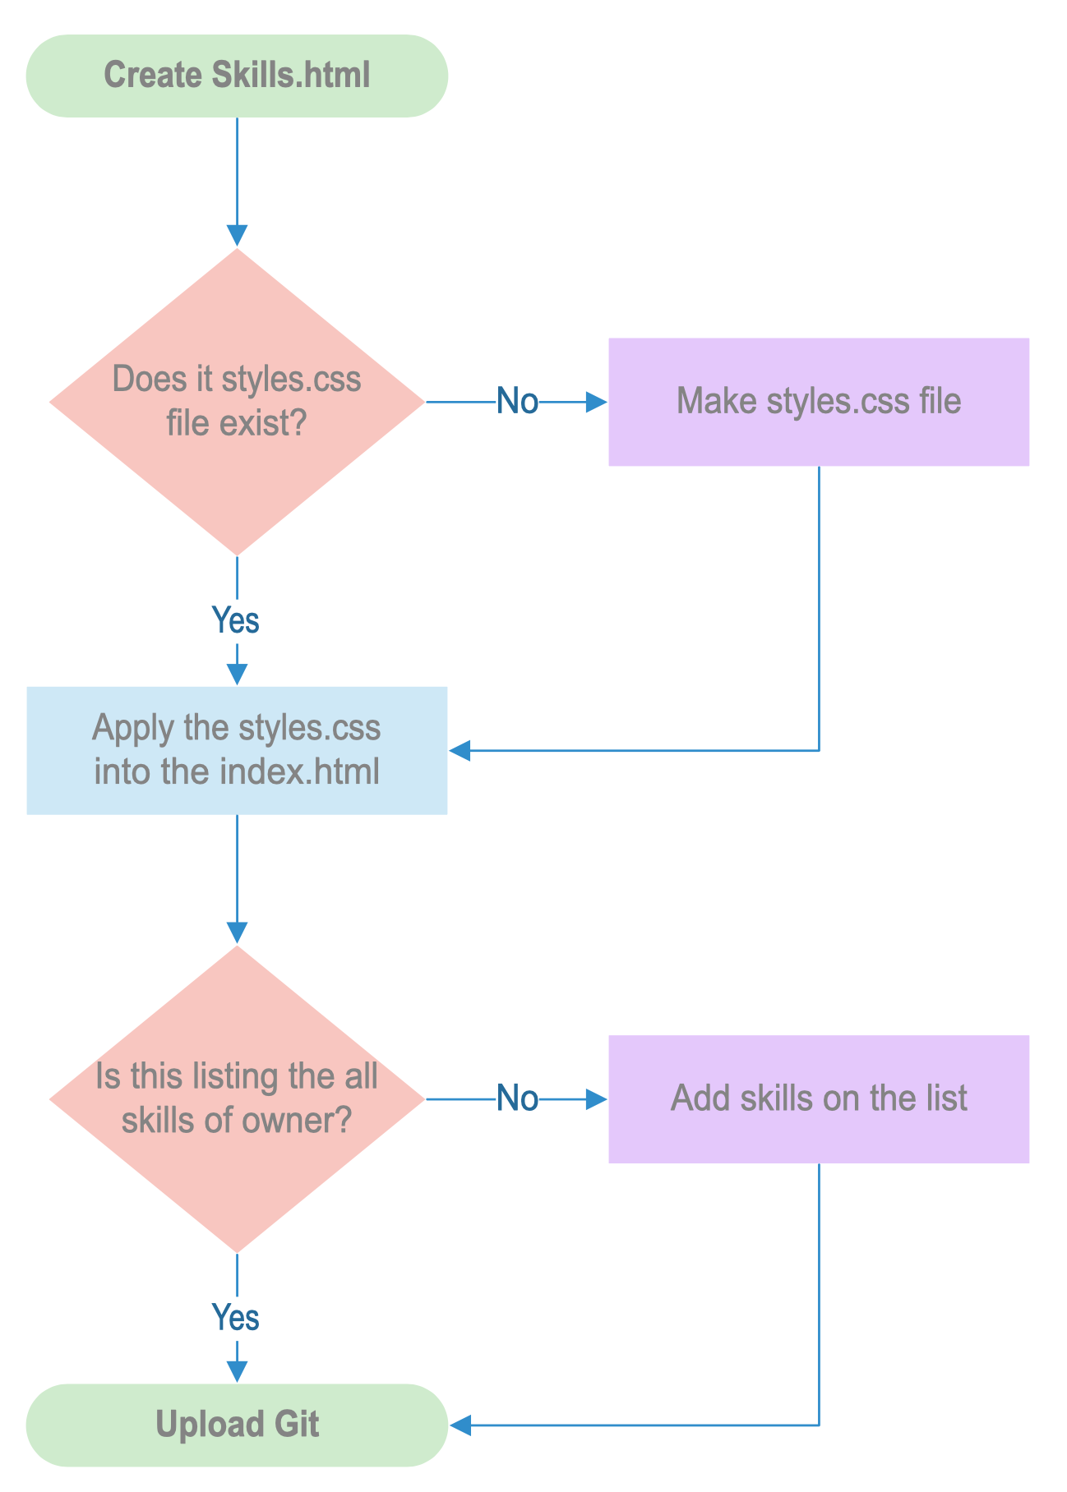
Skills.html Diagram
Implementation Diagram more detail for development on the Skills.html

Slide 11
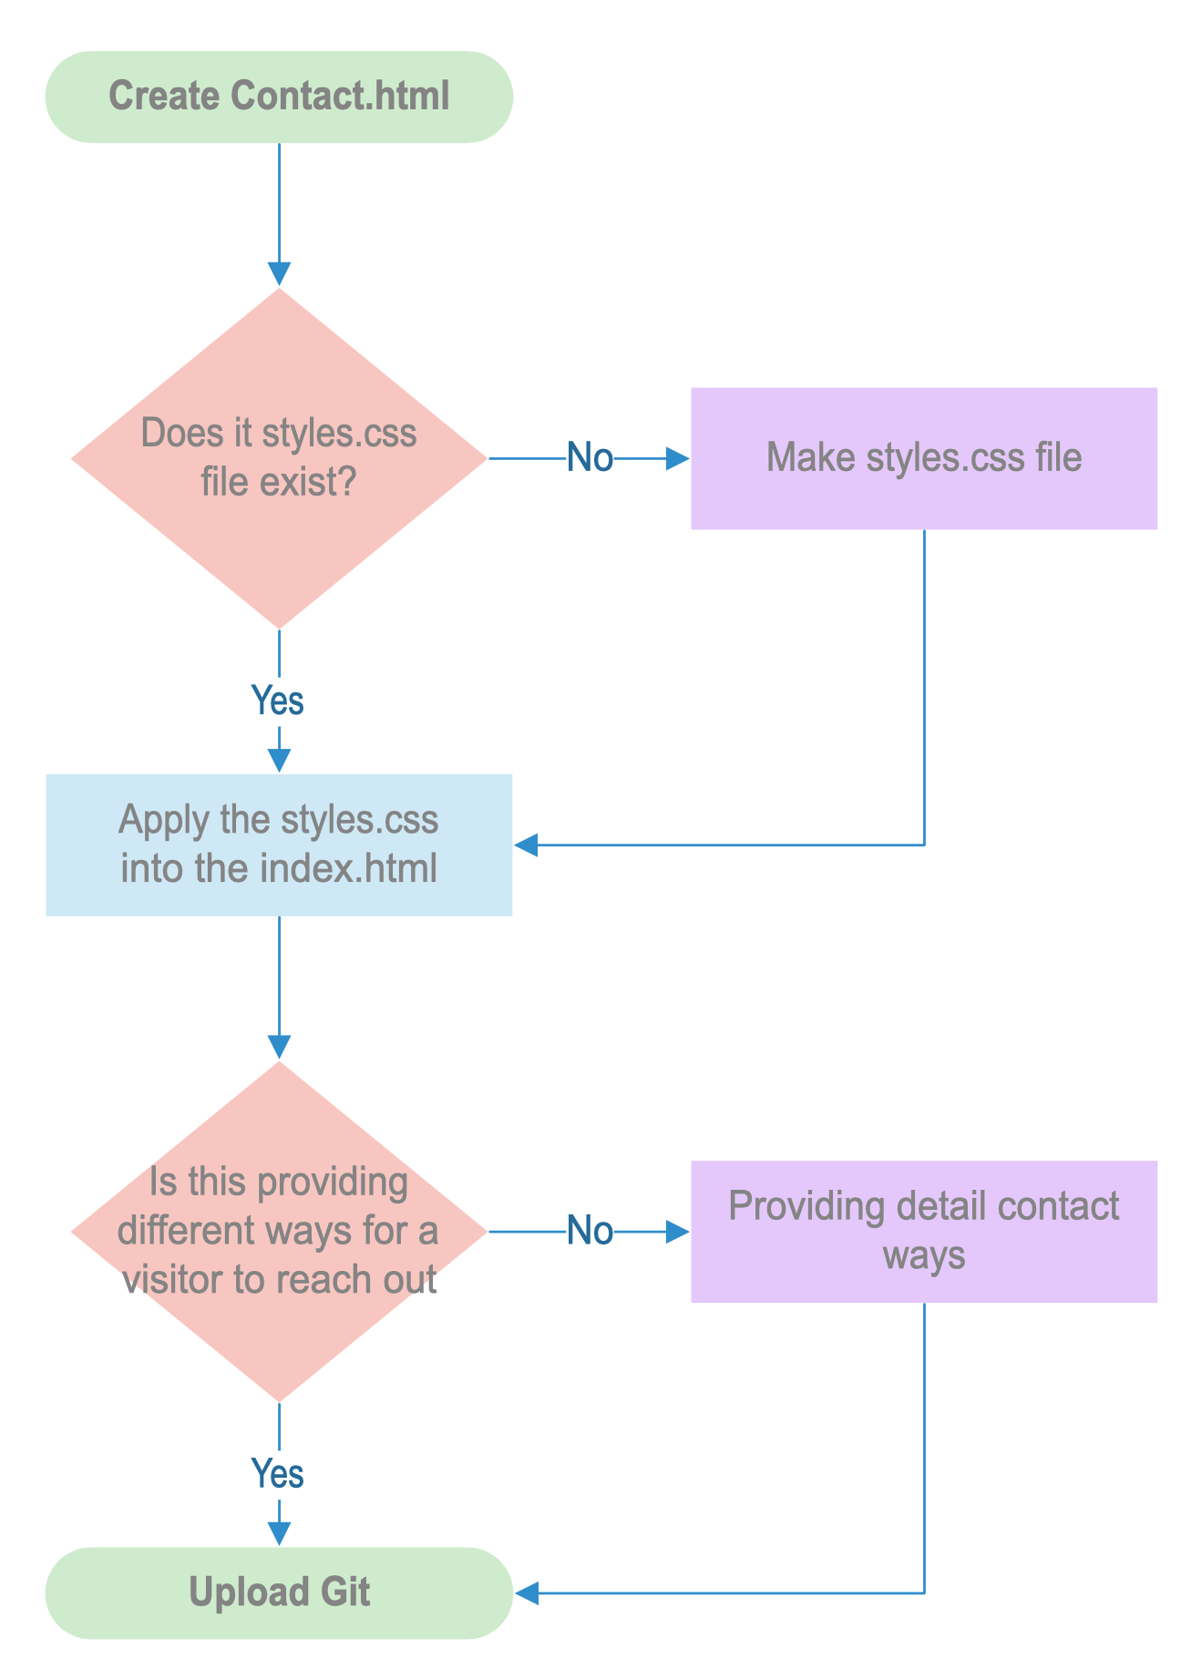
contact.html Diagram
Implementation Diagram more detail for development on the Contact.html

