Slide 1
Analysis of Carbon Radio Recombination Lines
with NenuFAR
Methodology: From Raw Spectra to Physical ISM Parameters
Lucie Cros
NenuFAR LT10 · Low-frequency CRRLs (10 – 85 MHz) · Diffuse interstellar medium
1

Slide 2
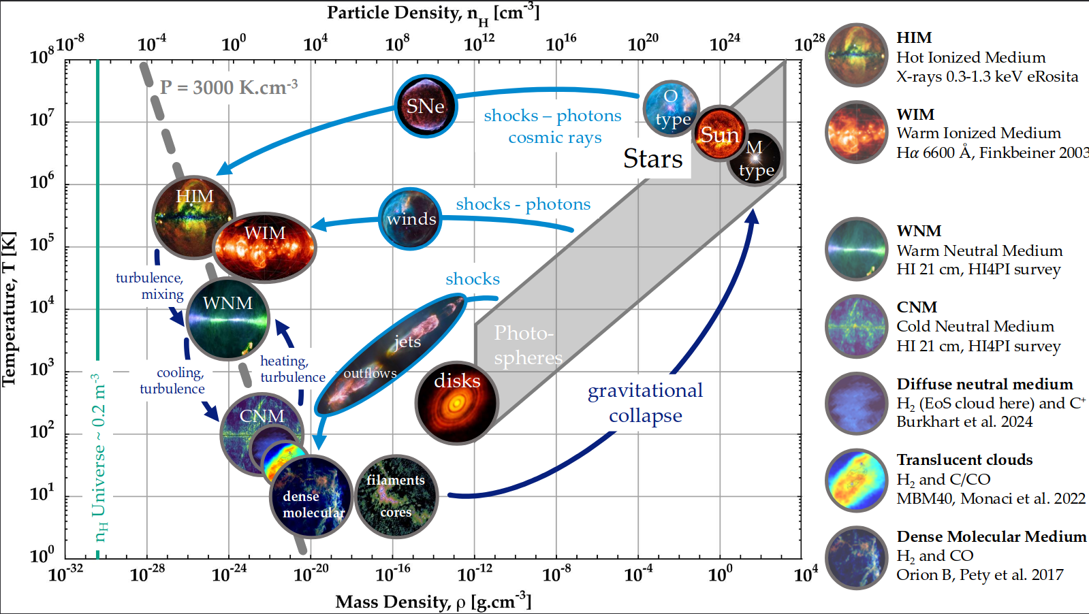
The matter cycle in the interstellar medium
Context: why study the ISM?
[ Figure ]
figure by A. Gusdorf
2

Slide 3
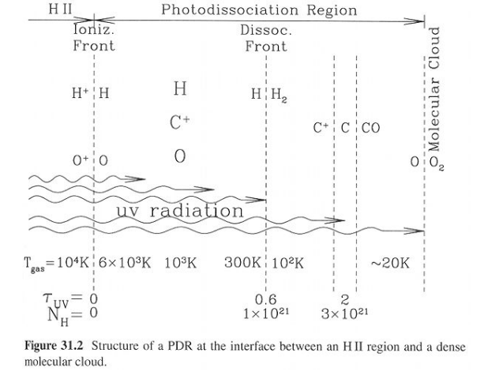
The diffuse interstellar medium
Context: why study the coldest ISM phases?
ISM phases — T–ρ diagram
Example: photodissociation region (PDR)
[ Figure ]
What drives phase transitions?
How do temperature and density evolve exactly?
E₀(C) = −11.2 eV < E₀(H) = −13.6 eV
⟹ Carbon is ionised where hydrogen is neutral
→ but where exactly? (HI? molecular? diffuse? dense?)
3

Slide 4
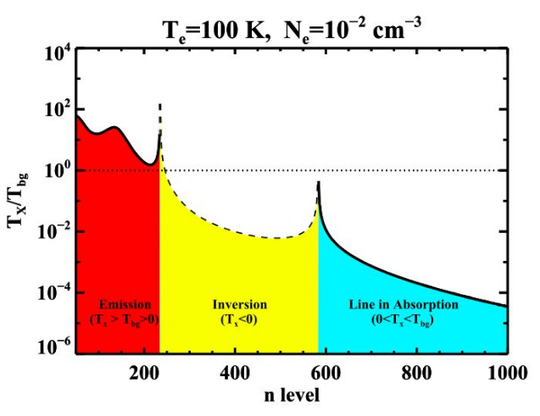
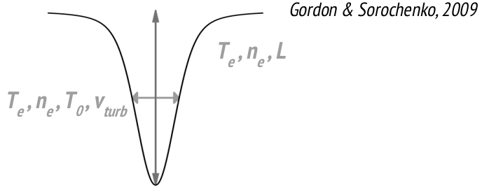
CRRLs at low frequencies — physical parameters
What carbon recombination lines tell us about the local ISM
Excitation regimes — Tx/Tbg vs n
Line profile & extracted parameters
[ Figure ]
Param. | Physical meaning | Typical range (CNM)
Te | Electron temperature | < 100 K
ne | Electron density | ~10⁻² cm⁻³
vt | Turbulent velocity | 2 – 8 km/s
T₀ | Radiation temperature | 1 000 – 3 000 K
L | Cloud depth (los) | < 50 pc
Cnα, n ∈ [400, 850] → ~450 lines within 70 MHz
Lines in absorption against the radio continuum source
⟹ physico-chemical constraints on the local ISM
4

Slide 5
Why CRRLs alone are not sufficient
Four obstacles to identifying physical clouds
1
L – T₀ degeneracy
2
Superimposed velocity components
Parameters L (cloud depth along the line of sight) and T₀ are hard to constrain independently from CRRLs alone. The χ² surface has multiple local minima.
→ An external prior on L is essential.
Several distinct clouds overlap along a single line of sight at close velocities (e.g. −47, −38, 0 km/s toward Cas A). Line profiles blend at low frequencies, making component separation delicate.
→ Independent velocity constraints are required.
3
Atomic phases without CO counterpart
4
No prior on velocity components
Some diffuse atomic clouds show no detectable CO emission (e.g. +3.5 km/s toward Cyg A). The classical molecular tracer is blind to these phases.
→ A diffuse atomic-phase tracer is essential.
For a source never observed in RRLs, the number of spectral components and their velocities are unknown a priori.
→ Multi-wavelength tracers guide the search for CRRLs.
5

Slide 6
Analysis Pipeline — Overview
From raw NenuFAR spectra to physical ISM parameters
1
2
3
4
5
ISM Cloud
Identification
Spectral
Cleaning
Weighted
Stacking
Voigt
Fitting
χ² Grid
Exploration
Dust · CO · HI
NenuFAR beams
RFI · baseline
Time averaging
1/σ² weighting
n-interval bins
Centre · FWHM · Area
per n-bin
Te · ne · L · T₀ · vt
constraints
→
→
→
→
Notebook 1
Pipelines
Notebook 3
Notebook 4
Notebook 5
6

Slide 7
Step 1 — ISM Cloud Identification
Three complementary tracers: 3D dust · CO · HI · NenuFAR beams
Interstellar dust
Edenhofer et al. 2024 (Gaia DR3)
HI 21 cm emission
HI4PI Collaboration 2016 (EBHIS)
Ang. res.: 14' · Radial res.: ~1 pc · Range: 1.25 kpc
3D mapping of absorbing clouds in the solar neighbourhood. FWHM along the line of sight → prior on L and cloud distance.
Ang. res.: 16.2' · Spectral res.: ~1.3 km/s · Full sky
Traces the diffuse atomic phase, including CO-dark clouds. Used analogously to CO cubes.
¹²CO emission (J = 1–0)
Dame et al. 2001 (CfA 1.2 m)
Theoretical vlsr
Reid et. al 2019 rotation modeling
Ang. res.: 8.5' · Spectral res.: 0.65 km/s · Full Galactic plane
Traces dense molecular gas. Velocity components identified by averaging spectra within the NenuFAR beam.
Compute theoretical vlsr vs heliocentric distance using theoretical galactic rotation modeling.
Output: position, distance and depth of each cloud → L prior injected into the 5-parameter grid (Te, ne, T₀, vt, L).
7

Slide 8
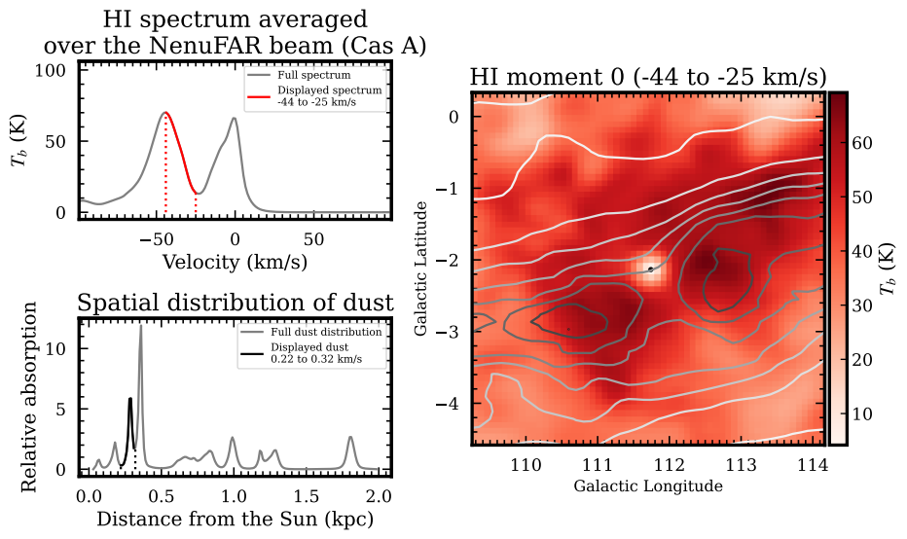
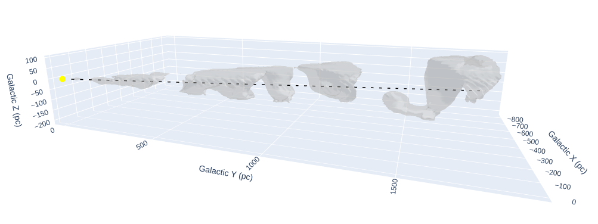
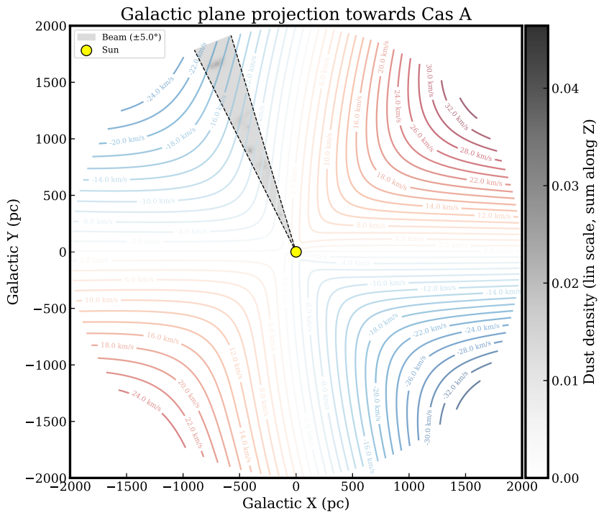
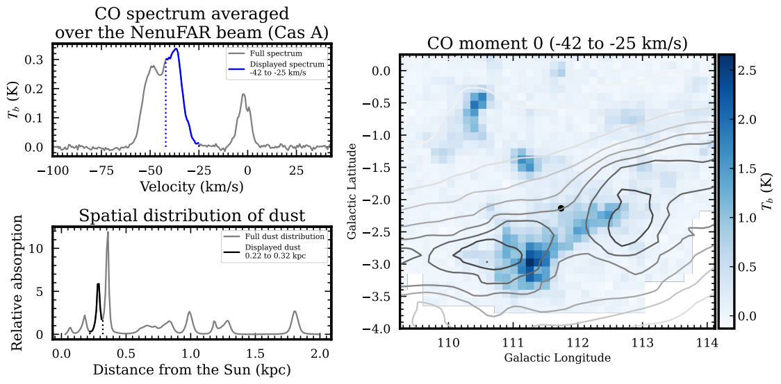
Step 1 — ISM Cloud Identification
Three complementary tracers: 3D dust · CO · HI · NenuFAR beams
7

Slide 9
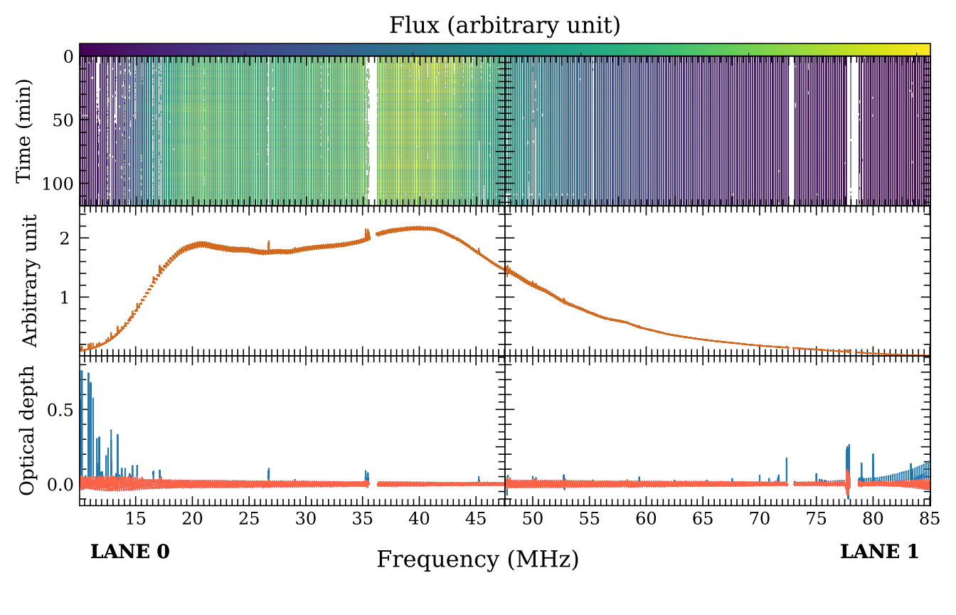
Step 2 — Spectral Cleaning & Temporal Averaging
Pipelines: clean_observation.py · run_time_average.py
• Input: NenuFAR Level-1 FITS spectra (one bloc per observation)
• RFI masking: channels with anomalous amplitude are flagged
• Continuum subtraction: log-polynomial baseline (McKean et al. 2016)
• Doppler correction: LSR velocity shift applied per observation (spectral_tools/tools.py)
• Temporal averaging: 1/RMS² inverse-variance weighting over all clean blocs
• Output: single alltime FITS spectrum per source per line
8

Slide 10
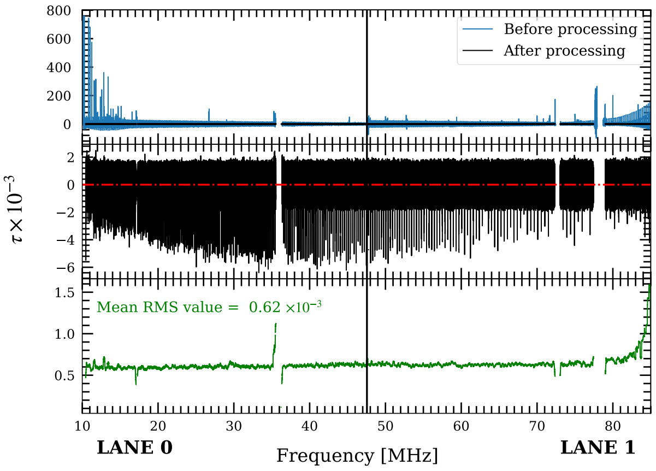
Step 2 — Spectral Cleaning & Temporal Averaging
Pipelines: clean_observation.py · run_time_average.py
• Input: NenuFAR Level-1 FITS spectra (one bloc per observation)
• RFI masking: channels with anomalous amplitude are flagged
• Continuum subtraction: log-polynomial baseline (McKean et al. 2016)
• Doppler correction: LSR velocity shift applied per observation (spectral_tools/tools.py)
• Temporal averaging: 1/RMS² inverse-variance weighting over all clean blocs
• Output: single alltime FITS spectrum per source per line
8

Slide 11
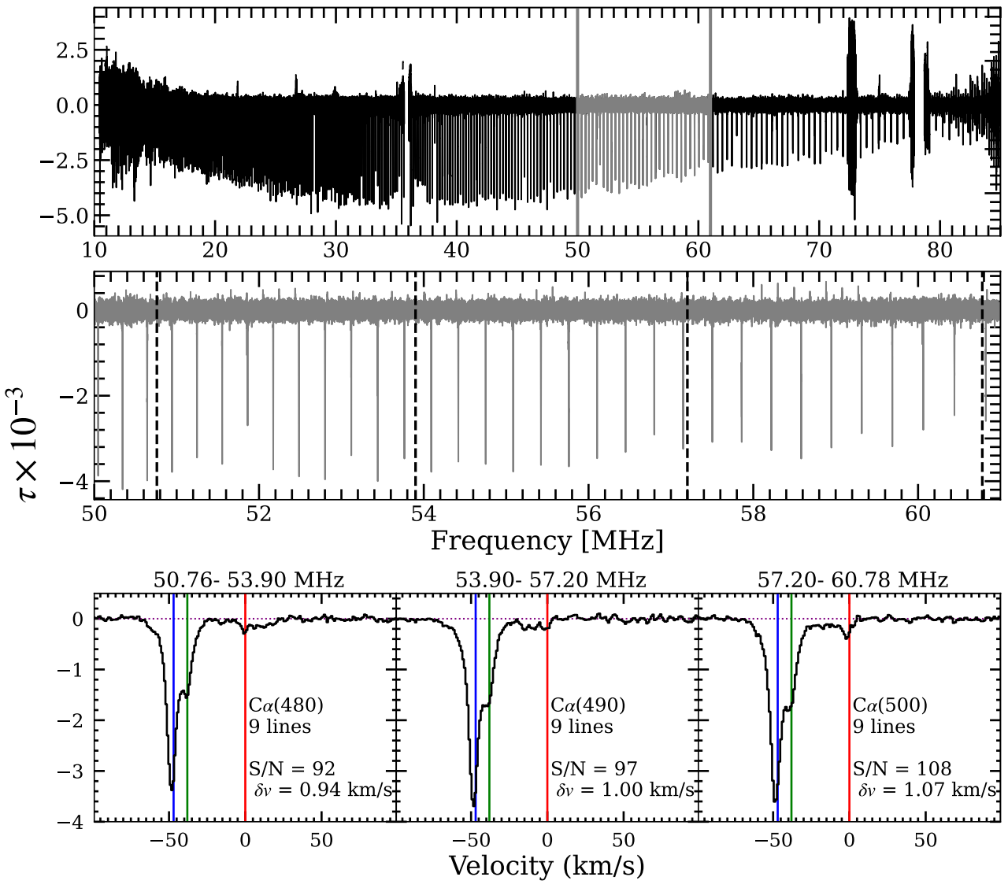
Step 2 — Spectral Cleaning & Temporal Averaging
Pipelines: clean_observation.py · run_time_average.py
• Input: NenuFAR Level-1 FITS spectra (one bloc per observation)
• RFI masking: channels with anomalous amplitude are flagged
• Continuum subtraction: log-polynomial baseline (McKean et al. 2016)
• Doppler correction: LSR velocity shift applied per observation (spectral_tools/tools.py)
• Temporal averaging: 1/RMS² inverse-variance weighting over all clean blocs
• Output: single alltime FITS spectrum per source per line
8

Slide 12
Step 3 — Weighted Stacking of CIα RRLs
Notebook 3_Stacking.ipynb · S/N boost by combining ~450 transitions
• CIα transitions span n ~ 400–850 across the NenuFAR bandwidth (10–85 MHz)
• Each transition extracted in a velocity window centred on f₀(n)
• S/N estimated as signal / wing RMS; contaminated lines rejected
• Inverse-variance weighted stack (weight = 1/RMS²) per n-interval
• S/N gain vs LOFAR: factor ~4
9

Slide 13
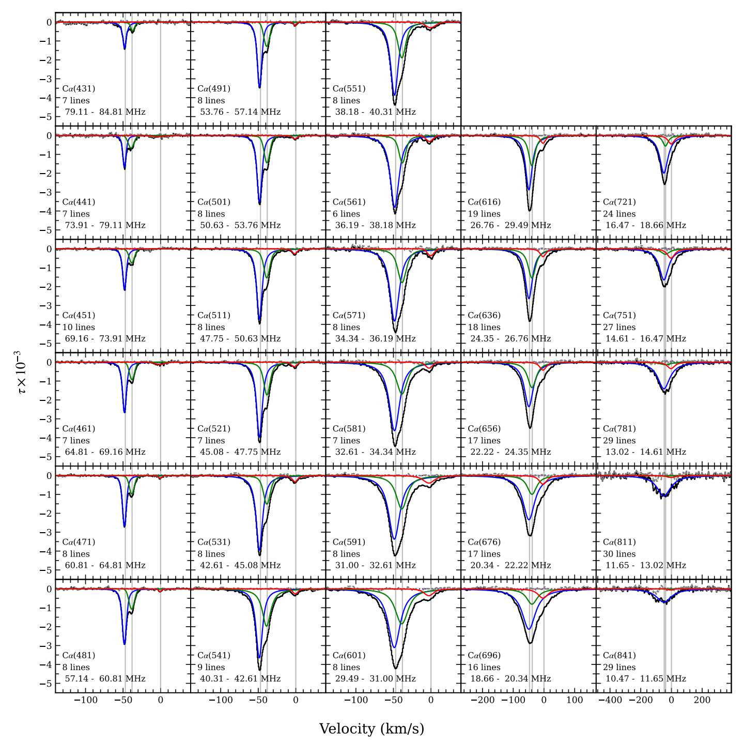
Step 4 — Voigt Profile Fitting
Notebook 4_Line-fitting.ipynb · Extract line parameters per n-bin
• Voigt = Gaussian (thermal + turbulent) ⊗ Lorentzian (radiation broadening)
• Multi-component fit when several ISM velocity components are detected
• Parameters: centre [km/s] · FWHM_G [Hz] · FWHM_L [Hz]
• Integrated line area [Hz] with full uncertainty propagation
• Output CSV: n, wV, dwV, Ifit, dIfit, CENTER, CENTER_err (per component)
10

Slide 14
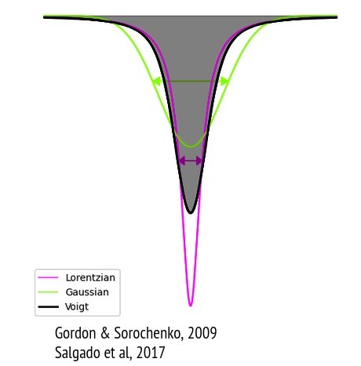
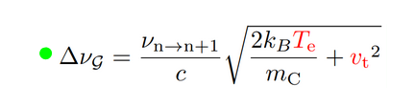
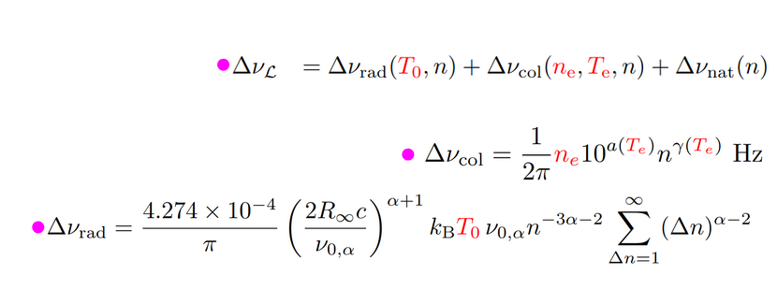
Physical CRRL Model
Line broadening & integrated area from non-LTE theory (spectral_tools/modeling.py)
Total line width
Δf²_tot = Δf²_natural + Δf²_Doppler + Δf²_pressure + Δf²_radiation
Integrated area — non-LTE
• bₙ, βₙ: non-LTE departure coefficients (pre-computed, interpolated from B1B2.pickle)
• f(Te, ne): electron temperature and density dependence
5 free parameters: Te [K] · ne [cm⁻³] · L [pc] · T₀ [K] · vt [km/s]
11

Slide 15
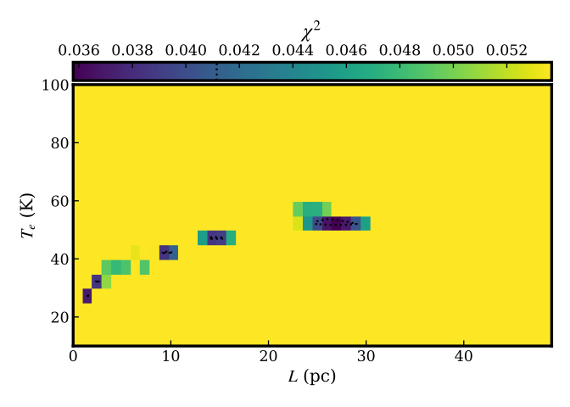
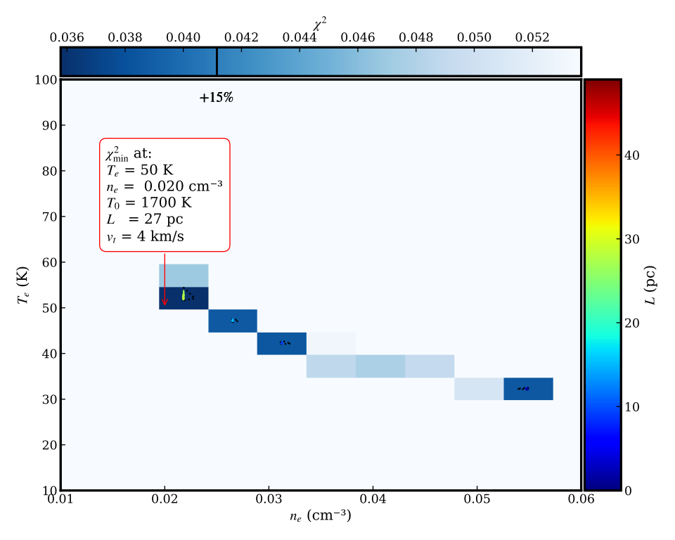
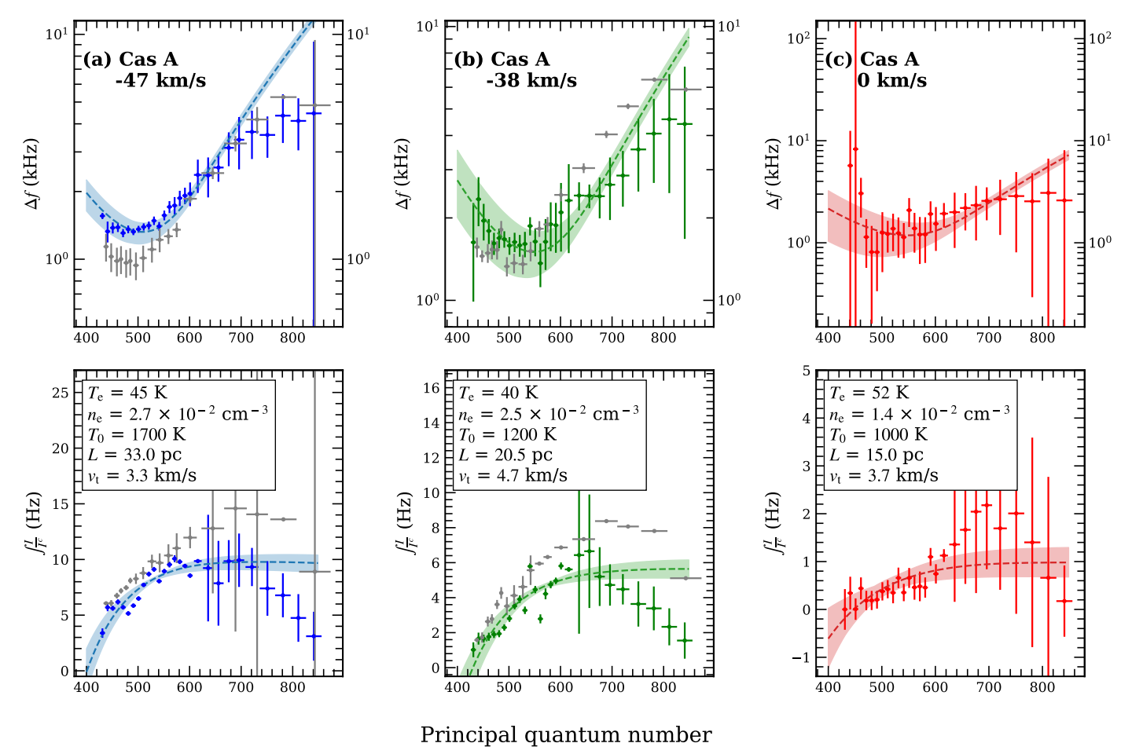
Step 5 — χ² Grid Exploration
Notebook 5_Grid-exploration.ipynb · Constrain Te, ne, L, T₀, vt
• 5D parameter grid: Te × ne × L × T₀ × vt (generated by generate_grid.py)
• χ² = Σₙ [ (Δf_obs − Δf_mod)² / σ²_Δf + (A_obs − A_mod)² / σ²_A ]
• Marginalise over parameters via minimum-χ² projection
• Confidence regions: +5%, +15%, +30% above χ²_min
• Possible geometric mask in (Te, L) plane to impose physical priors
• Marginal histograms of each parameter within the accepted solution set
Output: best-fit solution (Te, ne, L, T₀, vt) + confidence intervals
12

Slide 16
Results — Physical Conditions of the Diffuse ISM
Sources: Cassiopeia A · Cygnus A · Taurus A in progress
Parameter | Cas A (−47 km/s) | Cas A (−38 km/s) | Cas A (0 km/s) | Cyg A
Te (K) | 35 - 50 | 37 - 44 | … | …
ne (cm⁻³) | 2.7 – 3.9 × 10⁻² | 2.5 × 10⁻² | … | …
L (pc) | 33 | … | … | …
T₀ (K) | 1700 | … | … | …
vt (km/s) | 2.7 – 3.8 | … | … | …
vlsr (km/s) | −47 | −38 | 0 | +3.5
Cros et al 2025
13

Slide 17
Summary & Perspectives
What was achieved and what comes next
What was achieved
Next steps
1. End-to-end pipeline: raw NenuFAR FITS → Te, ne, L, T₀, vt with full uncertainty propagation.
2. Multi-tracer cloud identification (3D dust + CO + HI) resolves velocity ambiguity and provides an L prior.
3. Weighted stacking of ~450 n-transitions boosts S/N by a factor ~4 vs LOFAR.
4. 9 components identified over 3 sources, including 4 purely atomic (CO-dark) — demonstrating CRRL complementarity to molecular tracers.
Extension to new sources
Apply to additional NenuFAR pointings (Tau A S2 series, Orion, …). Scale to the full LT10 programme.
Full automation of Cloud-id
Make line masking and component selection entirely automatic for pipeline-scale processing of large source catalogues.
Break remaining degeneracies
Observe Cnβ, Cnγ, Cnδ transitions to constrain T₀ and L independently. Use the 45 MHz Galactic background map (Guzman 2011).
Galactic mapping & SKA preparation
Build a (ne, Te) map along the Galactic plane. Adapt the pipeline to forthcoming SKA diffuse-ISM surveys.
Cloud-id.ipynb makes the identification procedure reproducible, transparent, and extensible to new lines of sight — a prerequisite for a systematic NenuFAR survey of the diffuse ISM.
14

