Slide 1
Information for Inspirations: The Roles of Local News in Civil Conflict Diffusion in DR Congo
Lucie Lu
Tianhong Yin
11/14/2022

Slide 2
Research question, and why matters?
Civil wars are contagious
Clustered conflicts in West Africa, the Balkans and African Great Lakes
Information matters for conflicts to travel across borders. How does news reporting diffuse civil conflicts within the border of a given country?
Why traditional news media?
We need journalists to dispel uncertainty and confusion in conflicting events.
Many people in developing countries still primarily rely on broadcasts for information.
Newspapers and broadcasters report and frame the conflict events. These decisions have a critical impact on shaping the perception of conflicts.

Slide 3
What do we know about civil conflict diffusion?
Direct diffusion (tangible factors)
Deepen ongoing tension in the target state: regional ethnic ties, economic recessions
Transfer of knowledge: influx of refugees, armed groups and military equipment
Indirect diffusion (intangible factors)
Information: learning from the strategies and interactions
Inspiration: inspire groups in other states to follow suit, especially from the successful stories (rebel success or government concession)
Rich evidence in tangible factors but scant evidence on intangible factors

Slide 4
What do we know about civil conflict diffusion?
We use news media articles to proxy sources of information and inspiration for ongoing conflicts.
Higher news coverage provides more information about the interactions of actors in the conflict, inspiring groups to mobilize for rebellion.
Expectations:
More news coverage + civil war diffusion
Effects are stronger in proximate diffusion.

Slide 5
A Case Study of Congo
Time: 2010-2020
News Report Data: Scraped a collection of 800 news articles under the category “News – Security” in Radio Okapi, an UN-supported national radio broadcast reaching the entire country.
Conflict Event Data: UCDP Georeferenced Event Dataset (GED)
3169 individual events of organized violence
Filtered by dyad limited to one side involving the government of DR Congo: 1055 state-based violent events
To identify the original lethal conflict events: death threshold > 25, resulting in 70 events

Slide 6
Research Design
IV: News Coverage of Original Lethal Conflict (binary)
Match the 70 conflict events with the news reports from the national broadcast Radio Okapi
DV: Contagious subsequent conflict events happened within a month of the original events
By geography, proximity ranges from 1-4
Same city same province: 1
Other cities same province: 2
Contiguous provinces: 3
Other provinces: 4
By actor (binary)

Slide 7
Research Design
Unit of analysis: Pairs of original – contagious conflict
Numbers of observations: 1167 pairs
How do we quantify contagious events?
91% of original lethal events are followed by conflicts performed by the same actor within a month.
54% are followed by conflicts performed by any actor, in the same city, within a month.
47% are followed by conflicts performed by the same actor, in the same city, within a month
Model specification:
Contagious Events Proximity ~ News Report + Same actor + Deaths

Slide 8
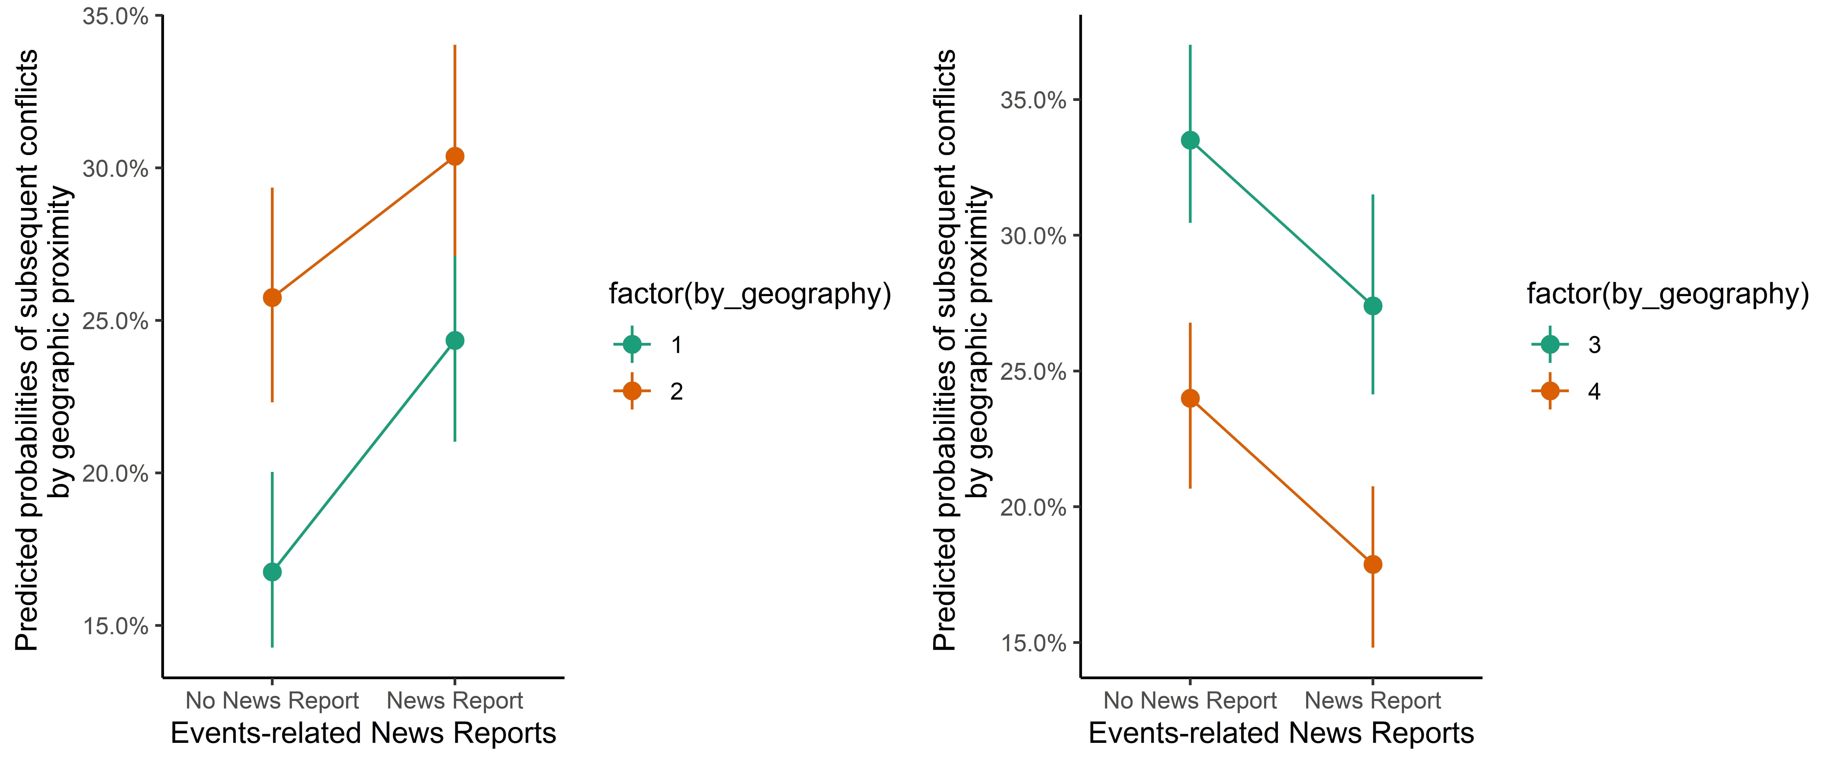
Findings From Multinomial Model

