Slide 1
API testing
Mihaela

Slide 2
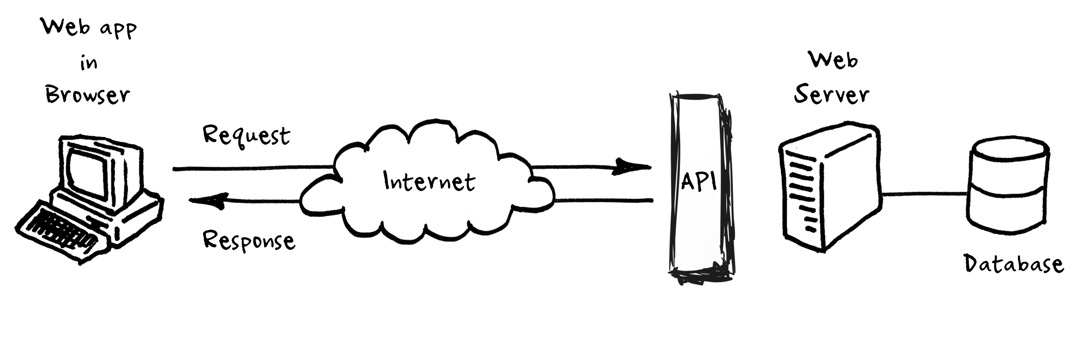
What is API?
Application Programming Interface
Every web page on the internet is stored on a remote server
The API is the code that governs the access point(s) for the server

Slide 3
REST architecture
REpresentational State Transfer
Is an architectural style for developing web services
Is popular due to its simplicity
API consumers are capable of sending GET, POST, PUT, and DELETE verbs, which greatly enhance the clarity of a given request

Slide 4
GET
It is used to read a specific resource (by an identifier) or a collection of resources
In the “happy” path, returns a representation in XML or JSON and an HTTP response code of 200 (OK)
In an error case, it most often returns a 404 (NOT FOUND) or 400 (BAD REQUEST)
According to the design of the HTTP specification, GET requests are used only to read data and not change it, so it is considered safe
GET is idempotent, which means that making multiple identical requests ends up having the same result as a single request

Slide 5
POST
It is used to create a new resource
It is also a catch-all verb for operations that don't fit into the other categories
On successful creation, return HTTP status 201 - created or 200 – ok
POST is neither safe nor idempotent

Slide 6
PUT
It is used to update a specific resource (by an identifier) or a collection of resources
On successful update, it returns 200 (or 204 if not returning any content in the body)
A body in the response is optional—providing one consumes more bandwidth
PUT is not a safe operation, in that it modifies (or creates) state on the server, but it is idempotent

Slide 7
DELETE
It is used to remove a specific resource by an identifier
On successful deletion, return HTTP status 200 (OK) along with a response body: representation of the deleted item or a wrapped response
Or return HTTP status 204 (NO CONTENT) with no response body
DELETE operations are idempotent

Slide 8
HTTP Response Code
Response status codes are part of the HTTP specification.
200 OK - Used to indicate success.
201 CREATED - Successful creation occurred (via either POST or PUT). Response body content may or may not be present.
204 NO CONTENT Indicates success but nothing is in the response body, often used for DELETE and PUT operations.
400 BAD REQUEST - General error for when fulfilling the request would cause an invalid state.
401 UNAUTHORIZED - Error code response for missing or invalid authentication token.
403 FORBIDDEN - Error code for when the user is not authorized to perform the operation or the resource is unavailable for some reason (e.g. time constraints, etc.).
404 NOT FOUND - Used when the requested resource is not found, whether it doesn't exist or if there was a 401 or 403 that, for security reasons, the service wants to mask.
405 METHOD NOT ALLOWED - Used to indicate that the requested URL exists, but the requested HTTP method is not applicable. The Allow HTTP header must be set when returning a 405 to indicate the HTTP methods that are supported.
409 CONFLICT - Whenever a resource conflict would be caused by fulfilling the request. Duplicate entries or deleting root objects when cascade-delete is not supported are a couple of examples.
500 INTERNAL SERVER ERROR- Never return this intentionally. The general catch-all error when the server-side throws an exception. Use this only for errors that the consumer cannot address from their end.

Slide 9
SOAP
Simple Object Access Protocol
REST takes a resource-based approach to web-based interactions
With REST, you locate a resource on the server, and you choose to either update that resource, delete it or get some information about it
With SOAP, the client doesn't choose to interact directly with a resource, but instead calls a service, and that service mitigates access to the various objects and resources behind the scenes

Slide 10
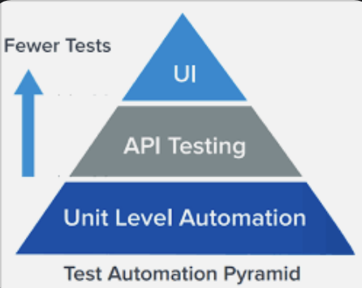
API testing
Service testing is also known as integration testing
Integration testing focuses on verifying that the interactions of many small components can integrate together without issue
Since API tests bypass the user interface, they tend to be quicker and much more reliable than GUI tests
And most importantly — since API tests don’t rely on a UI to be ready, they can be created early in the development cycle

Slide 11
API tester skills
- have good architectural knowledge of various web services, REST, SOAP and Micro Services.
- able to use all the web methods like GET, POST, DELETE, etc
- validate the response, response time, error code
- able to validate the xml and Json body by using parsers
- must know to use OAuth and OAuth2 authentication mechanisms
- able to read and understand the API documentations
- able to derive good number of test cases and scenarios.
- should be good in SQL queries to validate API and DB data elements

Slide 12
Cucumber Scenario for API Testing
List all users
Get email from random user
Register another user with the same email from above (save token to backpack)
Login with the email and password and compare the token
Scenario: Register User with same email
Given I get all the users from "https://reqres.in/api/users"
And I save an email from a random user
When I register another user using the same email at "https://reqres.in/api/register"
And I login with the newly created user at "https://reqres.in/api/login"
Then The register user token and login token should be the same

Slide 13
RestAssured API client
RestAssured is an open-source library that emulates an API client that can be used to testREST endpoints. It supports the whole set of verbs (GET, POST, PUT, DELETE, PATCH etc.)
To use the RestAssured library, simply add the following maven dependency
<dependency> <groupId>io.rest-assured</groupId> <artifactId>rest-assured</artifactId> <version>4.3.3</version> </dependency>
Examples:
[GET] given().when().get("/garage").then().statusCode(200);
[GET] given().when().get("/garage").then().body(containsString("garage"));
[POST] given().contentType("application/json").body(new Car()).when().post("/garage").then().statusCode(201);
[PUT] given().pathParam(“carId", 25).body(new Car(“green”)).when().put("/garage/{carId}").then().statusCode(202);
[DELETE] given().pathParam(“carId", 27).when().delete("/garage/{carId}").then().statusCode(204);

Slide 14
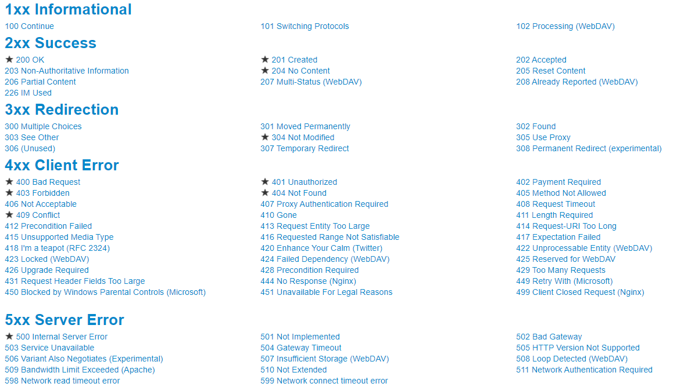
HTTP Status Codes

Slide 15
Object Mapper Dependency
The ObjectMapper enables a programmatic approach of working using a Java class from the model of a file, in this case a JSON file.
To enable mapping of files add the following maven dependency.
<dependency> <groupId>com.fasterxml.jackson.core</groupId> <artifactId>jackson-databind</artifactId> <version>2.14.1</version> </dependency>
Then use the following snippet to read (map) a json file into a certain object.
ObjectMapper objectMapper = new ObjectMapper();
Data data = objectMapper.readValue(new File("src/test/resources/json/single-user.json"), Data.class);

Slide 16
RestAssured – Object Mapping
Let’s consider the following json response body
{
"id": 2,
"email": "janet.weaver@reqres.in",
"firstName": "Janet",
"lastName": "Weaver",
"avatar": https://s3.amazonaws.com/uifaces/faces/twitter/josephstein/128.jpg
}
The corresponding Java class (POJO) will look like this
public class User {
private int id;
private String email;
private String firstName;
private String lastName;
private String avatar;
}
Then the GET request can be performed as following
[GET] User user = given().get(“https://reqres.in/api/users/2”).as(User.class);

Slide 17
RestAssured – Using jsonPath
To retrieve a certain field from the json response body without having to map it into yet another object, we can use the jsonPath() method along with getString(“jsonKey”)
Let’s say we have the following response body
{
"id": 2,
"token": "QpwL5tke4Pnpja7X2"
}
To retrieve a certain field, such as “token” we can use jsonPath with getString(“token”)
given().contentType("application/json") .body(registerUser).when().post("https://reqres.in/api/login")
.jsonPath().getString("token")
Result will be the token string = "QpwL5tke4Pnpja7X2“

Slide 18
Spring Annotations - @Component and TestBackpack
@Component - can be used on classes within the project (not libraries) to autowire them
TestBackpack can store information about currentPage, session reuse or anything scenario related.
Main advantage for a component is that it can be autowired anywhere and share state between scenarios.
@Component
public class TestBackpack {
private String email;
private String password;
private String registrationToken;
private String loginToken;
// getters & setters
}

Slide 19


Questions?

