Slide 1
Mobile Test Automation using Appium/w Java
by Andrei Bart

Slide 2
What is this Appium tool ?
What is Appium ?
"Appium is an open source test automation framework for use with native, hybrid and mobile web apps."
Requirements
iOS : MacOsX XCode (includes Command Line Tools). It uses XCUITest Driver.
Note: iOS testing only on MACOS because there is no xcode for windows :)
Android: MacOSX or Windows or Linux with Android Sdk. It uses UiAutomator2 Driver

Slide 3

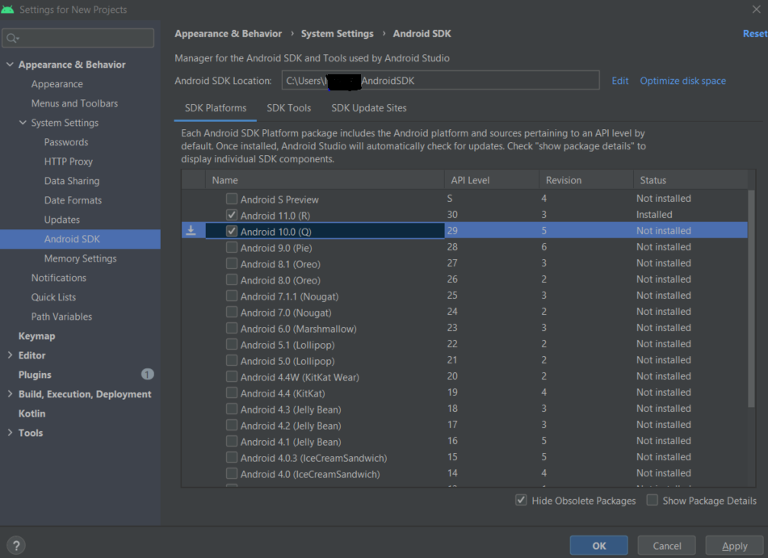
Getting Started with Android Setup
Download Android Developer Studio which has the Android Sdk bundled with it
https://developer.android.com/studio#downloads
When starting the IDE let the wizard download and install Android Sdk Tooks and Platform Tools
Add the sdk coresponding to your device(e.g:Api Level 29 for Android10 ) by searching in settings by Android SDK.
Add the env variables ANDROID_HOME to point to the android sdk. I installed sdk to in C:\Users\Maria\AppData\Local\Android\Sdk
Add platform-tools to PATH env variable C:\Users\Maria\AppData\Local\Android\Sdk\platform-tools. This is needed for the adb(Android Debug Bridge) to manage Android apps ( e.g: installing, loading)

Slide 4
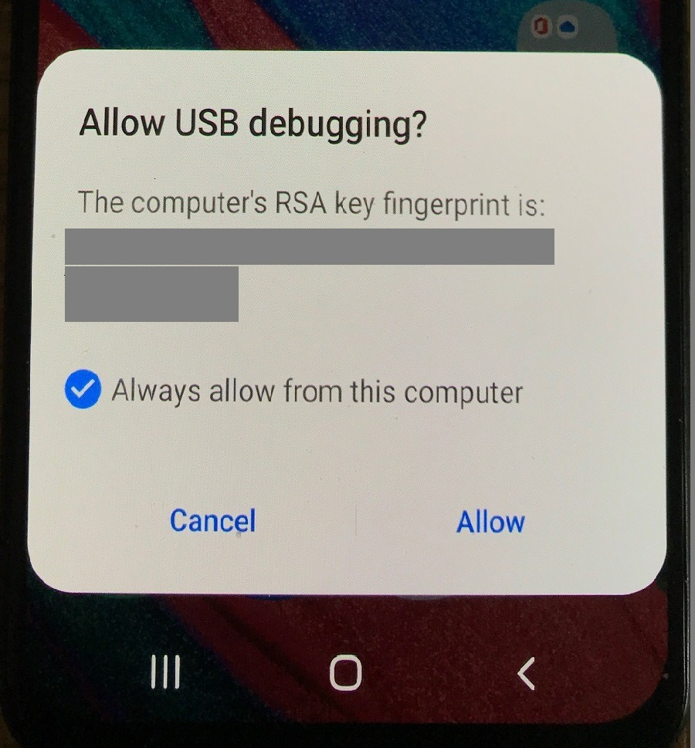
Connect the Android Device
Enable USB debugging on the Phone
https://developer.android.com/studio/debug/dev-options
Connect the phone
Set Always Allow on the phone for the Usb debugging
Check via adb from cmd or terminal
c:\>adb devices -l
* daemon not running; starting now at tcp:5037
* daemon started successfully
List of devices attached
R58N34VSV1A device product:a40eea model:SM_A405FN device:a40 transport_id:1

Slide 5
What do I install
2 Main Installation Options
Install the Appium Desktop –recommended if you just want to get things rolling fast.
It is supported up to Appium server 1.x
https://github.com/appium/appium-desktop/releases/
Download the exe(Windows) or dmg(Mac)
Or
Install via NPM(Node.js) - the only way to do it for beta
If you only have access to command line(e.g: on a server) or need the latest beta
npm install -g appium
npm install -g appium@next for the latest beta( 2.0 is beta at the moment )

Slide 6
Key concepts
Session
-client initiates a session with Appium server. All further commands are bound to that session referenced by an ID
Capabilities
-it’s a Map that contains key value pairs to instruct the server what type of session we want to start:
e.g.: iOS,Android , maybe certain version of OS
Appium clients:
-these are client libraries (in Java, C#, JavaScript, Ruby, Python, PHP) which support Appium's extensions to the WebDriver protocol

Slide 7
Start a session – the old way
Desired Capabilities must be set in order to start a session.
This is compatible with Appium 1.x server version(the one supported by Appium server desktop)
It works on Appium 2.x because because the java client translates capabilities in w3c capabilities using the AndroidUiautomator2Driver for Android, and it puts “appium:" in front of vendor specific capabilities.
Starting a session can be done through:
-Appium inspector(when searching for ui elements locators)
-programmatically
new AndroidDriver<>(new URL("http://127.0.0.1:4723/wd/hub"), getDesiredCapabilities());
private DesiredCapabilities getDesiredCapabilities() {
DesiredCapabilities desiredCapabilities = new DesiredCapabilities(); desiredCapabilities.setCapability(MobileCapabilityType.PLATFORM_NAME, "Android"); desiredCapabilities.setCapability(MobileCapabilityType.PLATFORM_VERSION, "13"); desiredCapabilities.setCapability(MobileCapabilityType.AUTOMATION_NAME, "UiAutomator2"); desiredCapabilities.setCapability(MobileCapabilityType.DEVICE_NAME, "AndroidDevice"); desiredCapabilities.setCapability(MobileCapabilityType.NEW_COMMAND_TIMEOUT, 2000); desiredCapabilities.setCapability(MobileCapabilityType.NO_RESET, true); desiredCapabilities.setCapability(MobileCapabilityType.APP, "C:\\Users\\Maria\\apks\\SauceLabDemo.apk");
//needed when switching context to webview desiredCapabilities.setCapability(UiAutomator2Options.CHROMEDRIVER_EXECUTABLE_OPTION, "C:\\Users\\Maria\\chromedrivers\\chromedriver103.exe"); return desiredCapabilities; }

Slide 8
Start a session – the new way
If we use uiautomator2 driver for Android, then we can use UiAutomator2Options in order to start a session
new AndroidDriver<>(new URL("http://127.0.0.1:4723/wd/hub"), getOptions());
private UiAutomator2Options getOptions() {
UiAutomator2Options uiAutomator2Options = new UiAutomator2Options() .setPlatformName("Android") .setPlatformVersion("13") .setAutomationName("UiAutomator2") .setDeviceName("AndroidDevice") .setNewCommandTimeout(Duration.ofSeconds(2000)) .setNoReset(false) .setApp("C:\\Users\\Maria\\apks\\SauceLabDemo.apk") .setChromedriverExecutable("C:\\Users\\Maria\\chromedrivers\\chromedriver103.exe"); return uiAutomator2Options;
}

Slide 9
Element locators
Define Element Locators in PageObjects
Locators strategies
You can use some of the known ones from Selenium( id, name, class name, xpath ) or native specific ones
ACCESSIBILITY("accessibility id"),
ANDROID_UI_AUTOMATOR("-android uiautomator"),
IOS_UI_AUTOMATION("-ios uiautomation"),
IOS_PREDICATE_STRING("-ios predicate string"),
IOS_CLASS_CHAIN("-ios class chain"),
WINDOWS_UI_AUTOMATION("-windows uiautomation"),
IMAGE("-image"),
ANDROID_VIEWTAG("-android viewtag"),
ANDROID_DATA_MATCHER("-android datamatcher"),
ANDROID_VIEW_MATCHER("-android viewmatcher")

Slide 10
Element locators continued
Locators example
-android uiautomator
e.g.: new UiSelector().text("Nume Buton")
-id (accessibility id)
-ios predicate string
e.g: type == 'XCUIElementTypeButton' and label == 'Login'
-ios class chain
e.g.: "**/XCUIElementTypeCell[`name BEGINSWITH 'NUME_CELULA'`]/XCUIElementTypeStaticText"
And if not… try to talk to devs to add ids ☺
And if not… use xpath

Slide 11
Further reading
https://bitrise.io/blog/post/getting-started-with-appium-2-0-your-beginners-guide
https://appium.github.io/appium/docs/en/2.0/quickstart/
https://appium.github.io/appium/docs/en/2.0/quickstart/install/
https://appium.github.io/appium/docs/en/2.0/quickstart/uiauto2-driver/
https://appium.github.io/appium/docs/en/2.0/guides/migrating-1-to-2/
https://blogs.halodoc.io/appium-java-client-v7-to-v8-migration/
https://github.com/appium/java-client#usage-examples
https://appium.github.io/appium/docs/en/2.0/guides/caps/
https://appiumpro.com/editions/8-how-to-find-elements-in-ios-not-by-xpath
https://appiumpro.com/editions/60-how-to-pick-the-right-locator-strategy

Slide 12
Resources
Demo app
https://github.com/saucelabs/my-demo-app-rn/releases/tag/v1.3.0
Android-MyDemoAppRN.1.3.0.build-244.apk
Node – needed for running Appium 2 or any other beta.
https://nodejs.org/en/download
Old bundled appium 1.x server gui. No node needed.
https://github.com/appium/appium-desktop/releases/download/v1.22.3-4/Appium-Server-GUI-windows-1.22.3-4.exe

Slide 13
Thank
you
for your time ☺

