Slide 1
Describe and plot the data (2018, 2019)
The goals:

Slide 2
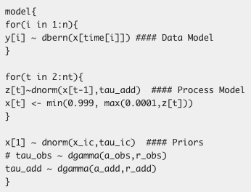
Random Walk Model (Binomial)

Slide 3
Random Walk Model (Binomial)

Slide 4
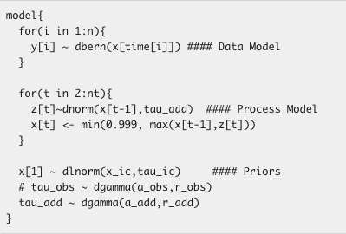
You can’t put the chlorophyll back in the leaves!
Phenology doesn’t progress backward:

Slide 5
You can’t put the chlorophyll back in the leaves!
Phenology doesn’t progress backward:

Slide 6
Cold degree days: accumulation of temperatures below 10°C

