Slide 1
Project Presentation
Jingtian Ji Yunhao Yu

Slide 2
Introduction
Main Purpose:
Identify people’s names in the texts
Compare with classifier based on Bert’s representation

Slide 3
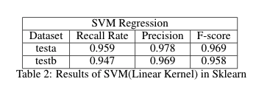
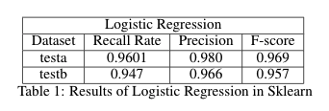
Preliminary Test: Logistic Regression & SVM
Pybind:
Python: Data Importation
C++: Logistic Regression & SVM
Compared with Sklearn:
Notes:
First, we use the 724-dimensional vector provided by the Bert model to try a simple classification.
We chose pybind11 to implement the code of c++ which can generate libraries for python, and we chose logistic classification and support vector machines as the classifiers.
For the choice of metric, we focus on recall rate and F-score since the dataset is unevenly distributed and we tend to protect the users’ information.
In the table, we did not show the results of our code, because after comparison, we found that compared with the existing machine learning library, our algorithm lacks many optimizations, which leads to long calculation time and unsatisfactory results. So they could not serve as the baseline for the following tasks. Therefore, we choose a more mature algorithm as the baseline for subsequent experiments.
After exploiting the 724 dim vector, we start analyse the original text.

Slide 4
Preliminary Test: Limitation of raw representation
Special symbols may be tagged as ‘I-PER’
‘(‘ or ‘)’ in sentence:
I remember Nolan Ryan saying in ' 91 or ' 92 that he was the best young pitcher coming around in a long time and he saw ( Tom ) Seaver and ( Jerry ) Koosman when they were starting . "
‘ " ’ in sentence:
Panamanian boxing legend Roberto " Hands of Stone " Duran climbs into the ring on Saturday in another age-defying attempt to sustain his long career .
Notes:
Then we conducted a through analysis on the original dataset to find out the main challenges of our task.
And we have the following observations.
First of all, some special characters are tagged as person. For example, these brackets are tagged as I-PER in this sentence. We think tag ‘O’is more appropriate for these special characters, so we removed these special characters in our data preprocessing process.

Slide 5
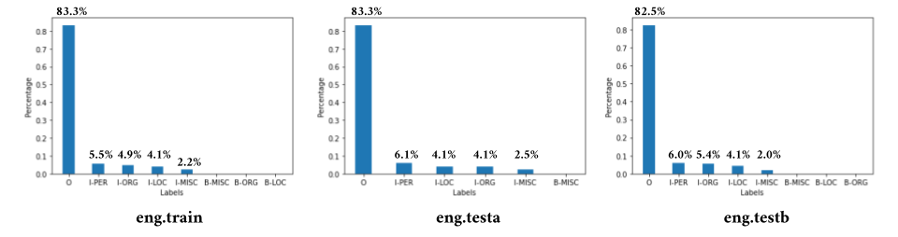
Preliminary Test: Limitation of raw representation
Special symbols may be tagged as ‘I-PER’
Label distribution in the original data set is uneven.
Notes:
Next, we found out that the label distribution in the original data set is uneven.
We can see they are much more words tagged with the label ‘O’.
In other words, in the train data set, because our task is binary classification, if for every input we predict it always as the tag ‘O’, then we have an accuracy of 1-5.5% = 94.5%. Thus, in our case, we should pay more attention on the recall rate, since we want to find people’s names and the consequence of not correctly finding the persons names is serious, because user privacy leaks are risky.

Slide 6
Preliminary Test: Limitation of raw representation
Special symbols may be tagged as ‘I-PER’
Label distribution in the original data set is uneven.
Different labels may appear for the same word
Ex: Multiple Tags
Brown : I-LOC in sentence
6,739-yard Brown Deer Park Golf Course after the first round
I-PER in sentence
6. Steve Brown ( U.S. ) 13.53
Notes:
We also find out that the same words can have multiple tags.
For example, the word “Brown” can not only be a person, but also be a location.

Slide 7
Preliminary Test: Limitation of raw representation
Special symbols may be tagged as ‘I-PER’
Label distribution in the original data set is uneven.
Different labels may appear for the same word
Ex: Multiple Tags in a same sentence.
Mother :
Happy Birthday to our Dearest Mother (O) , " read a placard at the Shishu Bhavan children 's home in central Calcutta run by Mother (I-PER) Teresa's Missionaries of Charity .
Notes:
A word may have different tags even in the same sentence.
For example, the word “Mother” is tagged as O and PER in this sentence.
Furthermore, these two words both starts with a capital letter, which suggests that a simple approach like if the word starts with a capital letter then it’s a person may not work in this case.
This observation reminds us to devise a method which should based on the context.

Slide 8
Preliminary Test: Limitation of raw representation
Special symbols may be tagged as ‘I-PER’
Label distribution in the original data set is uneven.
Different labels may appear for the same word
The results of Bert are not very linearly separable.
Notes:
使用的是bert-large-case的model和tokenizer
Finally, we used the bert larg case model to get the 1024-dimension representation for each token, then we average the tokens for the same word to get the 1024-dimension representation for a word.

Slide 9
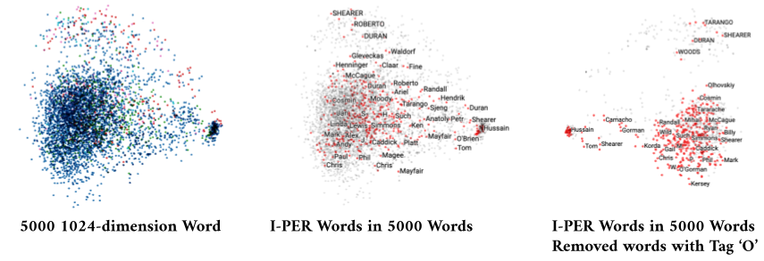
Preliminary Test: Limitation of raw representation
Special symbols may be tagged as ‘I-PER’
Label distribution in the original data set is uneven.
Different labels may appear for the same word
The results of Bert are not very linearly separable.
Notes:
Then we conducted a PCA Analysis on these word representations, we found out that The results of Bert are not very linearly separable.
Since the person’s name are mixed with words with tag “O”. Even if we removed the words with tag “O”, we can find out in the third picture that the persons names are also mixed with words with other tags.

Slide 10
Preliminary Test: Conclusion
Main Challenge:
Special symbols may be tagged as ‘I-PER’ → Data Preprocessing
Unevenly distributed samples → Data Augmentation
Different labels may appear for the same word → BiLSTM
Unobserved words during test → Char Embedding
Notes:
So let’s make a quick recap for the preliminary part.
Since the Bert ‘s representation combined with simple classifier has already achieved good results, our following tasks then will focus on building a pipeline which proves to be more efficient and more task-related than BERT’s model.
In terms of challenges, we want to clean the dataset and propose a method to facilitate the training. Besides, considering the example of Brown, we also need to build a model to extract the contextual information. Moreover, we also want to infer the unseen word in test dataset, since BERT model use the words embedding so it may perform worse when classifying the word which is not in his dictionary.

Slide 11
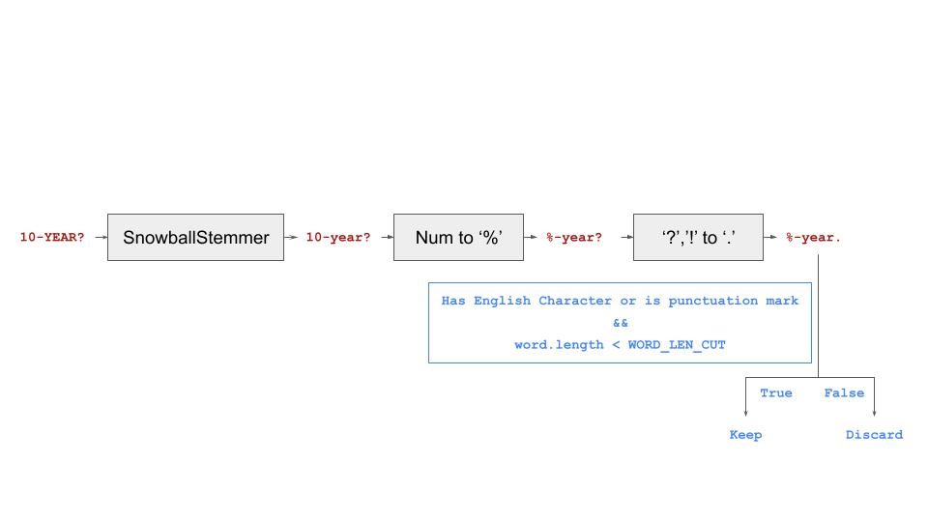
OUR Work: Data processing
Notes:
To begin with, we performed the following pre-processing on the raw data to get our training data.
We only consider sentences that have at least 2 words, and in addition if the sentence length exceeds 65 words, we divide it into 2 sentences.
For each word in the sentence, we use the process in this picture. First we pass it through SnowballStemmer in the nltk package, then we change the number in it to the Percent sign, and finally we change the ‘?’(question mark) and ‘!’(Exclamation mark) uniformly to ‘.’(Period).
We keep only the words which contain English characters, or some punctuation mark like comma and period. In addition, if the word still exceeds 25 characters after preprocessing, we will also discard it.

Slide 12
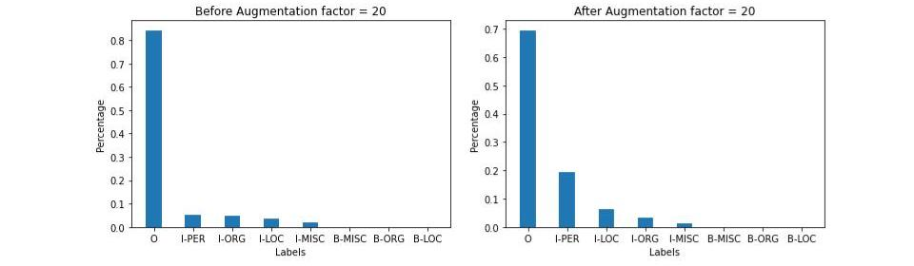
OUR Work: Data processing
Problem:
Uneven label distribution
Main idea:
Increase the proportion of sentences involving names
Classification should be invariant to any name.
Replace randomly the people’s name in the sentence with the names of the same length.
Only consider sentences with dense ’I-PER’ tags.
Notes:
To solve the problem of uneven label distribution, we try to augment the proportion of sentences involving names.
This idea is feasible, since our classification task should be invariant to any names.
The implementation is simple. For every sentence which is short and contains names, we replace the name in the sentence by sampling randomly other names in the training data set.
From this picture, we can see that, to a certain extent, this approach has alleviated the problem of uneven data distribution.

Slide 13
Our work: Word & char embedding
Problem: Basic tokenization and word embedding can not infer unobserved word in test
Main Idea: Combine character embedding and word embedding
Word Embedding: we apply a 2-layer BiLSTM on the tokenized word to extract contextual information.
Char Embedding:
Apply multiple 1D Convolution filters with different sizes and MaxPooling filters on the character.
Add the highway module to add nonlinearity.
Apply a 2-layer BiLSTM on the concatenated characters.
Attention Encoder:
We apply self attention module before the classifier to extract more contextual information.
Classifier
Self Attention
Add
Add
h
h
w
bilstm
w
h
h
bilstm
Highway
Highway
w
w
1d CNN
1d CNN
c
c
c
c
c
c
c
c
c
c
green
apple
g
r
e
e
n
a
p
p
l
e
Notes:
这个Highway 之后才是 char embedding
Now, let’s move on our neural network where we mainly want to achieve the same performance as BERT’s model and can infer unseen words during test by using a lighter model.
First of all, we use the BILSTM which is supposed to be capable of capturing the contextual information to embed the words in the prepared dictionary. During our experiment, with only using the word embedding, we can train fast on the dataset and reach excellent train loss however it is uncapable of classifying the new words in test dataset.
Then, we try the char embedding which has the important 1D convolution filters applied on the characters so it can see every input word no matter whether it’s in dictionary or not. Here we still use the bilstm to capture the contextual information.
Finally, after testing the two models, we find combining the different embeddings can achieve better performance during training and testing. And we also add a self-attention module before the classifier since more contextual information may appear after combining two parts.

Slide 14
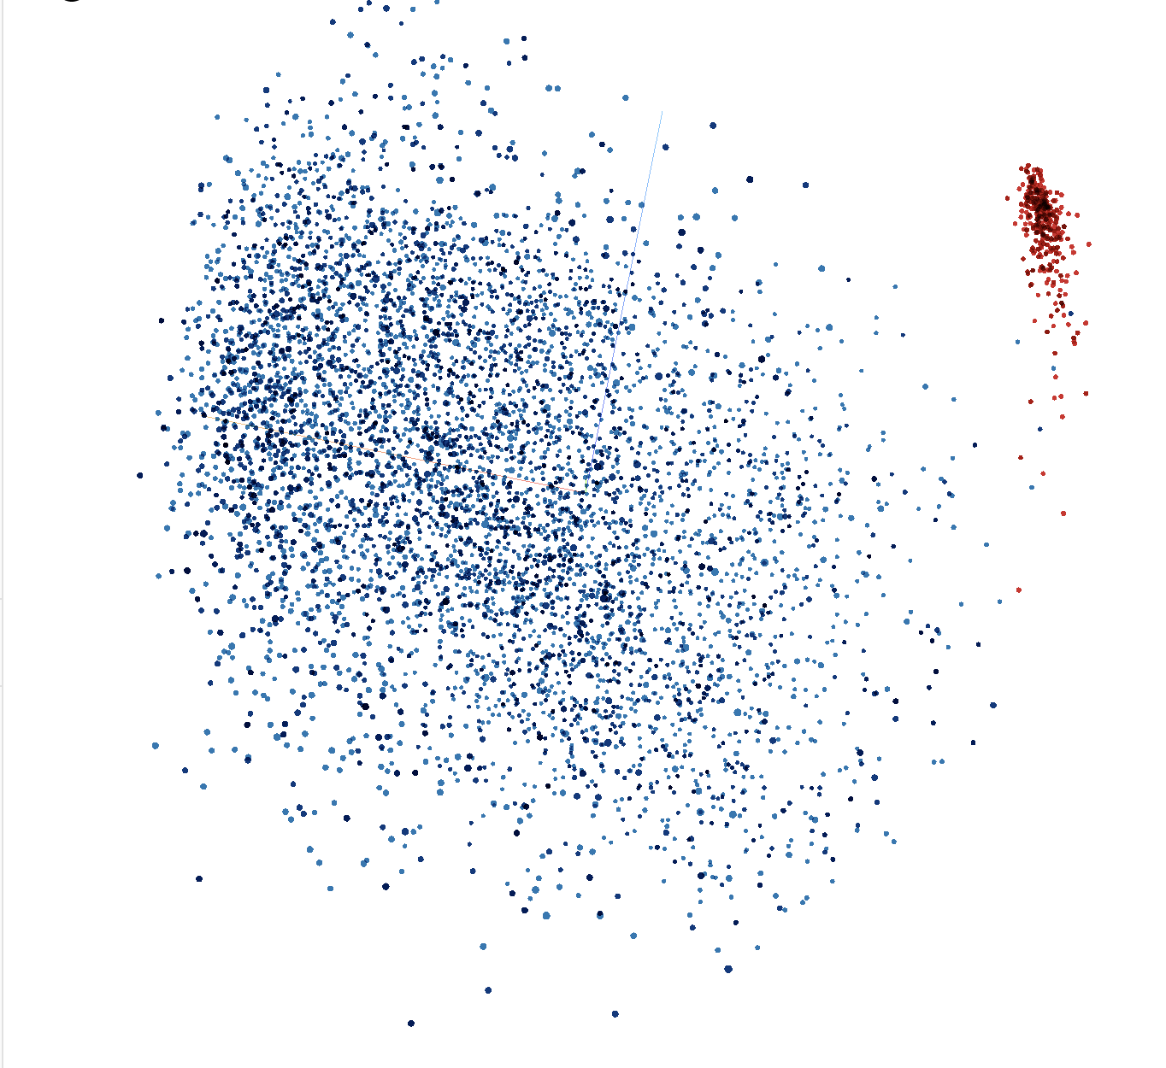
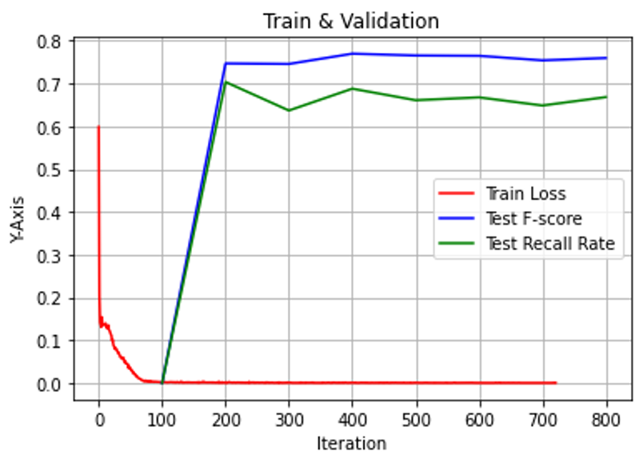
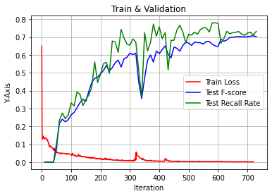
Our work: Word & char embedding
Intuition behind network:
Why char embedding ?
Filters of different sizes can learn word components such as prefixes, affixes, and infer the unseen words.
Char embedding can adapt to input noise such as spelling errors.
Why word embedding ?
Combine char and word embedding is like an ensemble method to improve the performance.
Why add a self attention ?
Char and word embedding could complement each other, which provide more contextual information to extract.
Name classification does not need extra long term dependency.
Final embedding
Word&char
Only Char
Notes:
Then we want to explain some intuition behind our model:
First of all, why the convolution-based char embedding could tackle the unseen words? Because the filters with different size may learn some word components frequently appeared in names. Like the luc in names Luca, Lucie, Lucien and Lucken. Besides, we think that the maxpooling layer could render the model more robust to misspelling error because the wrong character may not appear in any word component before so the component containing the this character will be suppressed by maxpooling.
Secondly, why we combine both two embedding which seems to contradict our purpose of building a light model. However, we find it works like an ensemble method since the two model takes different input, one from word another uses the character. And the experiment proves our idea so we finally adapt the models.
Finally, why we use the another attention module before the classifier? Since we believe the combined embedding may provide more contextual information so adding another module could be useful. Besides, our sentences are usually short and the name classification usually doesn’t need long term dependency, so looking the surrounding word would be sufficient.

Slide 15
Conclusion
What we learn ?
Familiar with using c++ as python library and understand the importance of algorithms optimization.
Propose a data augmentation method to alleviate the unevenly distributed data.
Combine word embedding and character embedding to propose a efficient and light neural network
What we can do ?
Admittedly, we still underperform the BERT’s representation.
Train our model on a bigger data set
Redesign out tokenization process
Try more unsupervised learning or more models
Notes:
Finally, we would like to make a conclusion for our project:
During this project , we have learned a lot about NLP and coding.
We first get familiar with pybind11 and know about the difference between professional implementation and our naïve, text book-based implementation.
Second, we learn the importance of analyzing the dataset before conceiving algorithms. And we find the data augmentation really interesting and useful. We think it would be important not only for this project but also for any other data-based problem.
Finally, it’s beneficial for us to design and implement the network. We got a taste of the unlimited potential of neural network.
However, there are still a lot of thing could be improved in the future:
Admittedly, compared with our baseline, we still underperform the BERT’s representation. But our training time and model size is much smaller than BERT.
So we reflect on our project to see why BERT proves to be so powerful and what ideas we can try without rendering the model bigger.
First of all, the BERT use a huge amount of dataset to feed himself during pretraining. So we can also apply our model on divers dataset.
Second, we see that BERT use its own complex tokenizer so we believe the redesigning tokenization will be useful for our model.
Finally, BERT use the LM model and next sentence prediction to improve its performance. These model seems too huge or unnecessary for the NER problem but still we can propose some unsupervised learning method which could help our model when it comes to unseen name or spelling error.

Slide 16
Thanks For your attention
Notes:
Tensorboard Bert Representation
https://colab.research.google.com/drive/14b4UAqXWyzE-apnxdthmuw-TrUVPijFI?usp=sharing

