Slide 1



Internship Project
Employee Attendance Data Analysis and Reporting
from:
May, June And July 2024

Slide 2
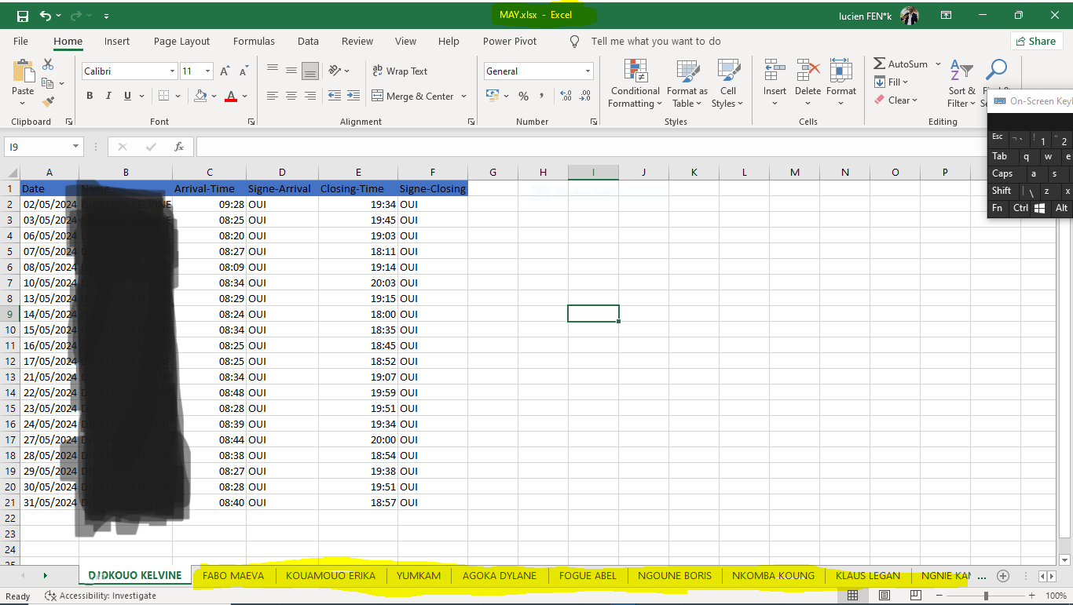
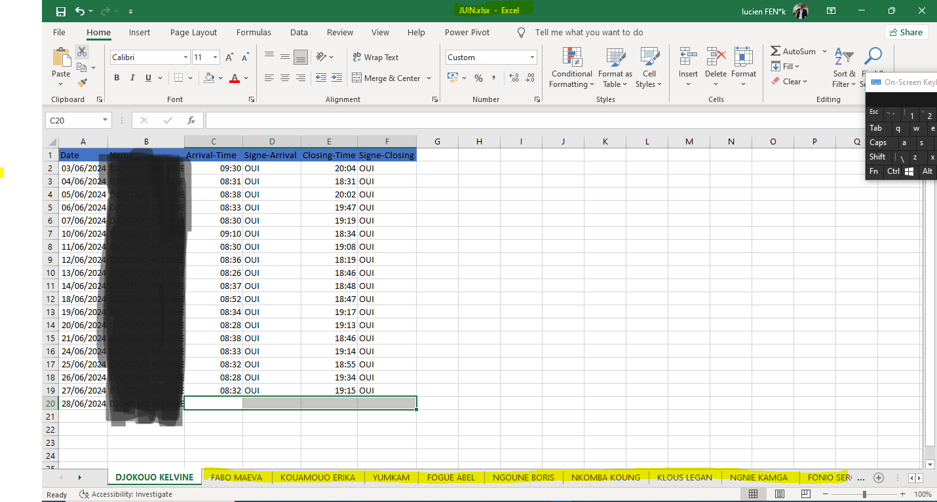
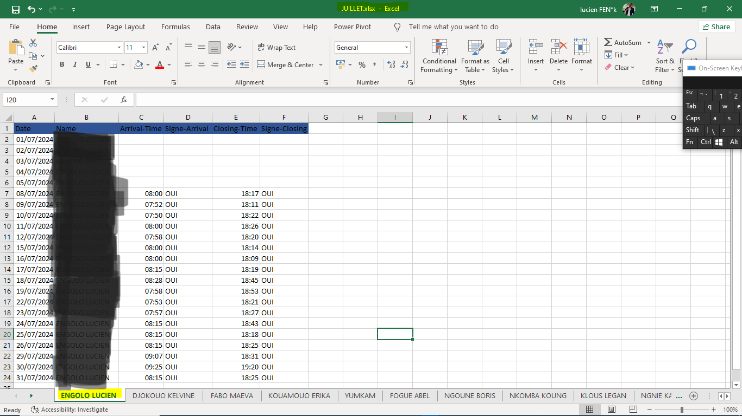
Data Collection
Created an Excel File For The 3 Month
With 23 Employees Sheets Inside
With Their Data Entry For Each Employees
Period Of : MAY, JUNE AND JULY 2024

Slide 3
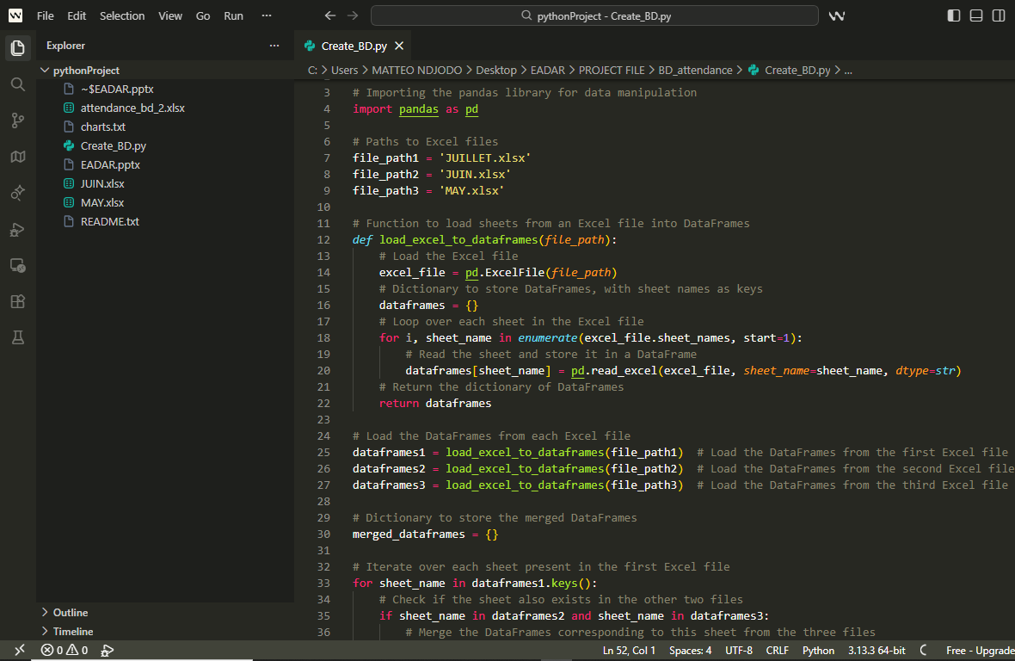
Data Processing
Combine Data to have Single Data Set On
PYTHON In WindSurf

Slide 4
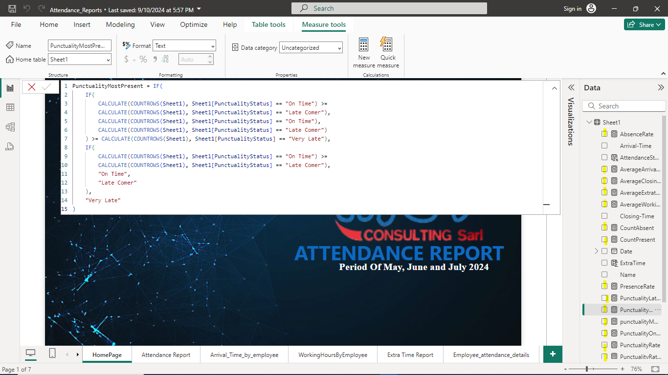
Data Visualization
Visualising Data By Creating Measure Like :
PunctualityMostPresent
AbsenceRate
AverageArrivalTime etc…

Slide 5
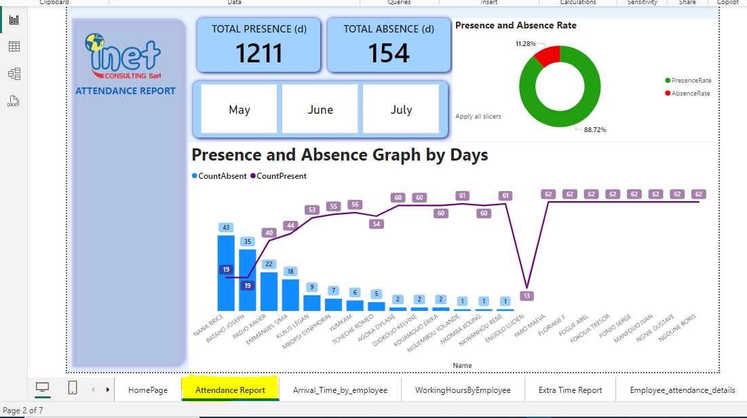
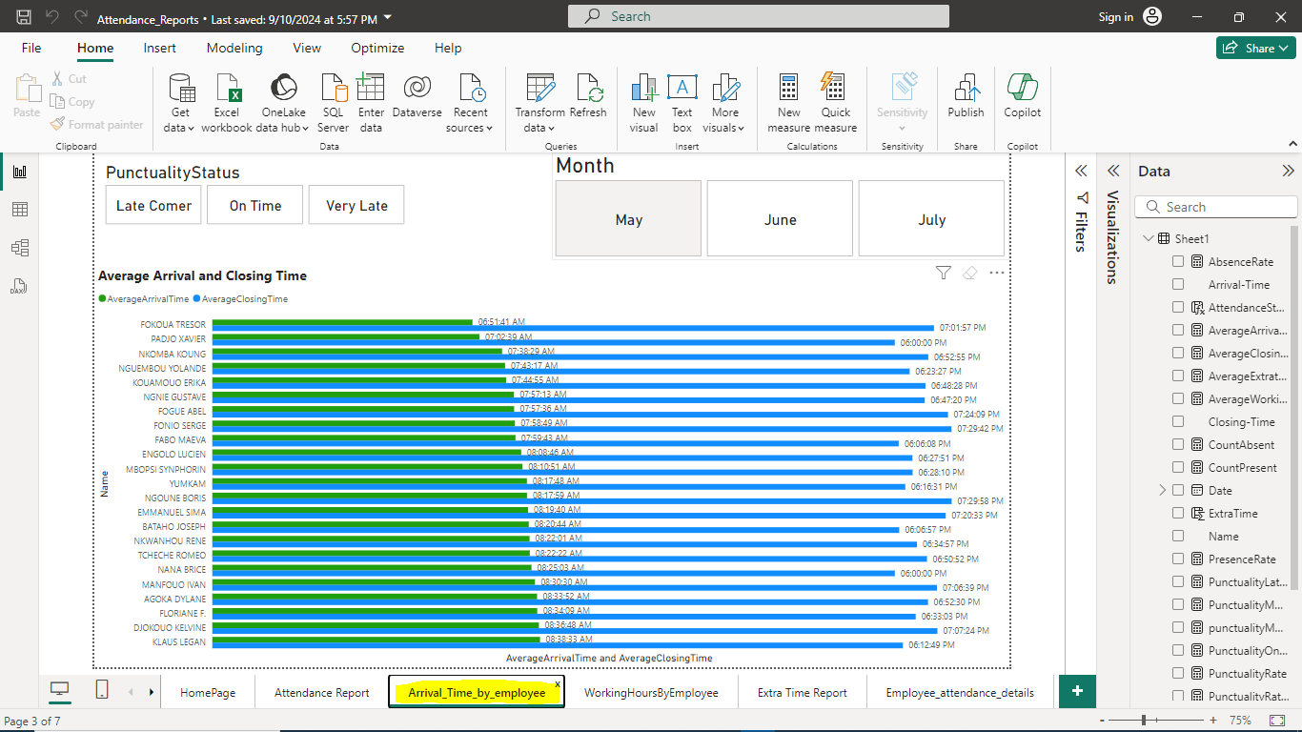
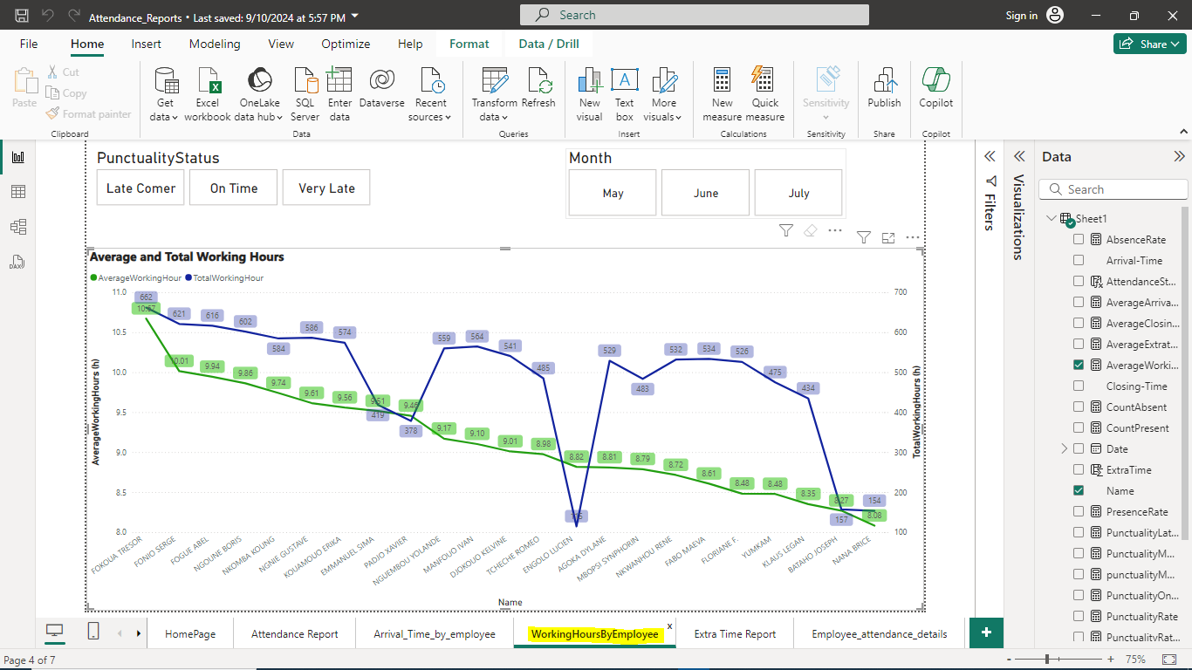
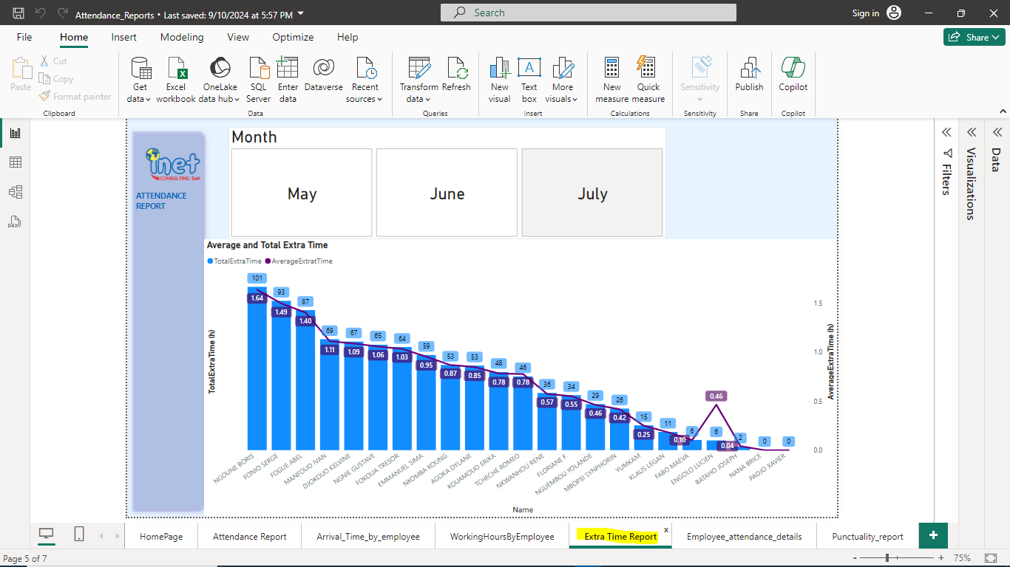
Analytic Reports
Attendance Report
Arrival Time Report
Working Hours Report
Extra Time Report
REPORT VIEW OF DIFFERENT MEASURES AND CALCULATION

Slide 6
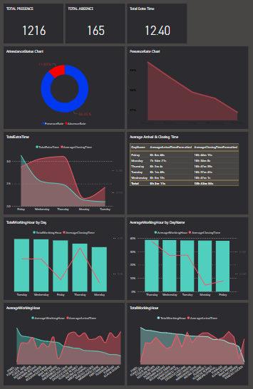
Dashboard Generation
The purpose of a DASHBOARD is to combine all the different REPORT VIEWS on a single PAGE to have a global view of the project.
These can only done in POWER BI SERVICE
DASHBOARD OF ALL THE DIFFERENT REPORTS

