Slide 1
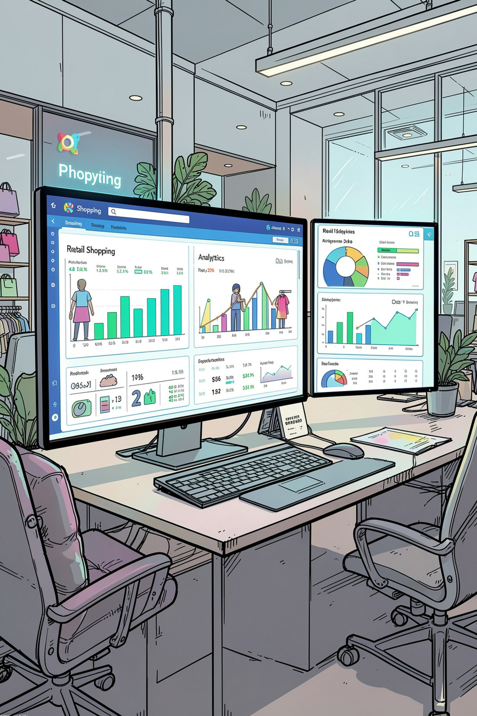
Customer Shopping Behavior Analysis
A data-driven study of consumer purchasing patterns using Python, SQL & Power BI
ANSH · MBA INTERNATIONAL BUSINESS · MIT PUNE · 2024–2026

Slide 2
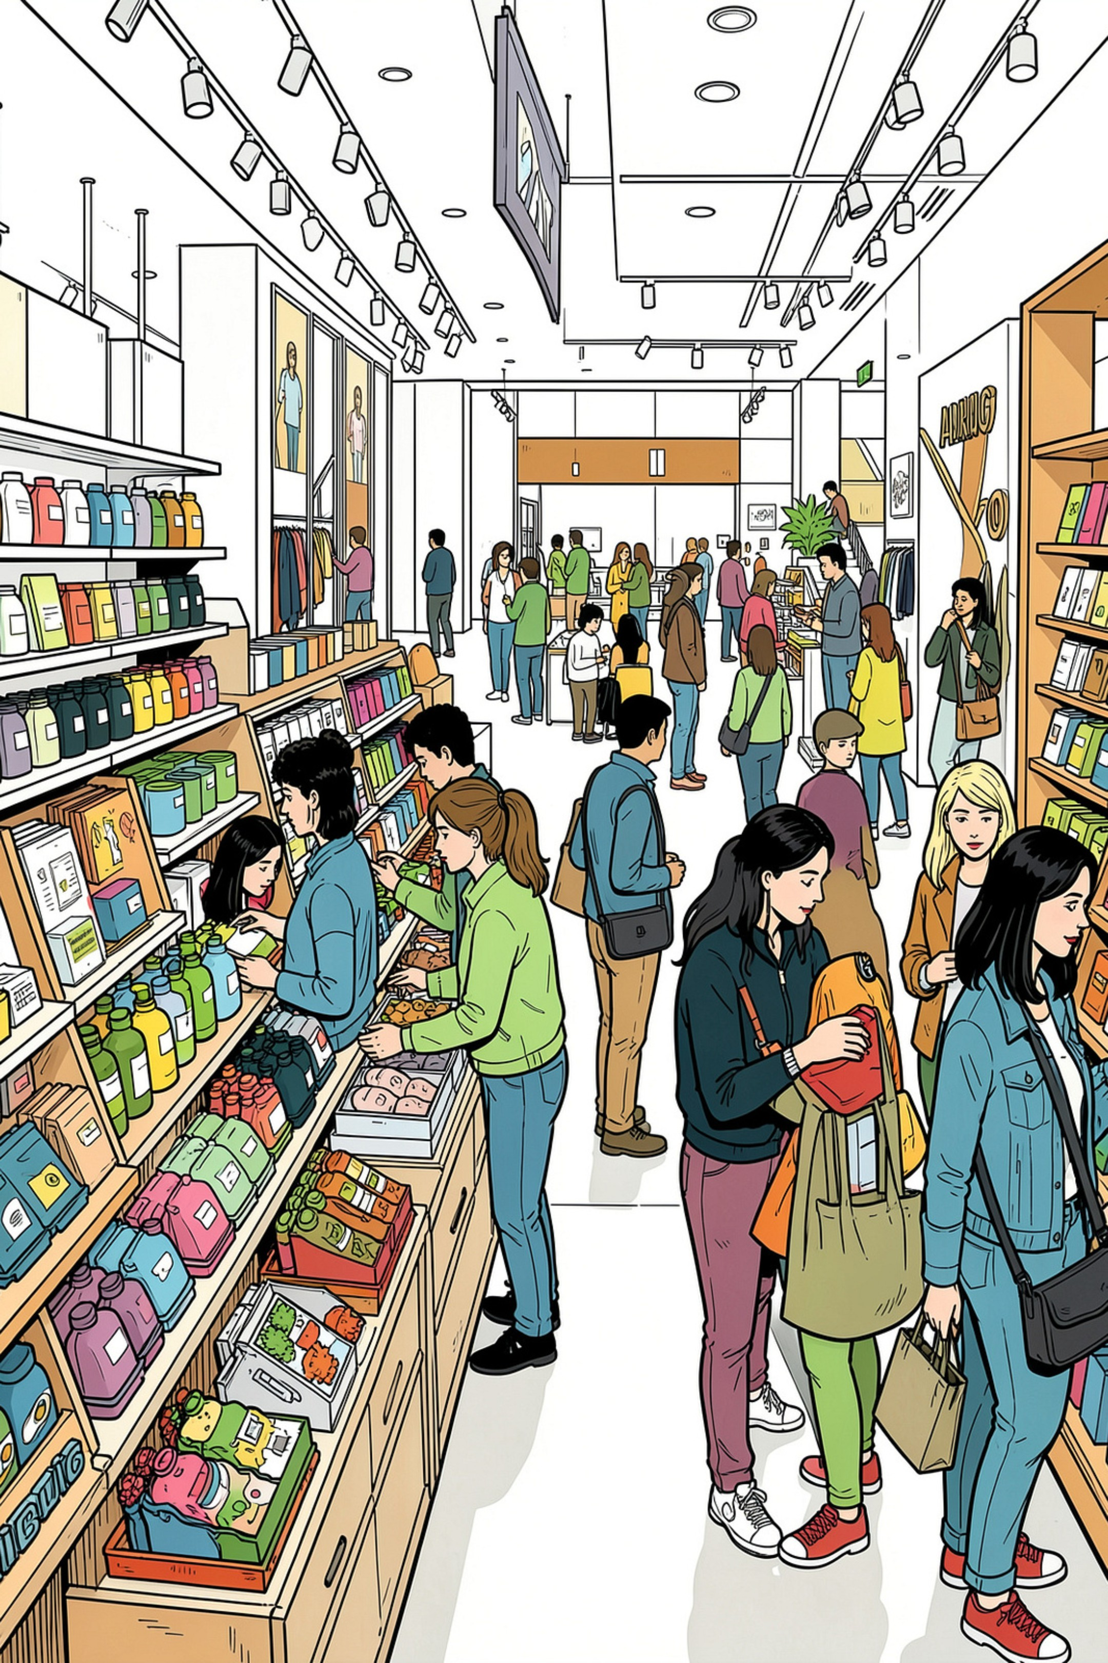
The Challenge
"How can the company leverage consumer shopping data to identify trends, improve engagement, and optimize marketing strategies?"
3,900 Transactions
$233,081 Revenue
18 attributes
$59.76 avg purchase
43% Discount Rate
27% subscribers

Slide 3
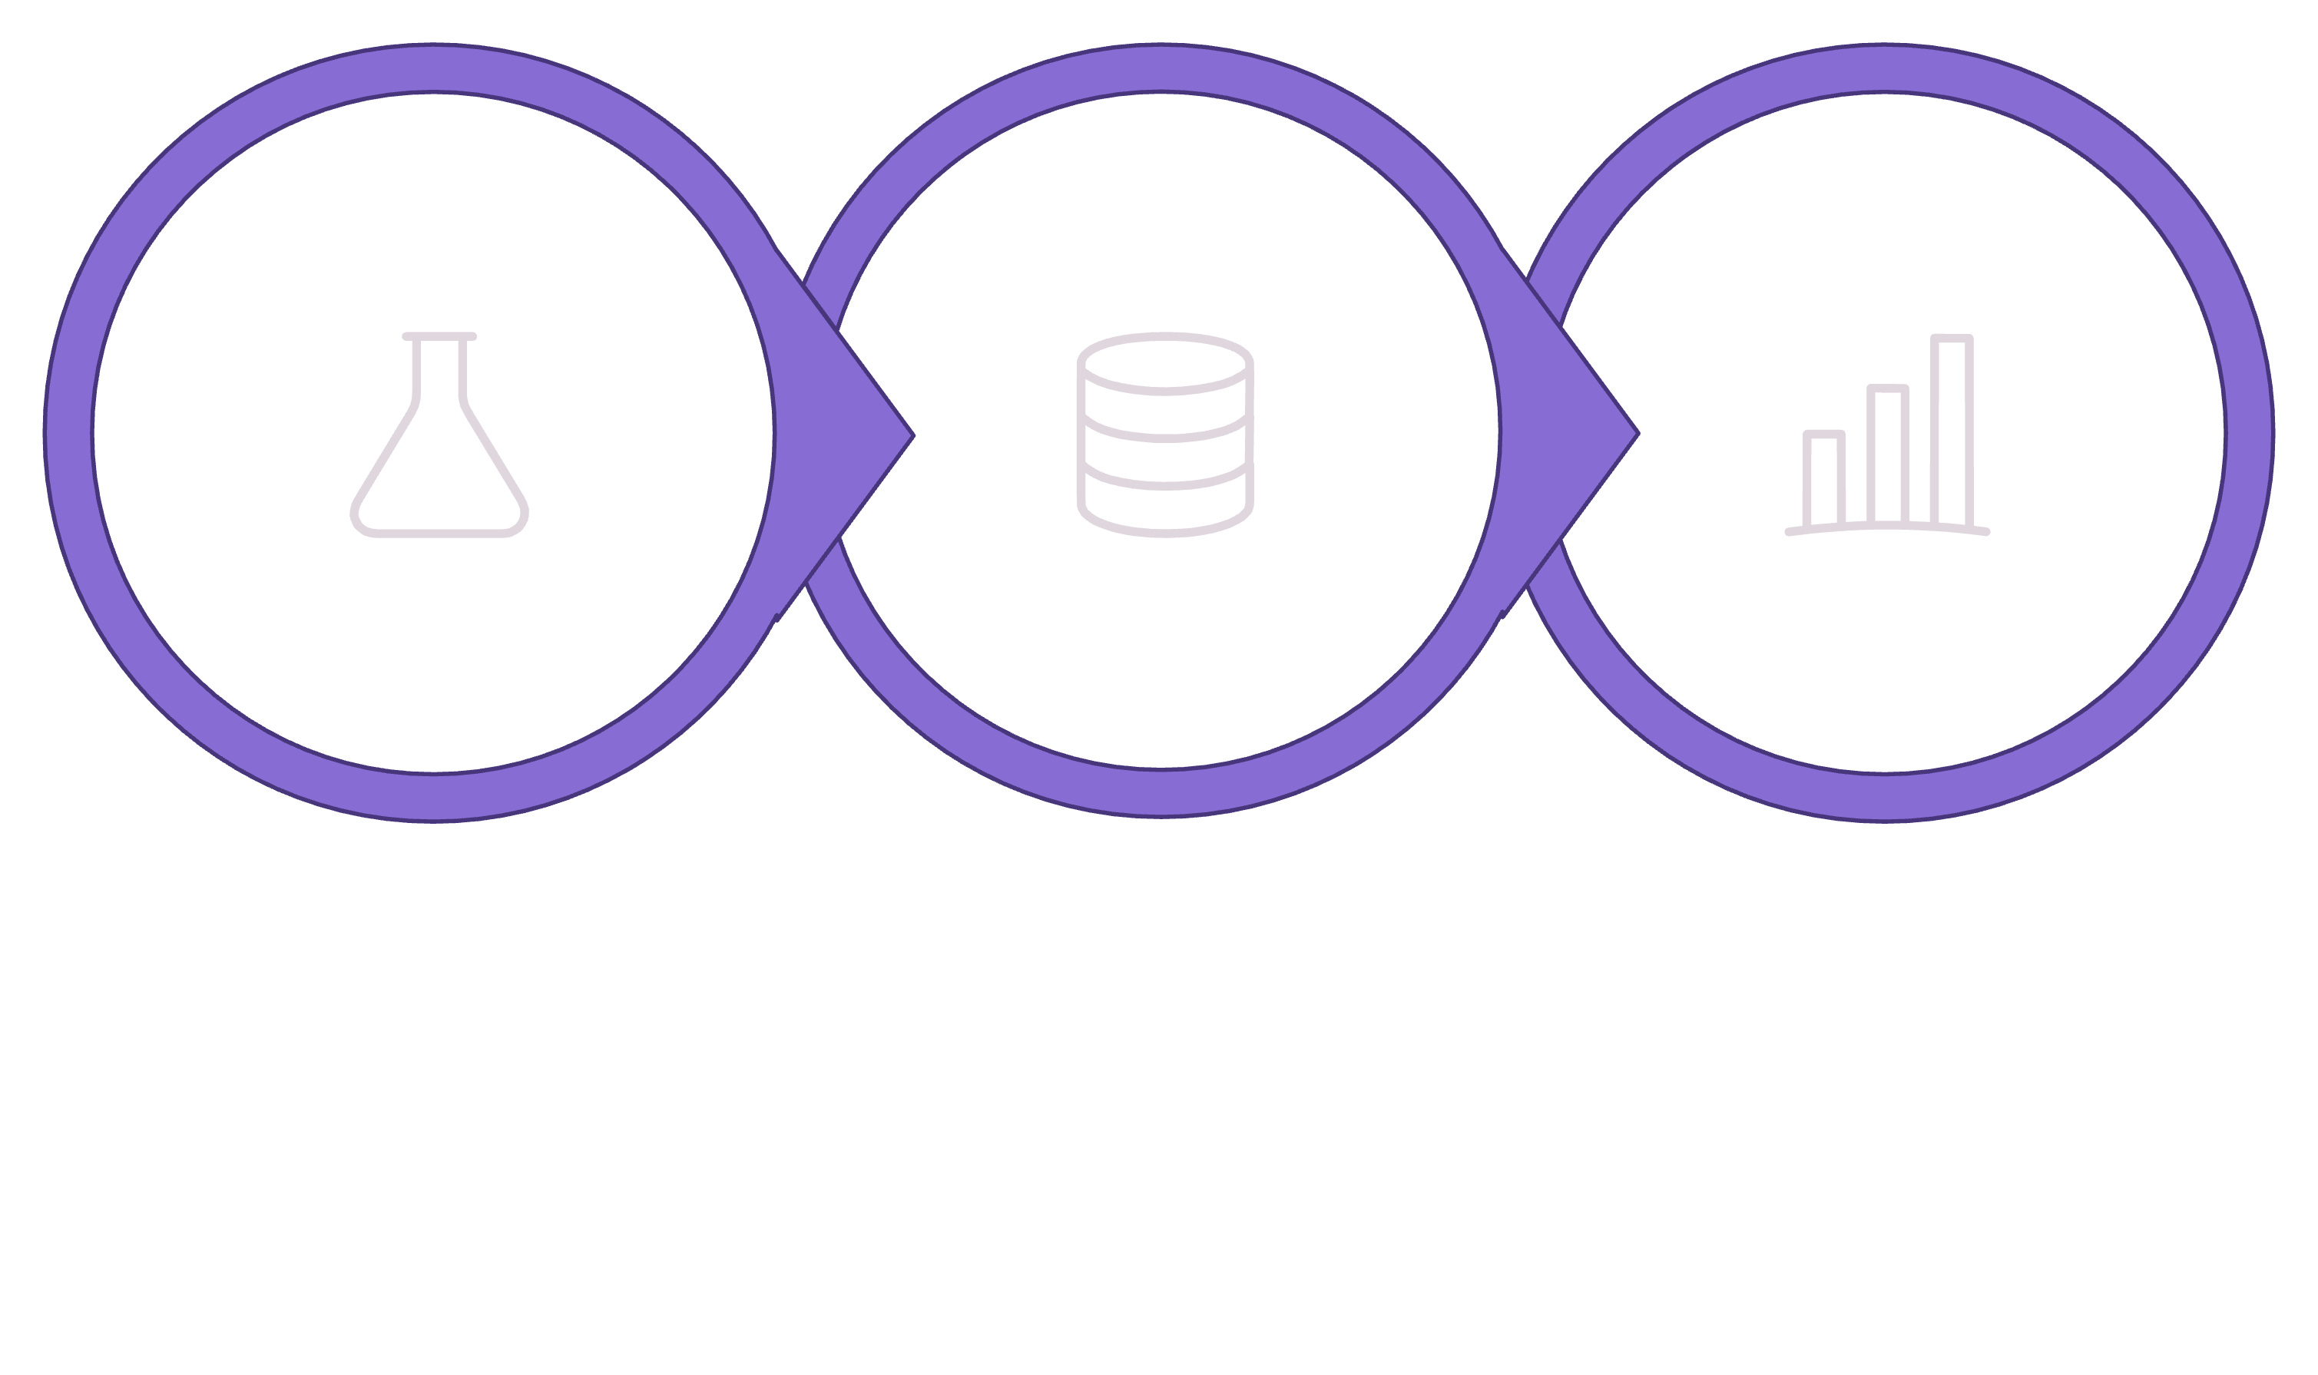
End-to-End Methodology
Data Prep
SQL Analysis
Power BI
From raw CSV to stakeholder-ready insights — fully reproducible on GitHub.

Slide 4

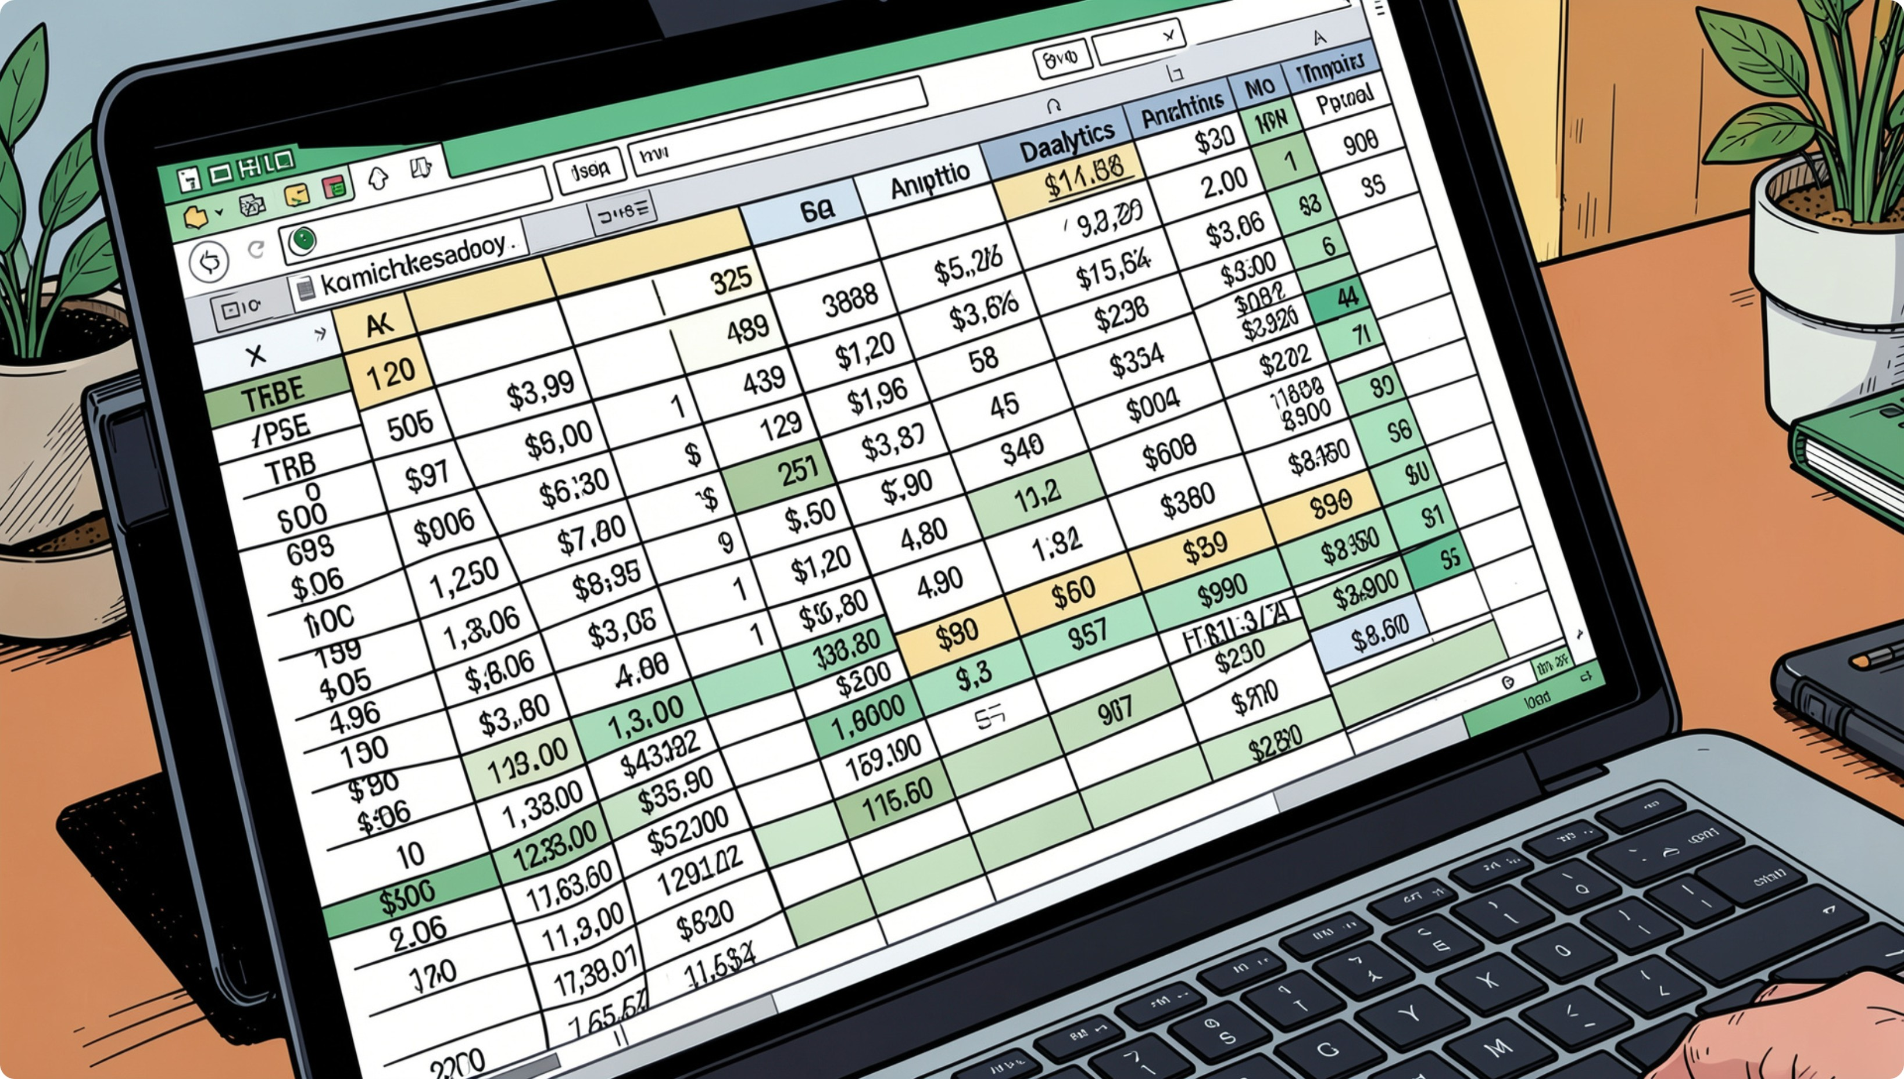

Dataset at a Glance
3,900 Records
18 attributes
50 US States
Demographics covered
4 Categories
Clothing, Footwear, Accessories, Outerwear
37 Missing Values
Review Rating only — imputed by category median

Slide 5
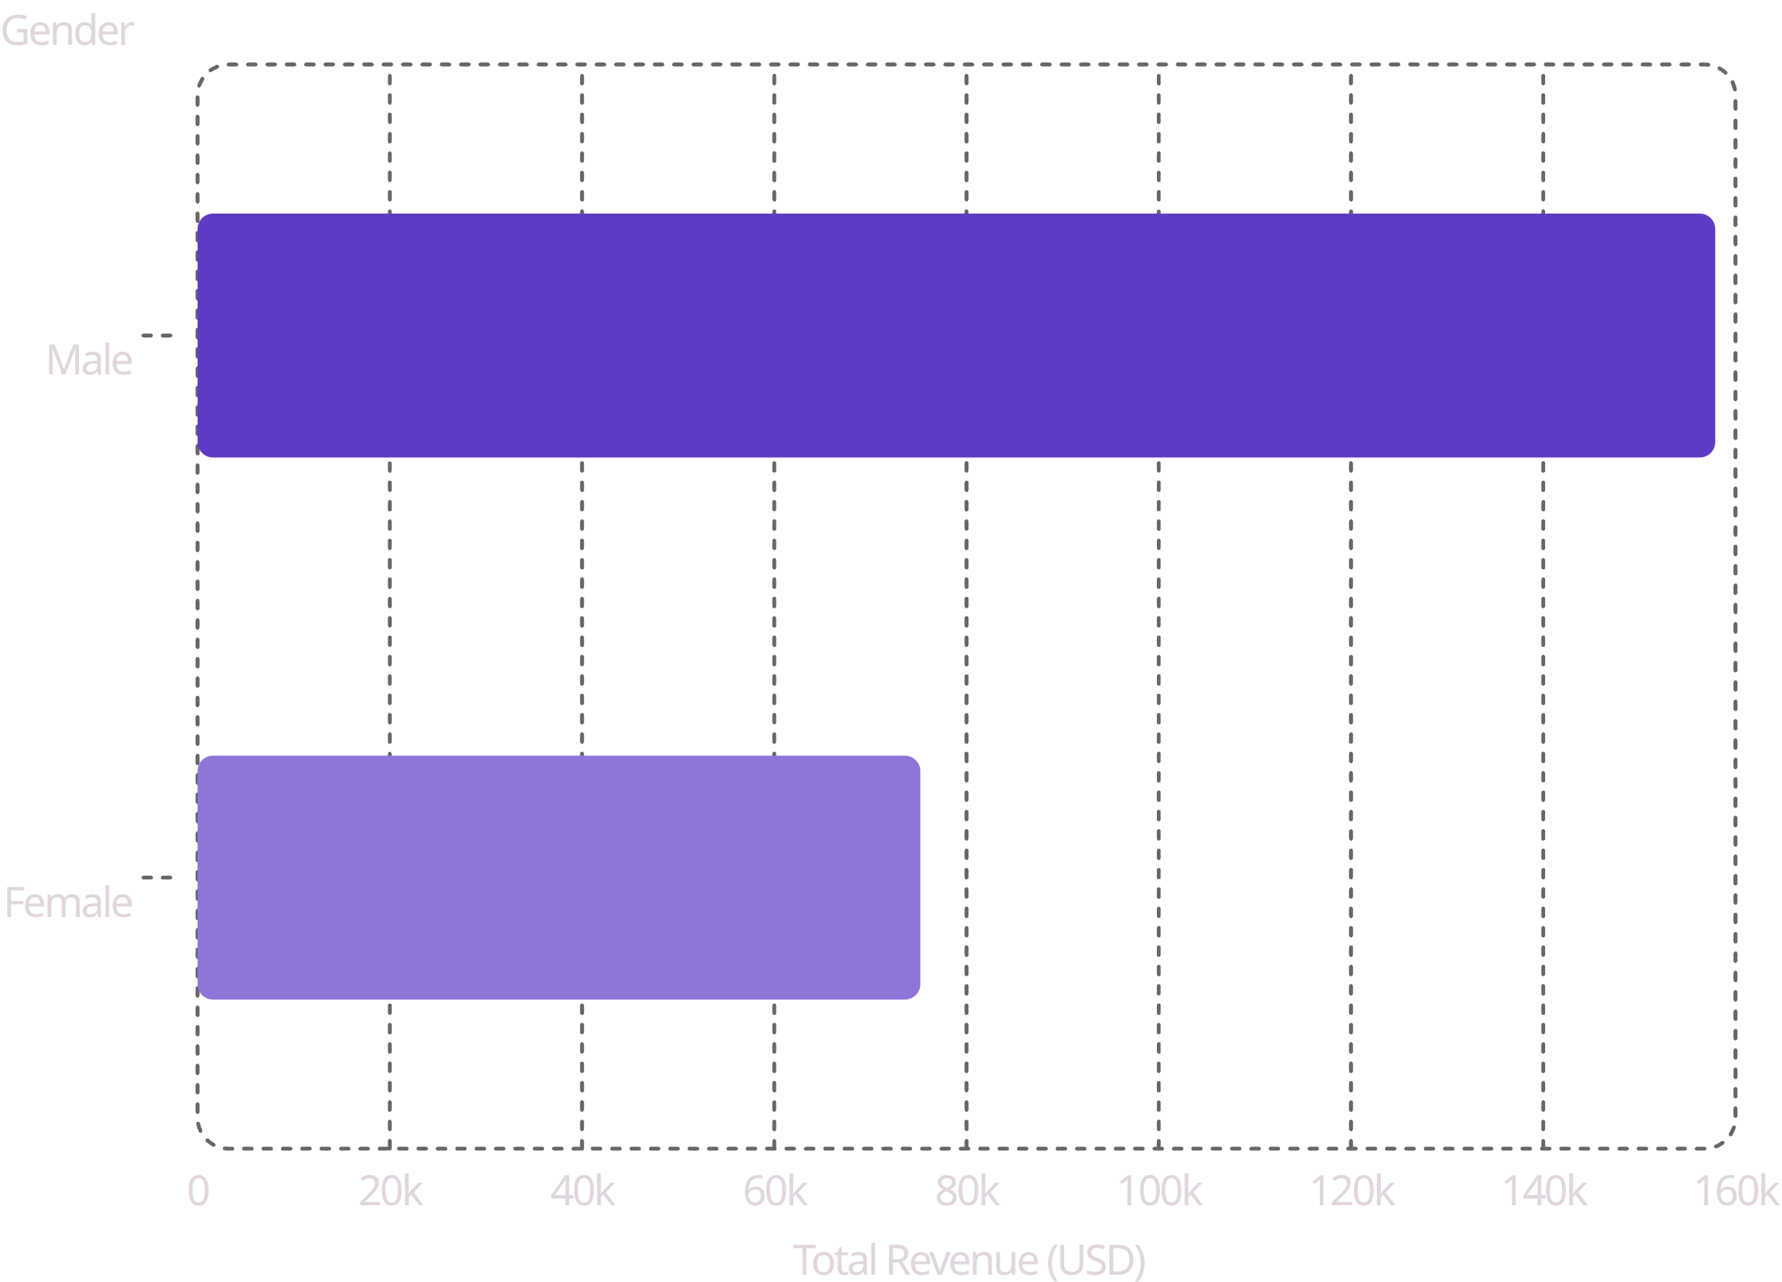
Revenue by Gender & Age
Gender
Male: $157,890 · Female: $75,191
68% of revenue from 68% of customers — gap driven by volume, not spend per customer.
Age Groups
Revenue evenly split ~24–27% each. Young Adults lead at $62,143. Age is a weak standalone targeting variable.

Slide 6
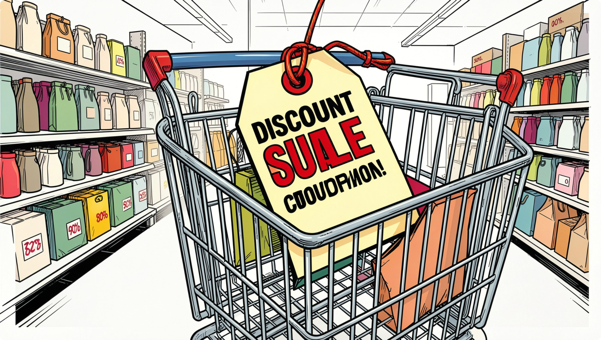
Discounts & Subscription Insights
43% of Transactions
Discounted — used by high & low spenders alike
839 Customers
Used discount AND spent above $59.76 avg
No Spend Premium
Subscribers $59.49 vs Non-subscribers $59.87
2.5:1 Ratio
Non-subscribers outnumber subscribers among repeat buyers

Slide 7
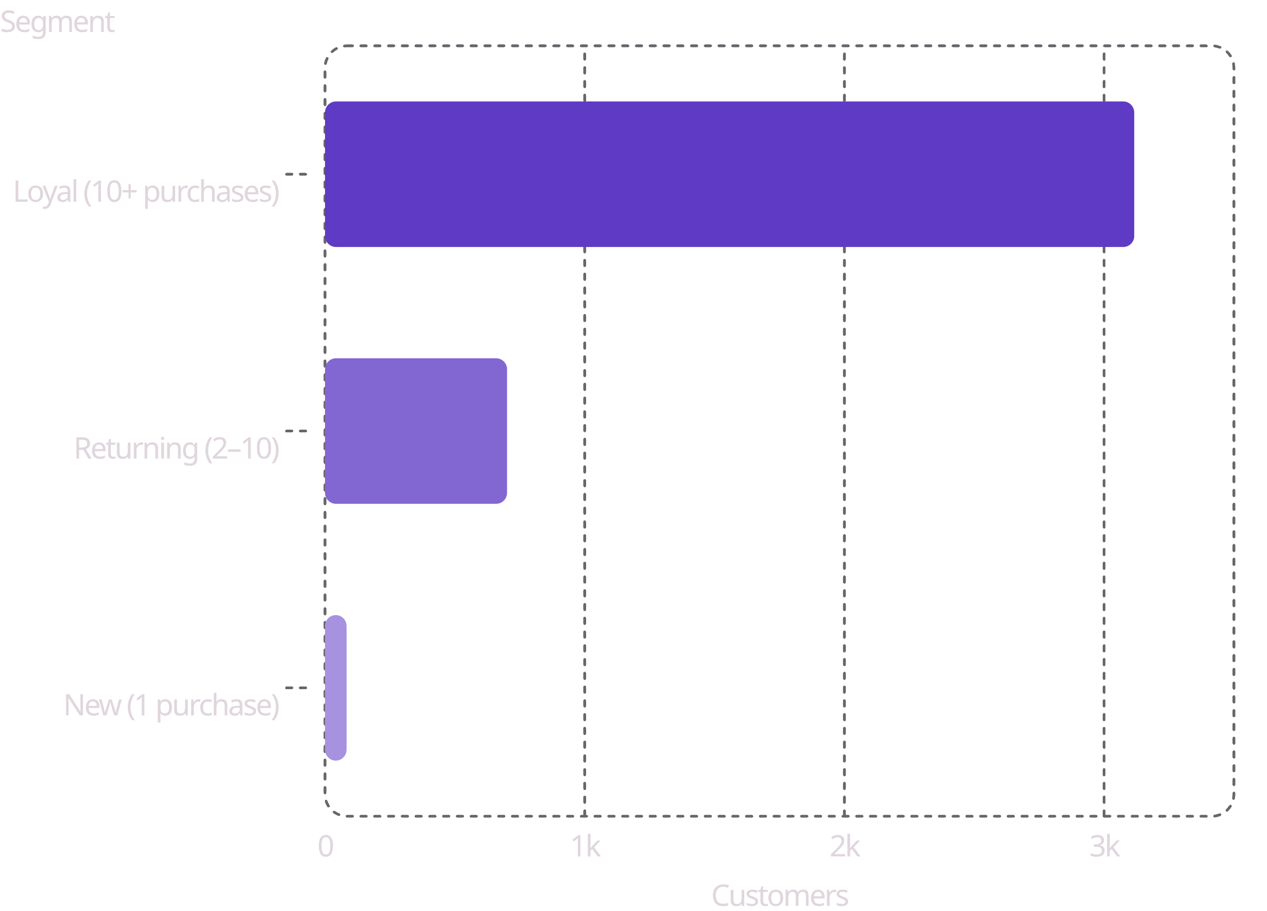

Customer Segmentation
A Retention-Heavy Base
80% Loyal · 18% Returning · 2% New
Only 83 genuinely new customers — acquisition is critically under-invested.
Long-term risk: growth depends almost entirely on retaining an already-loyal file.

Slide 8
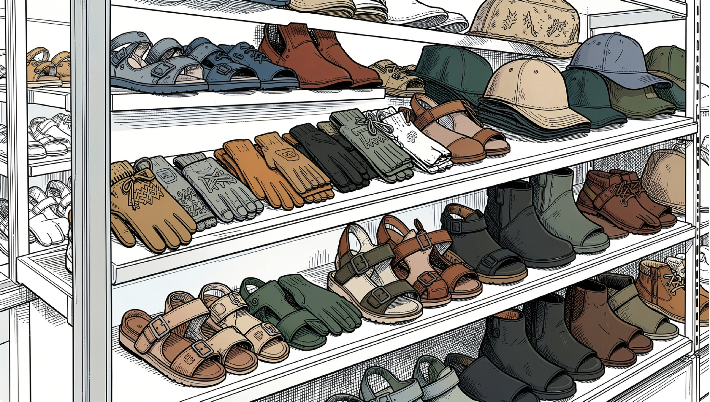

Product Ratings & Shipping
Top-Rated Products
All above dataset avg of 3.75. Accessories & footwear dominate.
Express vs Standard Shipping
Express: $60.48 · Standard: $58.46 — larger orders marginally prefer faster delivery.
Gloves — 3.86
Sandals — 3.84
Boots — 3.82
Hat — 3.80

Slide 9

Business Recommendations
1
Grow Female Segment
Clear headroom — under-indexes on count & revenue
2
Target Discounts
Shift from blanket promos to behavior-triggered offers
3
Acquire New Customers
Only 2% new — invest in acquisition channels
4
Redesign Subscription
Add exclusive pricing & early access to convert repeat buyers

Slide 10


Conclusion
Complete analytics pipeline — Python → SQL → Power BI — delivering actionable insights on revenue, loyalty & growth.
Revenue Concentration
Underperforming Levers
Growth Exposure
Gender & category drive spend
Subscription & discounting need redesign
New-customer acquisition is critical

