Slide 1
GameCast Director
Team NDA

Slide 2
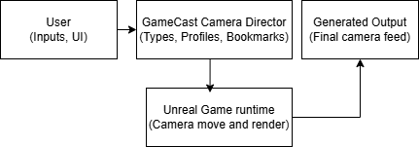
Problem Statement
Manual camera operation for esports production.
Lack of reusable camera presets can lead to hours/days of setup and testing.
Camera transitions cause 5-8 ms spike in uncontrolled scenarios.
Technology Used
Unreal Engine 5.6.1 – Gameplay Profiling tools, Enhanced Input System, Slate/UMG, Subsystem
Built on abstract base class with template method.
Uses data driven camera profiles
All camera types follows the State pattern
Mechanics
State pattern for camera modes.
Flyweight for camera profiles.
Template method for camera lifecycle
SOLID principles
Noah
Setup the UI with dynamic render texture for displaying different camera perspectives.
Divith
Scripted Camera Transition system and initial camera type setup
Adhithya
Created the plugin documentation, implemented coding patterns and the bookmark system.
Solution Pitch
First Unreal plugin to unify different camera modes into a single controllable director system.
Switching camera takes less than 1ms.
Profiling shows CPU cost is less than 3ms
Plugin Composition
C++: 94%
Process flowchart
BP: 5%
Misc: 1%
Primary Customer/Target Audience
Esports production crews
Gameplay/Level designers
Depending on production levels, free software – OBS for small scale production to around $1200 for vMix license for mid to high level productions.
Intuitive design challenges includes tracking multiple players and providing the ability to switch between different camera types.
Profiling Stats
Camera transitions, camera tick and bookmark methods.
stat CameraDirectorPawn and stat CameraMomentRecorder for custom profiling.
GameThreadTime with manual flying 12-18 ms. With the plugin it is stable 10-14 ms.
Switching cameras takes only 1-1.5 ms.
Future Roadmap
Explore network integration.
Expanded bookmark and sequencer system.
Performance improvements for the UI.
Marketplace release and documentation expansion.
User Interface Customizable Options
Engineering Expenditure (in hours)
Time spent on MVP: ~35 hours (Camera Types, Flyweight, Bookmark recording, Documentation)
Time spent on Next Scope: ~35 hours (Profiling, UI integration)
Stretch Goal Scope estimate: 120 hours (3 FTE) (Networking, Sequencer Support, Optimization)
GPU 22%
18%
GameThreadTime 14%
11%
Before
After

Slide 3
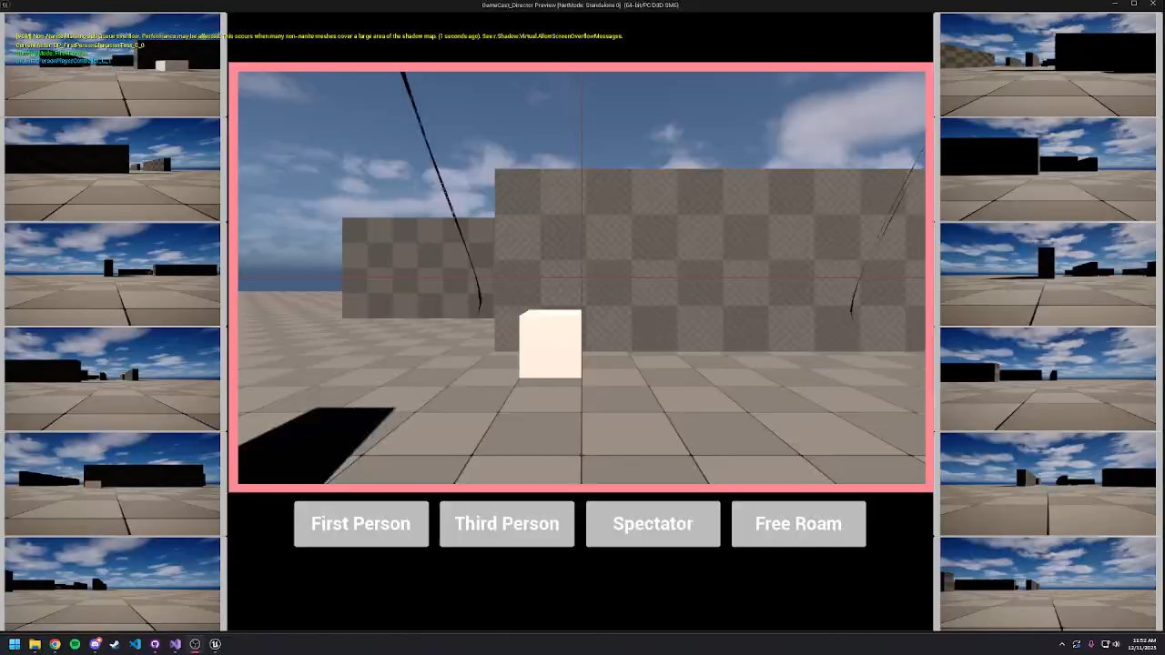

Slide 4

Q&A
What questions do you have for us?

Slide 5

Thank You

