Slide 1

Artificial Intelligence Mini-project
Topic: AI based agent to play PACMAN game
TEAM MEMBERS:
Aniket Agarwal – RA1911033010039
Rishy Parasar- RA1911033010040
Saurav Kumar – RA1911033010064

Slide 2
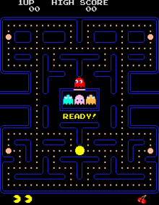
Abstract
PACMAN is an iconic arcade game from Atari 2600. This game is redesigned in such a way that an AI model understands the environment and the current situation and plays accordingly. The game environment is used from OpenAI’s gym framework which has got the environment of similar arcade games. The actors in this environment are trained using DQN model which follows Q-learning approach to present rewards to the model.

Slide 3
Issues in existing system
The algorithm is very slow in finding the safer path for the PACMAN to move over the maze
Problem in understanding the behavior of the ghost.
Less optimal solution.

Slide 4
Problem statement
To provide an AI based approach to find an optimal and safer path for the PACMAN to eat all the food particles without getting attacked by the ghost with the available lifelines.

Slide 5
Objective
The objective is that Pac-Man eat all of the pellets (white circles), while avoiding the ghosts that pursue him.
If a ghost ever catches Pac-Man then Pac-Man is defeated. If this occurs, the level will reset, but this will happen only if Pac-Man still has some lives remaining. (The pellets already collected on the level remain collected.)
However, when Pac-Man eats a Power-Pellet (large white circle) he can turn the tide, and the ghosts will be scared and flee from him, for with the power of the Power-Pellet, Pac-Man can eat the ghosts! Once a ghost is eaten it will return to its base, where it is born again, immune to the Power-Pellet until Pac-Man can find a new one to consume. Pac-Man had to do just that, because unfortunately, the power of the Power-Pellet does not last forever, and will begin to wear off over time. (You will see the ghosts start to flash back to their normal appearance during the last few seconds of the Power-Pellet's effectiveness.)
Finally, occasionally a bonus (rotating star) will appear in the maze. This bonus gives Pac-Man extra points if he eats it, but it will disappear if Pac-Man doesn't get it within a limited amount of time.

Slide 6
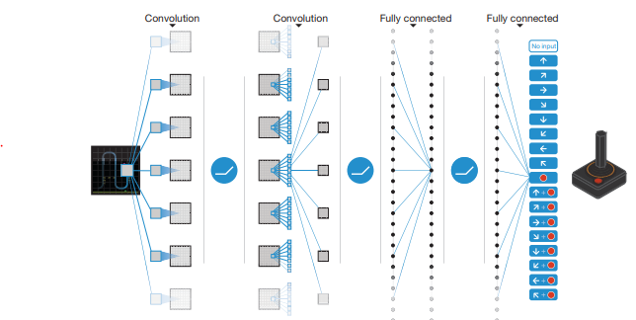
Diagrammatic approach of our solution

Slide 7
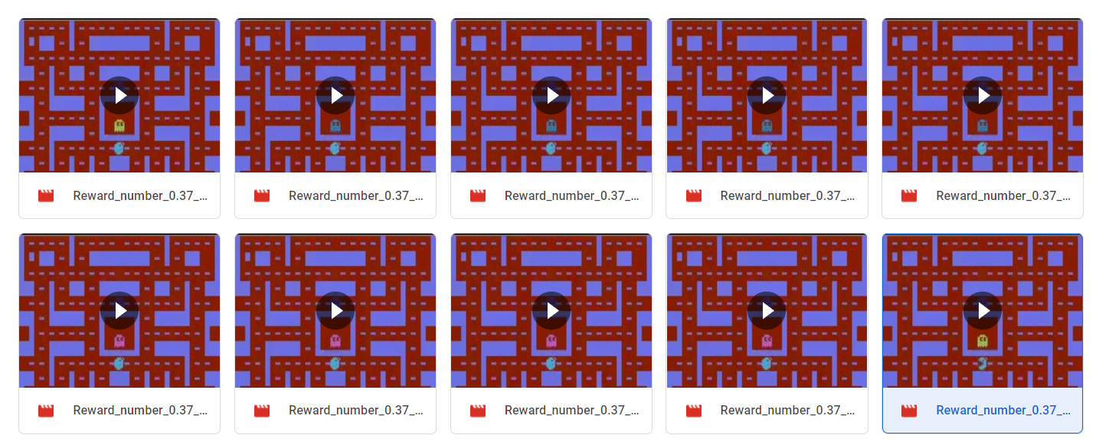
Demo screenshot

Slide 8

Proof for github repository

Slide 9
The purpose of the problem statement
The PACMAN problem environment helps us in understanding the Reinforcement algorithm concepts. This game environment can be related to real world scenarios and the model built can be used to solve using the deep reinforcement algorithms.
Eg: This model can be used to navigate people past dynamic obstacles in an optimistic path.

Slide 10
OPEN-AI’s gym toolkit
OpenAI Gym is a toolkit that provides a wide variety of simulated environments (Atari games, board games, 2D and 3D physical simulations, and so on), so you can train agents, compare them, or develop new Machine Learning algorithms (Reinforcement Learning).
OpenAI is an artificial intelligence research company, funded in part by Elon Musk. Its stated goal is to promote and develop friendly AIs that will benefit humanity (rather than exterminate it).

Slide 11
DQN : Deep q networks
Q-learning is a simple yet quite powerful algorithm to create a cheat sheet for our agent. This helps the agent figure out exactly which action to perform.
But what if this cheatsheet is too long? Imagine an environment with 10,000 states and 1,000 actions per state. This would create a table of 10 million cells. Things will quickly get out of control!
It is pretty clear that we can’t infer the Q-value of new states from already explored states. This presents two problems:
First, the amount of memory required to save and update that table would increase as the number of states increases
Second, the amount of time required to explore each state to create the required Q-table would be unrealistic
Here’s a thought – what if we approximate these Q-values with machine learning models such as a neural network? Well, this was the idea behind DeepMind’s algorithm that led to its acquisition by Google for 500 million dollars!

Slide 12
DQN : Deep q networks
In Q-learning (and in general value based reinforcement learning) we are typically interested in learning a Q-function, Q(s,a)Q(s,a). This is defined as
Q(s,a)=Eπ[Gt|St=s,At=a].Q(s,a)=Eπ[Gt|St=s,At=a].
For tabular Q-learning, where you have a finite state and action space you can maintain a table lookup that maintains your current estimate of the Q-value. Note that in practice even the spaces being finite might not be enough to not use DQN, if e.g. your state space contains a large number, say 10100001010000, of states, then it might not be manageable to maintain a separate Q-function for each state-action pair
When you have an infinite state space (and/or action space) then it becomes impossible to use a table, and so you need to use function approximation to generalise across states. This is typically done using a deep neural network due to their expressive power. As a technical aside, the Q-networks don't usually take state and action as input, but take in a representation of the state (e.g. a dd-dimensional vector, or an image) and output a real valued vector of size |A||A|, where AA is the action space.

Slide 13
THANK YOU

