Slide 1

Model Selection in ML
Lab 10
Presented By
VAIBHAV PATIL
SALMAN SHAIKH
Guided By
Prof. Ashish Awate
Department of Computer Engineering
T.Y. Computer Academic Year 2024-2025 Sem - VI

Slide 2
Outline
Problem Statement
Data Dictionary
About Dataset
Preprocessing steps used
ML Algorithm Used
KNN
Decision Tree
Support Vector Machine
Logistic Regression
Model Evaluation
Using Comparative Score
Using K-fold Cross Validation
Using ROC AUC Curve
Conclusion
Dept of Computer Engg. SVKM IOT Dhule T1 BATCH

Slide 3
Problem Statement
Develop a machine learning model to predict whether it will rain tomorrow based on various weather attributes recorded today. The goal is to utilize different classification algorithms to find the most accurate model for this prediction.
Dept of Computer Engg. SVKM IOT Dhule T1 BATCH

Slide 4
Data Dictionary Dataset Used =whether.csv
Feature Name | Data Type | Description
MinTemp | Float | Minimum temperature of the day
MaxTemp | Float | Maximum temperature of the day
Rainfall | Float | Total rainfall recorded for the day
Evaporation | Float | Total evaporation recorded for the day
WindSpeed9am | Float | Wind speed recorded at 9 AM
Humidity9am | Float | Humidity level recorded at 9 AM
Pressure9am | Float | Atmospheric pressure recorded at 9 AM
RainToday | Object (Categor ical) | Binary attribute indicating

Slide 5
About Dataset
Dataset Name – Whether_Data.csv
Dimension of Dataset : (1500,8)
Name of Column : Index(['MinTemp', 'MaxTemp', 'Rainfall', 'Evaporation', 'WindSpeed9am', 'Humidity9am', 'Pressure9am', 'RainToday'])
Is there any missing values : No
How many Categorical columns : 1 (RainToday)

Slide 6
Pre-processing Steps Performed
EDA : Display dataset dimensions, column names, statistical summary, and data types.
Categorical Data Conversion : Convert categorical features to numerical using One-Hot Encoding.
Feature Selection : Select features for the model and map the target variable to binary values.
Data Normalization : Normalize features to have zero mean and unit variance.
Train-Test Split : Split the dataset into training
and testing sets.

Slide 7
ML Algorithms used
Since the output feature of your dataset is categorical, we will be performing classification on the dataset. Classification involves predicting the class or category to which a data instance belongs based on its input features. In this case, we will be using the input features to determine whether a patient is diabetic or not.
We have used this following algorthims in our model:-
KNN
Decision Tree
SVM
Logistic Regression
Dept of Computer Engg. SVKM IOT Dhule

Slide 8
1. KNN
Best Estimator:
{‘n_neighbours’ : 30, ‘p’:1, ‘weights’’: ‘uniform’}
Jaccard Score : 0.04
F1 Score : 0.58
Accuracy Score : 0.69
Dept of Computer Engg. SVKM IOT Dhule

Slide 9
2. Decision Tree
Best Estimator:
{ ‘ccp_alpha’ : 0.1, ‘criterion’: ‘gini’, ‘max-depth’ : 5 , ‘max_features’ : ‘sqrt’}
Jaccard Score : 0.00
F1 Score : 0.56
Accuracy Score :0.69
Dept of Computer Engg. SVKM IOT Dhule

Slide 10
3. SVM
Best Estimator:
{‘C’ : 1 , ‘gamma’:1, ‘kernal’ : ‘rbf’}
Jaccard Score : 0.09
F1 Score : 0.56
Accuracy Score : 0.61
Dept of Computer Engg. SVKM IOT Dhule

Slide 11
4. Logistic Regression
Best Estimator:
{‘C’ : 1000.0, ‘panelty’ : ‘l1’, ‘solver’: ’liblinear’}
Jaccard Score : 0.00
F1 Score : 0.56
Accuracy Score :0.69
Dept of Computer Engg. SVKM IOT Dhule

Slide 12
Model Evaluation

Slide 13
1. Using Comparative Table
Model | Jaccard Score | F1 Score | Accuracy Score
KNN | 0.04 | 0.58 | 0.69
Decision Tree | 0.00 | 0.56 | 0.69
SVM | 0.09 | 0.56 | 0.61
Logistic Regression | 0.00 | 0.56 | 0.69
KNN and Logistic Regression and Decision Tree demonstrate high accuracy based on the provided table. Hence, these three models perform well in terms of accurately predicting the outcomes on the given dataset.

Slide 14
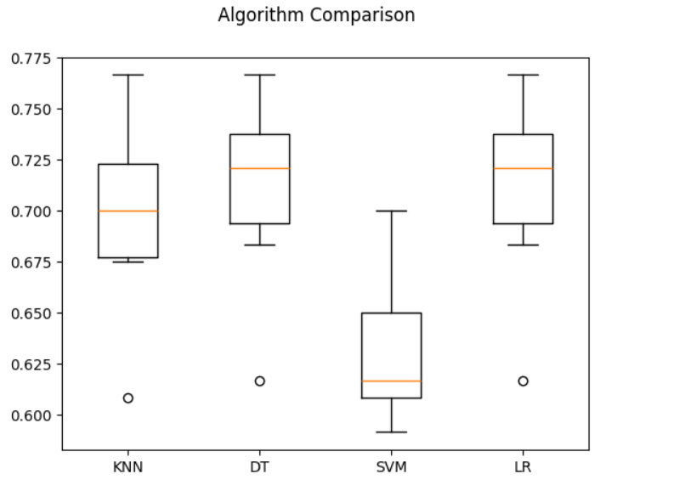
2. K-fold Cross Validation

Slide 15
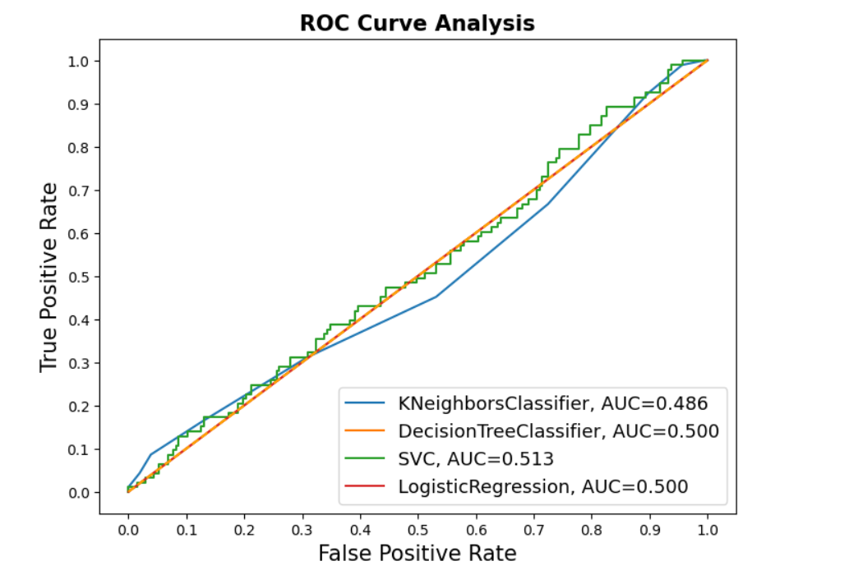
3. Using ROC_AUC Curve

Slide 16
Conclusion
After testing different models, KNN, Decision Tree, and Logistic Regression showed good accuracy. Among them, KNN performed slightly better based on various evaluation metrics. So, KNN is the most effective model for predicting rainfall in this dataset
Dept of Computer Engg. SVKM IOT Dhule T3 BATCH

