Slide 1

COGNIZANT NPN · HEALTHCARE
Age Verification
that knows when it is wrong
Age estimation from a facial image, wrapped in a clinical decision path
with human review, calibrated uncertainty, and an audit trail that stores no image.

Slide 2



THE PROBLEM
Age verification today is documents, or a guess
Documents
Human judgement
Time
Not always available. Forgeable. Intrusive to demand, and excludes people who have none.
Inconsistent between assessors, and inconsistent for the same assessor across a shift.
Manual checks do not scale to a queue, and the cost lands on the patient waiting.
In healthcare the consequences are concrete: clinical trial eligibility, consent thresholds, age-appropriate dosing. Getting it wrong is a compliance failure or a patient harm, not a poor user experience.

Slide 3
THE PART EVERYONE MISSES
An age estimate on its own cannot be acted on
True age
Average error: 3 years. Sounds small.
17
But the eligibility decision has flipped.
Model says
20
A minor has just been classified as an adult. Accuracy metrics
call this a near miss. A clinician calls it a failure.
The useful question is not how accurate is it, but does it know when to stop.

Slide 4
PROPOSED SOLUTION
A decision path, not a prediction
The model is the small half. What makes it usable is what happens to the number afterwards.
STEP 1
STEP 2
STEP 3
STEP 4
STEP 5
Estimate
Clinical band
Policy decision
Human review
Audit trail
Age, plus a range and a confidence score.
Paediatric through geriatric, five bands.
When uncertain, a person decides instead.
Every step recorded. No image stored.
Verified, rejected, or undecidable.
The invariant, enforced in code: review beats both verified and rejected. An uncertain prediction is never auto-actioned. That is the entire point of the system.

Slide 5
PART ONE
How the engine works
The model, the distribution it predicts, and the rule that sends a case to a human.

Slide 6
THE MODEL
EfficientNet-B0, fine-tuned
4.1 million parameters. Small on purpose, so the whole system runs offline on one laptop.
Pretrained on ImageNet, then fine-tuned on faces. The network already knows edges, texture and shape, so we only teach it the age-specific part.
224 x 224 input, 12 epochs, about 50 minutes on a laptop GPU.
Training from scratch on 167,000 images would have been far worse. Transfer learning is the reason a small model works here.
WHY NOT SOMETHING BIGGER
A larger backbone buys accuracy we are not scored on, and costs the offline
guarantee we are. The bottleneck in this problem is not model capacity, it is knowing when the answer
is untrustworthy.
VERIFIED ON THE HARDWARE
654 img/s · 4.7 min/epoch
17 MB checkpoint · 24 ms per prediction

Slide 7
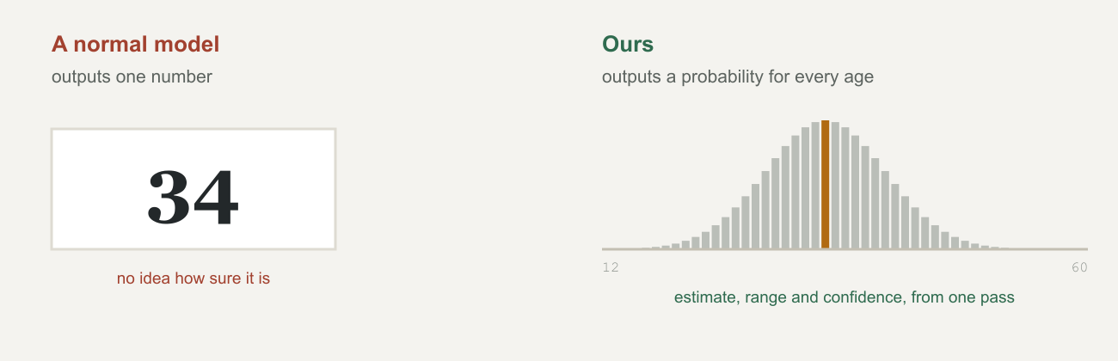
THE KEY DESIGN CHOICE
Predict a distribution, not a number
This is a published method: Deep Label Distribution Learning (DLDL, IJCAI 2018). We arrived at it from our own requirements and then found it in the literature, so the choice is defensible rather than improvised.

Slide 8
HOW IT TRAINS
Soft labels: 34 is nearly right
THE NAIVE WAY
WHAT WE DO
Tell the model "35 is correct, every other age is wrong."
Give it a bell curve centred on 35.
Now 34 and 36 are nearly right, 40 is somewhat wrong, and 70 is badly wrong. The ordering of
age is built into the training signal itself.
A prediction of 34 is then penalised exactly as hard as a prediction of 70. The model is never
told that age has an order, so it cannot learn to be close.
The loss follows directly from this. Because both the prediction and the target are distributions, training means making one match the other. We compute cross-entropy against the soft label, which equals KL-divergence up to a constant.

Slide 9
WHAT THE DISTRIBUTION BUYS
Three numbers from one forward pass
TAKE THE AVERAGE
TAKE THE PERCENTILES
TAKE THE SPREAD
24.2
17.5–31.5
0.32
The age estimate
An 80% range
A confidence score
Expected value across all 100 age bins.
The 10th and 90th percentile of the same curve.
How concentrated the curve is, normalised.
A model that outputs a single number gives you only the first of these. The other two are
what the review queue runs on, and there is no way to bolt them on afterwards without ensembles or
a second model.

Slide 10
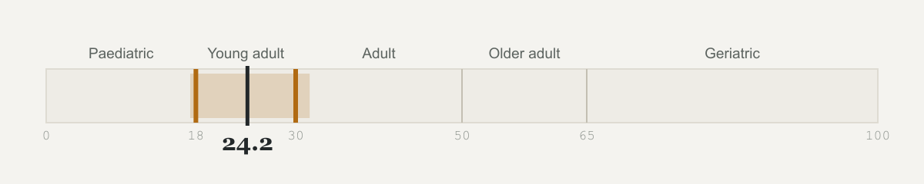
THE ROUTING RULE
Two ways a case reaches a human
1 LOW CONFIDENCE
2 THE RANGE CROSSES A BOUNDARY
Bottom 15% of the validation confidence distribution.
Even when the model is confident.
A percentile, not a fixed cutoff. "Below 0.3" is meaningless without knowing how
this model's confidence is actually distributed, so the rule is defined against measured behaviour.
A confident estimate sitting on the age-18 line is still not decisive. This asks
whether the uncertainty threatens the decision, not merely whether it exists.
Estimate 24.2, range 17.5 to 31.5, crossing the boundaries at 18 and 30.

Slide 11
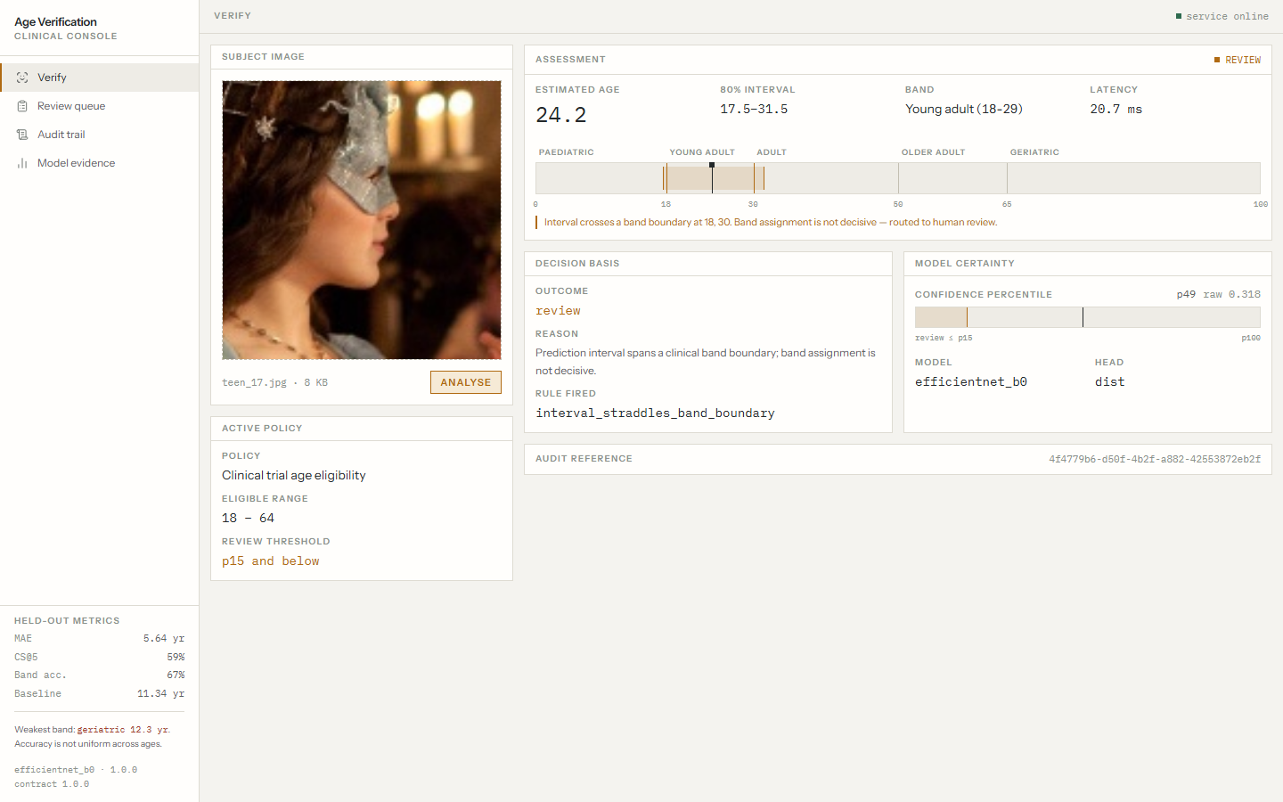
A WORKED EXAMPLE
The model is wrong, and the system holds
TRUE AGE
MODEL READS
17
24.2
OUTCOME
Routed to review
interval_straddles_band_boundary
Masked, in profile. A genuine miss.
It got a minor wrong by seven years and refused to act on it. On a randomly chosen held-out image, not a staged case.

Slide 12
PART TWO
Where this is used
Healthcare settings where an age boundary carries a clinical or legal consequence.

Slide 13

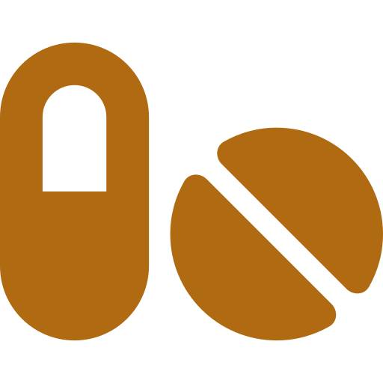


HEALTHCARE APPLICATIONS
Four settings, one shared property
Trial eligibility
Dosing bands
Consent thresholds
Telehealth intake
Screening candidates against an age-bounded protocol, where enrolling
outside the range invalidates the arm.
Paediatric, adult and geriatric dosing differ. The band matters more
than the exact year.
Whether a patient can consent for themselves, or needs a guardian
present.
Confirming an age claim remotely when no document is available at
point of contact.
What they share: the decision is a band, not a year, and an error near a boundary is far more costly than the same error in the middle of a band. That is precisely the shape our routing rule is built around.

Slide 14
PART THREE
How it is built
Stack, architecture, and the path a single request takes end to end.

Slide 15

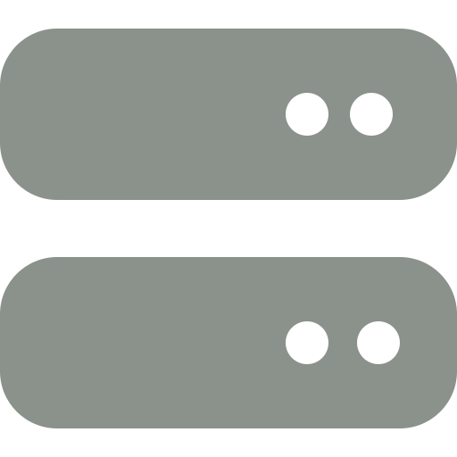

TECH STACK
Deliberately boring
MACHINE LEARNING
BACKEND
FRONTEND
PyTorch 2.11 (cu128)
timm — EfficientNet-B0
OpenCV — face detection
Pillow
Python 3.13
FastAPI + Uvicorn
SQLite, stdlib sqlite3
no ORM
React 19 + TypeScript
Vite, Tailwind v4
self-hosted fonts
no router, no state lib
What we deliberately did not add: no ORM, no state library, no router, no charting library. Three views and three small plots do not justify the dependencies, and every dependency is something that can fail offline on demo day.
Testing is assert-based selfchecks per module plus a 7-test contract suite. No pytest.

Slide 16
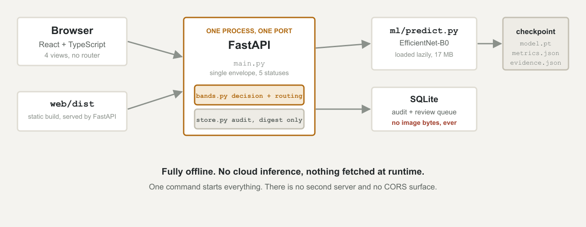
SYSTEM ARCHITECTURE
One process, one port

Slide 17
END TO END
What happens to one image
01
02
03
04
Upload
Hash, then discard
Detect and crop
Infer
Multipart POST. Type and size checked before anything else runs.
SHA-256 taken. The pixels are freed and never written to disk.
No face found means predict on the full frame and force review, never reject.
Distribution over 100 ages. Decoded to estimate, range, confidence.
05
06
07
08
Band and policy
Route
Audit
Respond
bands.py maps the estimate to a clinical band and a decision.
Uncertain or boundary-crossing cases enter the review queue.
Digest, estimate, band, decision, rule and timestamp recorded.
One envelope shape, whatever the outcome. Five defined statuses.
Every status returns the same JSON structure — success, no face, multiple faces, poor quality, service error. Frozen on day one so the frontend could be built while the model trained.

Slide 18
PART FOUR
Results and evaluation
All figures measured on 47,568 images the model never saw during training.

Slide 19
HELD-OUT PERFORMANCE
Twice as good as guessing
MEAN ABS. ERROR
BASELINE
WITHIN 5 YEARS
CORRECT BAND
5.64
11.34
59.3%
66.8%
years
guess the average age
CS@5
the decision that matters
The honest figure is a range: 5.64 to 6.57 years.
The dataset is celebrity photography and the publisher split it per image rather
than per person, so the same faces appear in both halves — we confirmed it visually. Excluding test images
that closely resemble training images moves the figure to 6.00, then 6.57. We found this ourselves and
published it rather than quoting the flattering number.

Slide 20
ACCURACY IS NOT UNIFORM
Per-band error, and why we report it
A single average hides the shape of the failure. Ours is worst exactly where the training data is
thinnest.
Geriatric is 2.5x worse than adult. The 90+ sub-band, on 77 test images, is 15.95 years.
This is not a defect we hid and were caught on. It is on the results screen
inside the product, with the geriatric row in red.

Slide 21
DOES CONFIDENCE MEAN ANYTHING
Error falls at every confidence step
PRE-REGISTERED
We wrote the pass mark into the code before training started, so it could not be adjusted afterwards to flatter us. There is a commit proving the order.
Bar to clear: low-confidence predictions at least 1.3x worse, and error falling consistently.
RESULT
3.89x worse, and monotonic across all ten deciles.

Slide 22
A STRONGER CLAIM THAN RANKING
An 80% range is right 79.1% of the time
Ranking errors correctly is one thing. Calibration asks something harder: when the model says 80% confident, is it right 80% of the time?
Measured across all 47,568 images. Worst deviation at any confidence level: 2.4 percentage points.
So the range shown on screen means what it says. The uncertainty it reports is the uncertainty it has.

Slide 23
DOES THE QUEUE EARN ITS PLACE
Deferring 15% cuts error by 11.5%
Send the least confident cases to a human and measure what happens to the error on
everything the system still decides by itself.
ALL CASES
DEFER 15%
5.64
4.99
This is the standard presentation for selective prediction. The dashed line is the oracle bound, which is what a perfect ranking of the errors would achieve.

Slide 24
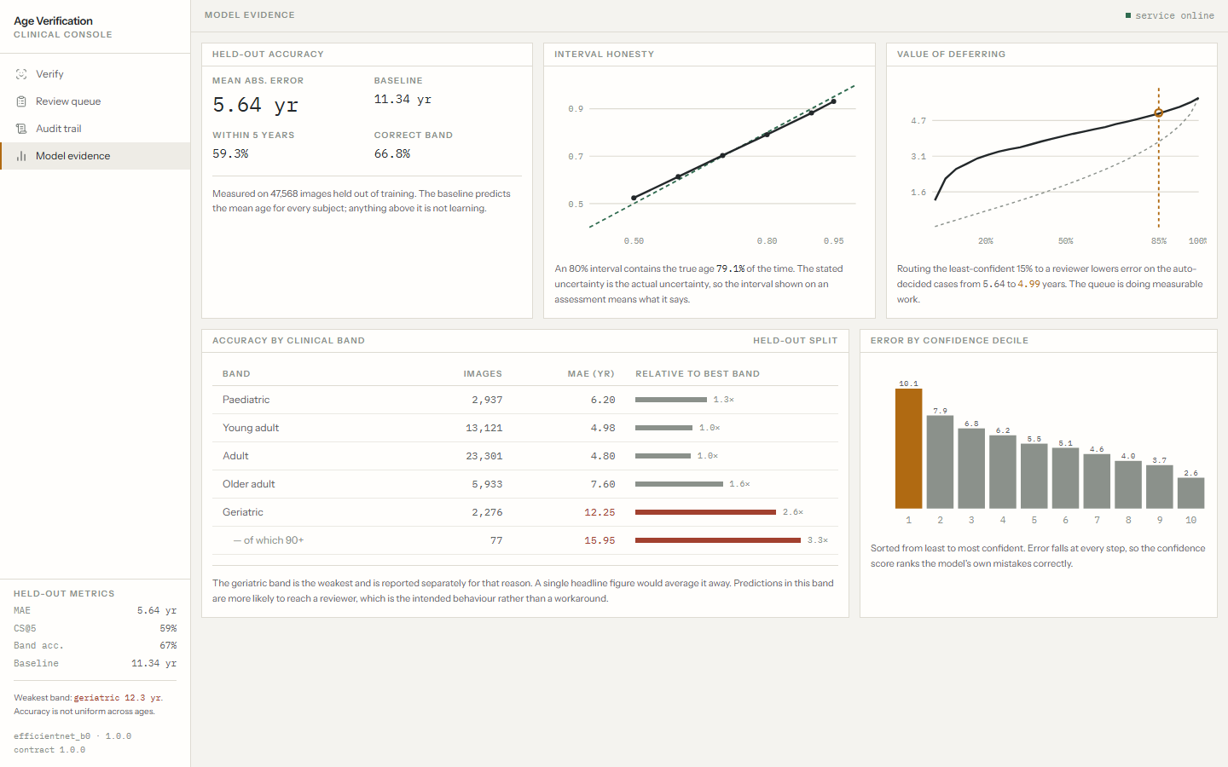
IN THE PRODUCT, NOT JUST THE DECK
The evidence screen
Our own accuracy figures ship inside the product, including the ones that do not flatter us. The headline MAE carries its caveat directly beneath it, and the geriatric row renders in red.

Slide 25
THE FINDING WE DID NOT WANT
The model is less accurate on Black faces
Our own data has no ethnicity labels, so we tested on UTKFace, which does — 23,684 images, inference only.
Groups differ in age composition, and young faces are easier, so raw per-group error is confounded. Comparing within age bands removes it.
Black subjects carry the highest error in four of five bands. The paediatric row is the serious one: 3.7x the best group, in exactly the band holding the age-18 threshold.

Slide 26


WHAT THE SYSTEM DOES ABOUT IT
Containment, and its cost
THE QUEUE DOES CATCH IT
BUT IT IS NOT A FIX
Routing fires on 15.7% of Black subjects, against 7.8% White and 4.1% for the best-served group.
The same people are then disproportionately subjected to manual review, which is a worse experience even when the decision is better.
The routing order matches the error order exactly, so the cases the model
serves worst are the ones it most often declines to decide alone.
A system that is less accurate for one group and also slower for that group
has not solved its fairness problem by adding a human.
Correcting it properly needs training data balanced across skin tones, which the reference dataset cannot provide. We are reporting a measured limitation, not a solved problem.

Slide 27
HONEST LIMITS
Stated by us, not discovered by you
The headline MAE is optimistic
Demographic gap, measured
5.64 to 6.57. Same people on both sides of the split. Unfixable on this
dataset: no identity labels exist, so a per-person split cannot be reconstructed.
Highest error on Black faces in four of five age bands. Contained by the
review queue, not corrected.
Image only
The 90+ tail is 273 images
The brief also lists voice and other biometrics. The reference dataset has
neither, so a second modality was scoped out rather than faked.
No public face dataset has real volume above 85. It is a structural gap in
the field, not an oversight in our search.
Not for clinical use. This is a research demonstration. Face-based age estimation carries real bias and consent problems and is not a substitute for a documented date of birth.

Slide 28
GIVEN MORE TIME
What we would do next
FIRST
SECOND
THIRD
Resolve the leakage range
Balanced training data
Conformal prediction
An identity-tuned face embedding would separate "same person" from
"similar-looking face of the same age", turning 5.64 to 6.57 into a single number.
The only real fix for the demographic gap. Needs a corpus balanced across
skin tones, which means new data collection, not resampling.
Upgrades "empirically 79.1% coverage" to a distribution-free guarantee,
retrofittable to the trained model with a calibration set.
One thing we would not do: chase a lower headline MAE. The bottleneck in this problem is not accuracy, and a system that is confidently wrong is more dangerous than one that is slightly less precise and knows it.

Slide 29
IN CLOSING
The model is wrong sometimes.
What matters is that it knows when, and stops.
Built
Measured
Disclosed
Trained model, clinical decision path, review queue, audit
trail, four-view console. One offline process.
Accuracy, per-band error, calibration, selective
prediction, and demographic fairness. All on held-out data.
Every limitation above, including the two we found by
auditing our own benchmark rather than waiting to be asked.

