Slide 1
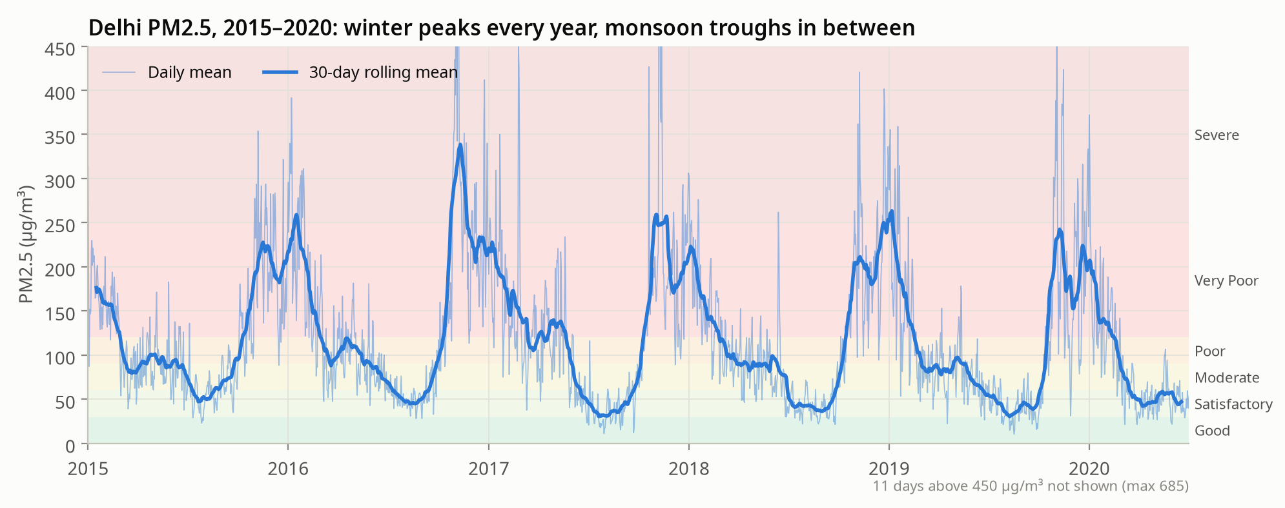
TIME SERIES ANALYSIS · PROGRESS UPDATE
Forecasting Delhi PM2.5 with SARIMAX, VAR and Granger causality
Goal: a 12-month AQI forecast with 95% intervals for health advisories, and evidence on whether wind and humidity drive PM2.5.
2,009
5 series
52%
daily records, Jan 2015 to Jul 2020
PM2.5, NO₂, SO₂ (CPCB); wind, humidity (ERA5)
of days rated Poor, Very Poor or Severe
Data: CPCB via Kaggle, Open-Meteo ERA5
1 / 4
Notes:
Delhi has some of the worst winter air in the world. We forecast PM2.5 for the next 12 months so health advisories can be planned. Data: CPCB daily Delhi records (2,009 days, Jan 2015 to Jul 2020) merged with ERA5 weather (wind, humidity, temperature, rain). The chart shows the story: a sharp winter peak every year and clean monsoon months. About half of all days are Poor, Very Poor or Severe. Done so far: cleaning, EDA, VAR and Granger. Next: SARIMAX, baselines, forecast.

Slide 2
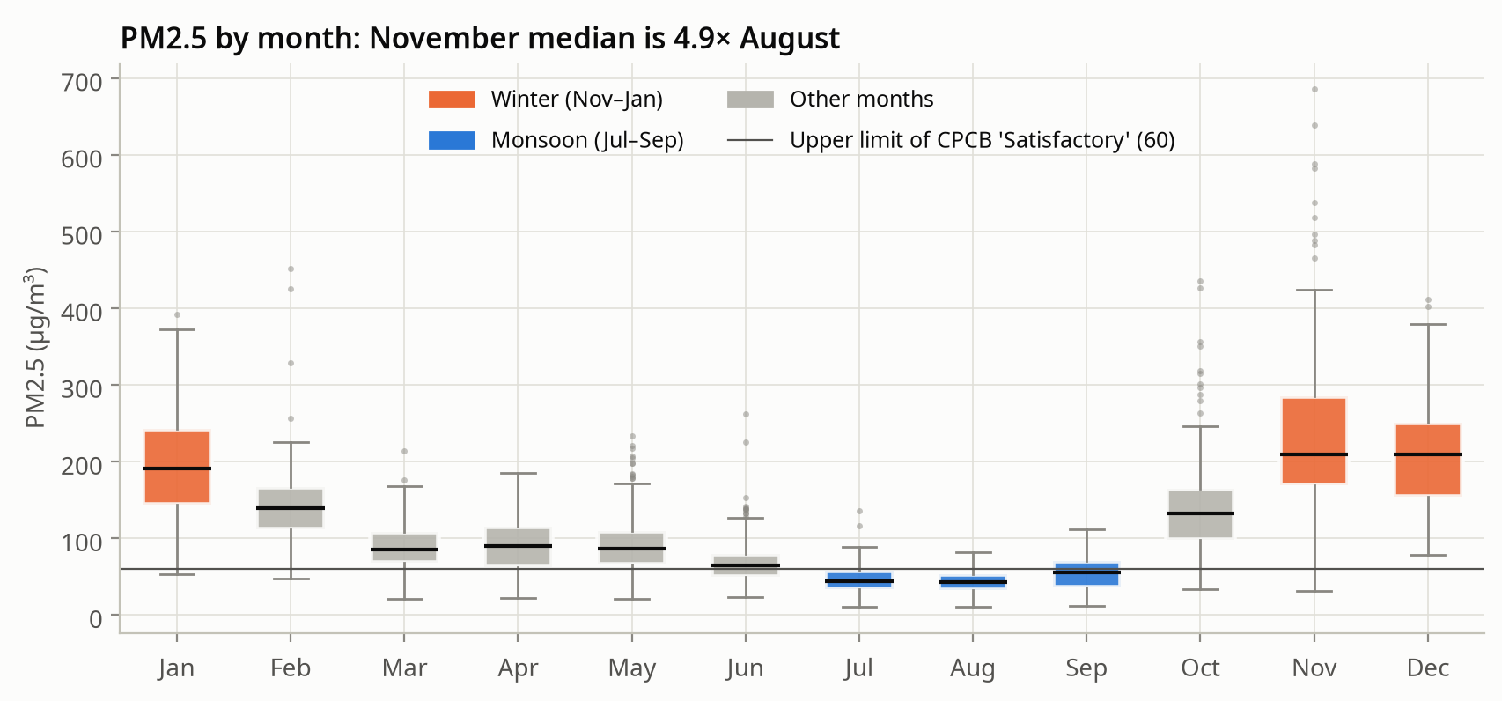
Seasonality dominates, and the series is stationary
4.4×
Winter mean 213 vs monsoon 48 µg/m³
0.89
STL seasonal strength; 1 means pure seasonality
Winter smog (Nov–Jan) and monsoon clearing (Jul–Sep) repeat every year, so a seasonal ARIMA with period 52 weeks is justified.
Stationary
Log PM2.5 passes ADF and KPSS; D = 0 vs 1 is decided in SARIMAX
Notebook 02 · daily PM2.5, 2015–2020 · Spearman, STL, ADF/KPSS
2 / 4
Notes:
The November median is about 4.9x the August median; winter averages 213 vs 48 ug/m3 in the monsoon (4.4x). STL seasonal strength is 0.89, so we use a seasonal model with period 52 weeks. ADF and KPSS both pass for log PM2.5 levels; the seasonal difference alone is borderline, so SARIMAX will compare D=0 vs D=1 using held-out error. Before the VAR we remove the seasonal cycle, otherwise Granger would detect the season itself.

Slide 3
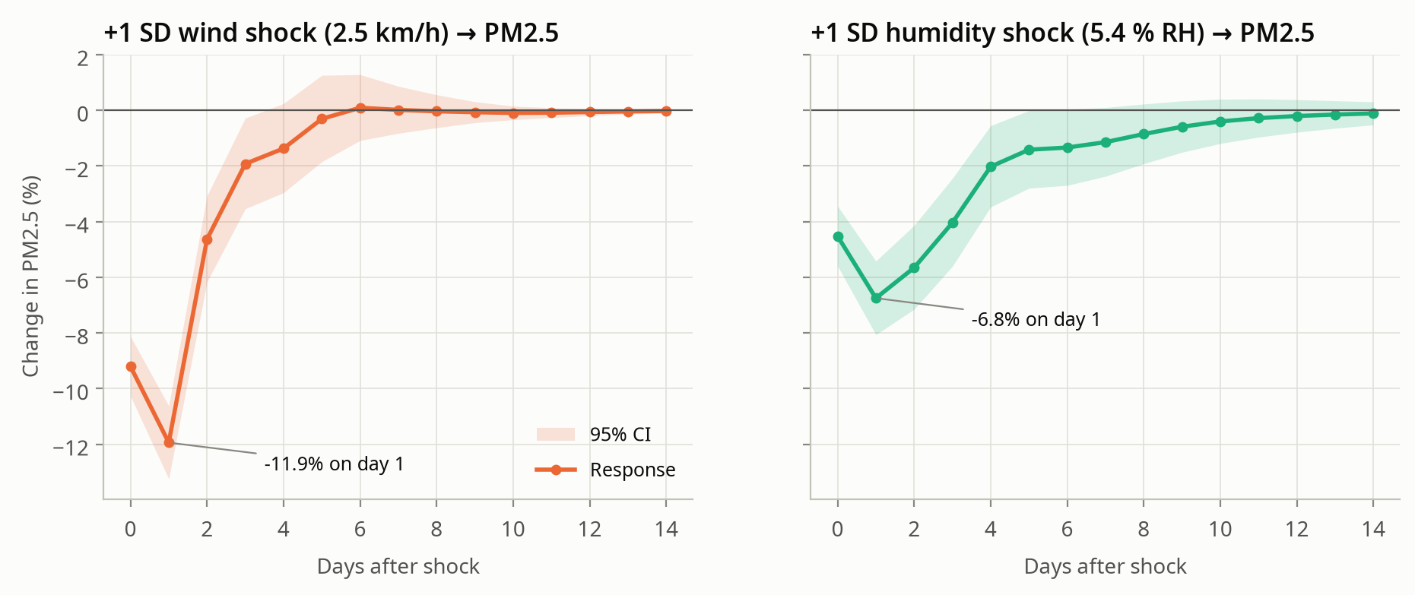
VAR and Granger: weather leads PM2.5, not the reverse
Direction | p-value | Verdict
Wind → PM2.5 | 1.7e-29 | Causes
Humidity → PM2.5 | 1.1e-11 | Causes
PM2.5 → Wind | 0.13 | No evidence
PM2.5 → Humidity | 0.61 | No evidence
VAR(4) on deseasonalised daily data, 2015–2019. Stable (max |λ| = 0.81) with white residuals (Portmanteau p = 0.17). Same result with the BIC lag and with first differences.
• +1 SD wind (2.5 km/h): PM2.5 down ≈12% next day
• +1 SD humidity (5.4% RH): PM2.5 down ≈7%
• Weather explains ≈30% of 14-day forecast error
Notebook 03 · F-tests from the fitted VAR · Granger = predictive causality
3 / 4
Notes:
We deseasonalised wind, humidity and log PM2.5, then fitted a VAR. AIC chose 4 lags; the model is stable and residuals pass a Portmanteau test. Wind and humidity each Granger-cause PM2.5 (p about 1e-29 and 1e-11). Reverse directions are not significant, which makes physical sense. Same result with BIC lag and first differences. A 1 SD wind increase cuts PM2.5 by about 12% next day; humidity by about 7%. Weather explains about 30% of 14-day forecast error (ordering-dependent). Caveat: Granger is predictive, not proof of physical cause.

Slide 4
What is done, and the road to the forecast
Done so far
Next
• Cleaned and merged 2,009 days of CPCB and ERA5 data; 2 missing PM2.5 days interpolated
• Showed a strong annual cycle and a stationary log PM2.5 series
• Showed wind and humidity Granger-cause PM2.5, one way only and robust to the model setup
1. SARIMAX
Weekly log PM2.5, period 52, wind and humidity as exogenous inputs; orders by AIC/BIC, Ljung-Box residual check
2. Baselines
Linear Regression and LSTM against seasonal naive; compare test MAE on 2019
Caveat: Granger shows prediction, not physical cause. Mixing height and stubble burning are not measured.
3. 12-month forecast
Refit on all data; 52 weeks with 95% intervals and a monthly AQI advisory table
Plan: train 2015–2018, test 2019, lockdown 2020 as a case study
4 / 4
Notes:
Recap: clean data, clear seasonal structure, and evidence that wind and humidity lead PM2.5, so they go in as exogenous regressors. Next: (1) SARIMAX on weekly log PM2.5, period 52, AIC/BIC orders, Ljung-Box residual checks; (2) Linear Regression and LSTM vs seasonal naive on 2019 test MAE; (3) 12-month forecast with 95% intervals and a monthly AQI advisory table. 2020 is a lockdown case study.

