Slide 1
Understanding User Behavior at Scale in a Mobile Video Chat Application
Lei Tian¹, Shaosong Li¹, Junho Ahn¹, David Chu², Richard Han¹, Qin Lv¹, Shivakant Mishra¹
University of Colorado Boulder¹
Microsoft Research²

Slide 2
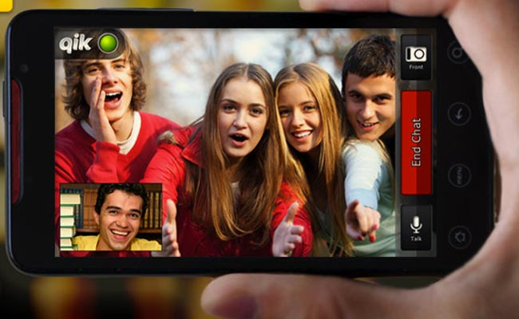

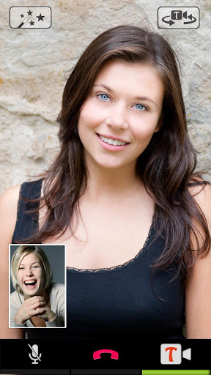
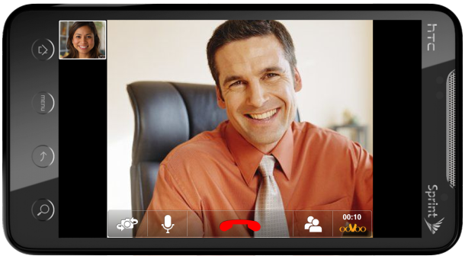
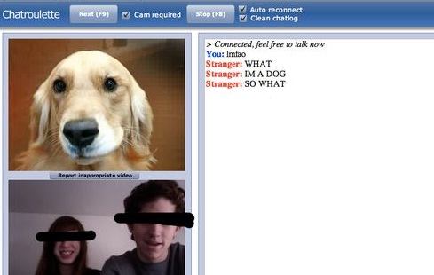

Background
Real-time, interactive video services are now commonplace for mobile
Random video chat recently gains in popularity

Slide 3
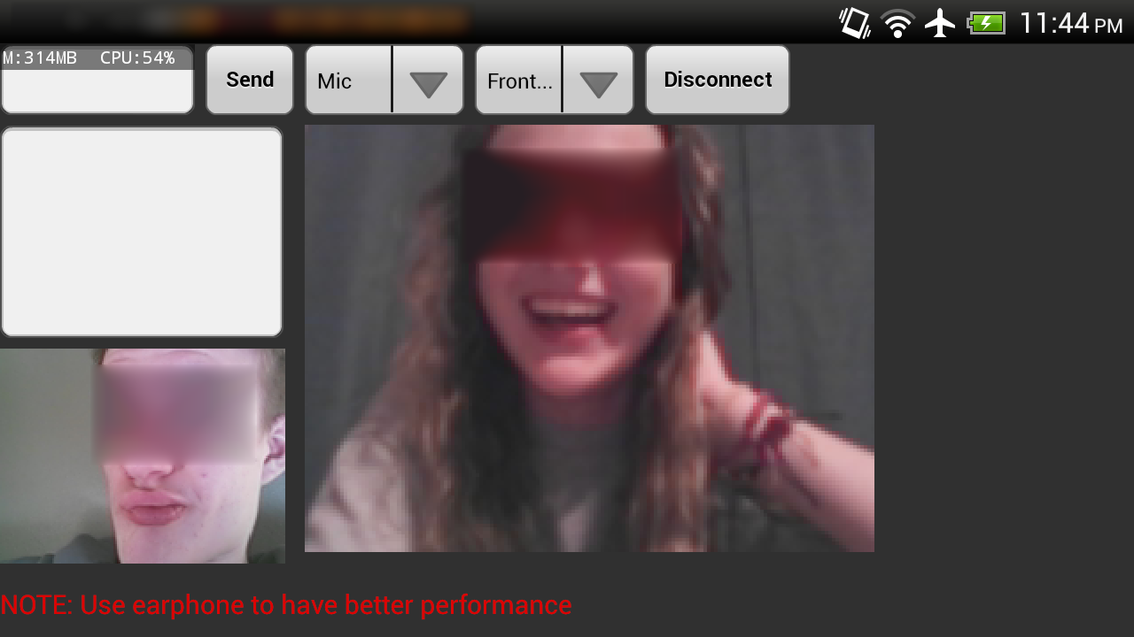
Overview
What’s new: mobile + random video chat!
How users extend behavior to random mobile video chat?
Does physical mobility change nature of interaction?
MVChat: An Android-based, Omegle compliant random video chat app
Collect 3-week, multi-sensors user behavior data
Analyze user behavior
Benefits: help to improve user experience
Effective matching
Safeguard from objectionable content

Slide 4
MVChat Dataset
About 50,000 downloads in total
About 400 GB sensor data
First-ever detailed study of mobile user behavior in random video chat at scale:
3 weeks
4632 users
Nearly 2,000,000 sessions
Multi-sensors data

Slide 5
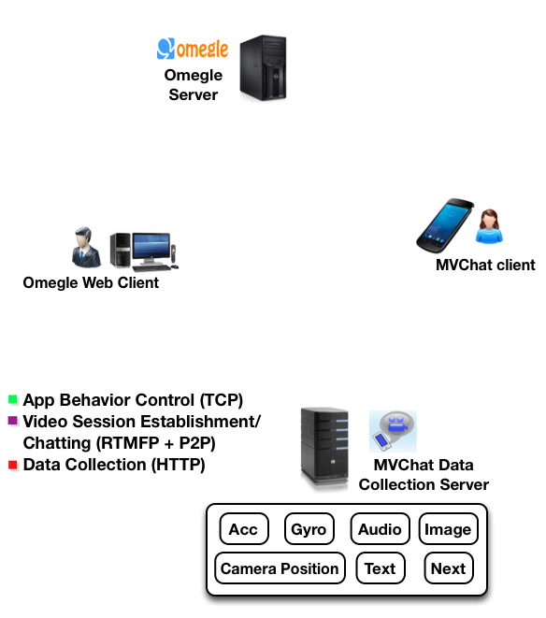
System architecture
Collect data
All data associated with its corresponding user id and session id
Control sample frequency, accommodate workload

Slide 6
User Behavior Analysis
Global analysis
Mobile-online video chat comparison
Taxonomy correlation analysis
Image-based
Session-based
“Meaningful” user analysis
Accelerometer data analysis

Slide 7
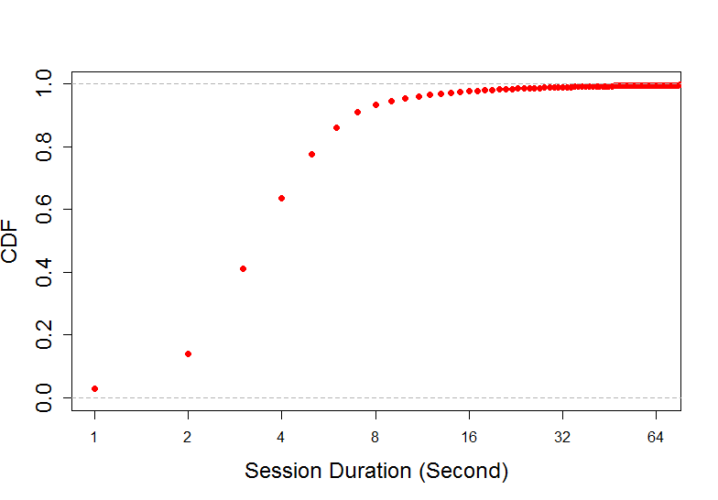
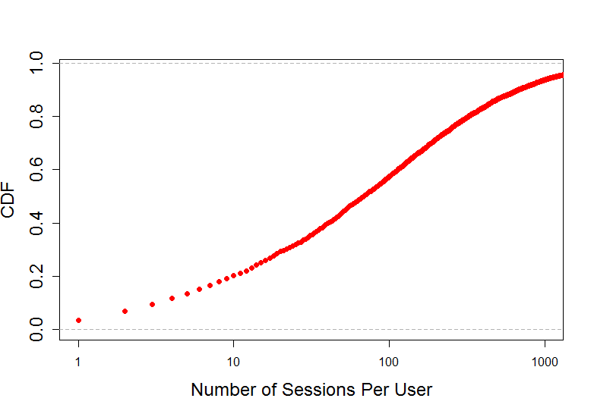
Global Analysis - takes effort to find “right” person
Session duration
80%: <5s
1%: >30s
0.5%: >60s
# of session per user user
80%: >10 sessions
42%: >100 sessions
6%: > 1000 sessions
Random pairing is ineffective
Users spend lots of effort finding “right” person
Study “meaningful” session/user for effective chatting

Slide 8
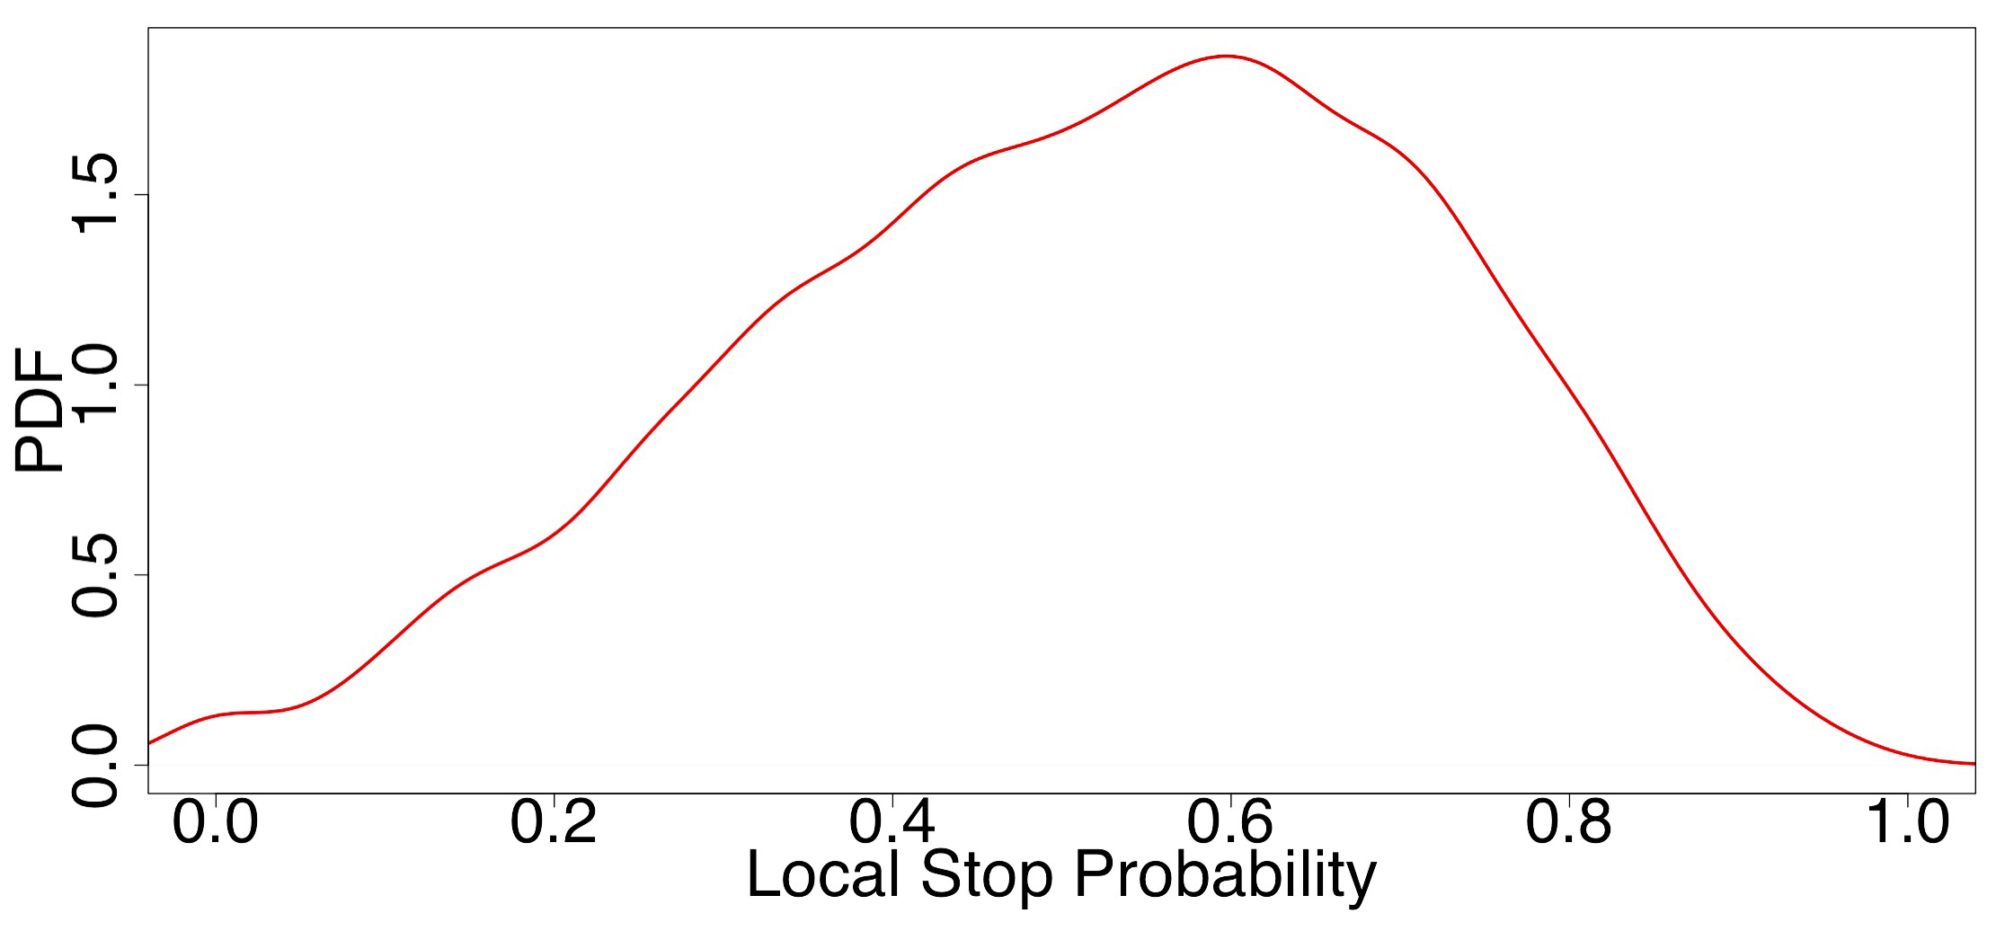
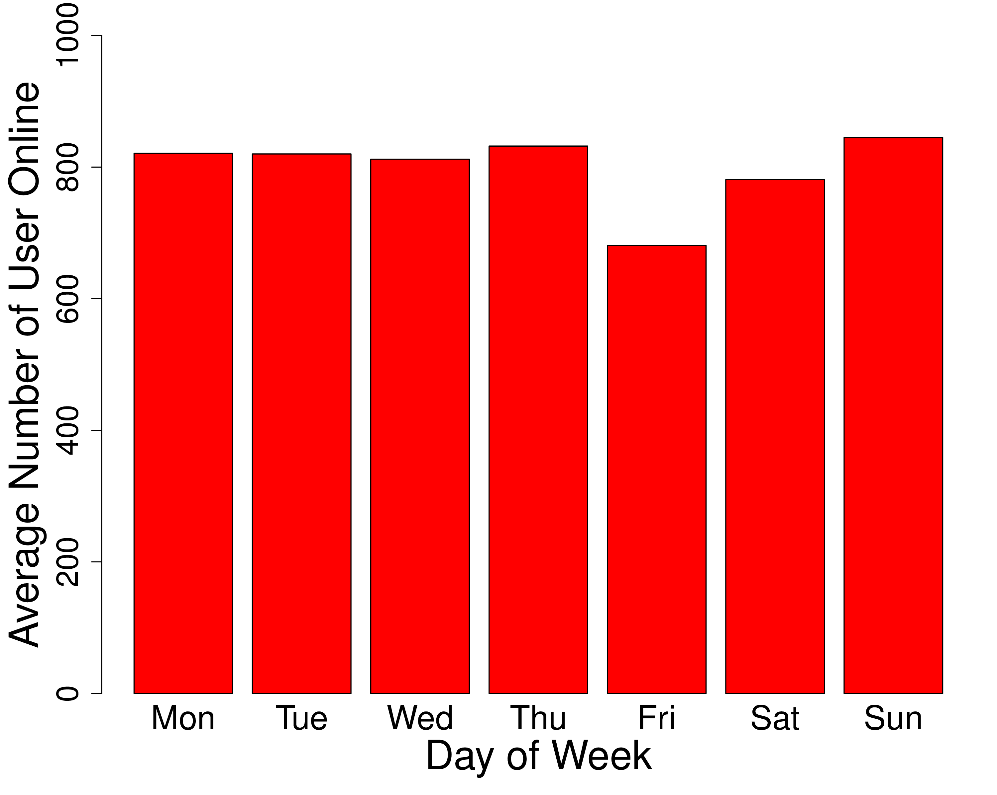
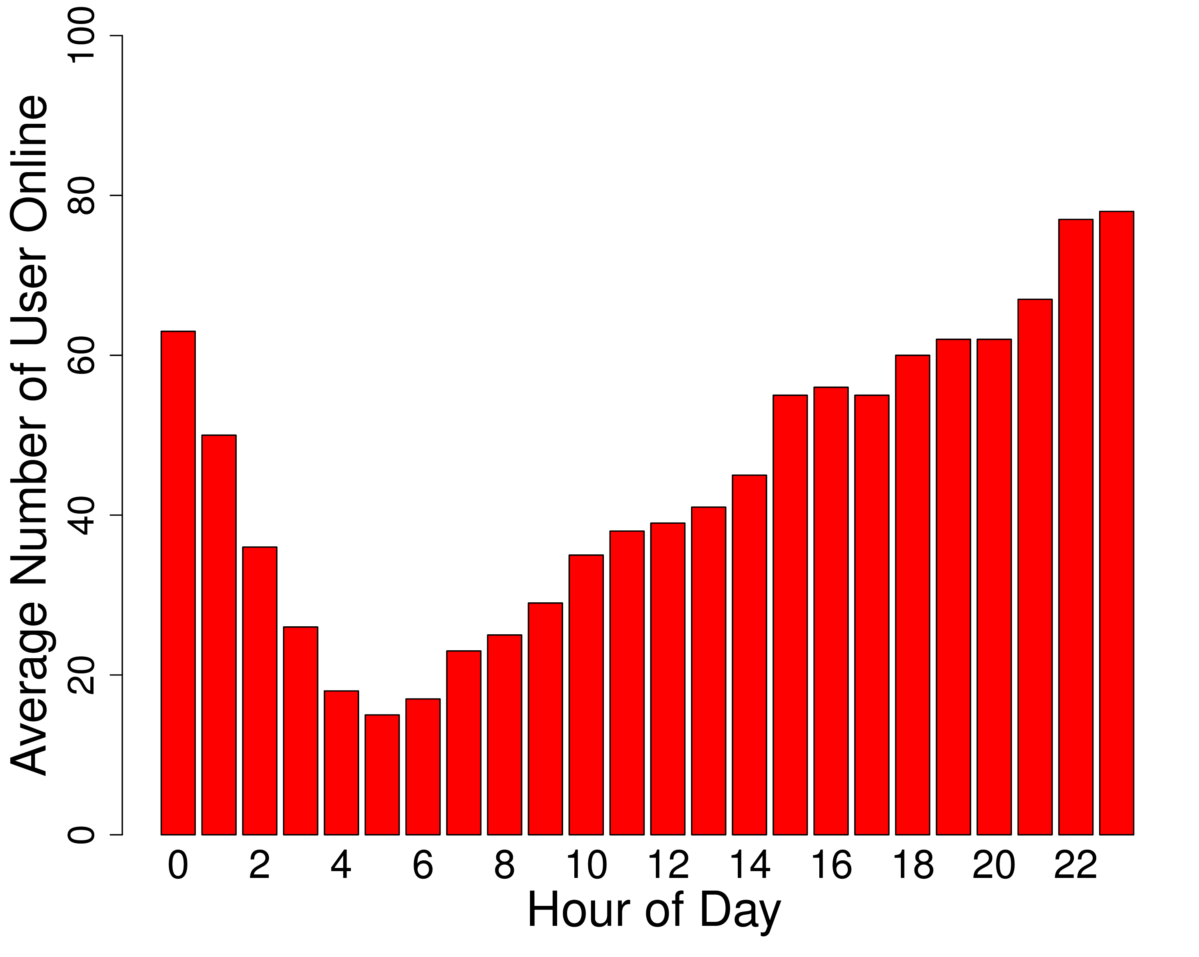
Global Analysis
Mobile network worse?
Mobile users more selective?
Phone interface easily click?
Time of use
Local stop prob
Text
58.3% users use text
2.8% sessions have text
GPS
No GPS data – private indoor activity
No text in short session
Audio more convenient

Slide 9
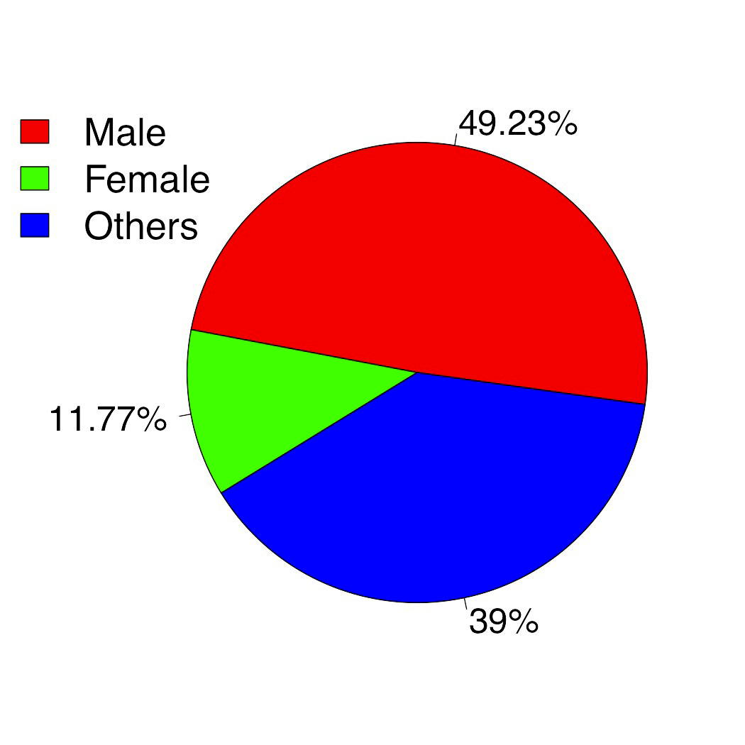
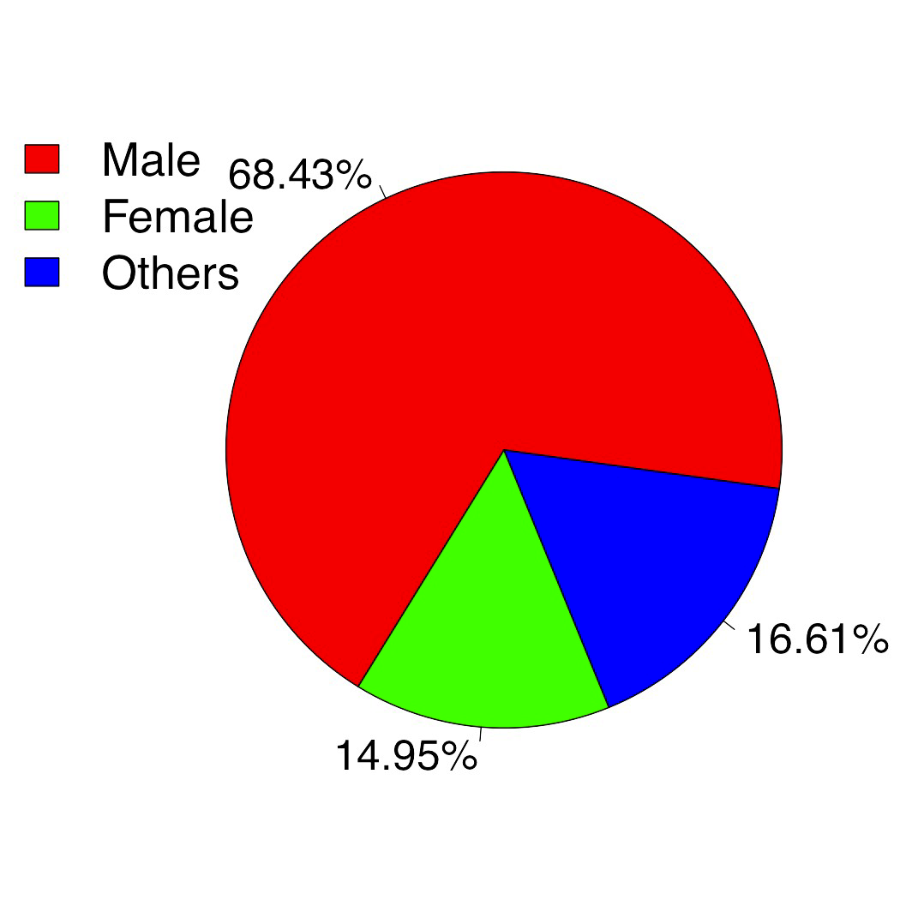



Mobile-Web Comparison
Gender distribution
MVChat Mobile Omegle Online
Male vs female: similar
More others in MVChat: Chat varies in different locations, postures
Mobile content more diverse than web
Content in bathroom
Trademark
Partial legs

Slide 10
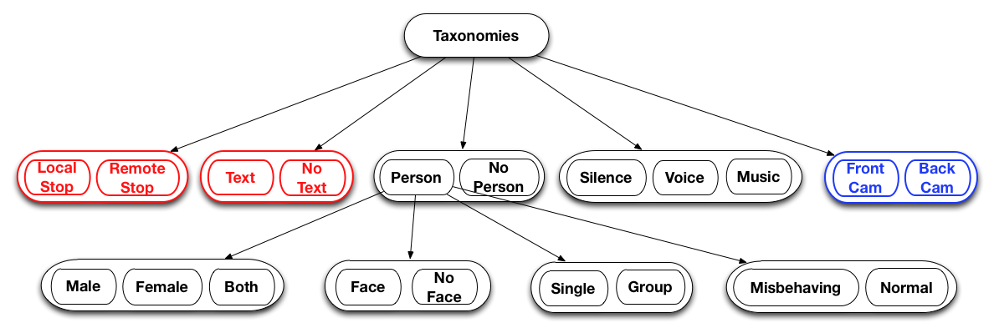
Meaningful sessions
Definition: session duration > 60s
Understand behavior features promoting longer sessions
At least 3 snapshots, 2 audios in a session
Almost 8000 such sessions
Subsample 218 sessions
Taxonomies on sessions and session images

Slide 11
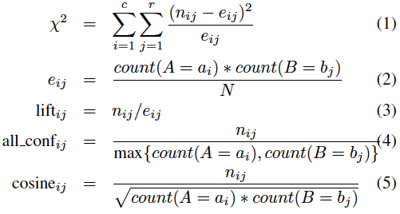
Taxonomy Correlation Analysis
Identify behavioral characteristics likely/unlikely occur together
Useful insights into designing pairing strategy, misbehavior detection
Target relations:
Highly correlated
Surprisingly non-correlated
Strong association rules
Measurements:
X²
Lift
All Confidence
Cosine similarity

Slide 12
Taxonomy Correlation Analysis

Slide 13

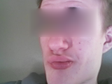
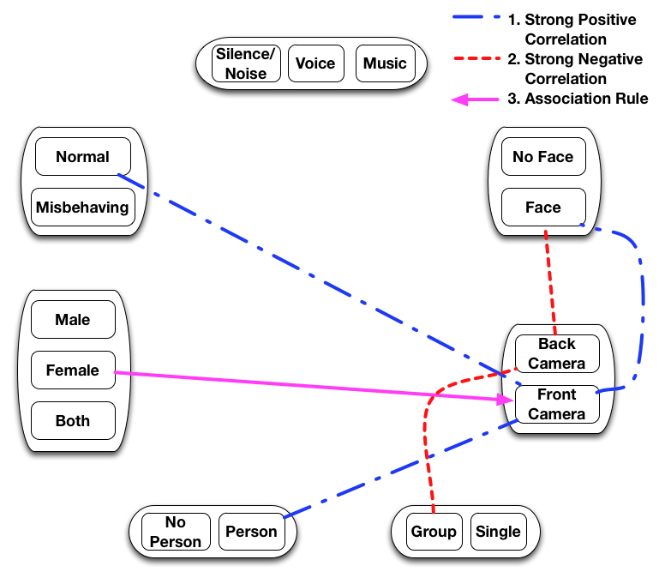
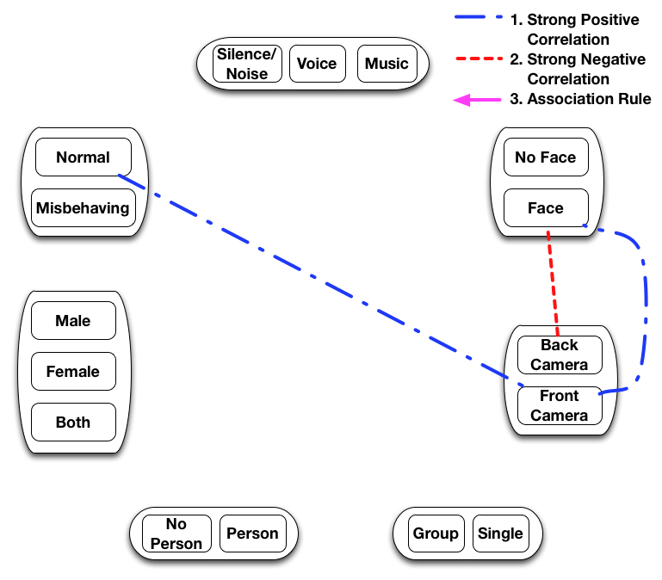


Taxonomy Correlation Analysis
Front Cam
Back Cam
Front cam positive correlated with normal and face
Back cam negative correlated with face
Cam position – effective and inexpensive for misbehavior detection

Slide 14
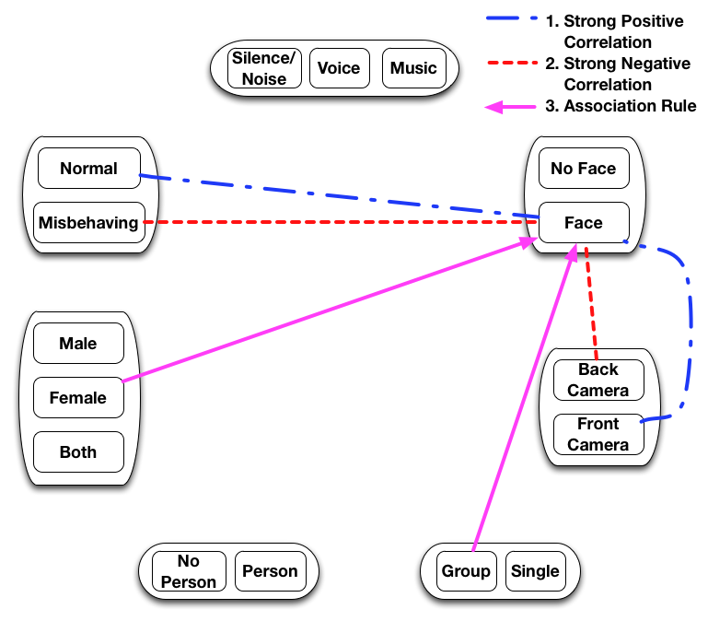
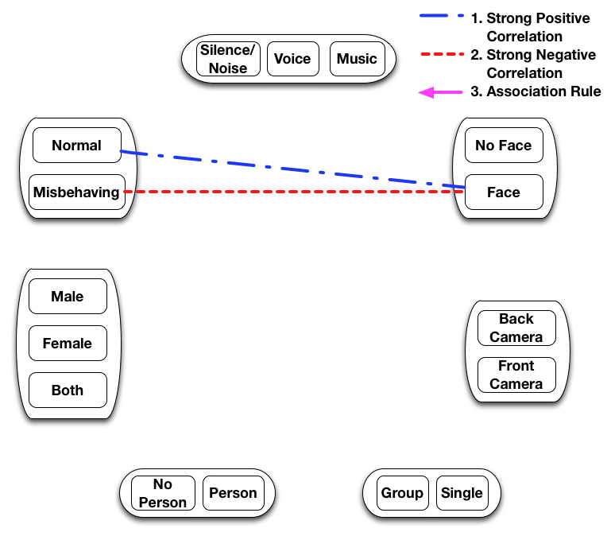
Taxonomy Correlation Analysis
Facial features highly positive correlated with normal, negative with misbehavior
Reasons:
Showing face helps chatting
Hiding face avoids being identified
Limited aperture angle hard to show face and body together
Facial features: differentiate normal from misbehavior

Slide 15
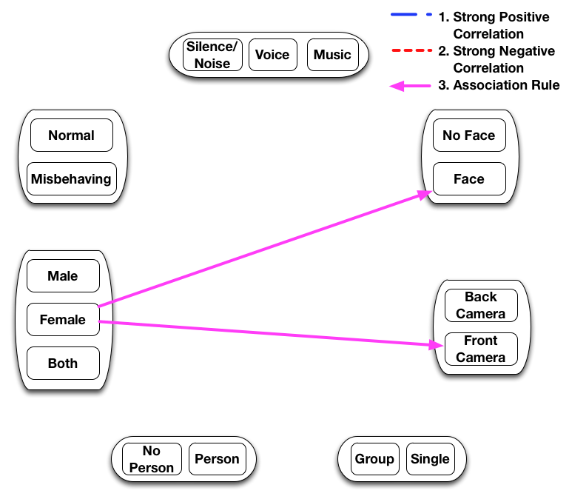
Taxonomy Correlation Analysis
92% females use front camera
84% females show faces
Females show faces more
appealing, effective in chatting

Slide 16
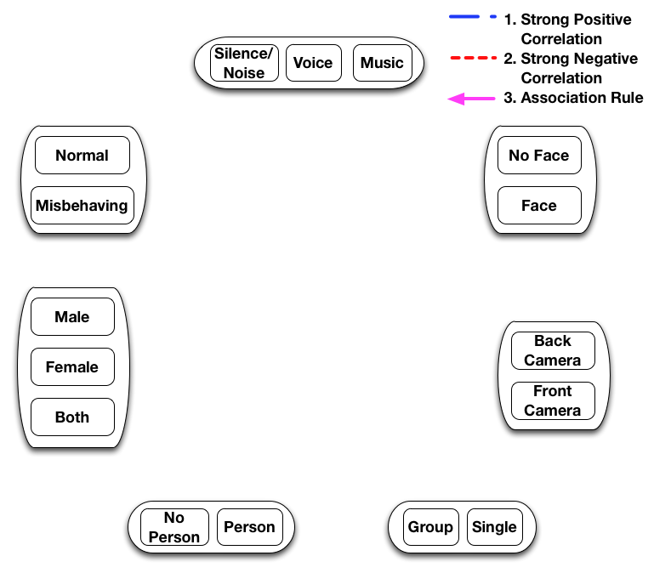
Taxonomy Correlation Analysis
No strong correlations, rules between gender vs normal/misbehavior
Misbehaving can be either male or female!
×

Slide 17
Meaningful User Analysis – female more popular
“Meaningful User”: successful in participating in longer chat sessions
Definition: >10% prob having chat >30s
Dataset:
Meaningful users: 114 users with 2714 images
Non-meaningful users: 123 users with 2832 images
Dominating factor: gender
Meaningful users: males: 8.8% vs females: 60.5%
Non-meaningful users: males: 45.5% vs females: 7.31%
Females more effective in having long sessions
Lots more males than females
Males interested in talking with females

Slide 18
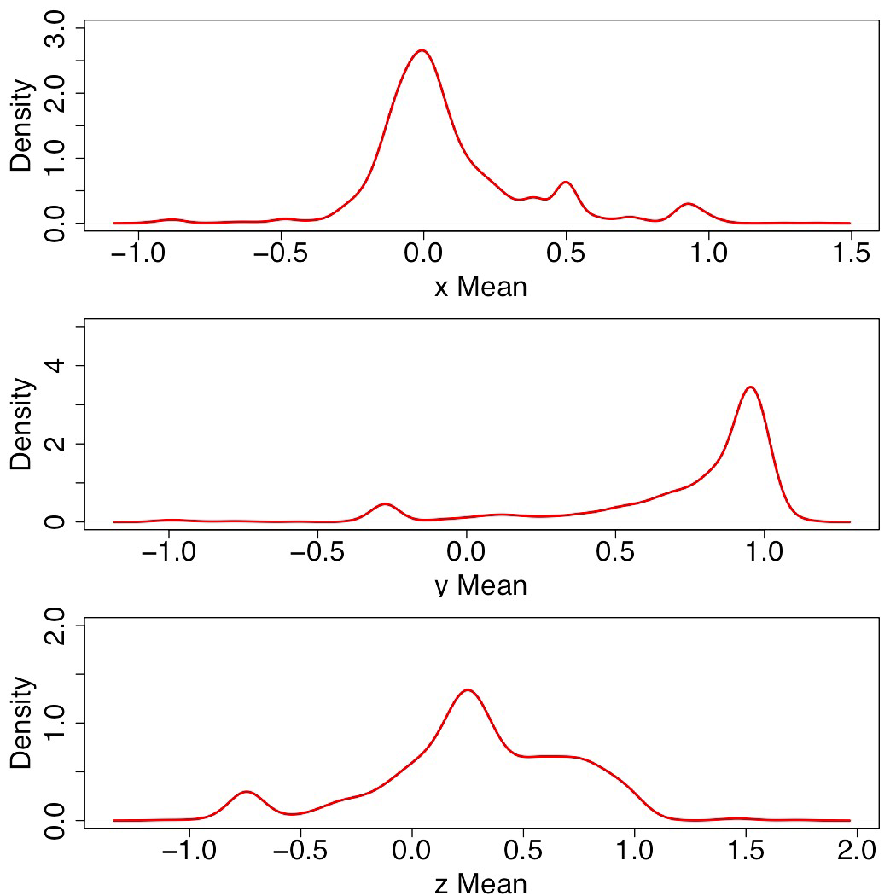
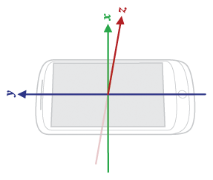
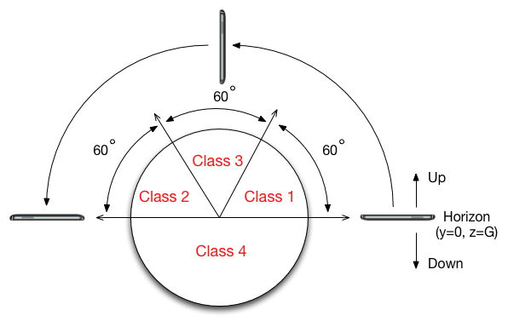
Acceleration Analysis
Class 1 and 2 occur frequently
Normal mostly in class 1 and 2 with front camera
Misbehavior prefer use back camera
y
z
x

Slide 19
Conclusions
First-ever, detailed random mobile video chat study at scale
Findings:
Users browse to find the “right” person
Mobility introduces content diversity
Cam position useful to detect misbehavior
Facial features differentiate normal from misbehavior
Female with faces have long sessions
No correlation between gender and normal/misbehaving
Acceleration plus cam position useful for misbehavior detection

Slide 20
Future Work
Design an accurate, scalable misbehavior classifier with multi-sensor information
Better understand meaningful users characteristics and build effective matching model by incorporating sensing modalities

Slide 21
Q & A?
Lei.Tian@colorado.edu

Slide 22
Thank you!

