Slide 1
Traversal String Edit Distance Filter
Free University of Bolzano
Approximation: Theory and Algorithms
Prof. Nikolaus Augsten
Elona Baku
Andreas Peer

Slide 2
Introduction
Motivation
Problem Definition
Solution
Experiments
Conclusion

Slide 3
Motivation
Goal: find a method for the approximate tree join that is efficient in terms of runtime.

Slide 4
Approximate Tree Join
cesare abba strasse
giuseppe-cesare-abba-strasse
{1}
{2}
{3}
{6}
{1}
{2}
{3}
{4}
{11}
{ }
{ }
{1}
{3}
{1}
{2}

Slide 5
Solution
Implement the tree edit distance and the traversal string filter
traversal string filter: lower bound for the tree edit distance

Slide 6
Approximate Tree Join Algorithm
for each Ti ∈ S1 do
for each Tj ∈ S2 do
if lowerBound(Ti , Tj ) ≤ τ then
if δt (Ti , Tj ) ≤ τ then
output(Ti , Tj )

Slide 7
Traversal String Filter: Algorithm
input: two trees A, B
output: lower bound
A-preorder = preorder-traversal(A)
B-preorder = preorder-traversal(B)
cost-pre = EditDistance(A-preorder, B-preorder)
A-postorder = postorder-traversal(A)
B-postorder = postorder-traversal(B)
cost-post = EditDistance(A-postorder, B-postorder)
return max(cost-pre, cost-post)

Slide 8
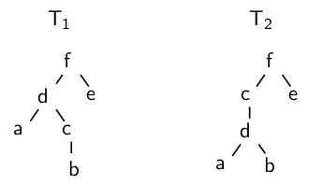
Traversal String Filter: Example
preorder of tree one: fdacbe
postorder of tree one: abcdef
preorder of tree two: fcdabe
postorder of tree two: abdcef
  Then, the String edit distances are:
  preorder: 2
  postorder: 2
  Tree edit distance: 2

Slide 9
Experiments
Dataset consists of 300x300 trees
Trees represent street
Max height: 4
Avg number of nodes: 175

Slide 10
Effectiveness of the filter

Slide 11
Runtime Performance
Without filter: 58 min!

