Slide 1
SIT111 – Task 9.3D
Lucifer Morningstar
SIT111 Computer Systems

Slide 2
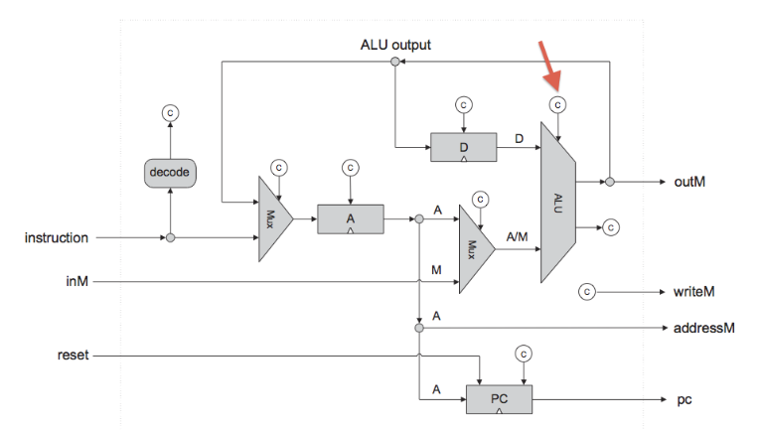
The CPU Architecture

Slide 3
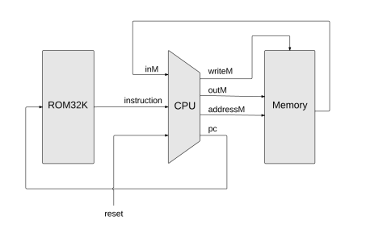
Overall Hack Computer Implementation

Slide 4
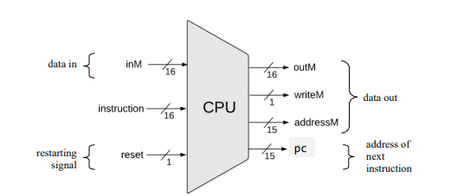
Hack CPU Interface

Slide 5
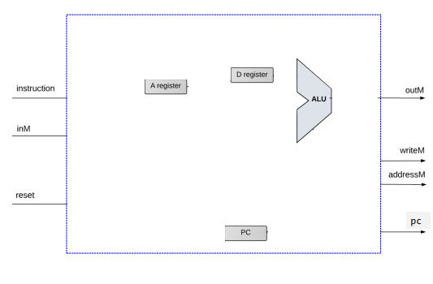
Key components and input/outputs of the Hack CPU

Slide 6
CPU Implementation

Slide 7
Translating the CPU Design into HDL code

Slide 8
CPU.hdl
IN inM[16], // M value input (M = contents of RAM[A])
instruction[16], // Instruction for execution
reset; // Signals whether to restart the current
// program (reset==1) or continue executing
// the current program (reset==0).
OUT outM[16], // M value output
writeM, // Write to M?
addressM[15], // Address in data memory (of M)
pc[15]; // Address of next instruction

Slide 9
CPU.hdl
// get type of instruction
Not(in=instruction[15], out=Ainstruction);
Not(in=Ainstruction, out=Cinstruction);
And(a=Cinstruction, b=instruction[5], out=ALUtoA); // C-inst and dest to A-reg?
Mux16(a=instruction, b=ALUout, sel=ALUtoA, out=Aregin);
Or(a=Ainstruction, b=ALUtoA, out=loadA); // load A if A-inst or C-inst&dest to A-reg
ARegister(in=Aregin, load=loadA, out=Aout);
Mux16(a=Aout, b=inM, sel=instruction[12], out=AMout); // select A or M based on a-bit
And(a=Cinstruction, b=instruction[4], out=loadD);
DRegister(in=ALUout, load=loadD, out=Dout); // load the D register from ALU

Slide 10
A-instruction
The A – instruction symbolic syntax:
@value: value is either number or symbol
If the value is a number, the A-register’s contents are set to the value.
If the value is a symbol: the contents of the A- register are set to the value that the symbol points to.

Slide 11
C - Instruction
Dest = comp;jump
Where :
Dest: Destination register
Comp: computation code
Jmp: jump directive
C-instruction performs a combination on the CPU which is stored into a destination register. it can also jump to another instruction memory address that is pointed by a value or a symbol.

Slide 12
CPU.hdl
ALU(x=Dout, y=AMout, zx=instruction[11], nx=instruction[10],
zy=instruction[9], ny=instruction[8], f=instruction[7],
no=instruction[6], out=ALUout, zr=ZRout, ng=NGout); // calculate
// Set outputs for writing memory
Or16(a=false, b=Aout, out[0..14]=addressM);
Or16(a=false, b=ALUout, out=outM);
And(a=Cinstruction, b=instruction[3], out=writeM);

Slide 13
CPU.hdl
// calc PCload & PCinc - whether to load PC with A reg
And(a=ZRout, b=instruction[1], out=jeq); // is zero and jump if zero
And(a=NGout, b=instruction[2], out=jlt); // is neg and jump if neg
Or(a=ZRout, b=NGout, out=zeroOrNeg);
Not(in=zeroOrNeg, out=positive); // is positive (not zero and not neg)
And(a=positive, b=instruction[0], out=jgt); // is pos and jump if pos
Or(a=jeq, b=jlt, out=jle);
Or(a=jle, b=jgt, out=jumpToA); // load PC if cond met and jump if cond
And(a=Cinstruction, b=jumpToA, out=PCload); // Only jump if C instruction
Not(in=PCload, out=PCinc); // only inc if not load
PC(in=Aout, inc=PCinc, load=PCload, reset=reset, out[0..14]=pc);

Slide 14
Thank you

