Slide 1
Android Course Day 1
Lucio Cossio
Luis Mazoni

Slide 2
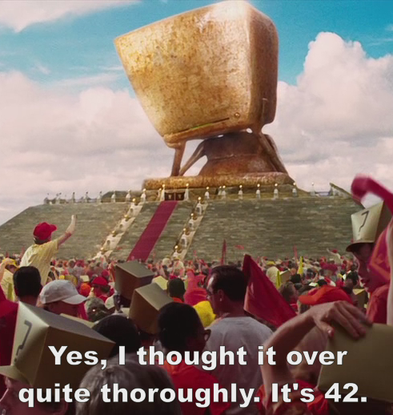
Introduction
Who are we?
Why are we here?

Slide 3
Course Agenda
Day 1
Day 2
Day 3
Day 4
Day 5
Development environment and tools
Android project structure
Source, tests , resources, manifest
Activity
Lifecycle
Layout interaction
ActionBar
Practice
Review Day 1
Layout
View Group
Relative, Linear
Views
TextView, Edit Text, Button
String resources
View listeners
Practice
Review Day 2
Intents
Open new activity
Sending data
Actions
Android Manifest
Overview
Add activities
Practice
Review Day 3
Fragments
Lifecycle
Inflate Layouts
Fragment Manager
Arguments
Practice
Review Day 4
ListView
Adapter
View Holder
Async Tasks
UI Thread
Practice

Slide 4
Development Environment and Tools
Java JDK 7
Android SDK 4.4
Android Studio (0.8x + )
Genymotion (uses VirtualBox)

Slide 5
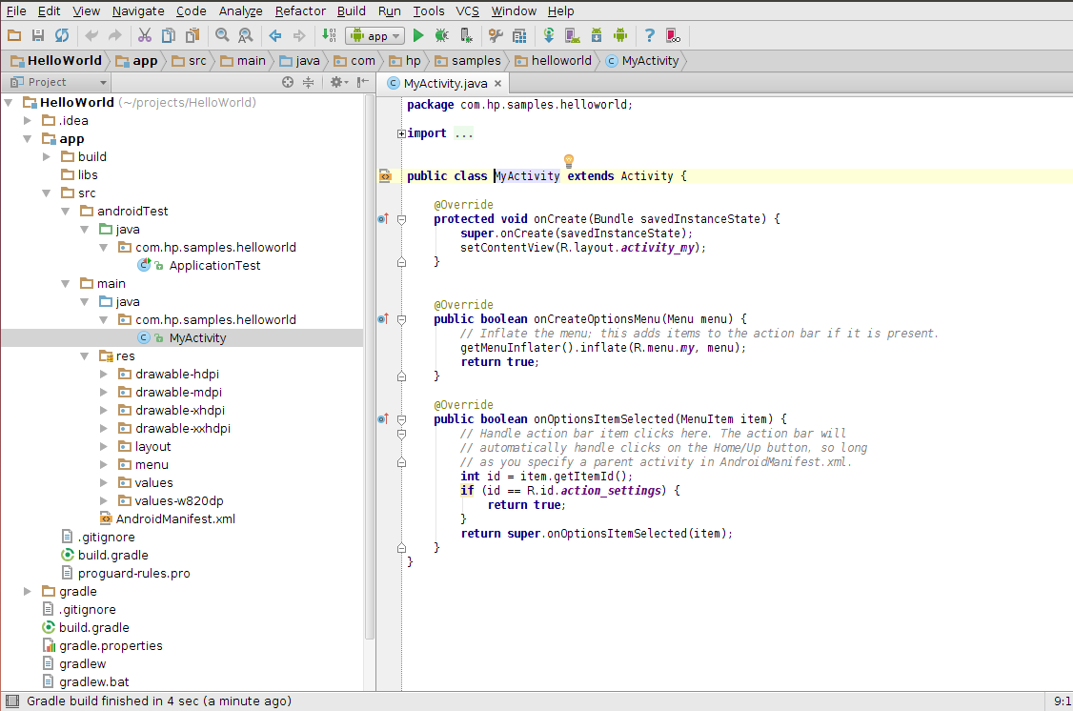
Android project structure
Android Studio

Slide 6

Android project structure
Gradle
It uses gradle by Default
build.gradle –> controls building and project dependencies
gradle.properties -> default gradle configurations
What is gradle?
Gradle can automate the building, testing, publishing and deployment. Gradle combines the power and flexibility of ant with the dependency management and conventions of Maven into a more effective way to build.

Slide 7
Android project structure
Android Folders
Folder structure:
Your app module
src
androidTest
java <- tests here
main
java <- app code here
res <- android resources (layouts, strings, dimensions, drawables)
AndroidManifest.xml <- info to android system about your app (java package name, activities, services, permissions, api required,...)

Slide 8
Activity
An Activity is an application component that provides a screen with which users can interact in order to do something. Each activity is given a window in which to draw its user interface.
Typically, one activity in an application is specified as the "main" activity, which is presented to the user when launching the application for the first time. Each activity can then start another activity in order to perform different actions. Each time a new activity starts, the previous activity is stopped, but the system preserves the activity in a stack.

Slide 9
Activity - onCreate
onCreate(Bundle) is where you initialize your activity. Most importantly, here you will usually call setContentView(int) with a layout resource defining your UI, and using findViewById(int) to retrieve the widgets in that UI that you need to interact with programmatically.
setContentView() can be used with both a layout resource or a instance of a ViewGroup object

Slide 10
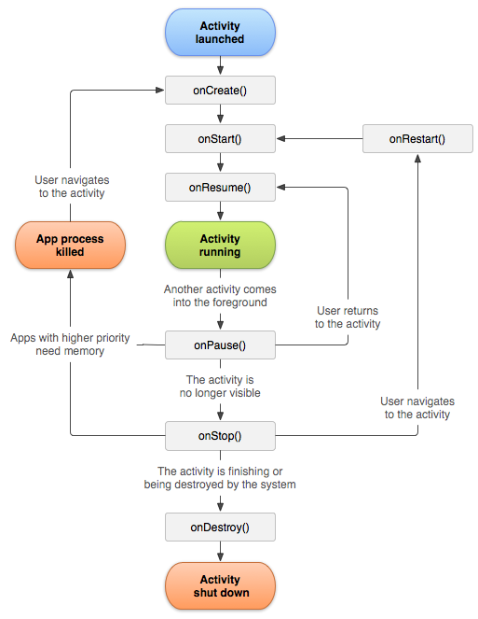
Activity Lifecycle

Slide 11
Activity Lifecycle
An activity has essentially four states:
If an activity in the foreground of the screen (at the top of the stack), it is active or running.
If an activity has lost focus but is still visible (that is, a new non-full-sized or transparent activity has focus on top of your activity), it is paused. A paused activity is completely alive (it maintains all state and member information and remains attached to the window manager), but can be killed by the system in extreme low memory situations.

Slide 12
Activity Lifecycle
If an activity is completely obscured by another activity, it is stopped. It still retains all state and member information, however, it is no longer visible to the user so its window is hidden and it will often be killed by the system when memory is needed elsewhere.
If an activity is paused or stopped, the system can drop the activity from memory by either asking it to finish, or simply killing its process. When it is displayed again to the user, it must be completely restarted and restored to its previous state.

Slide 13
Activity Lifecycle
You should use the onPause() method to write any persistent data (such as user edits) to storage. In addition, the method onSaveInstanceState(Bundle) is called before placing the activity in such a background state, allowing you to save away any dynamic instance state in your activity into the given Bundle, to be later received in onCreate(Bundle) if the activity needs to be re-created.

Slide 14
Configuration Changed
Unless you specify otherwise, a configuration change (such as a change in screen orientation, language, input devices, etc) will cause your current activity to be destroyed, going through the normal activity lifecycle process of onPause(), onStop(), and onDestroy() as appropriate.
If the activity had been in the foreground or visible to the user, once onDestroy() is called in that instance then a new instance of the activity will be created, with whatever savedInstanceState the previous instance had generated from onSaveInstanceState(Bundle).

Slide 15
Practice: Create and run new project on genymotion

Slide 16
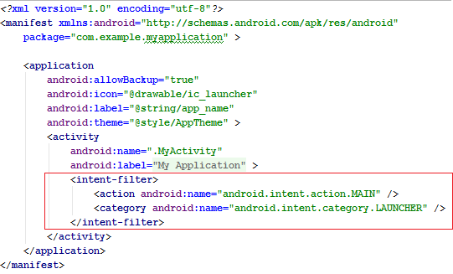
Main Activity

Slide 17
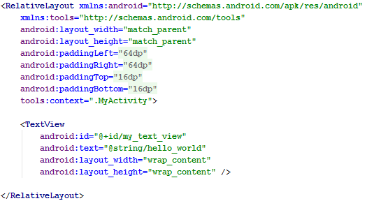
Layout Interaction
Activity Layout

Slide 18
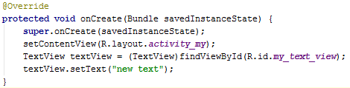
Layout Interaction
Change Text View Text

Slide 19
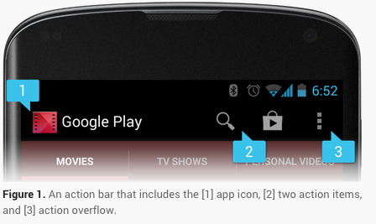
Action Bar
The action bar is a window feature that identifies the user location, and provides user actions and navigation modes.
Using the action bar offers your users a familiar interface across applications that the system gracefully adapts for different screen configurations.

Slide 20
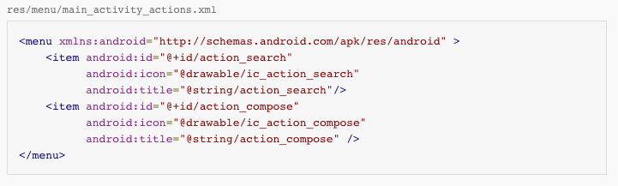
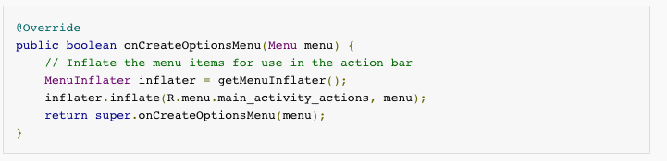
Action Bar – Adding Action Items
When your activity starts, the system populates the action items by calling your activity's onCreateOptionsMenu() method. Use this method to inflate a menu resource that defines all the action items. For example, here's a menu resource defining a couple of menu items:

Slide 21
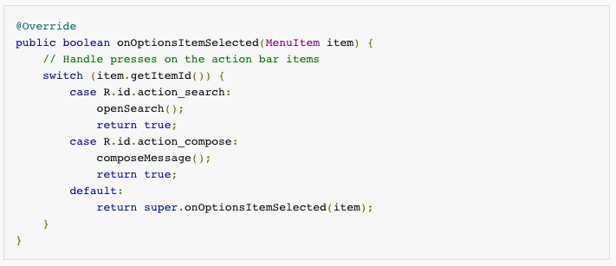
Action Bar – Handling clicks
When the user presses an action, the system calls your activity's onOptionsItemSelected() method. Using the MenuItem passed to this method, you can identify the action by calling getItemId(). This returns the unique ID provided by the <item> tag's id attribute so you can perform the appropriate action.

Slide 22
Resources
Android Developers - Training
http://developer.android.com/training/index.html
Genymotion
http://www.genymotion.com/
Gradle
http://www.gradle.org/
Portions of this work are modifications based on work created and shared by the Android Open Source Project and used according to terms described in the Creative Commons 2.5 Attribution License.

Slide 23
Practice: Create simple textview clock

Slide 24
Practice: Count activity visible time

Slide 25
Thank you
Lucio Cossio
Luis Mazoni

