Slide 1
Android Course Day 2
Lucio Cossio
Luis Mazoni

Slide 2
Course Agenda
Day 1
Day 2
Day 3
Day 4
Day 5
Development environment and tools
Android project structure
Source, tests , resources, manifest
Activity
Lifecycle
Layout interaction
ActionBar
Practice
Review Day 1
Resources
String
Dimensions
Layout
Views
TextView, Edit Text, Button
String resources
View listeners
Animation
Practice
Review Day 2
Intents
Open new activity
Sending data
Actions
Android Manifest
Overview
Add activities
Practice
Review Day 3
Fragments
Lifecycle
Fragment Manager
Arguments
Practice
Review Day 4
ListView
Adapter
View Holder
Async Tasks
UI Thread
Practice

Slide 3
Review
The visible lifetime of an activity happens between a call to onStart() until a corresponding call to onStop()
The foreground lifetime of an activity happens between a call to onResume() until a corresponding call to onPause()
onPause() is always called when an activity is being placed in the background or on its way to destruction. One example of when onPause() and onStop() is called and onSaveInstanceState(Bundle) is not is when a user navigates back from activity B to activity A: there is no need to call onSaveInstanceState(Bundle) on B because that particular instance will never be restored, so the system avoids calling it.
onStop() may never be called, in low memory situations where the system does not have enough memory to keep your activity's process running after its onPause() method is called.

Slide 4
Resources
Located under res folder
There are several types of resources, such as:
Animation
Color State List
Drawable
Layout
Menu
String
Style
Bool
Color
Dimension
ID
Integer
Integer Array
Typed Array

Slide 5
Resources - Specifying for configurations
Any resource folder can be appended with a configuration suffix, such as:
Language and Region (en, fr, pt-rBR…)
Screen size (small, normal, large, xlarge)
Orientation (port, land)
UI mode (car, desk, television, appliance and watch)
Screen pixel density (ldpi, mdpi, hdpi, xhdpi, xxhdpi, xxxhdpi, nodpi and tvdpi)

Slide 6
We’ll be using the following
Drawable
String
Dimension
Color
Layout

Slide 7

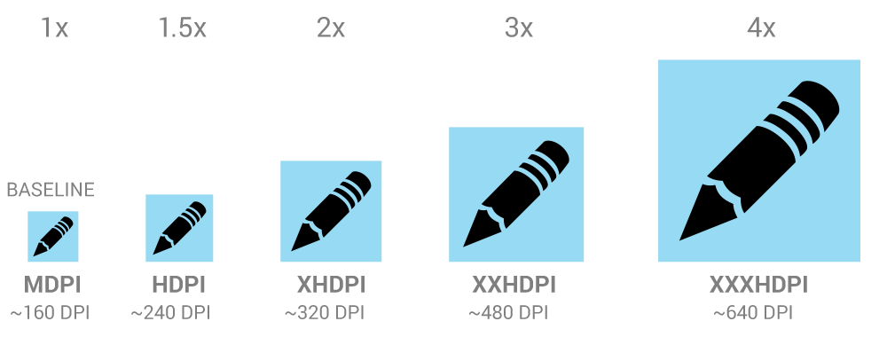
Drawable Resources
A Drawable can be a bitmap file, like .png, .jpg, or .gif file. Android creates a Drawable resource for any of these files when you save them in the res/drawable/ directory.
When creating icons, it's important to keep in mind that your app may be installed on a variety of devices that offer a range of pixel densities. But you can make your icons look great on all devices by providing each icon in multiple sizes.

Slide 8
String Resources
There are three kind of string resources, that are all described as XML:
String
String Array
Quantity String (Plurals)

Slide 9
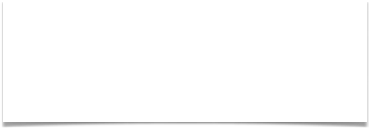





String Resource - String
Defining it
Using it
or

Slide 10


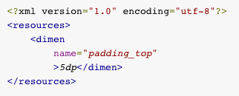
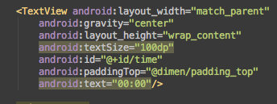
Dimension
A dimension value defined in XML. A dimension is specified with a number followed by a unit of measure. For example: 10px, 2in, 5sp, 8dp
Defining it
Using it

Slide 11




Color
A color value defined in XML. The color is specified with an RGB value and alpha channel. You can use a color resource any place that accepts a hexadecimal color value. You can also use a color resource when a drawable resource is expected in XML (for example, android:drawable="@color/green").
Defining it
Using it

Slide 12
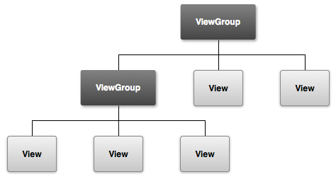
Layout
The graphical user interface for an Android app is built using a hierarchy of View and ViewGroup objects.

Slide 13


Layout
Common View Groups
Linear Layout
Relative Layout
organizes its children into a single horizontal or vertical row. Creates a scrollbar if the length of the window exceeds the length of the screen
Enables you to specify the location of child objects relative to each other (child A to the left of child B) or to the parent (aligned to the top of the parent).

Slide 14
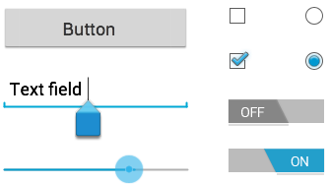
Layout - Views
Common Controls
Control Type | Related Classes
Button | Button
Text field | EditText,AutoCompleteTextView
Checkbox | CheckBox
Radio button | RadioGroup RadioButton
Toggle button | ToggleButton
Spinner | Spinner
Pickers | DatePicker,TimePicker

Slide 15

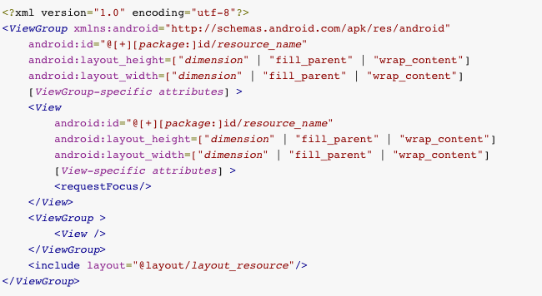
Layout - XML Definition

Slide 16




Layout - Using your XML
As an Activity
With layout inflater

Slide 17
Practice: Simple login form

Slide 18
Listeners
All Views have the following events that could be listen to:
onClick()
onLongClick()
onFocusChange()
onKey()
onTouch()
onCreateContextMenu()

Slide 19

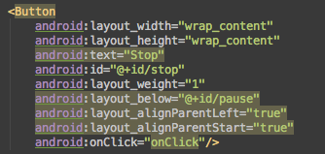

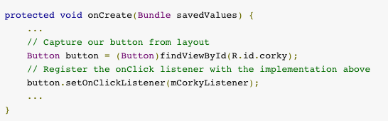
Listeners
or

Slide 20
Practice: Simple Chronometer

Slide 21
Animation
The Android framework provides two animation systems: property animation (introduced in Android 3.0) and view animation. Both animation systems are viable options, but the property animation system, in general, is the preferred method to use, because it is more flexible and offers more features. In addition to these two systems, you can utilize Drawable animation, which allows you to load drawable resources and display them one frame after another.
Drawable Animation
View Animation
Property Animation

Slide 22
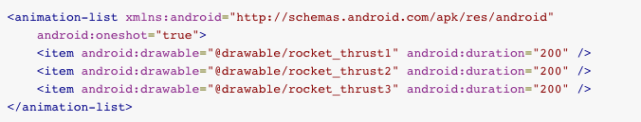
Animation – Drawable Animation – Defining it

Slide 23
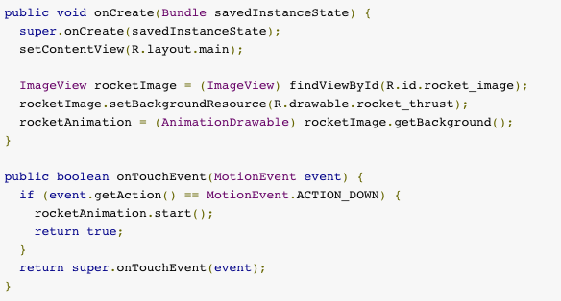
Animation – Drawable Animation – Using it

Slide 24
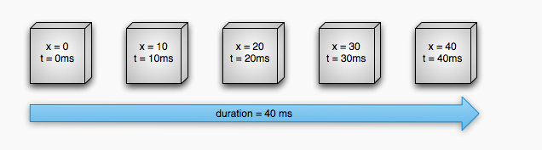
But first! How property animation works?
Linear (interpolator) animation

Slide 25
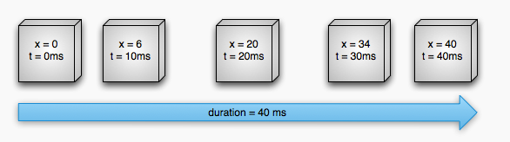
But first! How property animation works?
Non-Linear (interpolator) animation

Slide 26
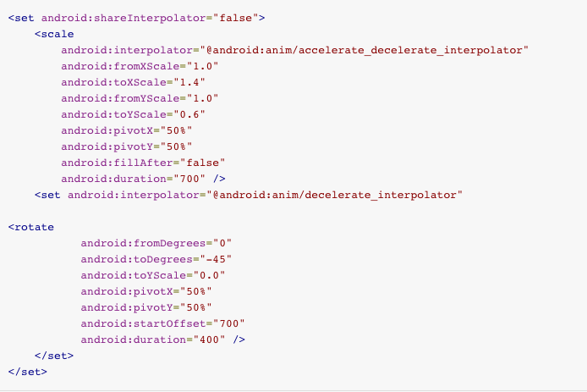
Animation – View Animation – Defining it

Slide 27

Animation – View Animation – Using it
On views:
On activities:

Slide 28

Animation – Property Animation
There are three main classes used to programmatically execute property
animation, those are:
ValueAnimator
ObjectAnimator
AnimatorSet
And this is how we use it:

Slide 29
Practice: Animated Chronometer

Slide 30
Practice: Draggable Drawables with Animation when intersecting

Slide 31
Thank you
Lucio Cossio
Luis Mazoni

