Slide 1
Android Course Day 3
Lucio Cossio
Luis Mazoni

Slide 2
Course Agenda
Day 1
Day 2
Day 3
Day 4
Day 5
Development environment and tools
Android project structure
Source, tests , resources, manifest
Activity
Lifecycle
Layout interaction
ActionBar
Practice
Review Day 1
Resources
String
Dimensions
Layout
Views
TextView, Edit Text, Button
String resources
View listeners
Animation
Practice
Review Day 2
Intents
Explicit
Extras
Implicit
Intent Filters
Android Manifest
Overview
Add activities
Notifications
Practice
Review Day 3
Fragments
Lifecycle
Fragment Manager
Arguments
Practice
Review Day 4
ListView
Adapter
View Holder
Async Tasks
UI Thread
Practice

Slide 3
Review day 2
Resources
Resources qualifiers
Layouts
Views
Animation

Slide 4
Intent
An abstract operation used to start new activities, start and bind services, communicate with background services. Notice that this also allow apps to communicate between one another
Explicit intents
Implicit intents

Slide 5
Intent – Explicit Intents
Those are the intents that specify the component to be started by name (the fully-qualified classs name). You’ll typically use an explicit intent to start a component in your own app, or a specific component of another app.
Starting an activity using explicit intent

Slide 6
Intent - Extra
Key-value pairs that carry additional information required to accomplish the started activity.
Example:

Slide 7
Practice: Login form that opens another activity to welcome the user

Slide 8
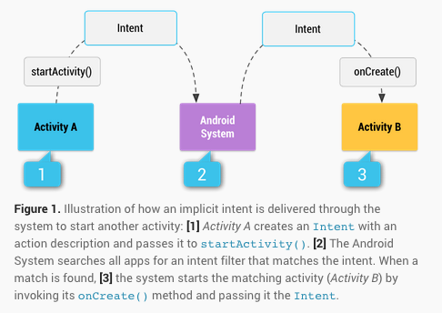
Intent – Implicit Intents
Those are the intents that declare only a general action to perform, which allows a component from any app to handle it.

Slide 9

Intent – Implicit Intents
Starting an implicit intent to perform the ACTION_VIEW of certain URL

Slide 10
Practice: Make an activity google search

Slide 11
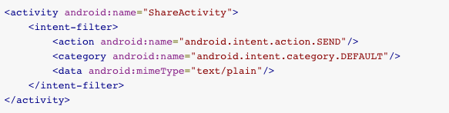
Intent Filters – Receiving an Implicit Intent
To advertise which implicit intents your activity can receive, declare one or more intent filters for each of your app components with an <intent-filter> element in your manifest file.
*Multiple <action> <category> and <data> can be added to each intent filter

Slide 12
Practice: Make an activity that receives the ACTION_VIEW intents

Slide 13
Android Manifest
The manifest file presents essential information about your app to the Android system.
It names the Java package for the application.
It describes the components of the application — the activities, services, broadcast receivers, and content providers that the application is composed of.
It declares which permissions the application must have in order to access protected parts of the API and interact with other applications.
It declares the minimum level of the Android API that the application requires.

Slide 14
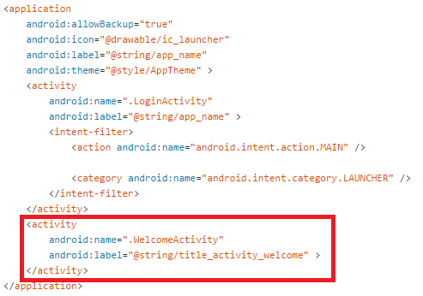
Add Activities

Slide 15
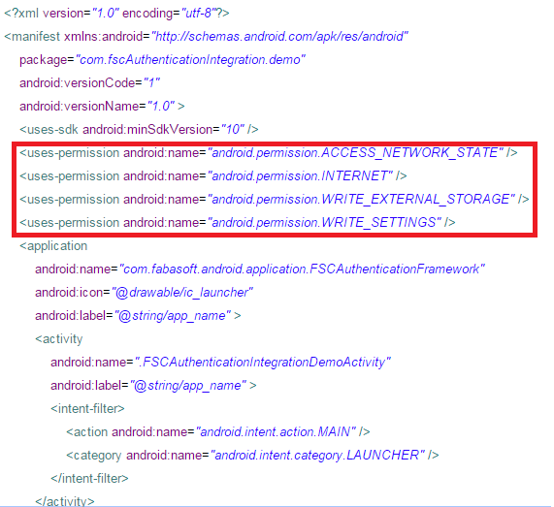
Add Permissions

Slide 16
Permissions
ACCESS_FINE_LOCATION
ACCESS_NETWORK_STATE
ACCESS_WIFI_STATE
CALL_PHONE
CAMERA
FLASHLIGHT
INTERNET
READ_SMS
SEND_SMS
VIBRATE
...
http://developer.android.com/reference/android/Manifest.permission.html

Slide 17
Application Icon

Slide 18
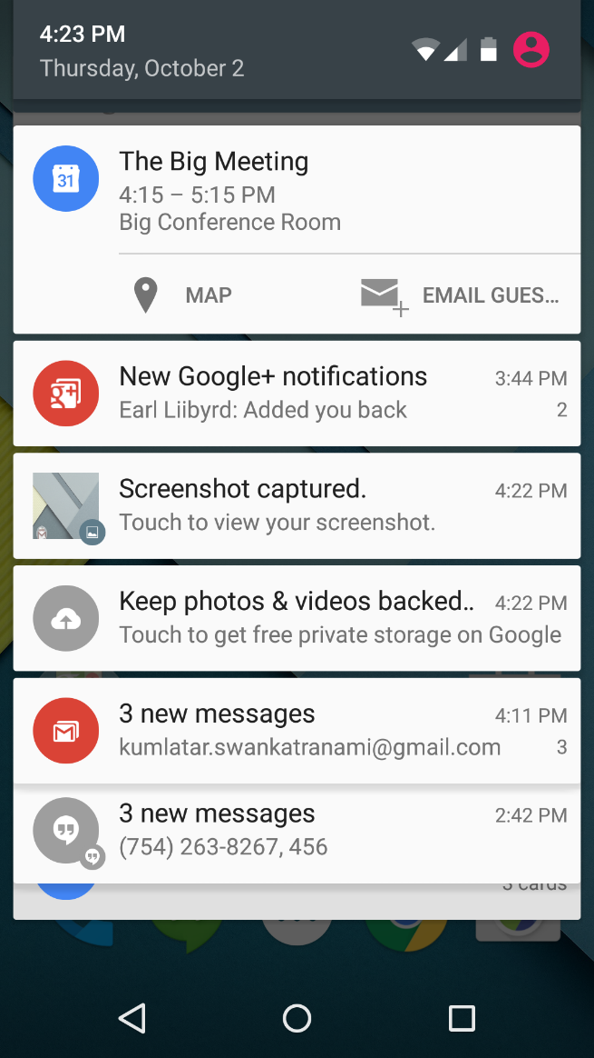

Notifications
A Notification object must contain the following:
A small icon, set by setSmallIcon()
A title, set by setContentTitle()
Detail text, set by setContentText()

Slide 19
Notifications - Actions
Although they're optional, you should add at least one action to your notification. An action allows users to go directly from the notification to an Activity in your application, where they can look at one or more events or do further work.
The action itself is defined by a PendingIntent containing an Intent that starts an Activity in your application.

Slide 20
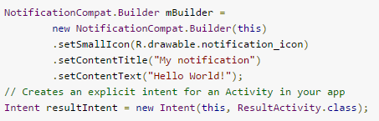
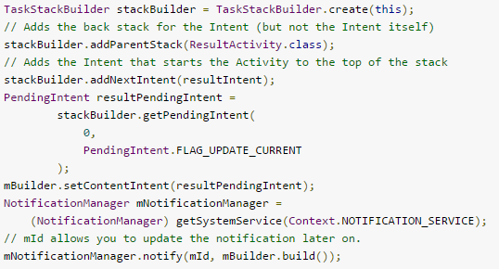
Notifications - Actions

Slide 21
Practice: “Remind Me In” application

Slide 22
Thank you
Lucio Cossio
Luis Mazoni

