Slide 1
Android Course Day 4
Lucio Cossio
Luis Mazoni

Slide 2
Course Agenda
Day 1
Day 2
Day 3
Day 4
Day 5
Development environment and tools
Android project structure
Source, tests , resources, manifest
Activity
Lifecycle
Layout interaction
ActionBar
Practice
Review Day 1
Resources
String
Dimensions
Layout
Views
TextView, Edit Text, Button
String resources
View listeners
Animation
Practice
Review Day 2
Intents
Explicit
Extras
Implicit
Intent Filters
Android Manifest
Overview
Add activities
Notifications
Practice
Review Day 3
Fragments
Lifecycle
Fragment Manager
Arguments
Broadcast Receiver
Otto
Async Task
Practice
Review Day 4
ListView
Adapter
View Holder
Service
Storage
SharedPreferences
SQLite
Practice

Slide 3
Review day 3
Intents
Explicit
Implicit
Android Manifest
Notifications

Slide 4
Fragments
A Fragment represents a behavior or a portion of user interface in an Activity. You can combine multiple fragments in a single activity to build a multi-pane UI and reuse a fragment in multiple activities.
You can think of a fragment as a modular section of an activity, which has its own lifecycle, receives its own input events, and which you can add or remove while the activity is running.

Slide 5
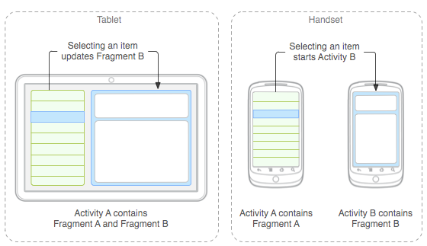
Fragments
Android introduced fragments in Android 3.0 (API level 11), primarily to support more dynamic and flexible UI designs on large screens, such as tablets.
Because a tablet's screen is much larger than that of a handset, there's more room to combine and interchange UI components.

Slide 6
Fragments or Activities?
Eric Burke from Square said they tried to create an application that worked with only one Activity, using fragments to change layouts. Didn’t work very well.
What he recommends is to use one activity for each “region” of the app:
On Boarding has several steps: name, address, bank account. One activity, several steps (fragments). :
Payment flow
Settings
Why? Action bar stay fixed. Smooth animations. Code Organization.

Slide 7
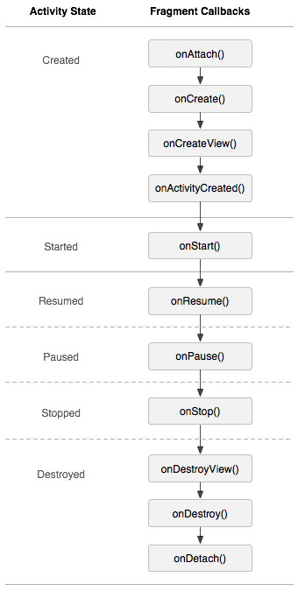
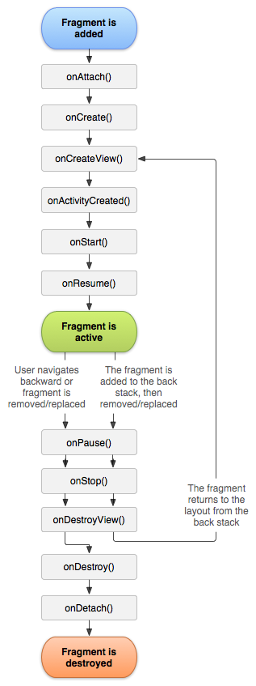
Fragments - Lifecycle

Slide 8
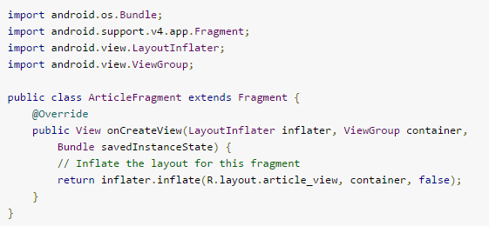
Fragments - Lifecycle

Slide 9
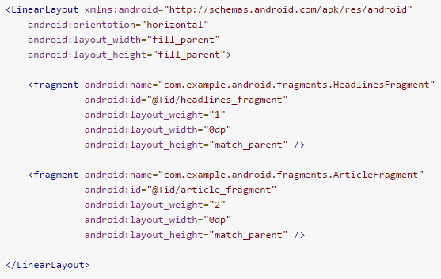
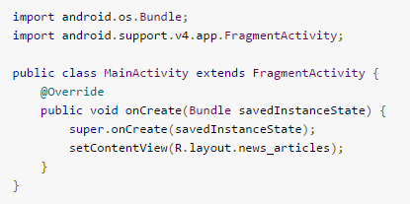
Fragments – Add To Activity Layout
news_articles Layout
Activity

Slide 10
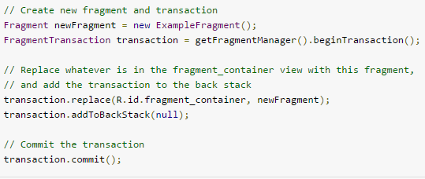
Fragments – Fragment Manager

Slide 11
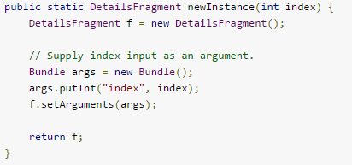
Fragments – Arguments

Slide 12
Practice: Drawer fragments for tablet and smartphone

Slide 13
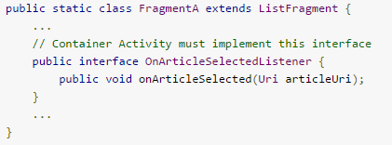
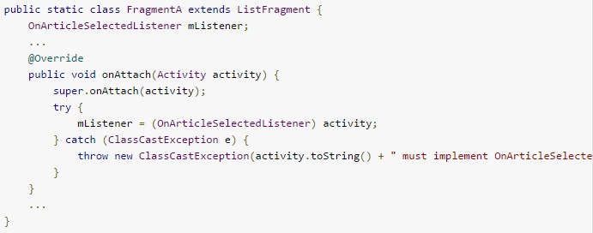
Activity-Fragment communication - Listeners

Slide 14
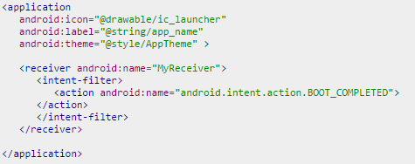
Broadcast Receivers
A broadcast is a message that any app can receive. The system delivers various broadcasts for system events, such as when the system boots up or the device starts charging. You can deliver a broadcast to other apps by passing an Intent to sendBroadcast(), sendOrderedBroadcast(), or sendStickyBroadcast().
Filters for broadcast receivers can be registered dynamically by calling registerReceiver(). You can then unregister the receiver with unregisterReceiver(). Doing so allows your app to listen for specific broadcasts during only a specified period of time while your app is running.

Slide 15
Broadcast Receivers
There are system broadcast intents that can be listen to:
ACTION_AIRPLANE_MODE_CHANGED
ACTION_BATTERY_LOW
ACTION_DEVICE_STORAGE_LOW
ACTION_HEADSET_PLUG
ACTION_POWER_CONNECTED
ACTION_POWER_DISCONNECTED
ACTION_SHUTDOWN

Slide 16
LocalBroadcastManager
Helper to register for and send broadcasts of Intents to local objects within your process.

Slide 17
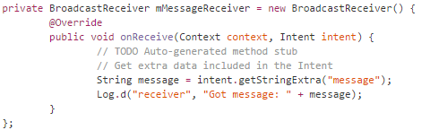

LocalBroadcastManager

Slide 18

Otto
Otto is an event bus designed to decouple different parts of your application while still allowing them to communicate efficiently.
Use as a Singleton
Publishing
Subscribing

Slide 19
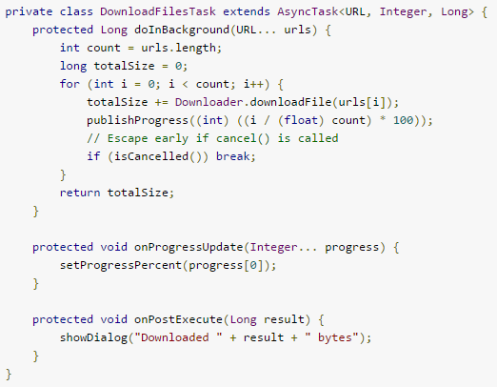
AsyncTasks
AsyncTask enables proper and easy use of the UI thread. This class allows to perform background operations and publish results on the UI thread without having to manipulate threads and/or handlers.

Slide 20
Thank you
Lucio Cossio
Luis Mazoni

