Slide 1
Android Course Day 5
Lucio Cossio
Luis Mazoni

Slide 2
Course Agenda
Day 1
Day 2
Day 3
Day 4
Day 5
Development environment and tools
Android project structure
Source, tests , resources, manifest
Activity
Lifecycle
Layout interaction
ActionBar
Practice
Review Day 1
Resources
String
Dimensions
Layout
Views
TextView, Edit Text, Button
String resources
View listeners
Animation
Practice
Review Day 2
Intents
Explicit
Extras
Implicit
Intent Filters
Android Manifest
Overview
Add activities
Notifications
Practice
Review Day 3
Fragments
Lifecycle
Fragment Manager
Arguments
Broadcast Receiver
Otto
Async Task
Practice
Review Day 4
ListView
Adapter
View Holder
Service
Storage
SharedPreferences
SQLite
Practice

Slide 3
Review day 4
Fragments
Broadcast Receivers
Otto
Async Tasks

Slide 4

ListView
ListView is a view group that displays a list of scrollable items. The list items are automatically inserted to the list using an Adapter that pulls content from a source such as an array or database query and converts each item result into a view that's placed into the list.

Slide 5


Adapter - ArrayAdapter
Use this adapter when your data source is an array. By default, ArrayAdapter creates a view for each array item by calling toString() on each item and placing the contents in a TextView.

Slide 6
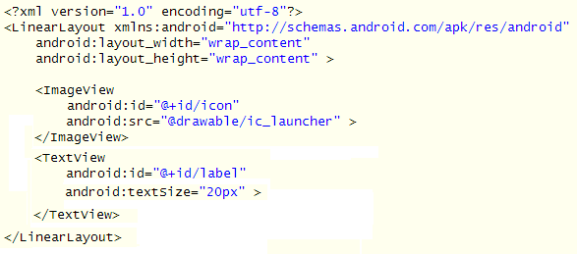
Custom Adapter
We can extend an arrayadapter and use a custom layout
Layout:

Slide 7
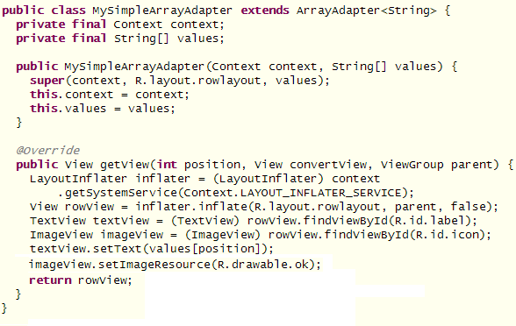
Custom Adapter

Slide 8
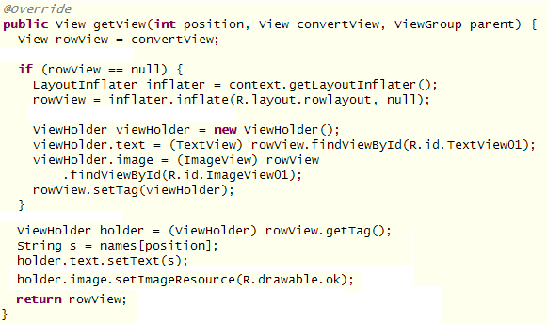
View Holder
To improve performance on a ListView you should use the View Holder pattern.

Slide 9
Practice: Movie search

Slide 10
Services
A Service is an application component that can perform long-running operations in the background and does not provide a user interface. Another application component can start a service and it will continue to run in the background even if the user switches to another application.
Additionally, a component can bind to a service to interact with it and even perform interprocess communication (IPC).
For example, a service might handle network transactions, play music, perform file I/O, or interact with a content provider, all from the background.

Slide 11
Services
A service can essentially take two forms:
Started: a service is "started" when an application component (such as an activity) starts it by calling startService(). Once started, a service can run in the background indefinitely, even if the component that started it is destroyed. Usually, a started service performs a single operation and does not return a result to the caller. For example, it might download or upload a file over the network. When the operation is done, the service should stop itself.

Slide 12
Services
Bound: A service is "bound" when an application component binds to it by calling bindService(). A bound service offers a client-server interface that allows components to interact with the service, send requests, get results, and even do so across processes with interprocess communication (IPC). A bound service runs only as long as another application component is bound to it. Multiple components can bind to the service at once, but when all of them unbind, the service is destroyed (unless the service was also started by startService()).

Slide 13
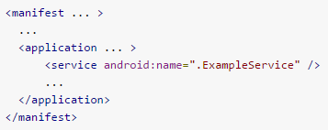

Services
A service should be declared in the manifest:
Starting a service:

Slide 14
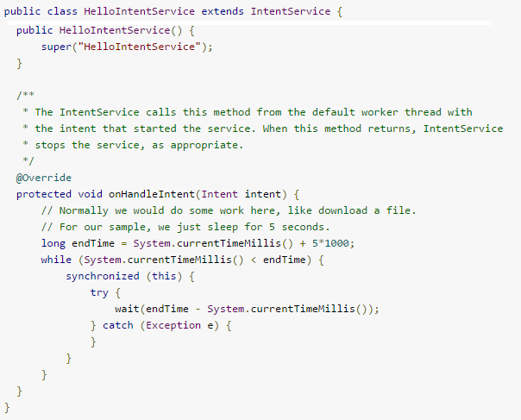
Services

Slide 15
Storage - options
Shared Preferences
Internal Storage
External Storage
SQLite Databases
Network Conneciton

Slide 16

SharedPreferences
The SharedPreferences class provides a general framework that allows you to save and retrieve persistent key-value pairs of primitive data types. You can use SharedPreferences to save any primitive data: booleans, floats, ints, longs, and strings. This data will persist across user sessions (even if your application is killed).

Slide 17
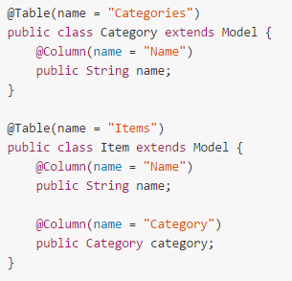
Sqlite – ActiveAndroid
ActiveAndroid is an active record style ORM.
Define your model:

Slide 18
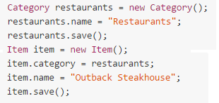
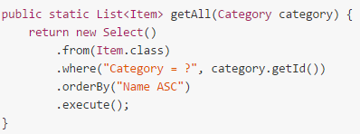
Sqlite – ActiveAndroid
Save Models:
Query Models

Slide 19
Practice: Save movie favorites

Slide 20
Thank you
Lucio Cossio
Luis Mazoni

