Slide 1

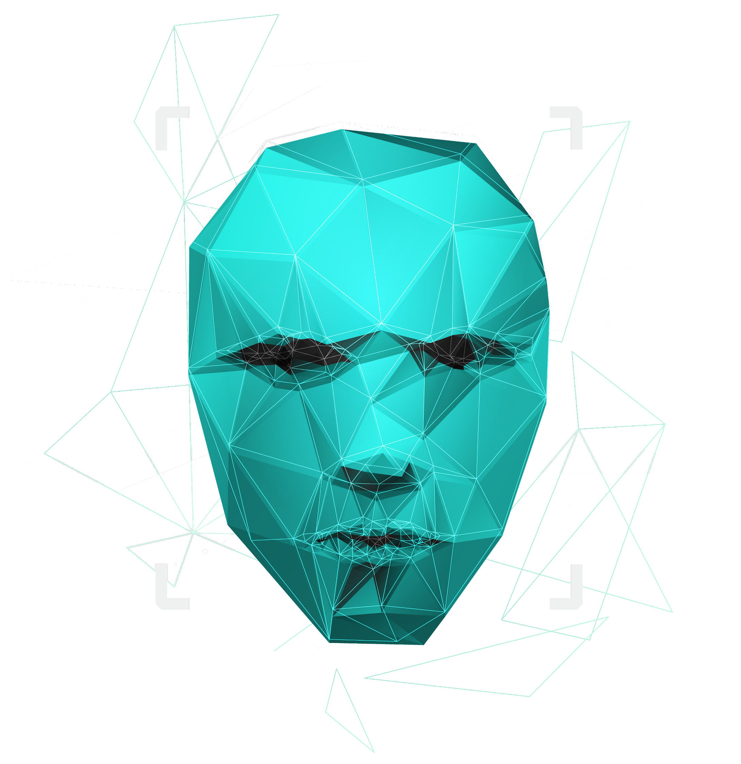
K9-Cluster Threat Surveillance System
Ignition Pipeline – Hyland Hackathon

Slide 2

INTRODUCTION
High Mobility
Fast Reaction
Cluster Of Distributed Systems
High Reachability
Virtual Synchrony Is Maintained Between Group Of Agents Forming A View .
Data Is Morphed To Fit Into Limited Storage Of The Embedded System.
Minimal State Defining Data Is Maintained And Broadcasted Between Agents

Slide 3

EVENT TAGGING
DISPATCH ALGORITHM
01
03
THREAT EVALUATION SYSTEM
INTER-NODE COMMUNICATION
02
04
Use High Number Of Agents Available.
Solve Complex Path Finding Problems And Work With Probabilistic Attributes Of Edges.
AI/ML assisted face recognition, victim and perpetrator tagging
A Real-time Threat Monitoring And Evaluation System

Slide 4

MOTIVATION
HIGH REACHABILITY OF PROPOSED SYTEM
PROHIBITED USE OF DRONES DUE TO LEGAL AND PRIVACY ISSUES
LIMITED RANGE OF CURRENT MANNED SURVEILLANCE SYSTEMS
PRESENCE OF BLINDSPOTS IN CONTEMPORARY STATIC SURVEILLANCE SYSTEMS

Slide 5

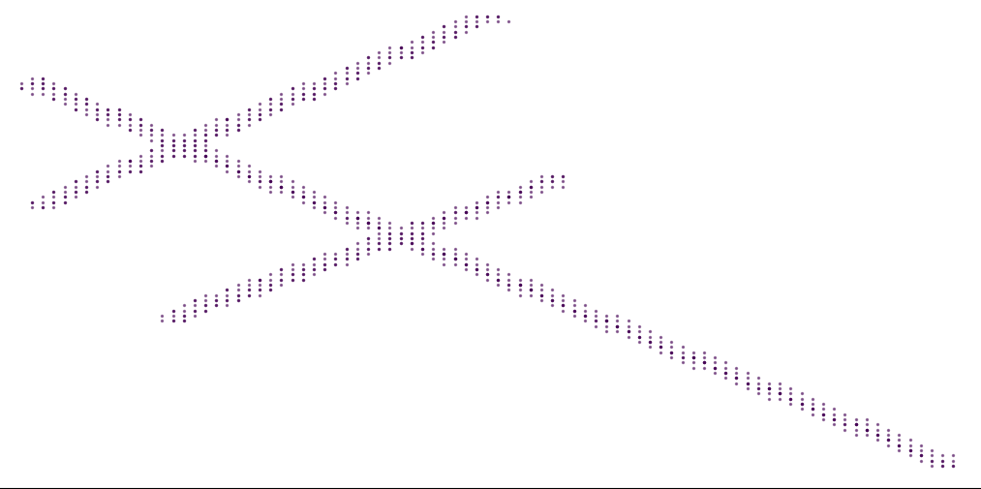
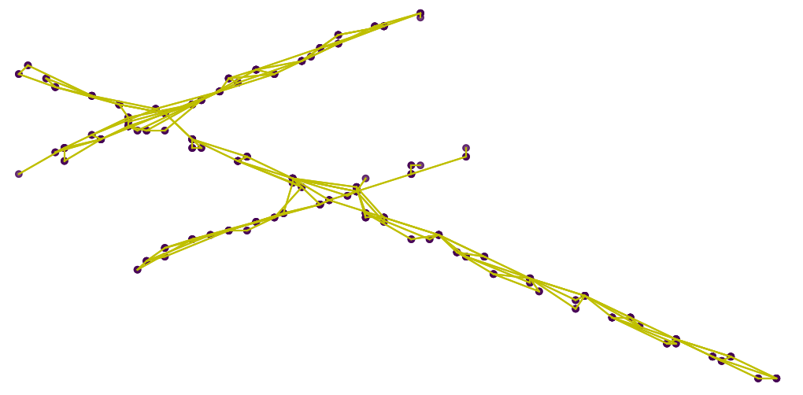
MAP EXTRACTION ALGORITHM

Slide 6

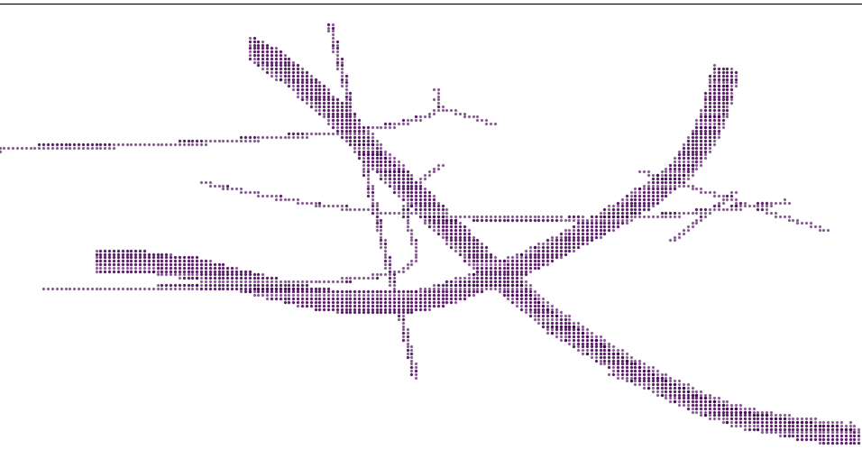
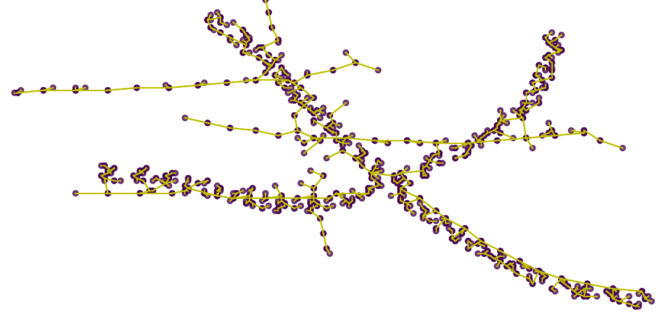
MAP EXTRACTION ALGORITHM

