Slide 1
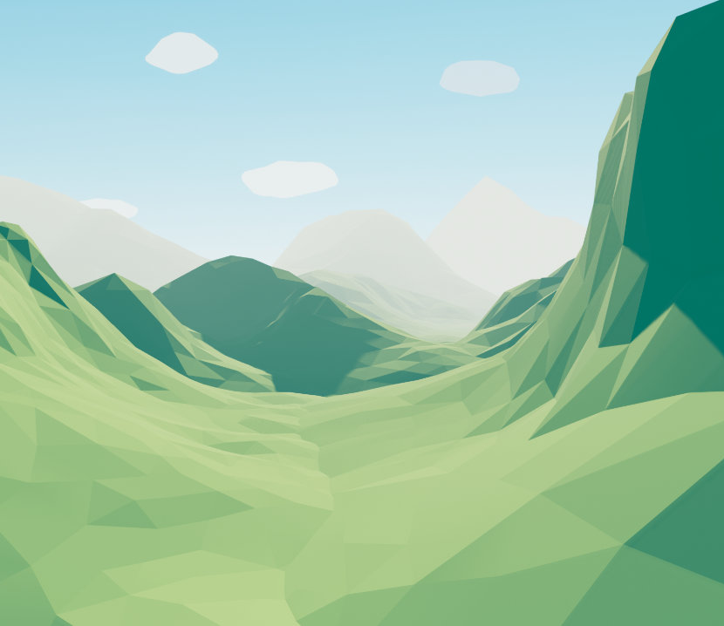
LOWPOLY TERRAIN EFFECTS

Slide 2
The mesh
Vec3 Pos Vec3 Colour Vec3 Normal
Indices

Slide 3
The basic idea
Lighting

Slide 4
The basic idea
Lighting

Slide 5
The basic idea
Lighting
”Stop interpolation”

Slide 6
Solution 1 – Grid changes
Duplicate vertices

Slide 7
Solution 1 – Grid changes
Duplicate vertices

Slide 8
Solution 1 – Grid changes
x, h, z ? r, g, b
x, h, z ? r, g, b
Duplicate vertices
Normal
x, h, z ? r, g, b

Slide 9
Solution 1 – Grid changes
Duplicate vertices
Normal
1
2
3
T1 = V2 – V1 T2 = V3 – V1 Normal = T1⨯T2

Slide 10
Solution 1 – Grid changes
x, h, z n r, g, b
x, h, z n r, g, b
Duplicate vertices
Normal
x, h, z n r, g, b

Slide 11
Solution 1 – Grid changes
Duplicate vertices
Normal
Cons

Slide 12
Solution 1 – Grid changes
Duplicate vertices
Normal
Cons
4 * 4 = 16 vertices
18 * 3 = 54 vertices (~335%)
Memory

Slide 13
Solution 2 – Geometry shader
Short introduction to GS

Slide 14
Solution 2 – Geometry shader
Short introduction to GS
Input (primitive)
Output (primitive)

Slide 15
Solution 2 – Geometry shader
VERTEX SHADER
Short introduction to GS
Input (primitive)
Output (primitive)
What happens
DATA
GEOMETRY SHADER

Slide 16
Solution 2 – Geometry shader
Short introduction to GS
Input (primitive)
Output (primitive)
What happens
Normal calculated
Lighting calculated
GEOMETRY SHADER

Slide 17
Solution 2 – Geometry shader
Short introduction to GS
Input (primitive)
Output (primitive)
What happens
Normal calculated
Lighting calculated
Cons
GPU expensive

Slide 18
Solution 3 – Flat Shading
glsl ”flat”
Provoking vertex glProvokingVertex(GL_FIRST_VERTEX_CONVENTION);
Final colour calculated per vertex

Slide 19
Solution 3 – Flat Shading
glsl ”flat”
Provoking vertex glProvokingVertex(GL_FIRST_VERTEX_CONVENTION);
Final colour calculated per vertex
Cons
Quads
1
0
0
2
1
2

Slide 20
Solution 3 – Flat Shading
New mesh generation
New Indices

Slide 21
Solution 3 – Flat Shading
provoking
New mesh generation
New Indices
Cons
Lighting

Slide 22
Solution 4 – Hybrid (flat, grid change) - Equilinox
Every triangle has its own provoking vertex
Cons
Vertex duplication (20% ≠ 335%)

Slide 23
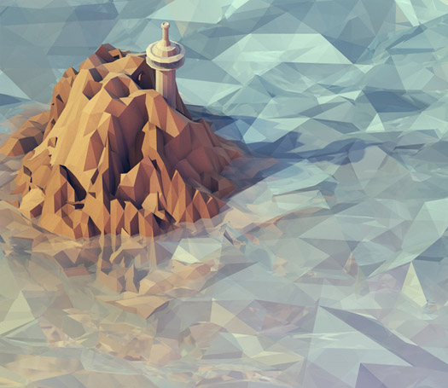
LOWPOLY WATER EFFECTS
TEASE

Slide 24
Water
REFLECTION FBO
REFRACTION FBO
MAIN FRAMEBUFFER
COLOUR
COLOUR
DEPTH
COLOUR

Slide 25
Water
REFLECTION FBO
REFRACTION FBO
COLOUR
COLOUR
DEPTH
DISTORT
DISTORT
MAIN FRAMEBUFFER
FRESNEL EFFECT OR OTHER OPACITY CALCULTION
COLOUR
LIGHTING
DEPTH EFFECTS

Slide 26
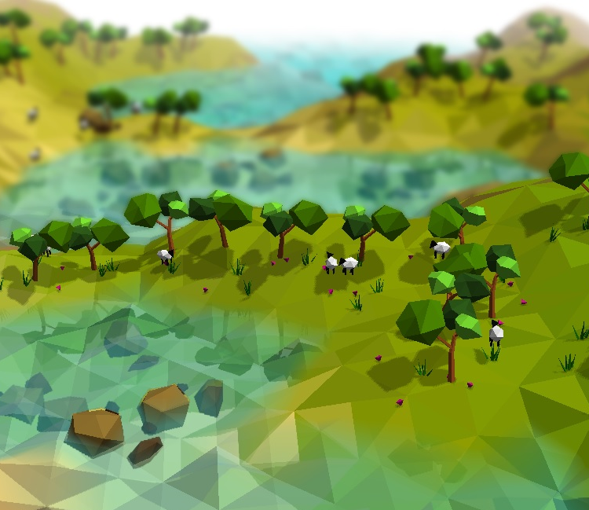
THANKS

