Slide 1

Go, Change the world
RV College of
Engineering
SUMMER INTERNSHIP
Presentation
BRANCH | Computer Science And Engineering

Slide 2
Go, Change the world
RV College of
Engineering
INTRODUCTION
USN | Name | Email Id
1RV21CS048 | Harsh Kumar | harshkumar.cs21@rvce.edu.in

Slide 3
Go, Change the world
RV College of
Engineering
Go, Change the world
INTERNSHIP DETAILS
Carried out internship: online/offline | Where ( portal/company/college Centre of Excellence name) | Title of the project work
Online | Internshala | Programming with python

Slide 4
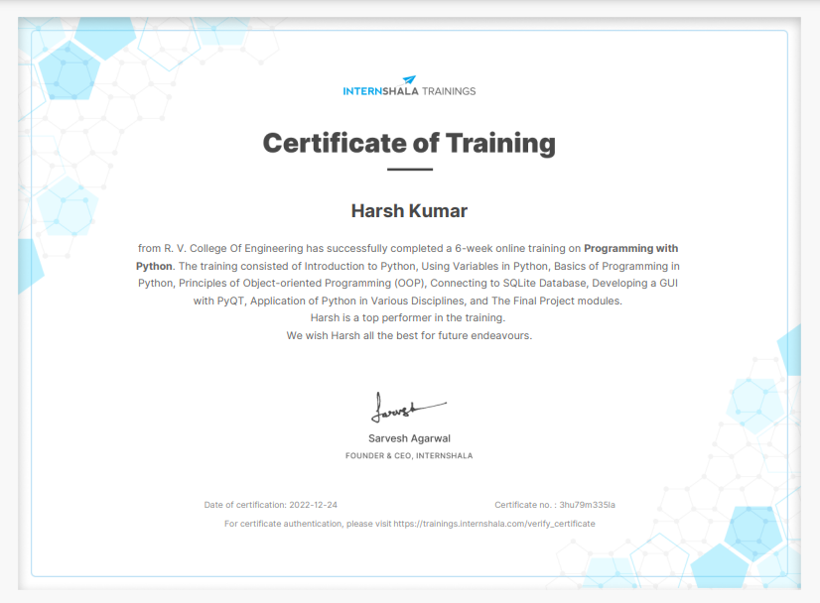
RV College of
Engineering
Go, Change the world
Cerificate of completion

Slide 5
RV College of
Engineering
Go, Change the world
Presentation Overview
Introduction
Why programming with python?
Project
Application of Python

Slide 6
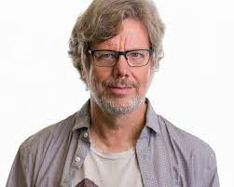
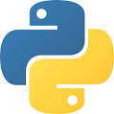
RV College of
Engineering
Go, Change the world
Topic Introduction
Python is a popular high-level programming language that was first released in 1991. It is an interpreted language, which means that code can be run without the need for a compiler, making it easy to use for beginners
Python was created by Guido van Rossum, a Dutch programmer, in 1989 while he was working at the National Research Institute for Mathematics and Computer Science in the Netherlands
Python is known for its simplicity, readability, and versatility.
Python is an open-source language, which means that its source code is available to everyone and can be freely modified and distributed.
Guido van Rossum

Slide 7
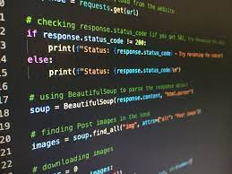
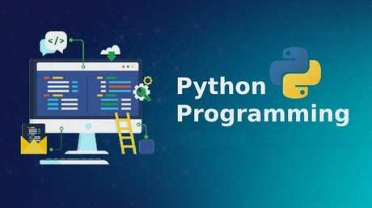
RV College of
Engineering
Go, Change the world
Python is used for a wide range of applications, from web development to data analysis and machine learning. This makes it a versatile language that can be applied to many different fields.
With the increasing demand for Python developers, learning Python can open up many career opportunities in fields such as data science, artificial intelligence, web development, and more.
Python runs on many different platforms, including Windows, Linux, and macOS, which makes it a portable language that can be used across different devices.

Slide 8
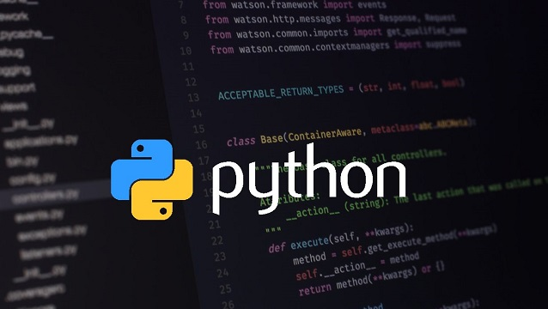
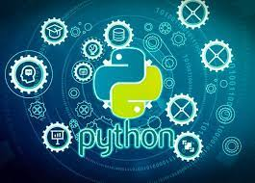
RV College of
Engineering
Go, Change the world
Why programming with python?
Python forms the basis to the high and advanced level technologies like Artificial intelligence, Data Analysis and Machine learning. At this point of time to understand those complicated technologies I feel that learning python is very crucial and important.
Python has a large and active community of developers, which means there are many resources available to help you learn and solve problems.
Python runs on many different platforms, including Windows, Linux, and macOS, which makes it a portable language that can be used across different devices.
With the increasing demand for Python developers, learning Python can open up many career opportunities in fields such as data science, artificial intelligence, web development, and more.

Slide 9
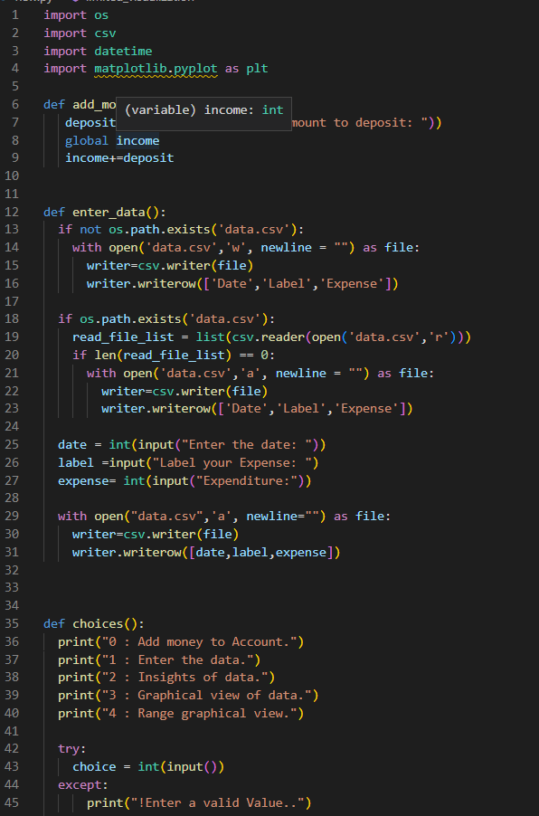
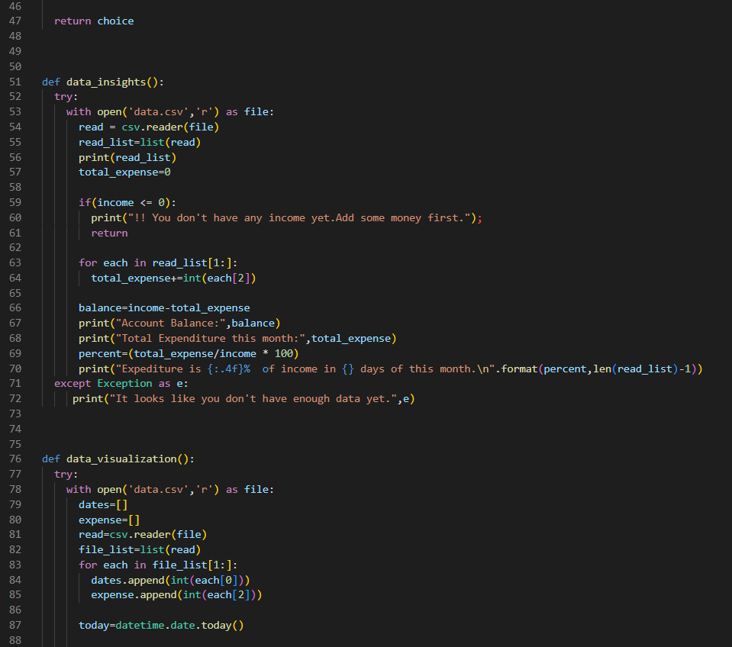
RV College of
Engineering
Go, Change the world
FINAL PROJECT – Budget Manager

Slide 10
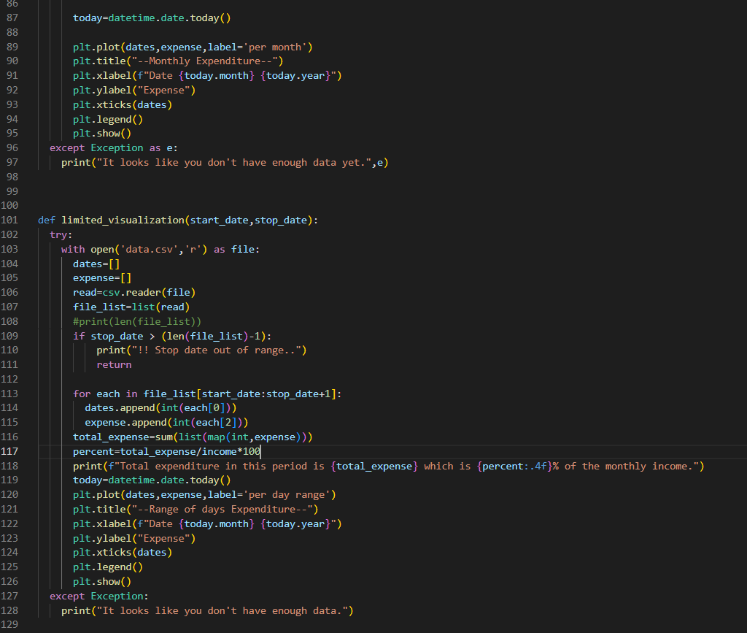
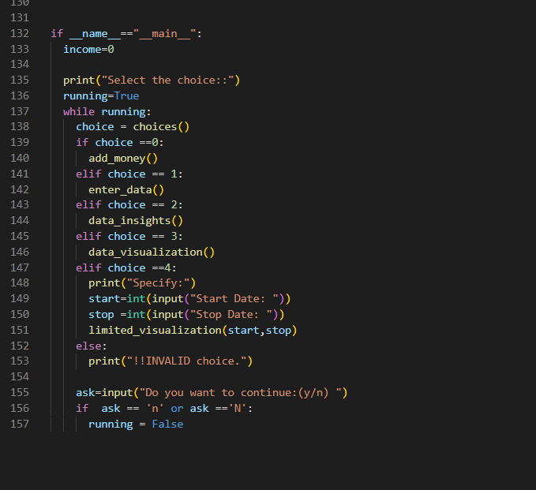
RV College of
Engineering
Go, Change the world
FINAL PROJECT – Budget Manager

Slide 11
RV College of
Engineering
Go, Change the world
FINAL PROJECT
Initialize the income as 0.
Display the menu of options for the user to choose from.
Take user input and execute the corresponding function based on their choice.
If the user chooses to add money to the account, ask for the amount and add it to the income variable.
If the user chooses to enter data, ask for the date, label, and expense, and write them to a CSV file named "data.csv".
If the user chooses to see data insights, read the "data.csv" file and calculate the total expense and the account balance by subtracting the total expense from the income. Calculate the percentage of expenditure to the income and display it to the user.

Slide 12
RV College of
Engineering
Go, Change the world
FINAL PROJECT
7. If the user chooses to see the graphical view of data, read the "data.csv" file and plot a line graph of the expenses against the dates. Display the graph to the user.
8. If the user chooses to see a range of graphical view of data, ask for the start and stop dates, read the "data.csv" file and plot a line graph of the expenses against the dates in the specified range. Calculate the total expenditure and the percentage of expenditure to the income in the specified range and display it to the user.
9. Ask the user if they want to continue and repeat the process until they choose to stop.

Slide 13
RV College of
Engineering
Go, Change the world
Application of python
Web Development: Python is used for developing web applications and websites using frameworks such as Django, Flask, and Pyramid.
2. Data Science: Python is widely used for data analysis, machine learning, and artificial intelligence projects. Popular libraries include Pandas, NumPy, SciPy, and Scikit-learn.
3. Game Development: Python can be used to create 2D and 3D games using popular game engines like Pygame, Panda3D, and PyOpenGL
.
4. Desktop Applications: Python can be used to develop desktop applications with the help of frameworks such as PyQt and PyGTK.
5. Automation: Python is used for automating repetitive tasks, such as web scraping, file handling, and testing.

Slide 14
RV College of
Engineering
Go, Change the world
Thank You

