Slide 1


Federated Reinforcement Learning for Therapeutic Interventions over ICUs with Noisy Labels
REPORT
2025
Linxiao Cao¹, Yifei Zhu², Haoquan Zhou³, Shilei Tan¹ and Wei Gong¹
1 University of Science and Technology of China
2 Shanghai Jiao Tong University
3 The First Affiliated Hospital of USTC
CSCWD 2025
Notes:
Good evening, Professor. My name is Linxiao Cao, and I am deeply honored to be here as a prospective Ph.D. candidate. I am excited to share my background and previous research experiences.

Slide 2
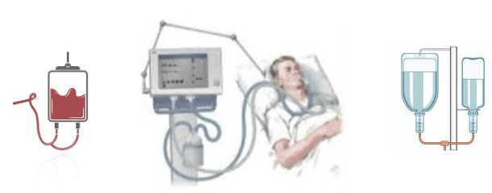
Motivation
Management of routine ICU interventions constitute a major part of intensive care, e.g.:
Invasive mechanical ventilation: the use of mechanical means to assist or replace spontaneous breathing. ^{[1]}
40% of ICU patients are ventilated at any given hour, accounting for 12% of US hospital costs.
Typically coupled with sedation to maintain comfort and stability.
Timely intervention can improve outcomes and reduce costs.
However, their effects are often poorly understood, especially in heterogeneous patient populations, leading to varying clinical opinions.
[1] A Reinforcement Learning Approach to Weaning of Mechanical Ventilation in Intensive Care Units. UAI 2018.
Notes:
However, implementing intelligent management of ventilator and sedatives faces some challenges. Due to the limited data resources in individual ICUs, we aim to leverage data from multiple ICUs to train a decision model. However, this data contains sensitive information, making data sharing inappropriate. So, How to construct the global model without sharing scattered private clinical raw data is our first challenge.

Slide 3
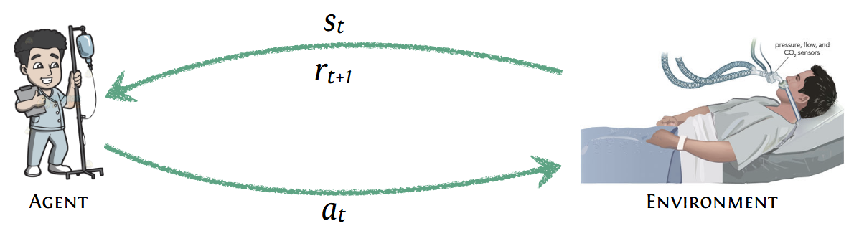
Motivation
Weaning: process of liberation from mechanical ventilation. ^{[1]}
Premature, delayed weaning both associated with worse outcomes.
We aim to develop a clinician-in-loop decision support tool to
alert caregivers when a patient is ready for weaning
recommend sedation and ventilation settings
...by modeling this as a Markov Decision Process (MDP).
[1] A Reinforcement Learning Approach to Weaning of Mechanical Ventilation in Intensive Care Units. UAI 2018.
Notes:
However, implementing intelligent management of ventilator and sedatives faces some challenges. Due to the limited data resources in individual ICUs, we aim to leverage data from multiple ICUs to train a decision model. However, this data contains sensitive information, making data sharing inappropriate. So, How to construct the global model without sharing scattered private clinical raw data is our first challenge.

Slide 4


Challenges
Challenge 1: ICU Data Utilization
Limited Data Volume: Individual hospitals often have limited patient data, which restricts the development of robust predictive models.
Data Incompleteness: The data collected may not be comprehensive, affecting the accuracy and reliability of clinical decisions.
Collaborative Learning
The sensitivity of clinical private data leads to the formation of data silos
A data-driven global clinical decision-making support tool
How to construct the global model without sharing scattered private clinical raw data?
Notes:
However, implementing intelligent management of ventilator and sedatives faces some challenges. Due to the limited data resources in individual ICUs, we aim to leverage data from multiple ICUs to train a decision model. However, this data contains sensitive information, making data sharing inappropriate. So, How to construct the global model without sharing scattered private clinical raw data is our first challenge.

Slide 5
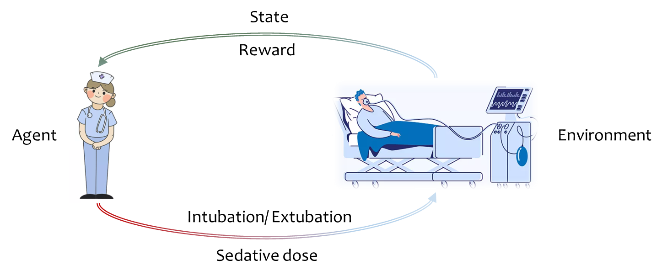
Challenges
Challenge 2: Addressing the difficulty of defining a reward function
In the medical field, many tasks involve sequential decision-making.
These tasks are typically modeled as Markov Decision Processes (MDPs) and tackled with reinforcement learning.
However, quantifying the reward function is often challenging due to the complexity of healthcare.
Inaccurate or arbitrary reward functions may have a negative impact on the policy model.
Notes:
The second challenge is that how to define the reward function. In the medical field, many tasks involve sequential decision-making. And these tasks model this problem as MDPs and tackled with RL. However, quantifying the reward function is often challenging due to the complexity of healthcare. And Inaccurate or arbitrary reward functions may have a negative impact on the policy model.

Slide 6
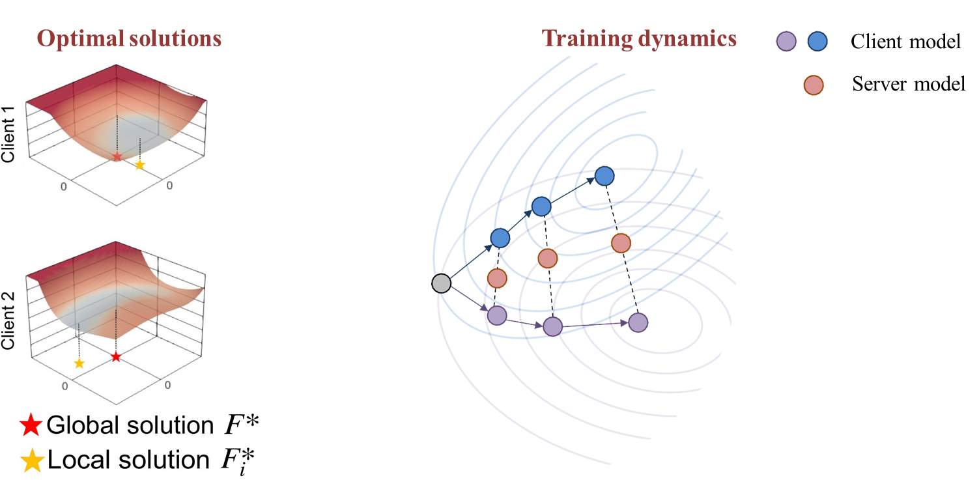
Challenges
Challenge 3: Overcoming data heterogeneity among different hospitals
Data heterogeneity can lead to suboptimal performance of global models.^{[1]}
[1] Jiang M, Wang Z, Dou Q. Harmofl: Harmonizing local and global drifts in federated learning on heterogeneous medical images. AAAI 2022.
Notes:
The third challenge involves overcoming data heterogeneity (ˌhetərədʒəˈniːəti) . Data distribution varies across different hospitals, leading to local optima of models that don't align with the global model. This creates a challenge in addressing performance degradation caused by distribution drifts.

Slide 7
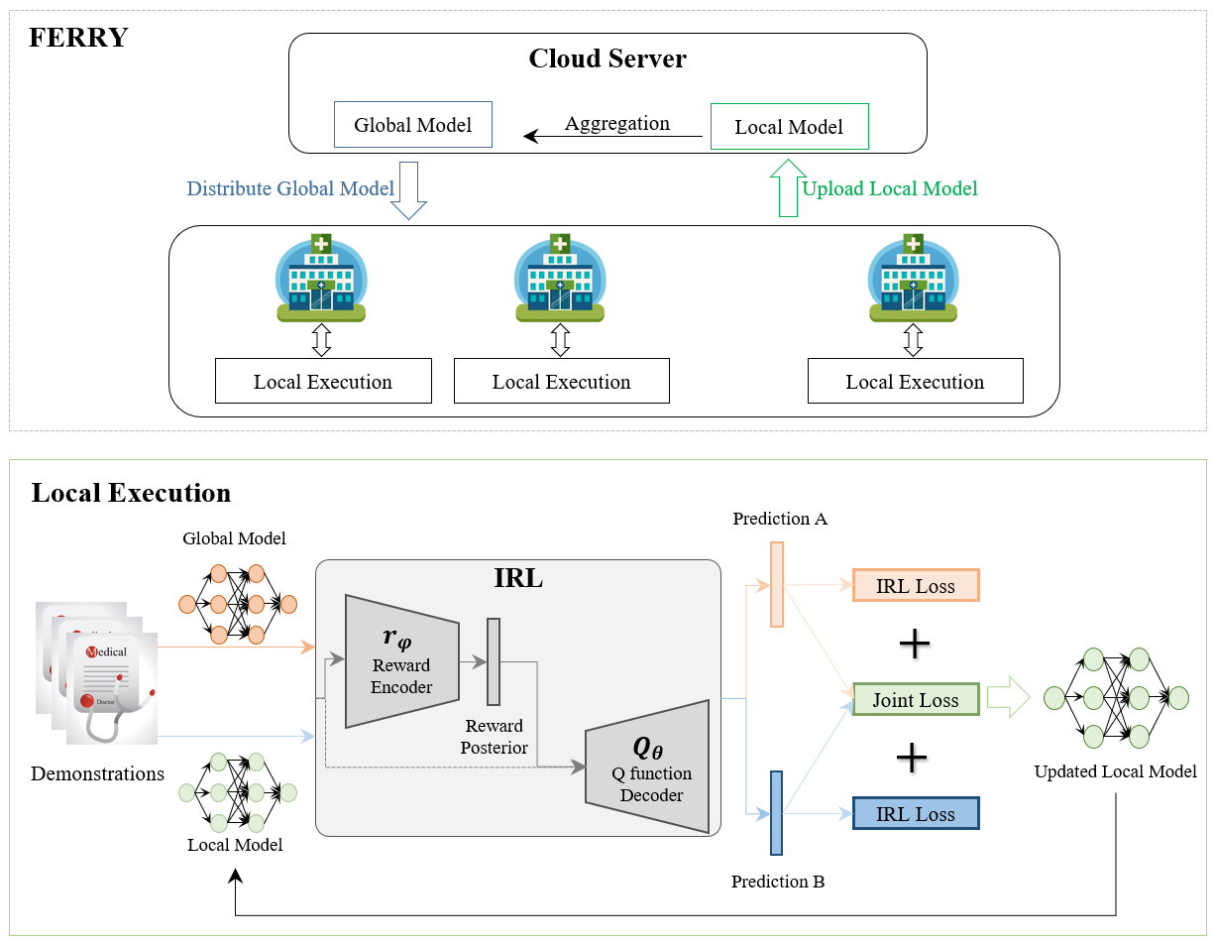
Method
FERRY: Federated Inverse Reinforcement Learning for Smart ICUs
The overview of FERRY
Notes:
In response to the above challenge, we have proposed FERRY, a novel federated inverse RL method. Its framework is illustrated in the slides.

Slide 8
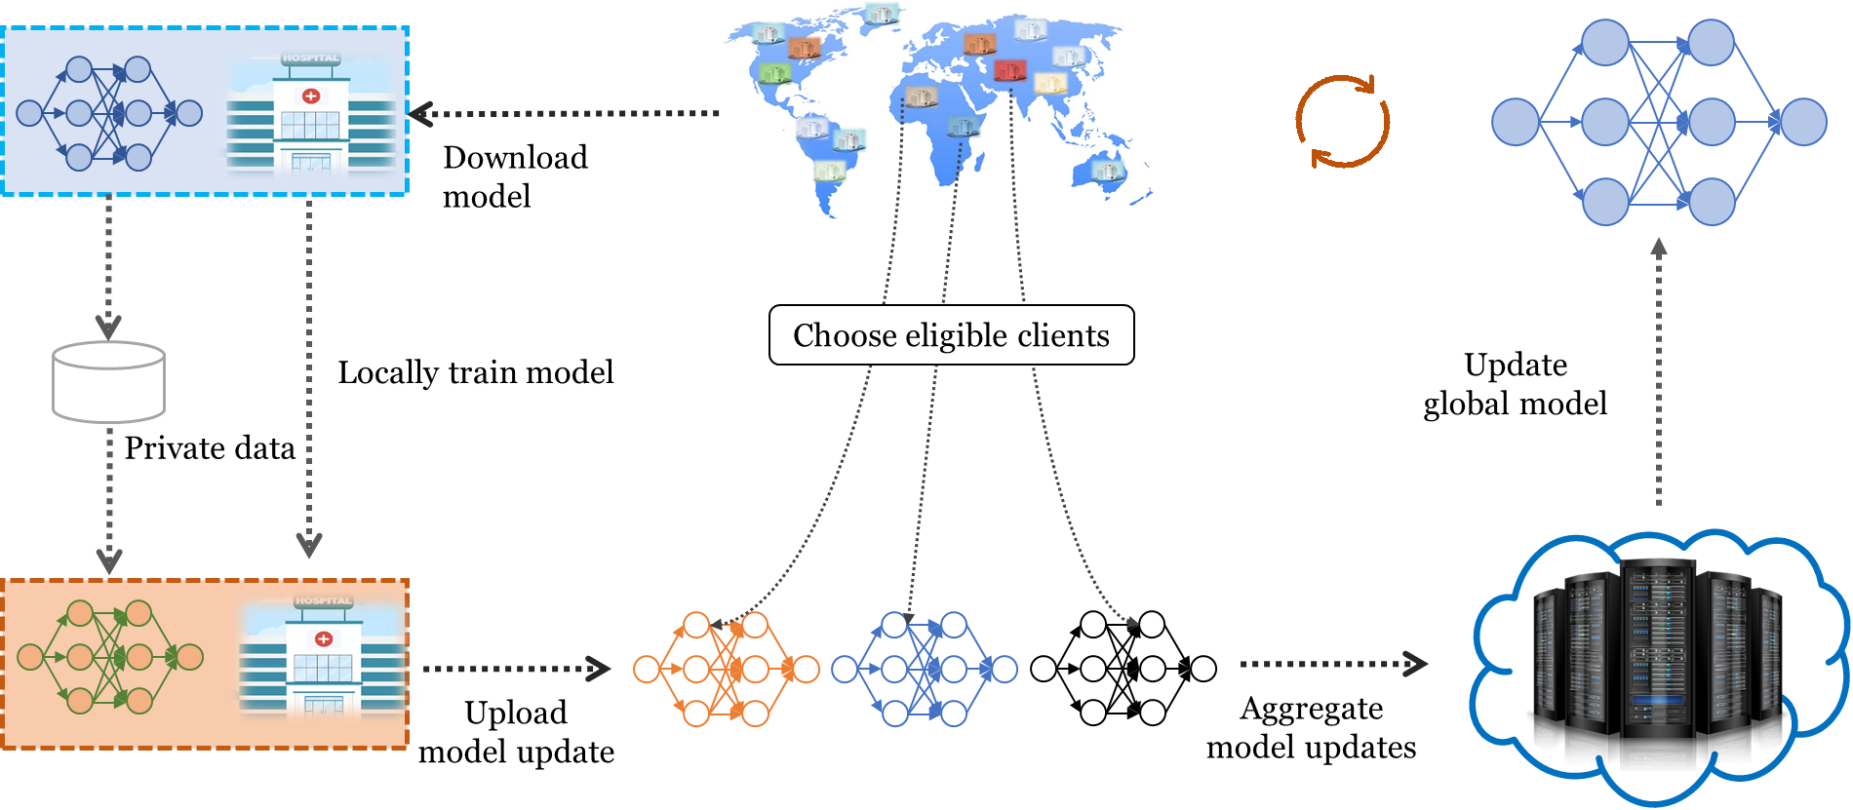
Method
Introducing federated learning (FL) to break data silos.
FL ensures data privacy and allows collaborative training using data from other hospitals.
Notes:
First, FERRY introduces FL to break the restriction of data silos. FL ensures data privacy and allows collaborative training using data from other hospitals.

Slide 9
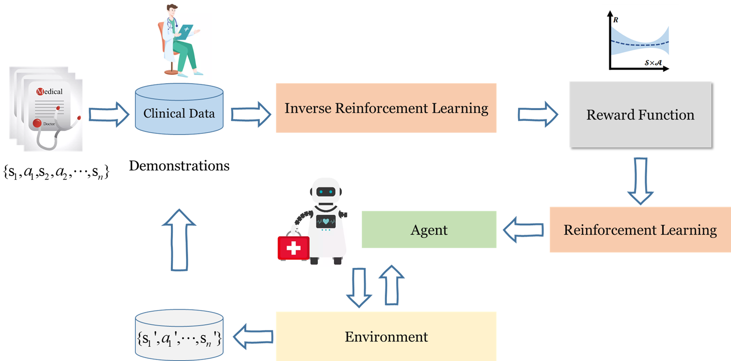
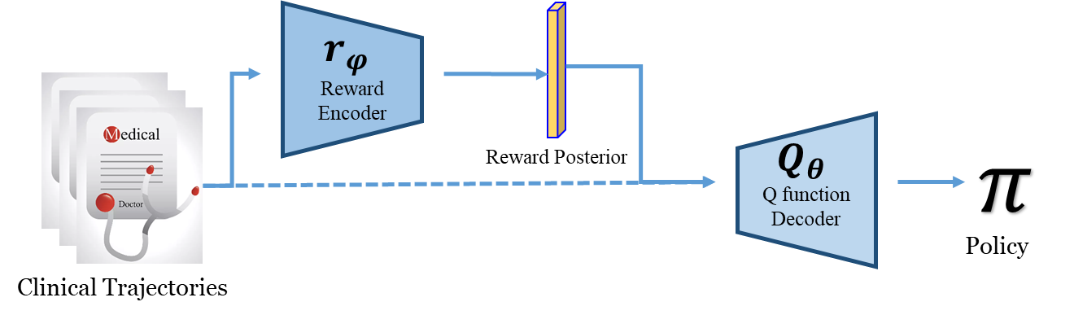
Method
Using inverse reinforcement learning (IRL) to solve the difficulty of defining reward functions
IRL
AVRIL ^{[1]}
IRL can derive suitable reward functions from historical data.
[1] Chan A J, van der Schaar M. Scalable bayesian inverse reinforcement learning[J]. ICLR 2022.
Notes:
Secondly, FERRY uses AVRIL, an IRL method, to approximate reward function from historical data, solving the challenge of defining reward functions.

Slide 10
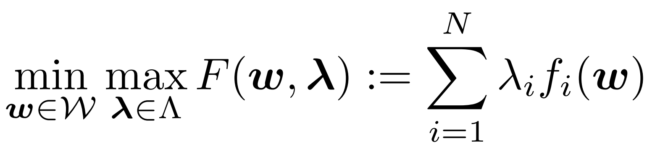
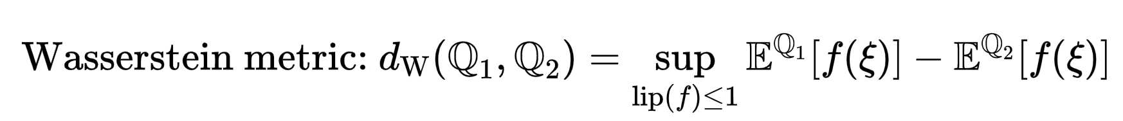
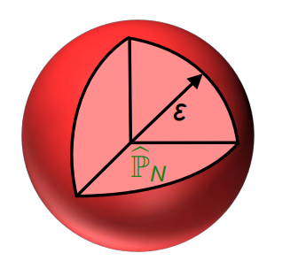
Method
Utilize distributionally robust optimization (DRO) to alleviate the impact of data heterogeneity.
DRO treats the data distribution of each hospital as an uncertainty factor and employs the approach of minimizing the worst-case under specified uncertainty to train the global model.
Use the Wasserstein distance to measure the distance between uncertainty sets and probability distributions.
During each global round, the client with the worst performance is selected for further optimization.
DRO enhances the robustness and generalization capacity of FERRY!
Notes:
Moreover, FERRY employ distributionally robust optimization to alleviate the impact of data heterogeneity. DRO treats the data distribution of each hospital as an uncertainty factor and employs the approach of minimizing the worst-case. During each global round, the client with the worst performance is selected for further optimization. Therefore, DRO enhances the robustness and generalization capacity of FERRY!

Slide 11
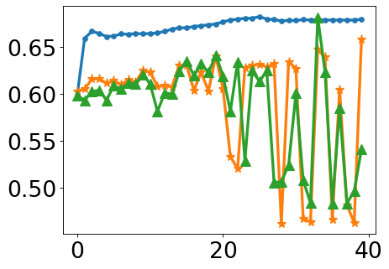
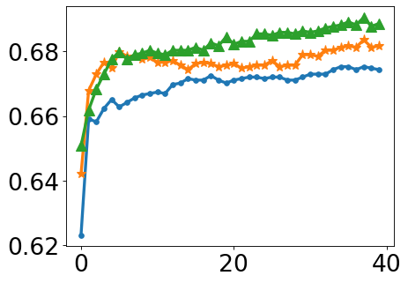
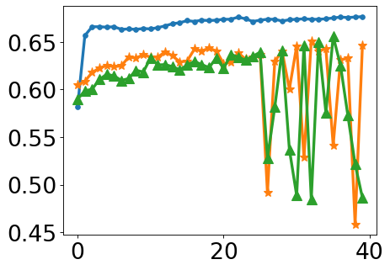
Method
Utilizing joint loss learning to mitigate the impact of noise
Previous research demonstrates that DRO can be sensitive to noisy data ^{[1][2]}.
DRO uses measurement methods such as norm or divergence in modeling uncertainty distribution, which takes the noise in the uncertainty set into consideration, making DRO sensitive to noise.
Original
No Outliers
Noise Added
Medical data has incorrect labels, and DRO's sensitivity to noise affects model performance!
Zhai R, Dan C, Kolter Z, et al. Doro: Distributional and outlier robust optimization. ICML 2021.
Wu B, Liang Z, Han Y, et al. DRFLM: Distributionally Robust Federated Learning with Inter-client Noise via Local Mixup[J]. arXiv:2204.07742, 2022.
Notes:
However, previous research has shown that DRO can be sensitive to noisy data. Medical data often contains incorrect labels, and DRO's sensitivity to noise can impact the performance of the model.

Slide 12
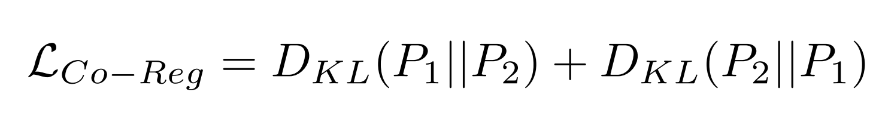
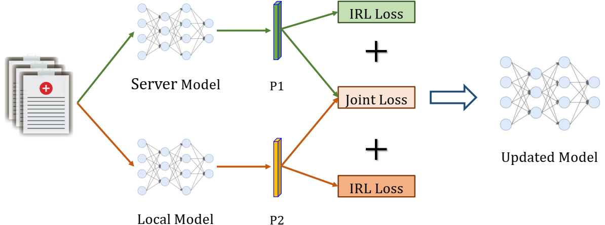
Method
Utilizing joint loss learning to mitigate the impact of noise.
During classifier training, noisy data is filtered out using consistency regularization, leading to improved model robustness.
Each classifier's output is compared with that of others; if similarity is found, it's deemed reliable; otherwise, it's likely noisy data.
Joint loss learning can help filter out noisy data
Notes:
We employ joint loss learning to reduce the influence of noise. By comparing the output of each classifier with that of others, we determine if the data is reliable based on similarity. Noisy data is identified by lack of similarity and filtered out, retaining only samples with small losses for training.

Slide 13
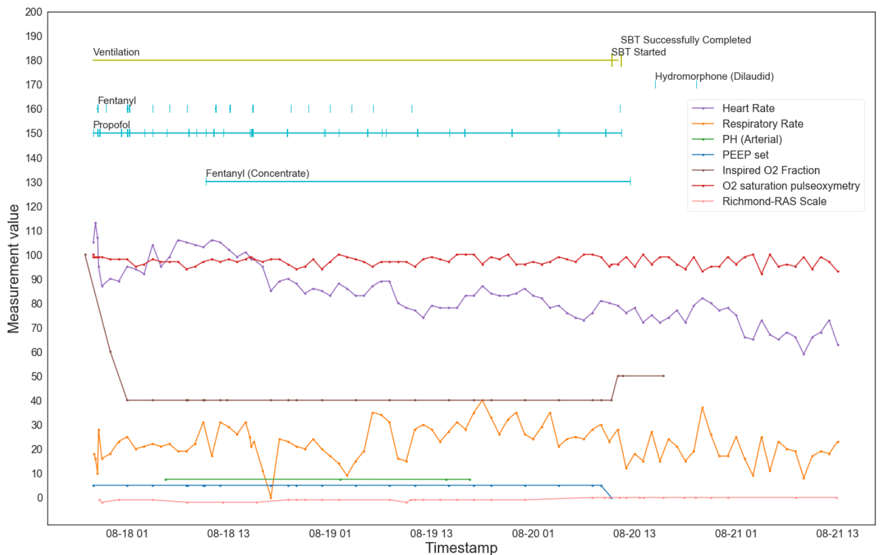
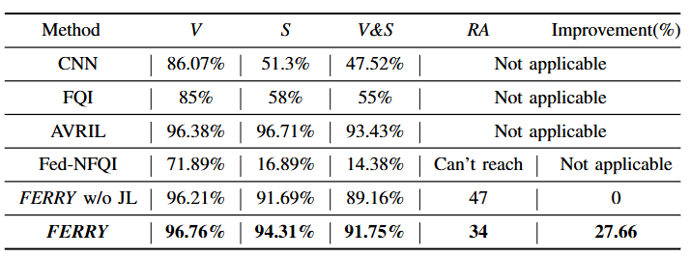
Evaluation
Dataset: MIMIC-III
Preprocess:
Filter further to include only those admissions in which the patient was kept under ventilator support for more than 24 hours.
Filter out admissions in which the patient in not successfully discharged from the hospital by the end of the admission
The evaluation results show that FERRY improves the overall ventilation and sedation decision-making accuracy by 36.75%
Example ventilated ICU patient.
Notes:
Our method has better performance under different noise levels.

Slide 14
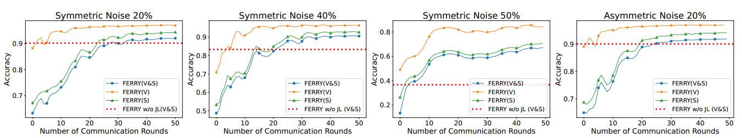
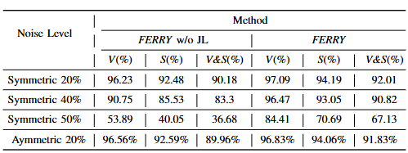
Evaluation
Our method has better performance under different noise levels.
We create synthetic noisy label by randomly flipping the labels with various ratio.
The results clearly demonstrate that FERRY exhibits significantly enhanced robustness against noisy labels.
Notes:
Our method has better performance under different noise levels.

Slide 15
Thanks!
REPORT
2025
CSCWD 2025
Notes:
Good evening, Professor. My name is Linxiao Cao, and I am deeply honored to be here as a prospective Ph.D. candidate. I am excited to share my background and previous research experiences.

