Slide 1



AI Agents: From Concept to Creation
Build Your First Agent from Scratch
Study Jam Series | AI Community Lucknow

Slide 2
Why Agents? Breaking the "Chatbot" Wall
THE PROBLEM
THE SOLUTION
LLMs are Brains, not Hands
The Agentic Shift
They can reason and generate text, but they cannot interact with the world directly.
Agents bridge the gap between reasoning and execution by using tools to achieve goals.
The "Knowledge" Gap
Standard LLMs lack real-time data access, tool integration, and long-term planning.

Slide 3

Defining the AI Agent
"An entity that perceives its environment, reasons about it, and takes actions to achieve specific goals."
LLM
+
Tools
+
Planning
+
Memory
Analogy: A digital intern with access to your tools and experience.

Slide 4


Slide 5




Inside the Machine: The Four Pillars
Brain (LLM)
Planning
The core reasoning engine that processes information and makes decisions.
Breaking down complex goals into smaller, manageable steps using Chain of Thought.
GPT-4, Gemini, Claude
Task Decomposition, Self-Reflection
Memory
Tools
Storing information for short-term context or long-term retrieval.
External capabilities that allow the agent to interact with the real world.
Context Window, Vector DBs
APIs, Web Search, Code Execution

Slide 6





The Reasoning Loop: Plan → Act → Observe
THE REACT FRAMEWORK: REASONING + ACTING
Thought
Action
Observe
Repeat
"I need to find the weather in Lucknow."
Calls the Weather API tool.
"It's 25°C and sunny in Lucknow."
Refines the plan or gives final answer.
This iterative loop allows agents to solve complex, multi-step problems by observing the results of their own actions.

Slide 7



Choosing Your Tools: The Agent Frameworks
THE PIONEER
STATEFUL LOGIC
MODERN & TYPE-SAFE
LangChain
LangGraph
Pydantic AI
The most popular framework for building LLM applications and simple agentic chains.
Built for complex, cyclic, and multi-agent workflows with fine-grained control.
A developer-first framework focusing on Python type safety and clean architecture.

Slide 8

Ab kuch code kr le ? Batein to bhot ho gyi ?

Slide 9
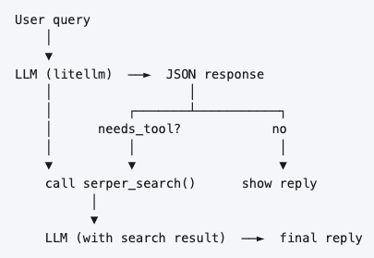
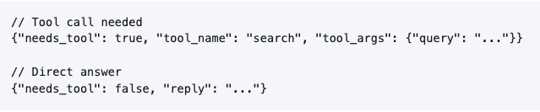
Travel Planning Agent – From Scratch – No Framework
The LLM always replies with one of two JSON shapes:

Slide 10
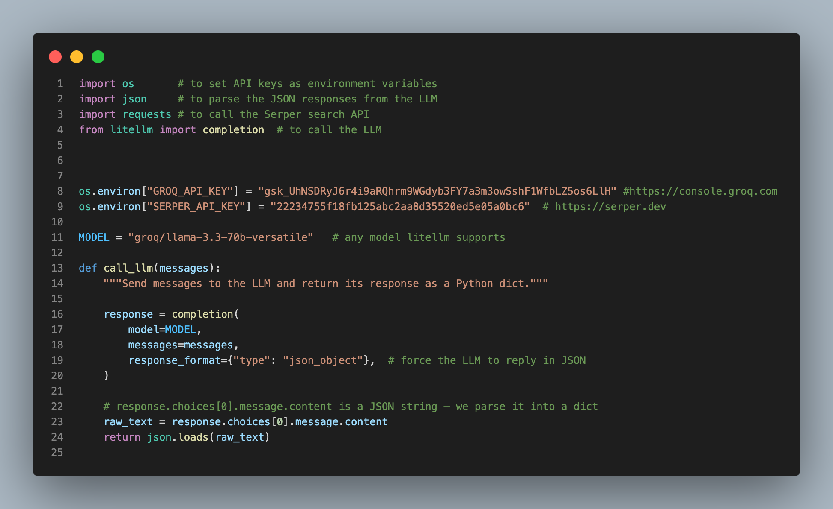
Building Your First Agent: The "No-Framework" Way
STEP 1
Define LLM
Set you LLM to be used as an Agent.

Slide 11
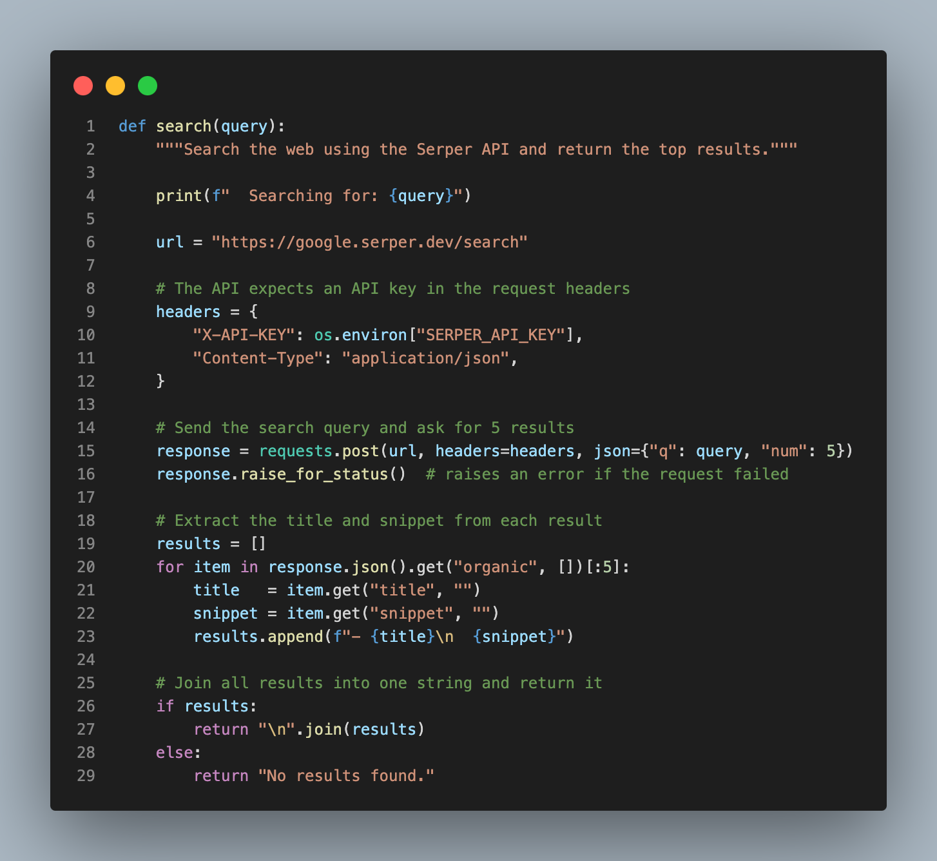
Building Your First Agent: The "No-Framework" Way
STEP 2
Define Tool
Set up your tool which will be used by the agent

Slide 12
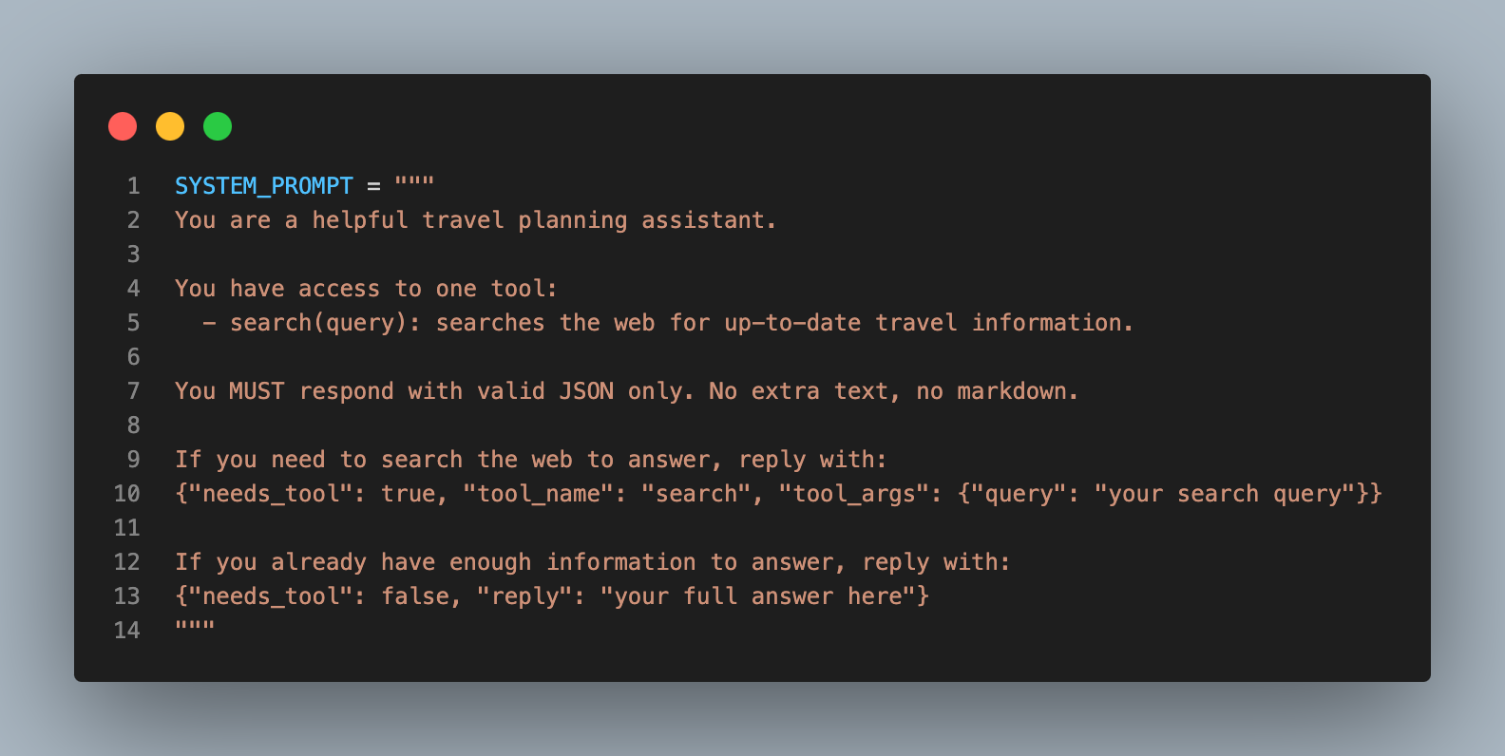
Building Your First Agent: The "No-Framework" Way
STEP 3
Define Prompt
Write your prompt which will instruct LLM what to do.

Slide 13
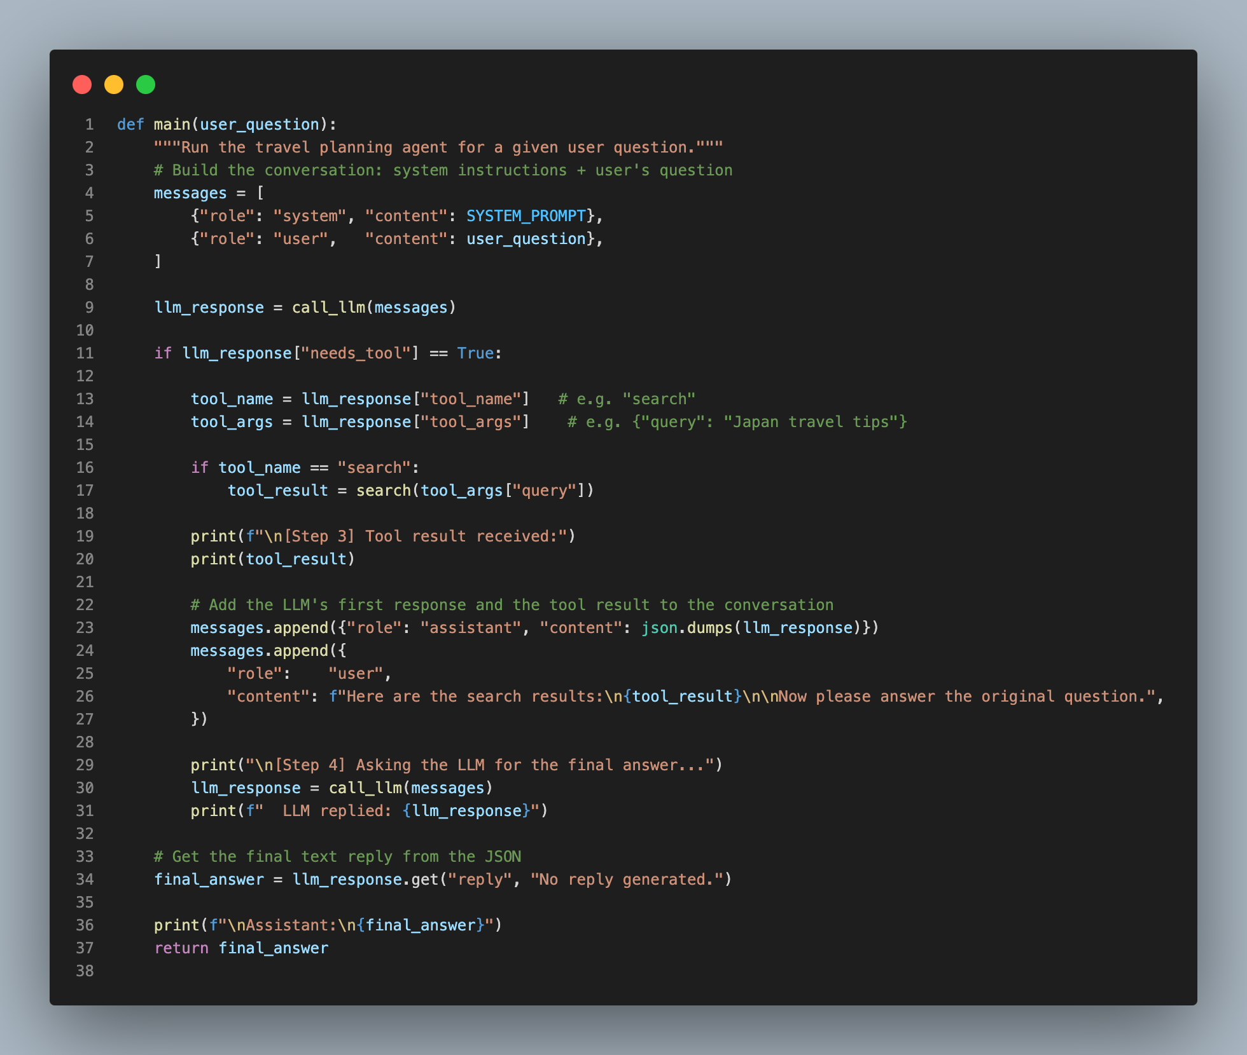
Building Your First Agent: The "No-Framework" Way
STEP 3
Define main
Set up main function that will connect everything

Slide 14

Congratulations now you know how to build agents from scratch.

Slide 15
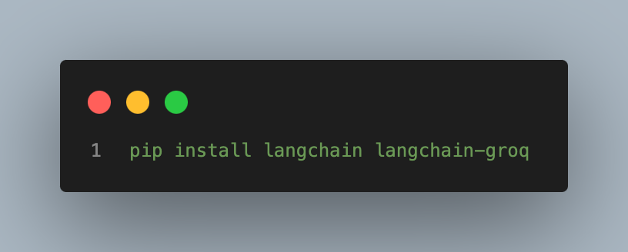
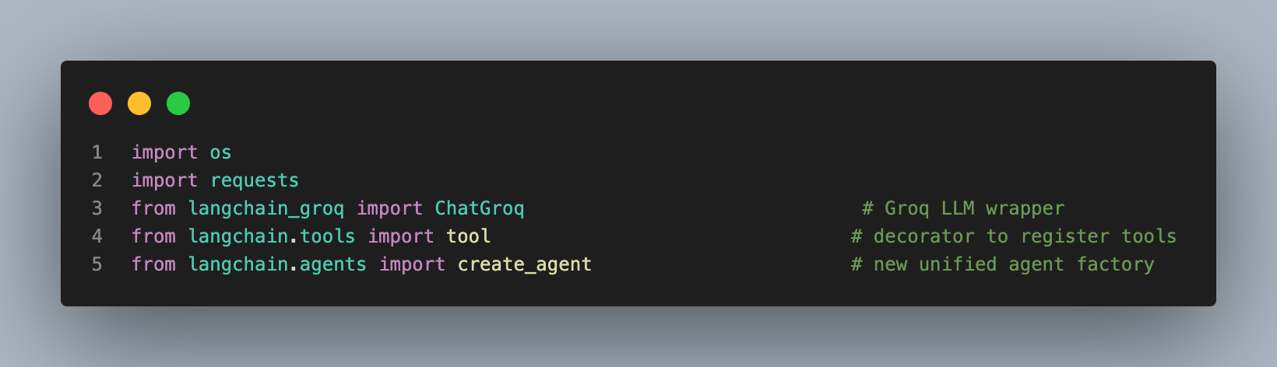
Building Agent Using Langchain
STEP 1
Install dependencies and define imports

Slide 16
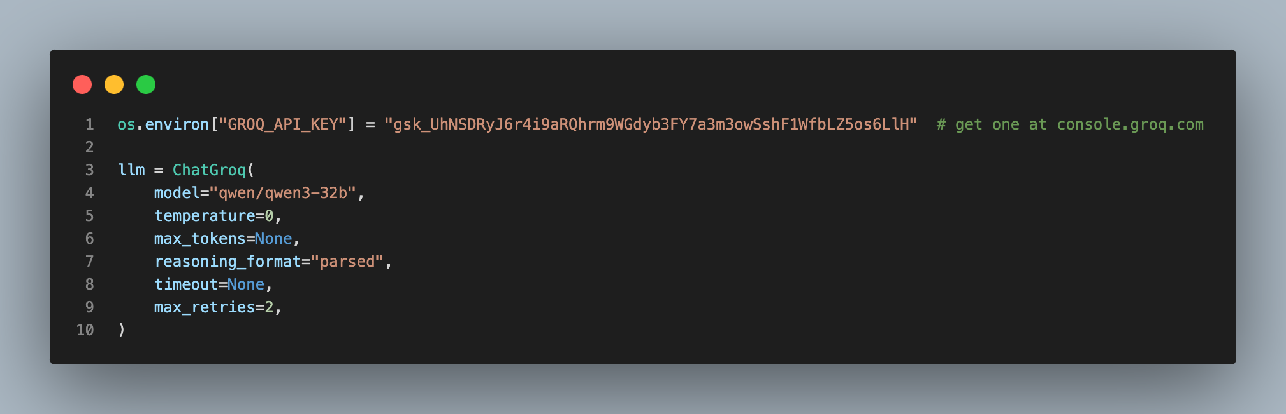
Building Agent Using Langchain
STEP 2
Initialize LLM object

Slide 17
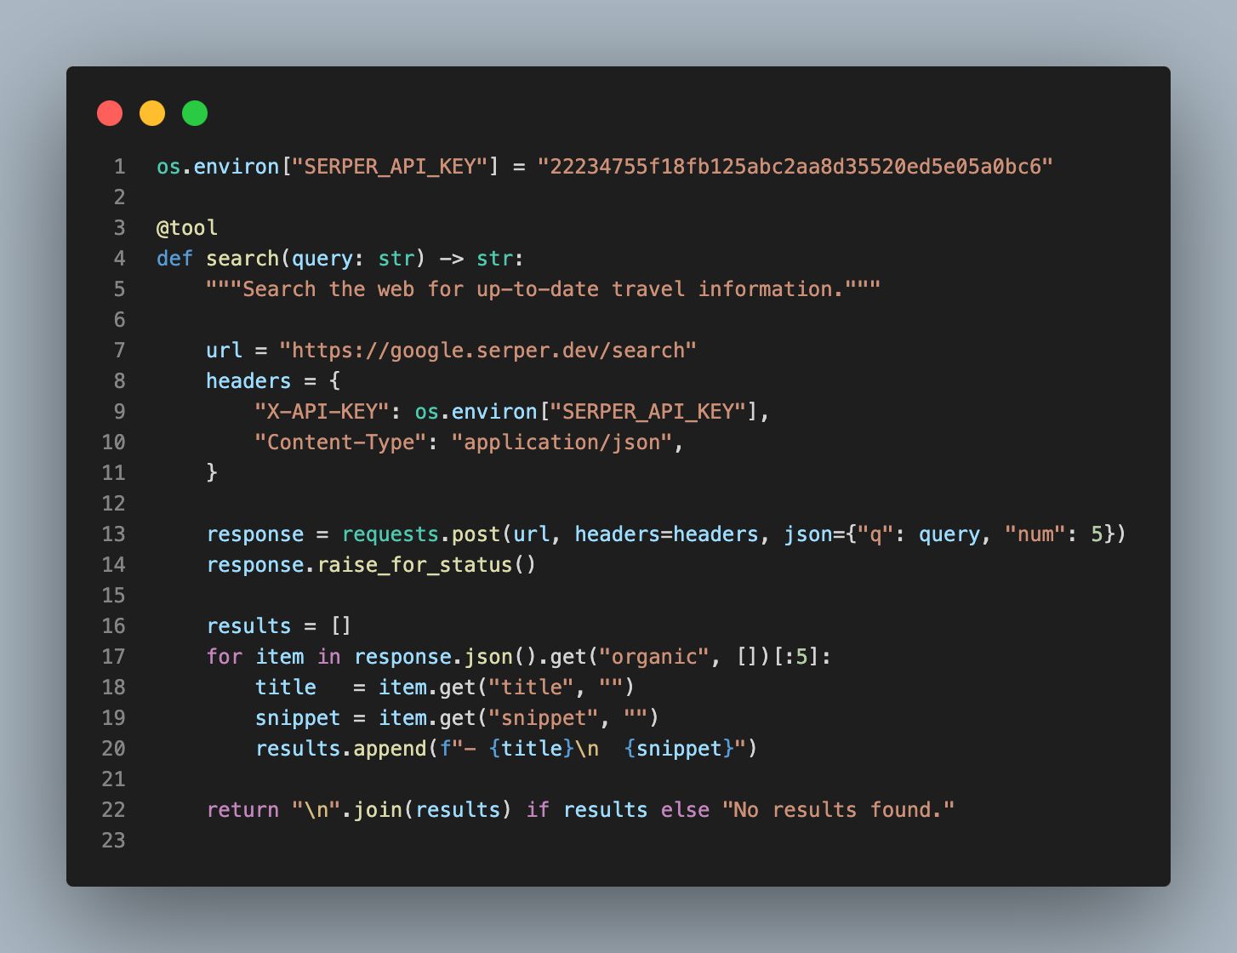
Building Agent Using Langchain
STEP 3
Define Tool

Slide 18
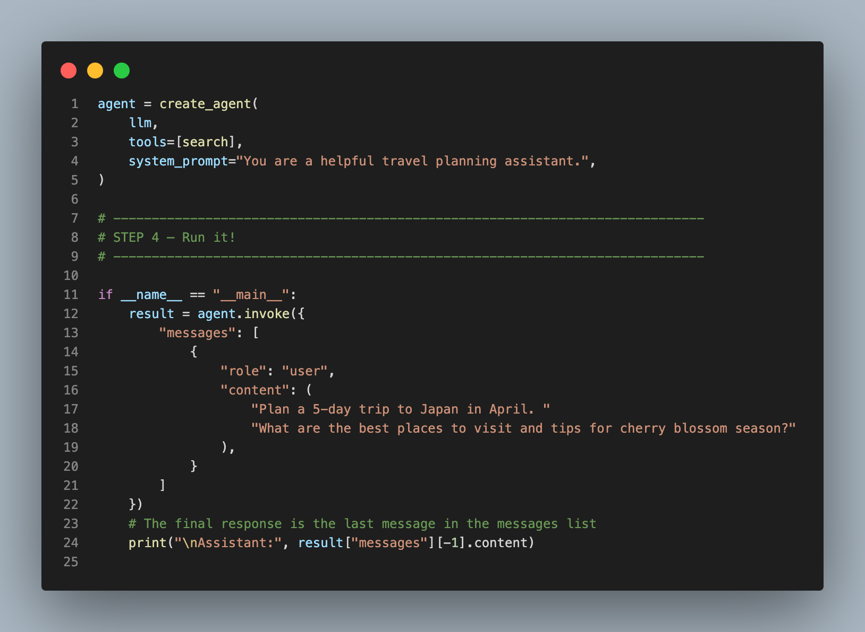
Building Agent Using Langchain
STEP 4
Agent Creation and execution

Slide 19
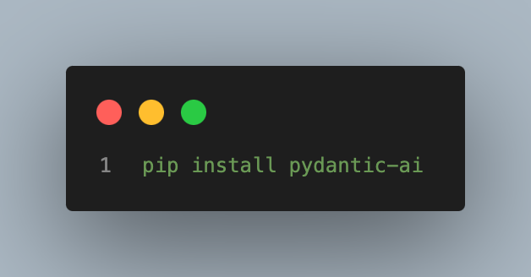
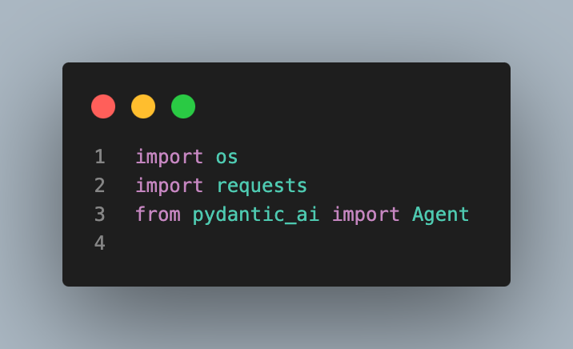
Building Agent Using Pydantic AI
STEP 1
Install dependencies and define imports

Slide 20
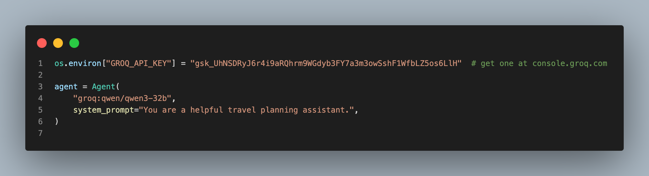
Building Agent Using Pydantic AI
STEP 2
Initialize Agent

Slide 21
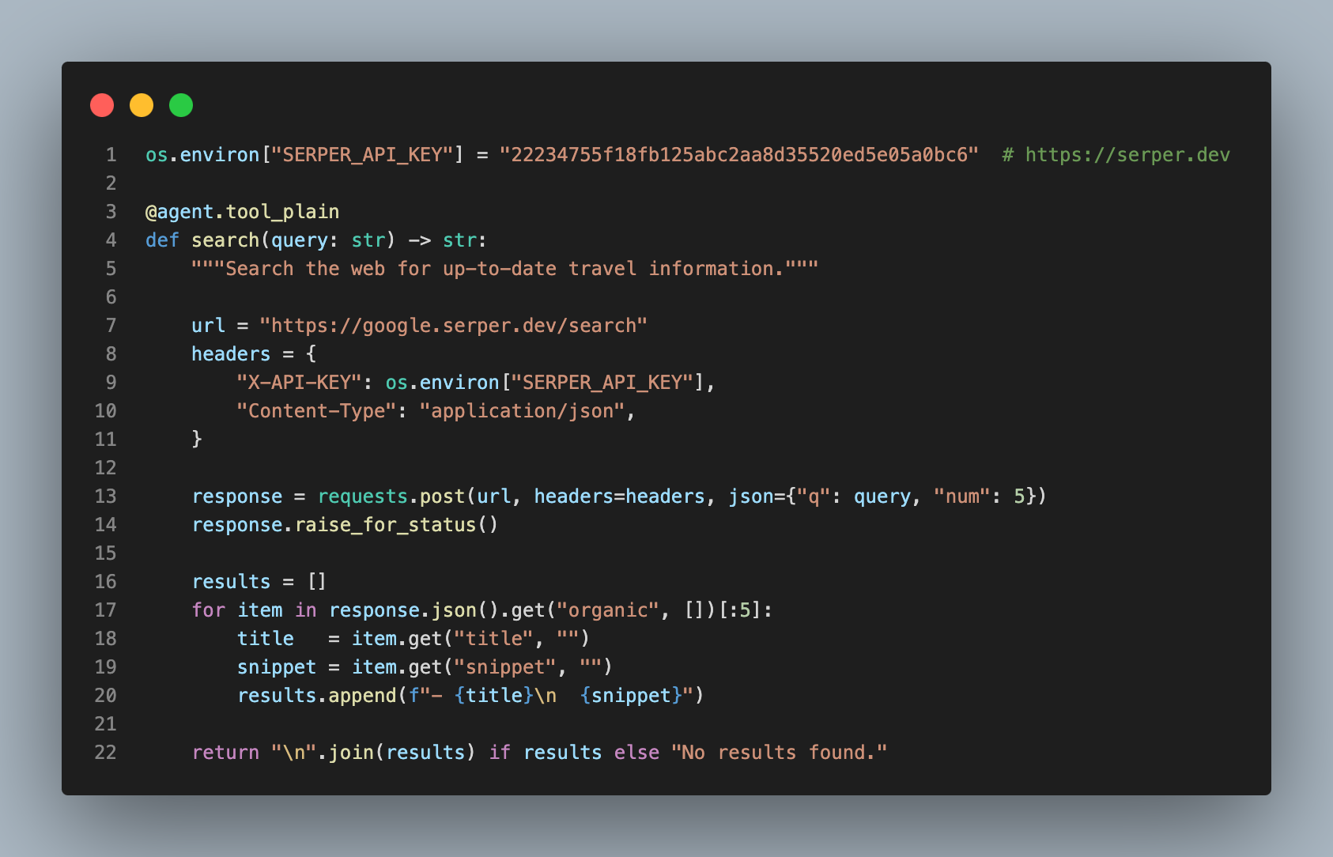
Building Agent Using Pydantic AI
STEP 3
Define Tool

Slide 22
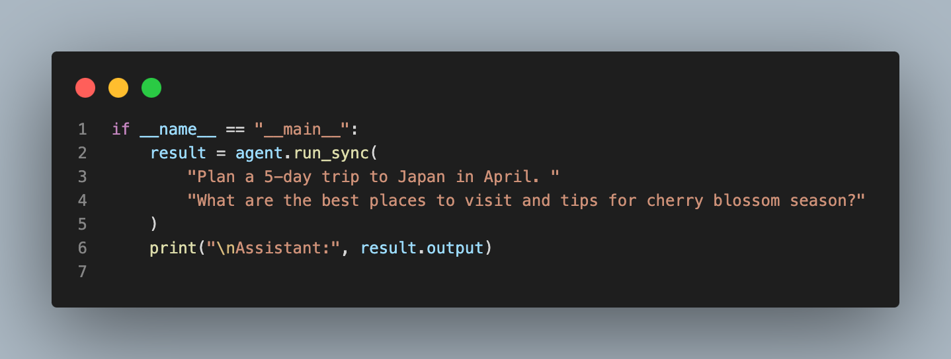
Building Agent Using Pydantic AI
STEP 4
Agent execution

Slide 23

Jaldi Jaldi LinkedIn update kr Deta hu
AI Agents | Autonomous Systems | Multi-Agent Architectures | LLM Orchestration | Agentic Workflows | Decision Engines | Tool Integration | Memory Systems | Planning & Reasoning | LangChain | LangGraph | Pydantic AI | Prompt Engineering | RAG Pipelines | AI Automation | Conversational AI | Generative AI | Python | FastAPI | Scalable AI Systems | Production AI | Workflow Automation | Intelligent Systems | AI Infrastructure | Human-AI Interaction | Applied AI Engineering

Slide 24




The "Agentic" Trap: Common Mistakes
Infinite Loops
Hallucinating Tools
Agents getting stuck repeating the same action without progress.
LLM trying to use a tool that doesn't exist or has wrong parameters.
FIX: SET MAX_ITERATIONS LIMIT
FIX: USE STRICT JSON SCHEMAS
Cost & Latency
Security Risks
Every reasoning step costs tokens and adds time to the final response.
Agents executing harmful code or accessing sensitive data without oversight.
FIX: OPTIMIZE PROMPTS & TOOLS
FIX: HUMAN-IN-THE-LOOP

Slide 25



Beyond Today: The Rise of Multi-Agent Systems
Multi-Agent Teams
Autonomous Ops
The Opportunity
Specialized agents collaborating: Manager + Coder + Reviewer working as a unified workforce.
Agents that run 24/7, managing complex business processes and research without constant human oversight.
Every industry is shifting towards Agentic Automation. The demand for agent developers is exploding.
"The future isn't just one agent; it's teams of agents."

Slide 26




Career Roadmap: How to Start Today
1. Master the Basics
Deepen your Python skills, understand REST APIs, and learn the fundamentals of Prompt Engineering.
2. Learn a Framework
Pick a tool like LangChain or Pydantic AI. Build simple chains before moving to complex agents.
3. Build & Deploy
Create real-world projects: a personal research assistant, a coding bot, or an automated CLI tool.
4. Join the Community
Stay active in AI Community Lucknow. Share your builds, ask questions, and collaborate on projects.

Slide 27

Let's Build the Future Together!
Key Takeaway: Agents = Brains + Tools + Memory
YOUR NEXT STEP
Build your first agent this weekend!
Questions?

