Slide 1

CYCLICIST
ANALYSIS ON CYCLICIST CUSTOMERS AND SUBSCRIBERS
BY LUCKY GBELODE
OCTOBER, 2022

Slide 2
INTRODUCTION
Cyclicist is a bike-sharing company that offers casual (customer) and annual membership (subscription) type services. The company wants to embark on a new advert campaign. This analysis is going to study how casual (customers) and annual members (subscribers) uses Cyclicist platform differently. This analysis will assist the marketing department in formulating a marketing strategy.

Slide 3
BUSINESS STRATEGY
This Analysis will be exploring the following three questions so as to guide future marketing strategy:
. How do annual members and casual riders use Cyclicist bike differently?
.Why would casual (customer) riders buy annual membership?
.How can Cyclicist use digital media to influence casual riders to become members

Slide 4
DATA SOURCE
Data contains a year of data about a ridership and membership type. Data is under license from Motivate International Inc.

Slide 5
DATA WRANGLING
Data is downloaded and loaded into Big Query.
Data Table is created in Big Query.
Some of the created tables are cleaned.
The tables are joined .
Weekdays, Months are extracted from the date column.
Some analysis is done in Big Query.
Some of the tables are exported to Microsoft Excel where the Charts are plotted.
Finally, the presentation is done in Microsoft Power Point.

Slide 6
HOW ARE CUSTOMERS AND SUBSCRIBERS USING BIKES DURING THE YEAR?
There is a spike in the use of bikes by Customers in the first few months of the year, before declining.
There is a slight increase of bikes by subscribers towards the end of the year.

Slide 7
HOW ARE CUSTOMERS AND SUBSCIBERS USING BIKES IN DIFFERENT SEASONS?
Customers uses bikes more in Winter.
Subscribers uses bikes consistently in the different seasons of the year.

Slide 8
HOW ARE CUSTOMERS AND SUBSCRIBERS USING BIKES ON DAYS OF THE WEEK?
Customers use bikes more on Sunday than on other days.
Subscribers bike usage stays consistent through out the week.

Slide 9
HOW ARE CUSTOMERS AND SUBSCRIBERS USING BIKE ON WEEKDAYS AND ON WEEKENDS?
Customers uses bikes more on weekends than on weekdays.
Subscribers bike usage stays consistent.

Slide 10
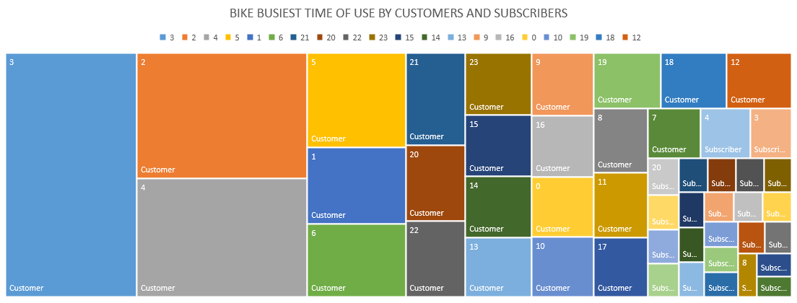
Customers uses bikes overwhelmingly at 3am, 2am and 4am.
Subscribers uses bikes at 4am and 3am than at any other time.
WHAT TIME ARE CUSTOMERS AND SUBSCRIBERS USING BIKES MORE OFTEN?

Slide 11
HOW ARE CUSTOMERS AND SUBSCRIBERS USING CYCLICIST BIKES?
Customers are making more use of bikes than Subscribers on average.

Slide 12
CONCLUSION
Marketing campaign should be targeted at Customers at the start of the year when they increasingly use Cyclycist services.
Marketing campaign should also be increasingly targeted at customers on weekends and Winter months.
Customers can be persuaded to switch to subscription services by offering them promo and other services.
Subscribers service has been very consistent through out the year, survey can be designed to ascertain what part of the services offered are they enjoying the most. Lessons learnt can be applied to designing services that will entice customers to switch to subscription service.
Lessons from survey carried out on subscribers and subscribers testimonials can be use to design digital ads that can be use to attract customers to switch to subscription service.
Incentives can be offered to subscribers who can convince or refer customers to subscription services.

