Slide 1
Data-based analysis of a battery
electric vehicle brake system and implementation of a squeal predictor using machine learning methods
Lucky-Aubrey Adam
Dynamics Group (M-14)
Hamburg University of Technology
Germany

Slide 2
Table of Content
Problem Description
Brake System
Real World Data
Time Series Classification
Brake Event Extraction
Sample Generation
Handling Class Imbalance
Machine Learning Models
Accuracy Measurement
Results
Conclusion

Slide 3
Problem Description
Brake Squeal
High-pitched noise during braking.
Significant quality concern for customers.
Over a century of research, yet remains challenging.
Especially relevant for Battery Electric Vehicles (BEVs) due to shift from traditional vehicles.
BEVs
Estimated 17% market share by 2030.
Use hybrid braking: combines friction brakes and regenerative braking.
Shift to BEVs alters sound design requirements for vehicles.
Poses new challenges for frictional brakes.
Machine Learning and Deep Learning
Rapid rise in popularity and advancement.
Offers powerful tools to analyze data.
→ Implementation of a real-time brake squeal prediction model using novel machine learning techniques.

Slide 4
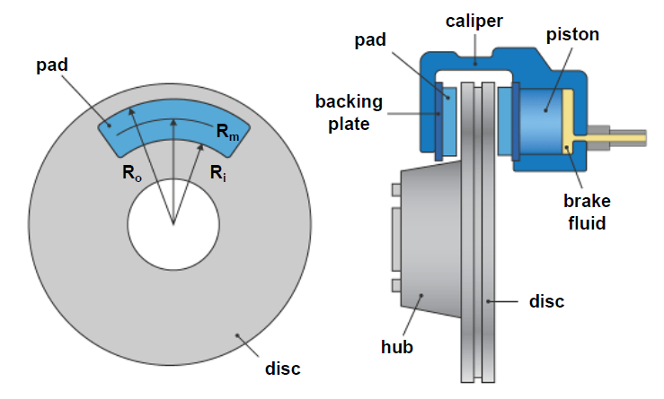
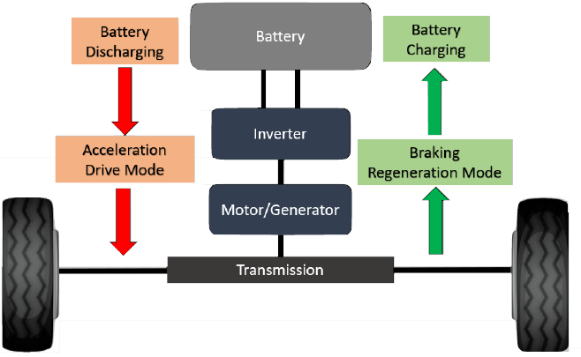
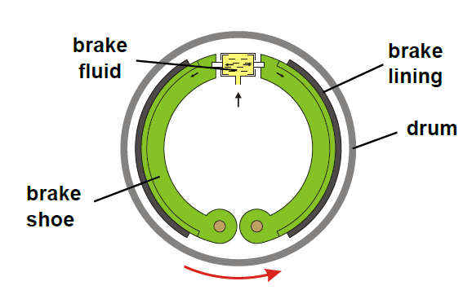
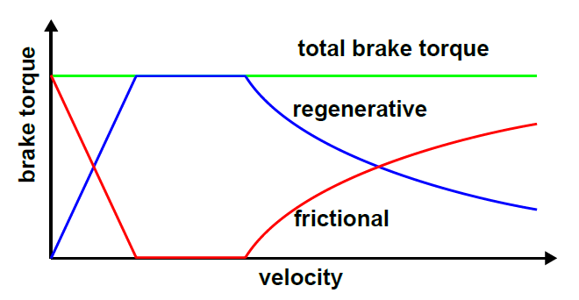
Brake System
Disc brake
Regenerative braking
Drum brake
Hybrid braking (blending)

Slide 5
Real World Data
Test Drive
4 BEVs
2 routes in Mojácar, Spain
1 month each vehicle, for ≈ 6 hours per day
Brake System
2 disc brakes at the front
2 drum brakes at the rear
Data
52 channels (mostly data from the brake controller)
Sampling rate of 100 [Hz] (except temperature measurements 10 [Hz])
Disc and drum temperature only for the left side
Relative humidity measurements missing for 2 BEVs
Squeal detector:
  500 [Hz] < fsq < 16 [kHz]
  Isq > 60 [db(A)]

Slide 6
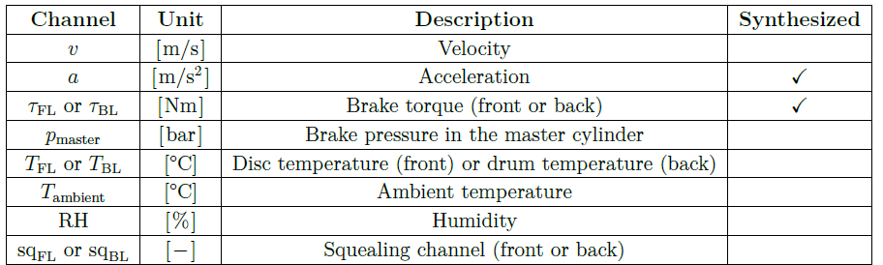
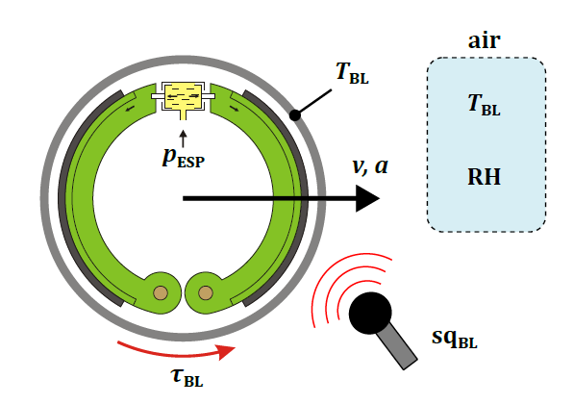
Selected Channels

Slide 7
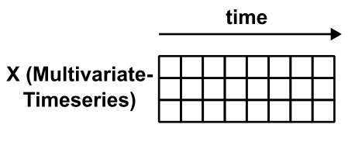







Time Series Classification
Univariate Time Series for duration T
Multivariate Time Series for M channels
Machine Learning Model
Label with K classes

Slide 8
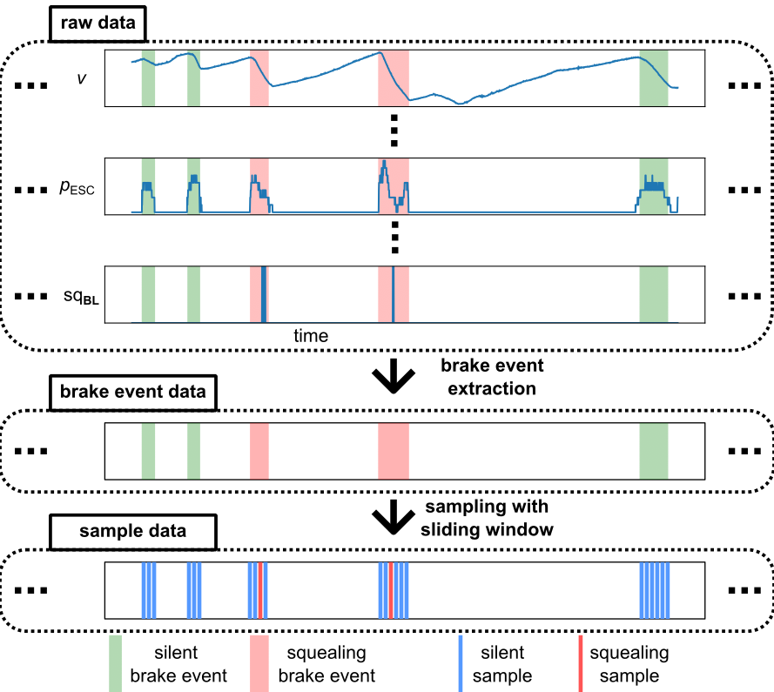
Preprocessing I
brake event start
v > 0 [m/s]
and
p ≥ 0.8 [bar]
brake event stop
v = 0 [m/s]
or
p < 0.4 [bar]

Slide 9
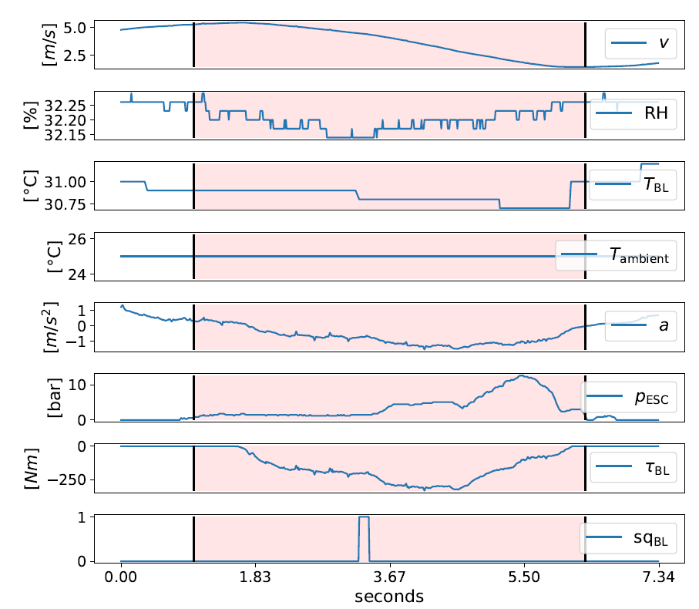
Brake Event

Slide 10
Preprocessing II

Slide 11
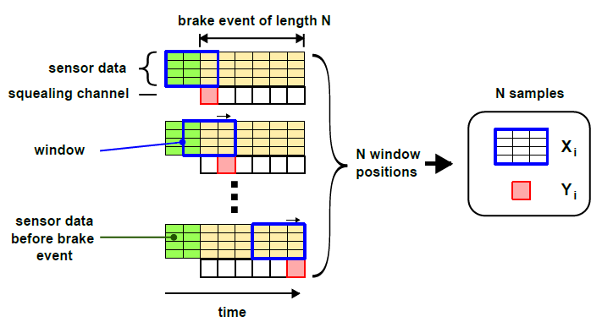
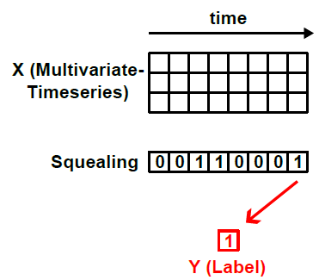
Sampling with Sliding Window
stride = 1 (0.01 [s])

Slide 12
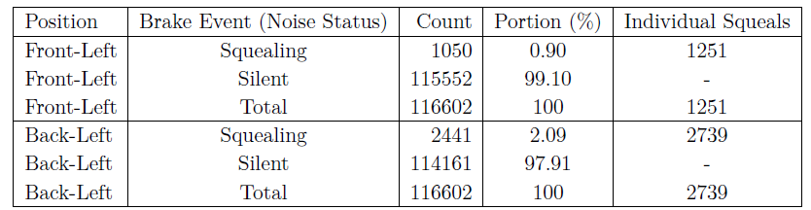

Processed Data Statistics
Brake Event data
Sample data

Slide 13
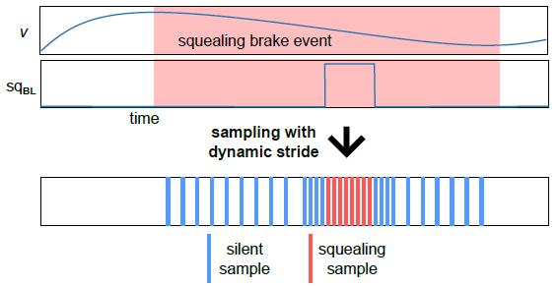
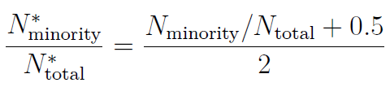

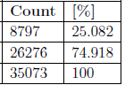
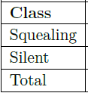
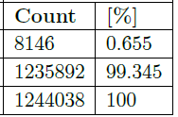
Tackling Class Imbalance
Undersampling Methods
Naive
Dynamic Stride
Oversampling Methods
Weighted Training
Dynamic Stride
Naive Undersampling

Slide 14
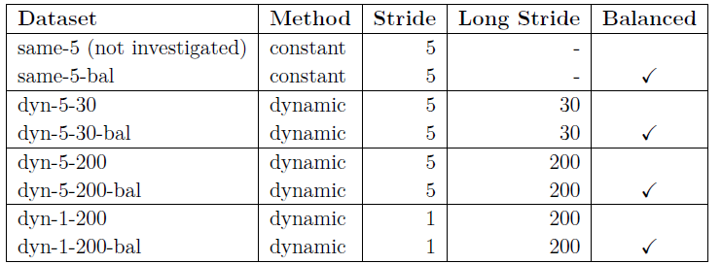
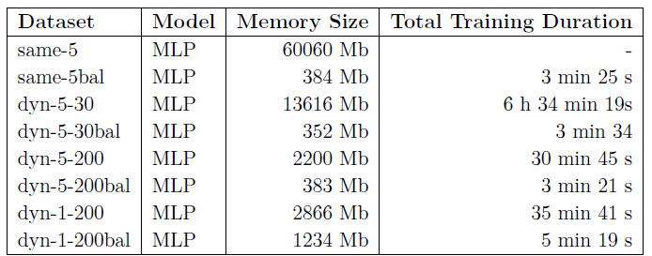
Comparison of generated Datasets

Slide 15
Models for Time Series Classification
Deep Learning Models
MLP
FCN
CNN
ResNet
LSTM
GRU
LSTM-FCN
InceptionTime
Time Series Transformer
Non-Deep Learning Models
DTW with 1-NN
SVM with kernel
Shapelet-based SVM
Gradient Boosted Trees
BOSS
HIVE-COTE
ROCKET
Advantage of deep learning models
No time consuming feature engineering
Scale well with bigger data
→ MLP, FCN, CNN, ResNet, LSTM

Slide 16
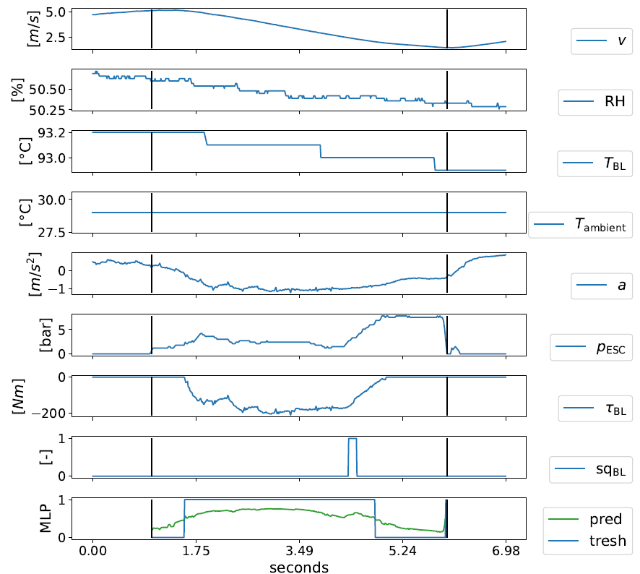
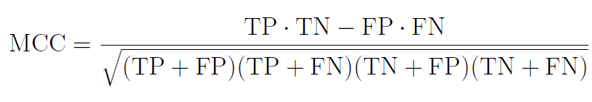
Accuracy Measurement
TP - True Positives
TN - True Negative
FP - False Positive
FN - False Negative
MCC - Matthews Correlation Coefficient [-1 … 0 … 1]

Slide 17
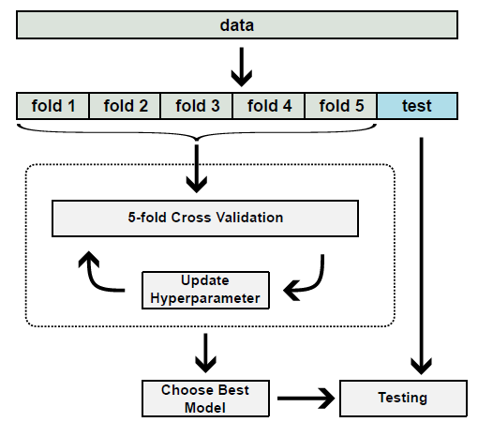
Workflow

Slide 18
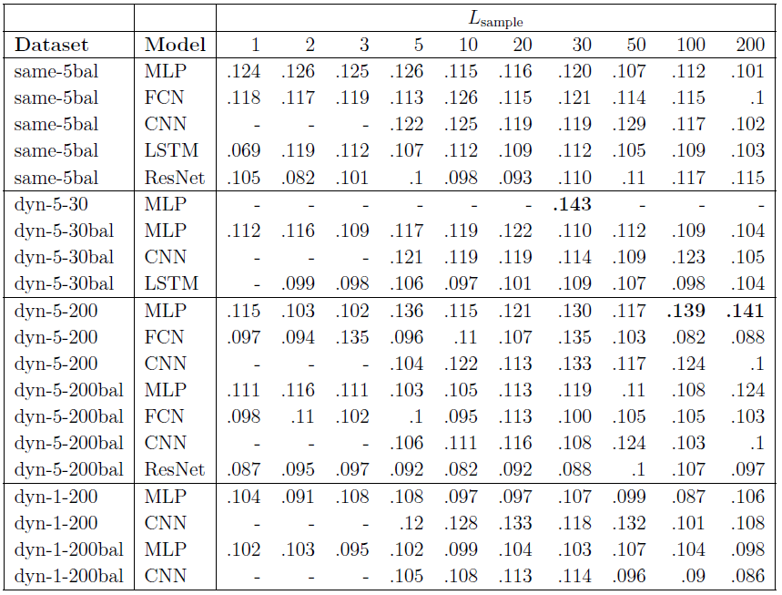
Results of 5-Fold Cross Validation
MCC: Dataset vs Model vs Sample Length

Slide 19
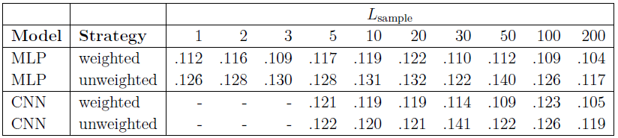
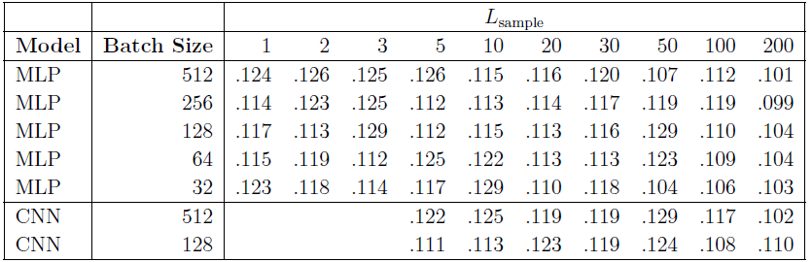
Results of 5-Fold Cross Validation
Weight Strategy vs Sample Length
Batch Size vs Sample Length

Slide 20
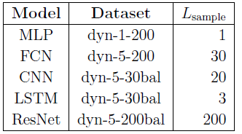
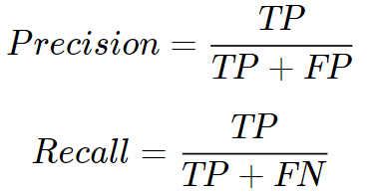
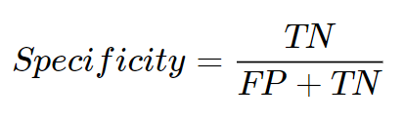
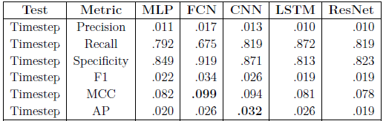
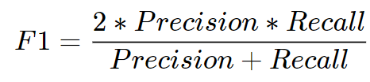
Results on Holdout Test Set
Selected Models + Hyperparameter
Results

Slide 21
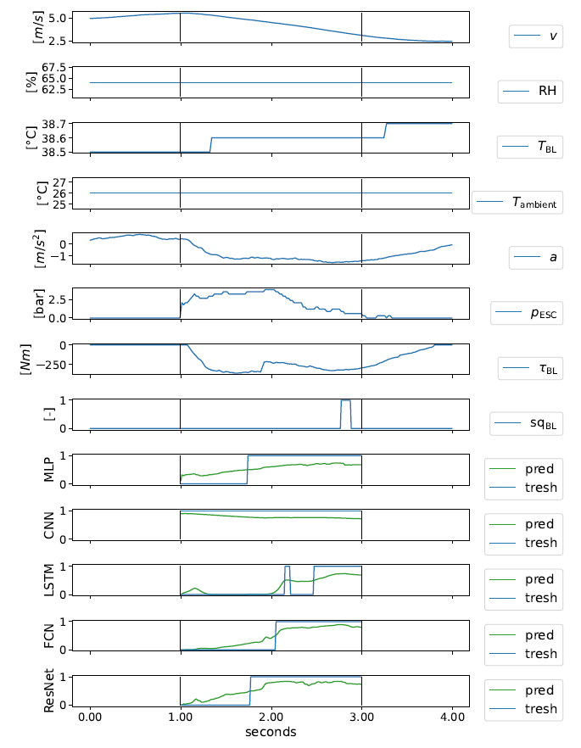
Results on Holdout Test Set

Slide 22
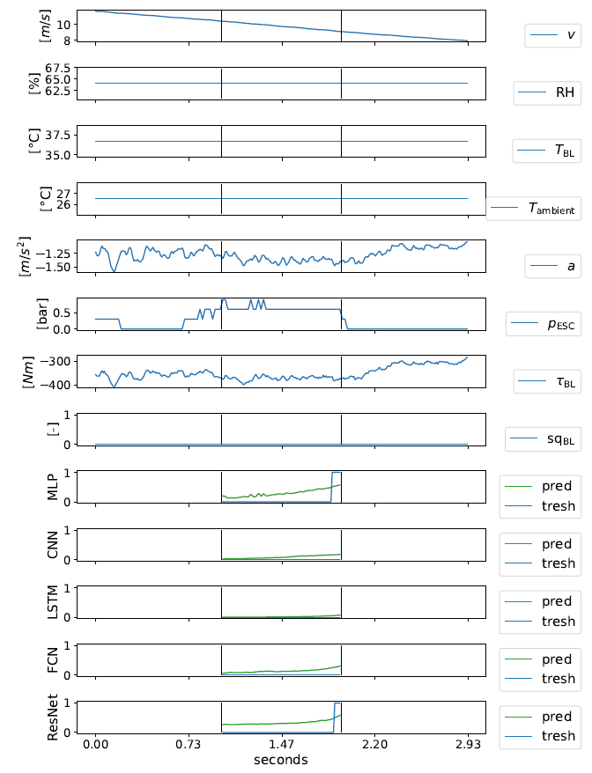
Results on Holdout Test Set

Slide 23
Conclusion
Summary
Raw Data Analysis
Channel corrections and channel synthesis
Preprocessing of real world brake data for time series classification
Investigation of various deep learning model
Limitations
Lack of raw data (4 vehicles, 1 month each)
Lack of squeals in the data and the resulting class imbalance
No measurement of the coefficient of friction μ
Approximation of the brake pressure through pressure in master cylinder pmaster
Approximation of the acceleration
Measurement errors across all channels, missing RH for 2 vehicles
Brake wear not considered
Outlook
Training machine learning models on front-left disc brake data
Investigation of more advanced undersampling and oversampling methods
Investigation of other machine learning models such as: InceptionTime, ROCKET, Gradient Boosted Trees, LSTM-FCN

Slide 24
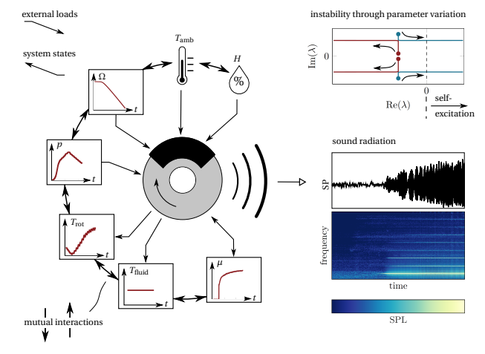
Previous Work

Slide 25
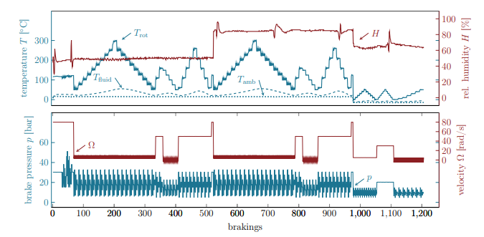
Previous Work

Slide 26
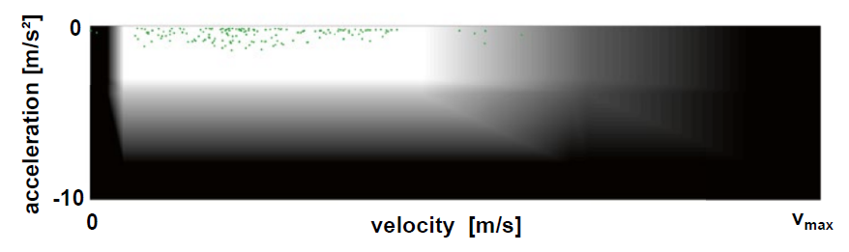
Blending

Slide 27
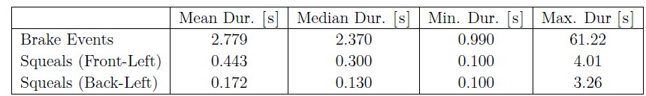
Brake Event Statistics
Number of squealing and silent brake events
Duration of brake events and squeals

Slide 28
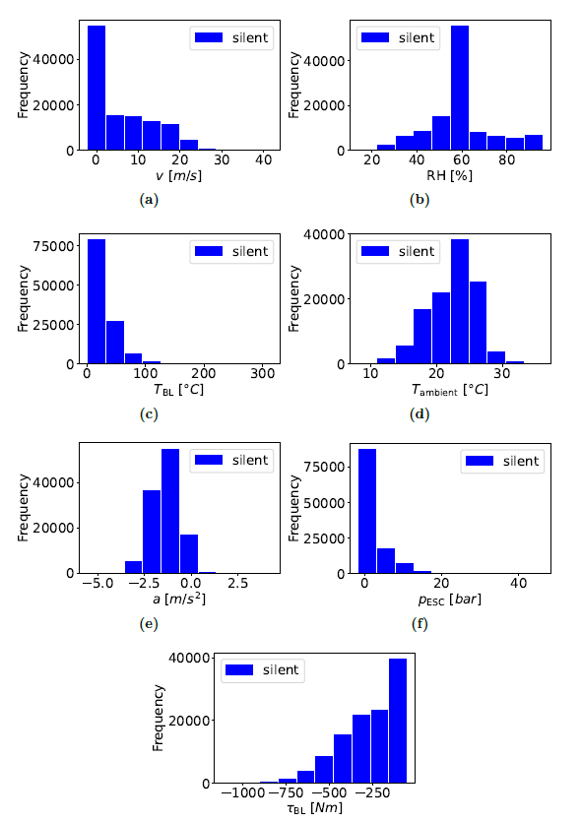
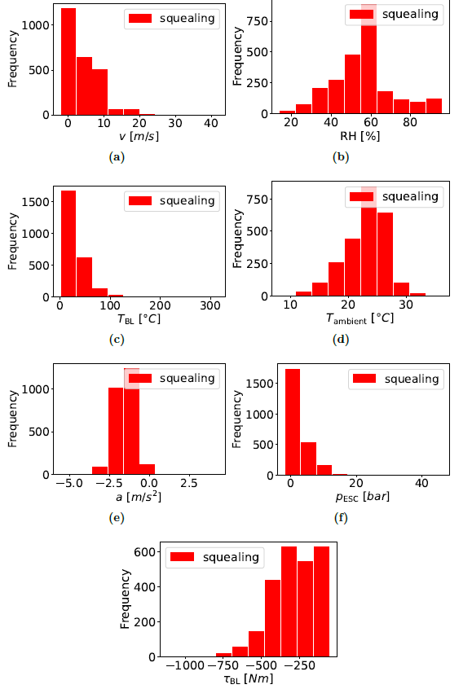
Brake Event III

Slide 29
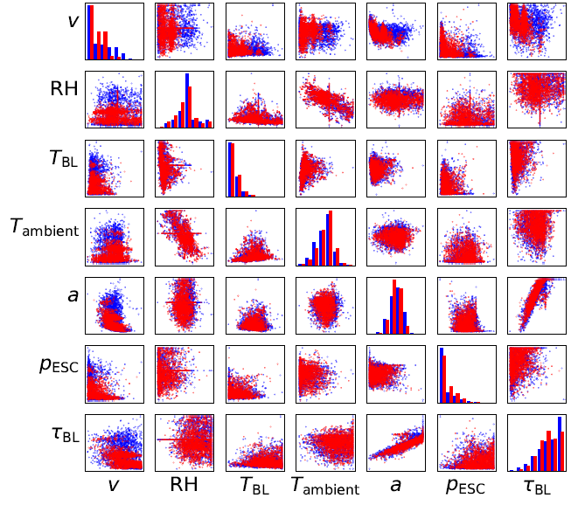

Brake Event IV

Slide 30
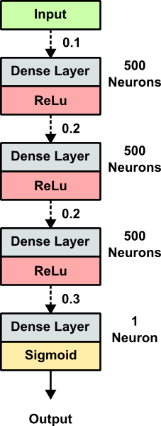
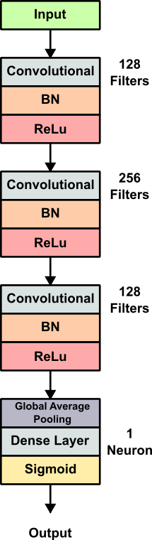
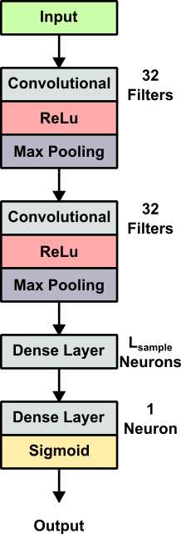
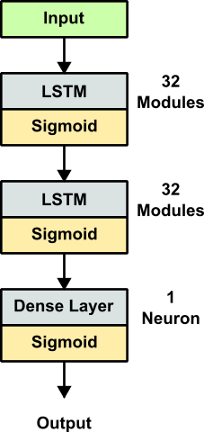
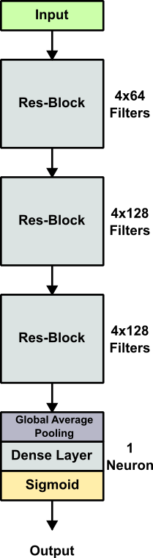
Deep Learning Models
MLP
FCN
CNN
LSTM
ResNet

Slide 31
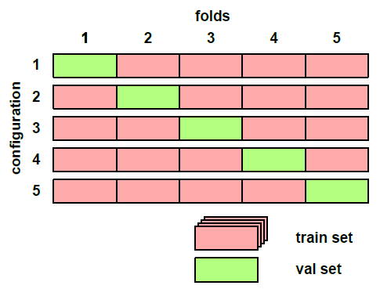
Train and Test Workflow

Slide 32
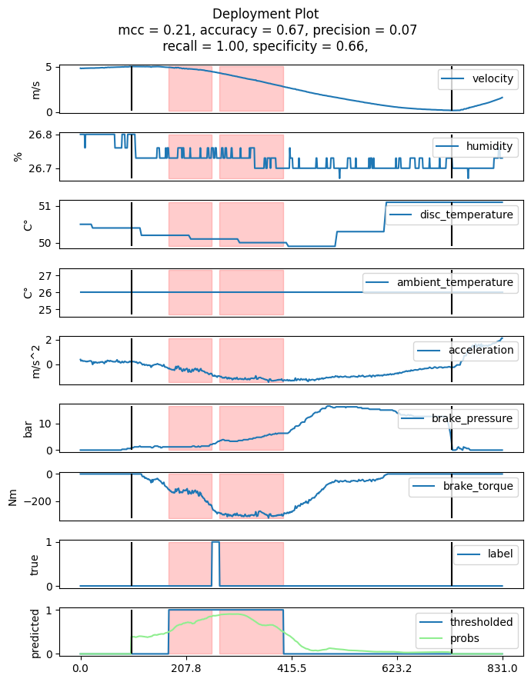
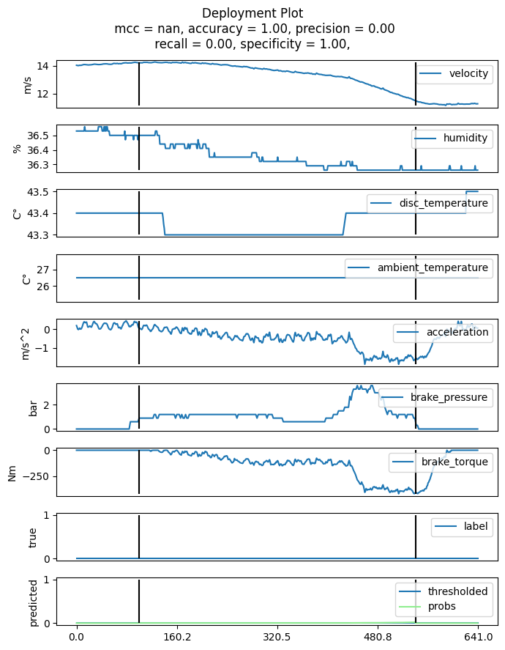
1D-CNN Results
Over 600 brake events (50-50):
MCC: 0.232
Precision: 0.132
Recall: 0.698

Slide 33
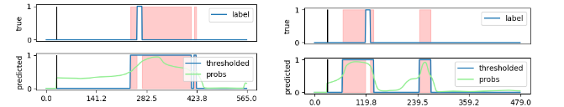
Discussion
MCC: 0.245
Precision: 0.101
Recall: 0.875
Low Scores (MCC, Precision)
BUT
Squeals are predicted
Predicting squeals before the actual squeal starts is not bad (and could be an advantage?)
Prediction of squeals being too long is not important
p_brake_pressure is only approximated
→ More Data
→ Model Optimization and Evaluation of different Models
→ Other metrics for evaluation

Slide 34
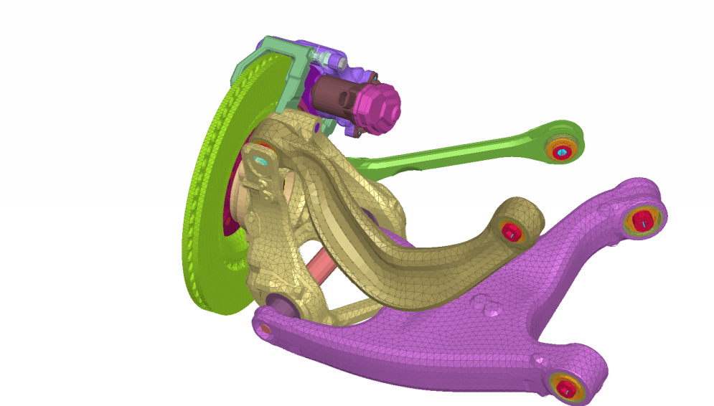
Inhalt
Dies ist die Version 1…
…der Inhaltsfolie
…

Slide 35
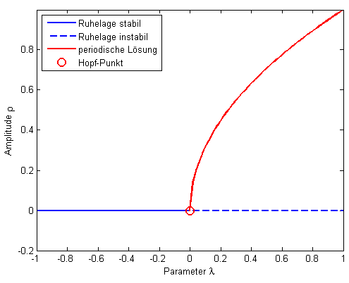


Analytische Betrachtung - Zusammenfassung
Ruhelage
Periodische Lösung

Slide 36

Inhalt
Dies ist die Version 1…
Dies ist die Version 1…

Slide 37
Gestaltungsraster,
Farben und Schrift 24pt
Abstand von der Kopfzeile 0,5 cm
DYN Präsentationsschrift
Arial
Überschriften sind in der Kopfzeile in 24pt und in der Schriftfarbe Türkis
(R=27 G=116 B=145) zu setzen
Unterüberschriften sind in 18pt und in der Schriftfarbe schwarz zu setzen
Fließtext ist in 16pt und in der Schriftfarbe schwarz zu setzen
Präsentationsgrafiken sind mit diesen Farben zu gestaltet
R=27 G=116 B=145
R=141 G=31 B=34
R=91 G=115 B=130
Abstand von links 1,5 cm
Abstand von rechts 1,5 cm
Abstand von der Fußzeile 0,5 cm

Slide 38
Thank you for your attention!
Lucky-Aubrey Adam
Dynamics Group (M-14)
Hamburg University of Technology
Germany

